Slide 1
Cloud-Native Computing Concepts Service Meshes and Gateways
<>

Slide 3
What is a Service Mesh
The term service mesh is often used to describe the network of microservices that make up such applications and the interactions between them. Its requirements can include discovery, load balancing, failure recovery, metrics, and monitoring, and often more complex operational requirements such as A/B testing, canary releases, rate limiting, access control, and end-to-end authentication.

Slide 4
High-Level Architecture of a Service Mesh
The data plane is composed of a set of intelligent proxies (Envoy) deployed as sidecars that mediate and control all network communication between microservices, along with a general-purpose policy and telemetry hub (Mixer).
The control plane is responsible for managing and configuring proxies to route traffic, and configuring Mixers to enforce policies and collect telemetry.

Slide 5
Core building blocks of the Istio Service Mesh
Envoy is a proxy that is deployed as a sidecar to a Kubernetes pod. It handles tasks like service discovery, circuit breakers, load balancing etc.
Mixer enforces access control and policies based on data collected by the proxies
Pilot provides service discovery, routing, traffic management and propagated them to the proxies
Citadel is responsible for authentication and access control

Slide 6
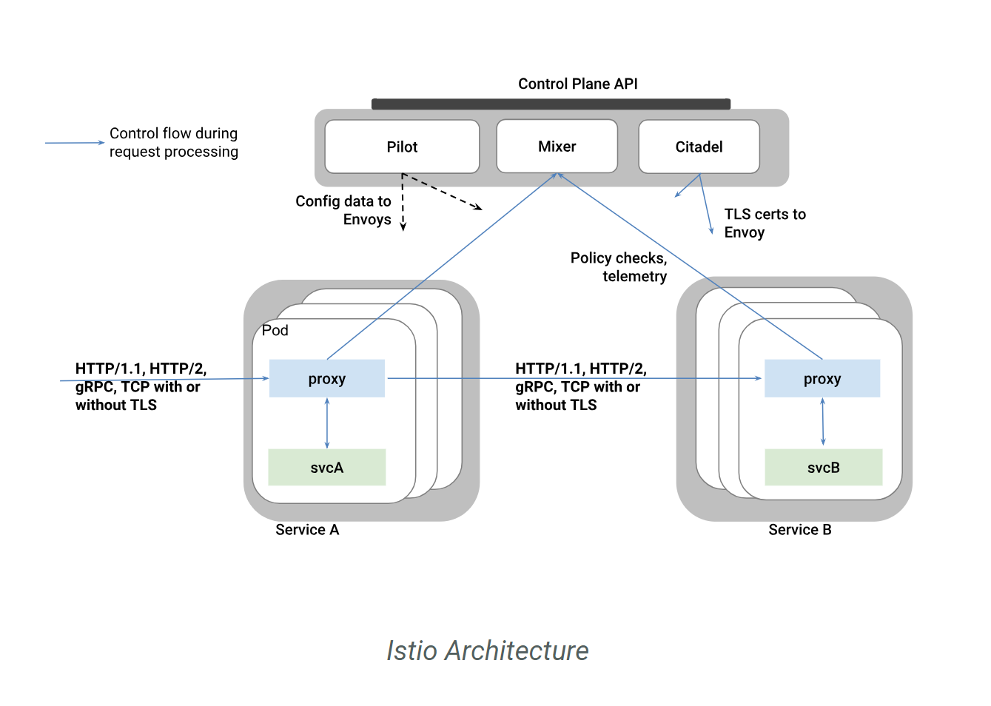
Istio Architecture

Slide 7
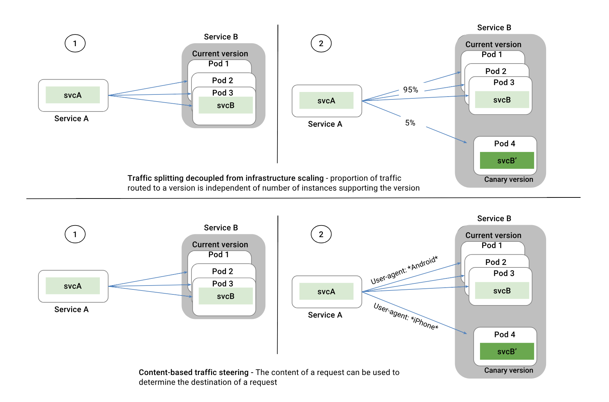
Example of using Pilot for Intelligent Traffic Control

Slide 8
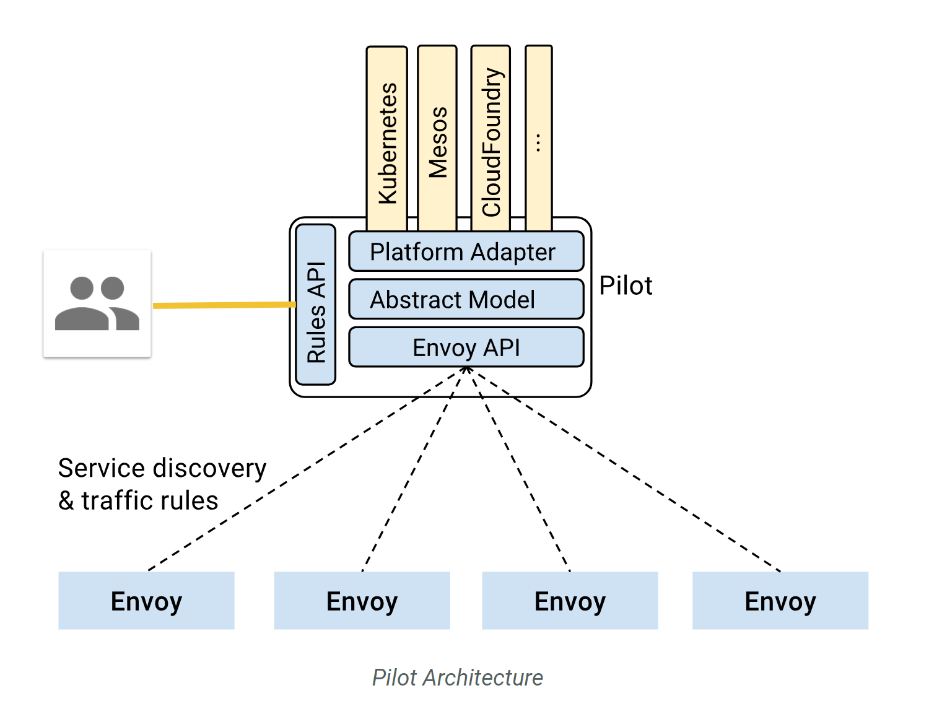
Pilot – High-level architecture

Slide 9
The Istio service model
Version describe different version of a service (e.g. V1, V2, or build numbers)
Environments define different environments (e.g. staging, production)
Traffic rules are used to specify routing for specific services supporting A/B testing or canary releases.

Slide 10
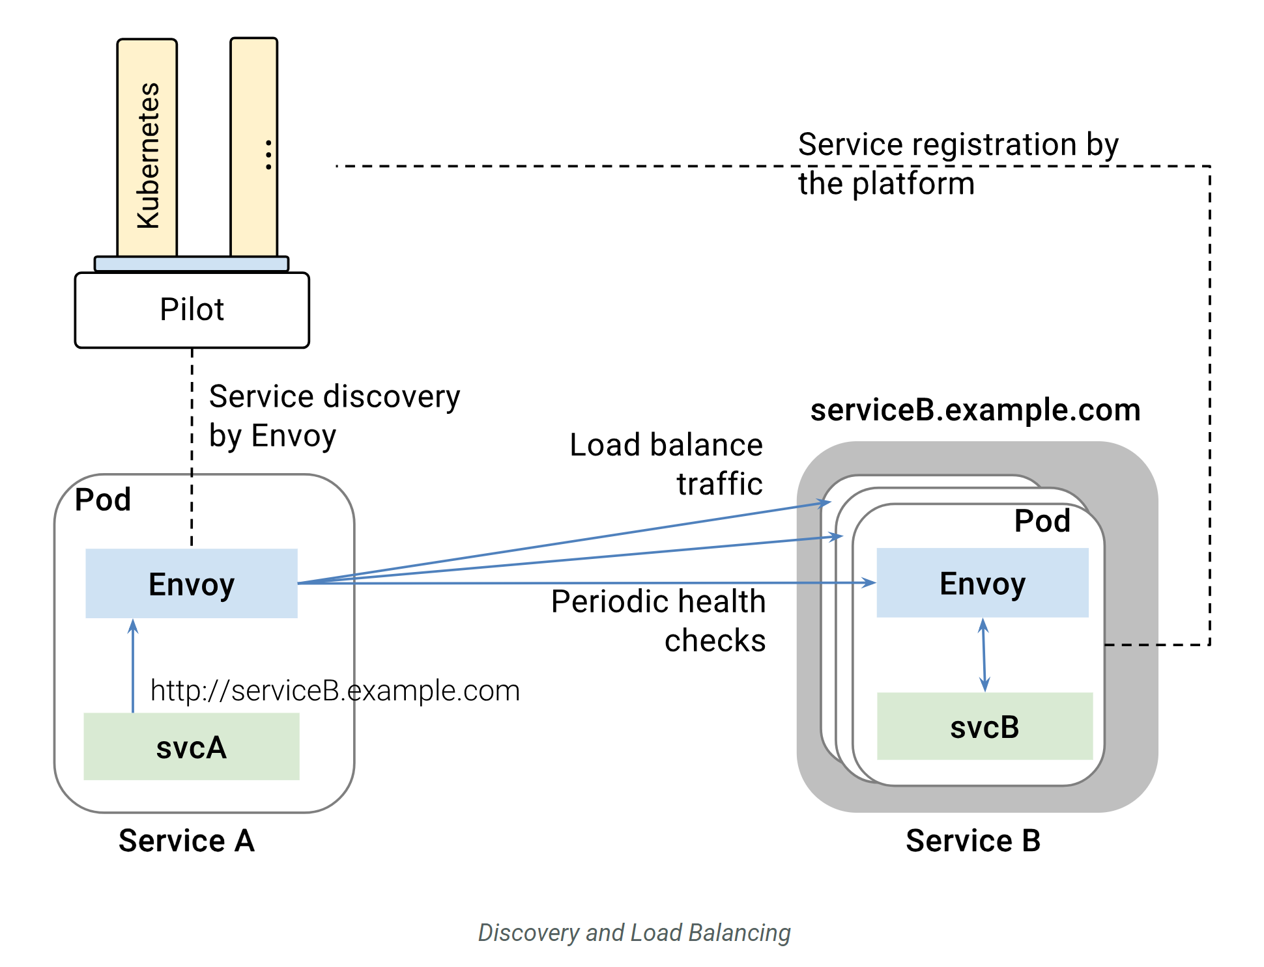

Slide 11
Understanding Istio Configuration

Slide 12
Defining a virtual service
apiVersion: networking.istio.io/v1alpha3
kind: VirtualService
metadata:
name: reviews
spec:
hosts:
- reviews
http:
- route:
- destination:
host: reviews
subset: v1

Slide 13
Define a destination rule (i.e. how to find these services)
apiVersion: networking.istio.io/v1alpha3
kind: DestinationRule
metadata:
name: reviews
spec:
host: reviews
subsets:
- name: v1
labels:
version: v1
- name: v2
labels:
version: v2

Slide 14
Weighted traffic splitting – A/B Testing and Canaries
…..
- route:
- destination:
host: reviews
subset: v1
weight: 75
- destination:
host: reviews
subset: v2
weight: 25

Slide 15
Header-based splitting – Canaries and feature releases
…
http:
- match:
- headers:
cookie:
regex: "^(.*?;)?(user=jason)(;.*)?$"
...

Slide 16
Caller-based routing
apiVersion: networking.istio.io/v1alpha3
kind: VirtualService
metadata:
name: ratings
spec:
hosts:
- ratings
http:
- match:
sourceLabels:
app: reviews
...

Slide 17
Mirror Traffic for testing service versions
…
http:
- route:
- destination:
host: httpbin
subset: v1
weight: 100
mirror:
host: httpbin
subset: v2
…

Slide 18
Enabling automated Istio Injection
# enable the default namespace with istio injection
kubectl label namespace default istio-injection=enabled

Slide 19
Working with a sample application

Slide 20
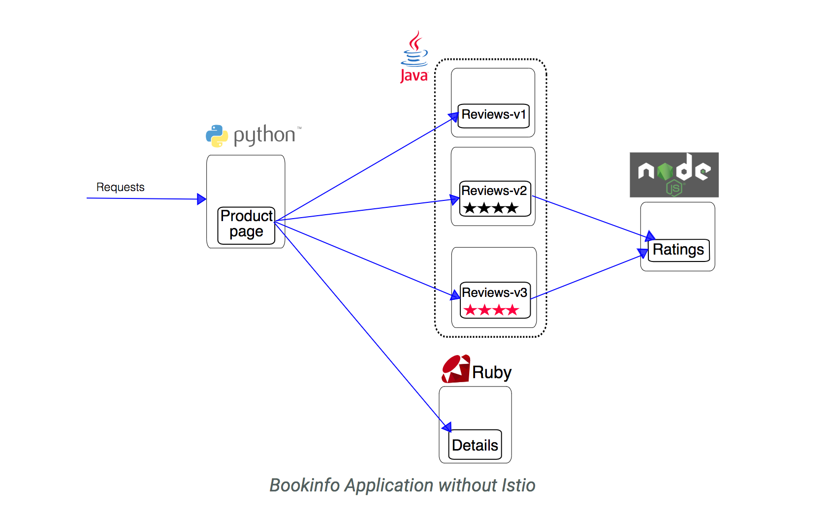
The Bookinfo sample application

Slide 21
Get your environment ready
curl -L https://git.io/getLatestIstio | sh -
# add the istio directory to your PATH variable
# deploy the sample application
kubectl apply -f install/kubernetes/istio-demo.yaml

Slide 22
Dynatrace configuration

Slide 23
Ensure OneAgent can send data – Get Endpoints
# query the API to get your agent endpoints
# future version of the operator should handle this automatically
curl "https://<environmentID>.live.dynatrace.com/api/v1/deployment/installer/agent/connectioninfo?Api-Token=<PaaS-token>"

Slide 24
Ensure OneAgent can send data – Create egress service
apiVersion: networking.istio.io/v1alpha3
kind: ServiceEntry
metadata:
name: dynatrace
spec:
hosts:
- ******.live.ruxit.com
….
ports:
- number: 443
name: https
protocol: HTTPS

Slide 25
Deploying the sample application
Option 1: enable automatic sidecar injection
kubectl label namespace default istio-injection=enabled
kubectl apply -f samples/bookinfo/kube/bookinfo.yaml
Option 2: use istioctl to modify the .yaml deployment file
kubectl apply -f <(istioctl kube-inject -f samples/bookinfo/kube/bookinfo.yaml)

Slide 26
Create service routing rules
# expose gateway for ingress traffic
istioctl create -f samples/bookinfo/routing/bookinfo-gateway.yaml
# deploy internal service routing
istioctl create -f samples/bookinfo/routing/route-rule-all-v1.yaml

Slide 27
Verify correct deployment of service rules
# query all installed service rules
istioctl get virtualservices
# get details about a specific service
istioctl get virtualservice reviews -o yaml

Slide 28
Your next task
Switch all services to V2 of the reviews service
Create a copy of the previous deployment file
Replace the service version
Redeploy the service
Verify correct deployment
Hope everything works as planned ;- )

Slide 29
Verify correct deployment of service rules
# update to sample for canary deployments
istioctl replace -f samples/bookinfo/routing/route-rule-reviews-test-v2.yaml
# verify proper service update

Slide 30
Example for fault injection
# update to the fault example
istioctl replace -f samples/bookinfo/routing/route-rule-ratings-test-delay.yaml
# what does this example do?
# create a new .yaml file and fix the problem

Slide 31
Blue/Green Deployments
# update to the blue green example
istioctl replace -f samples/bookinfo/routing/route-rule-reviews-50-v3.yaml
# what does this example do?
# update the example so only logged-in users see V3

