Slide 1
Performance as a Self Service
ACL Detroit
November, 2018

Slide 2

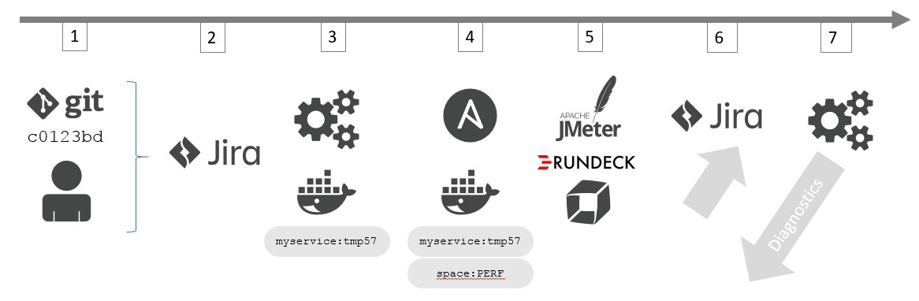

Based on - Continuous Performance as Self-Service
Mark Tomlinson

Slide 3
Agenda
Introduction – What is the workshop about?
Labs
Write Load Test Script
Define Request Attributes in Dynatrace
Define Performance Signature
Define Performance Pipeline
Run Performance Tests
Compare Tests in Dynatrace
Retry Performance Test
Summary

Slide 4
Monolith to Microservices

Slide 5
Pre-Requisites
Run through all of the labs in Dynatrace Monitoring as a Service
JMeter scripts are already using Dynatrace X-Dynatrace-Test tags
Useful Links:
Follow the steps to configure the Request Attributes as described here https://www.dynatrace.com/support/help/integrations/test-automation-frameworks/how-do-i-integrate-dynatrace-into-my-load-testing-process/

Slide 6
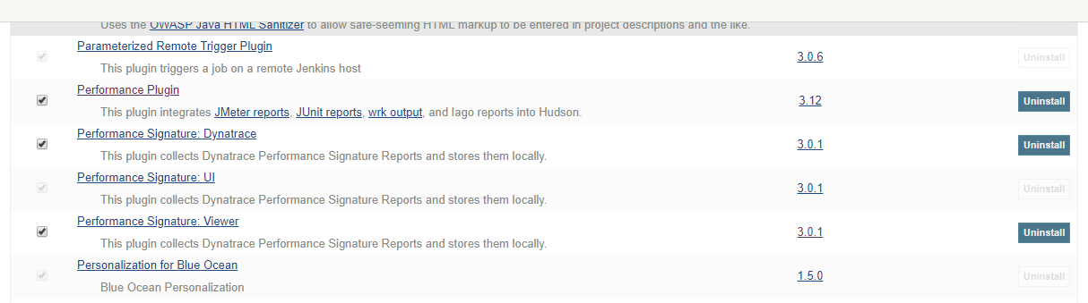
Pre-Requisites – Jenkins Plugins to be Installed
#1 Performance Signature: Dynatrace
#2 Performance Signature: Viewer

Slide 7
Load Testing Integration Use Cases
Push Metrics, Pull Metrics, Tagging, Events

Slide 8
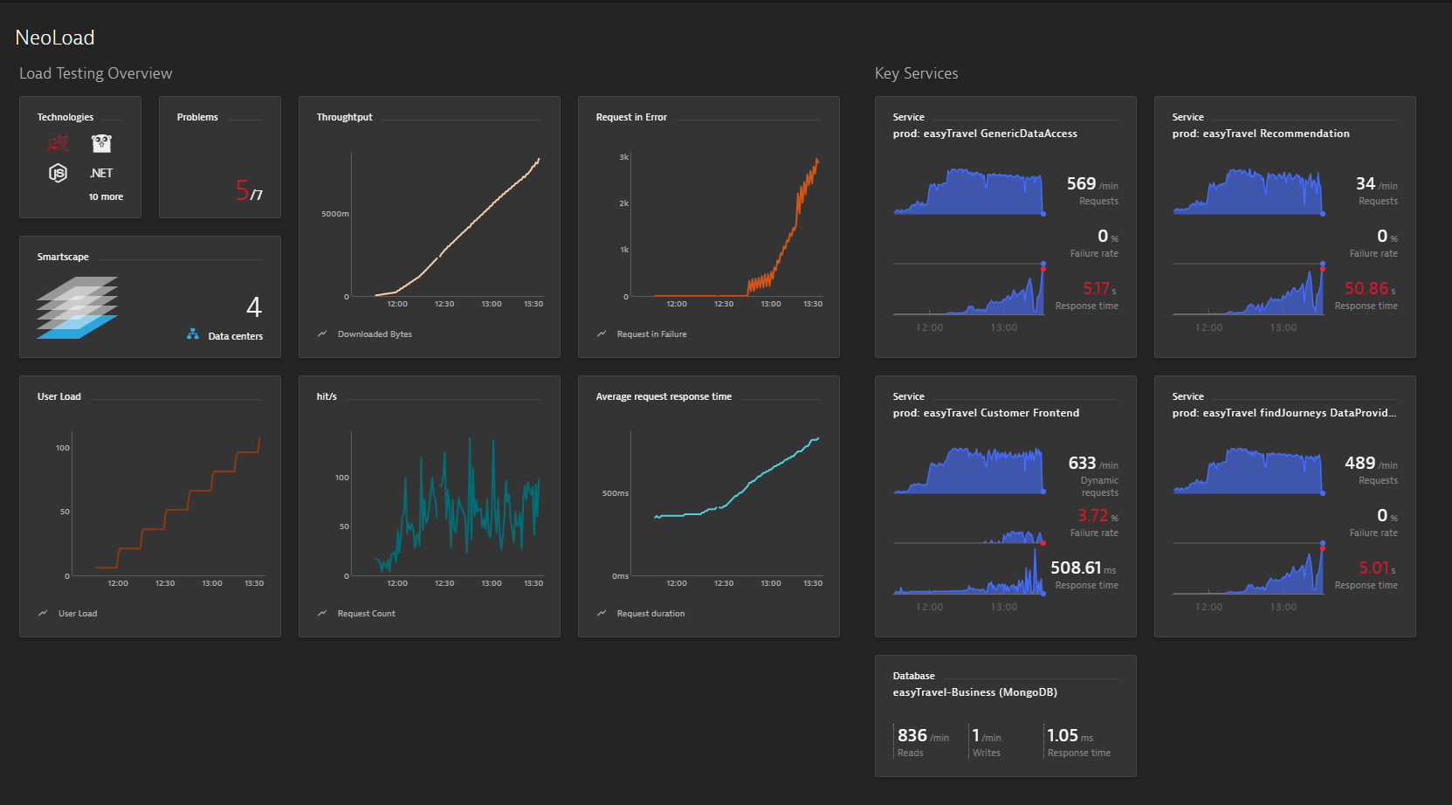
Tool Integration: Push Testing Metrics to Dynatrace
LT Metrics
Dynatrace Data
Enabled through Timeseries API

Slide 9
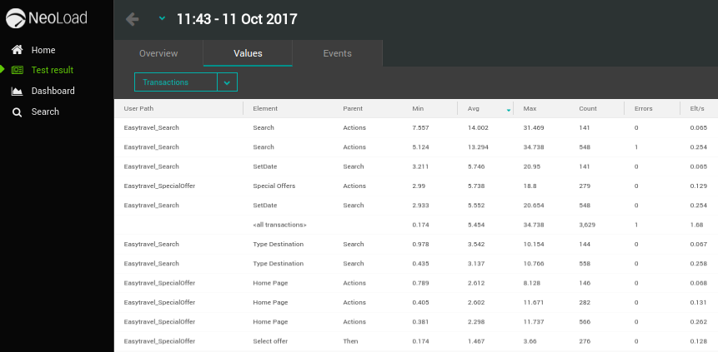
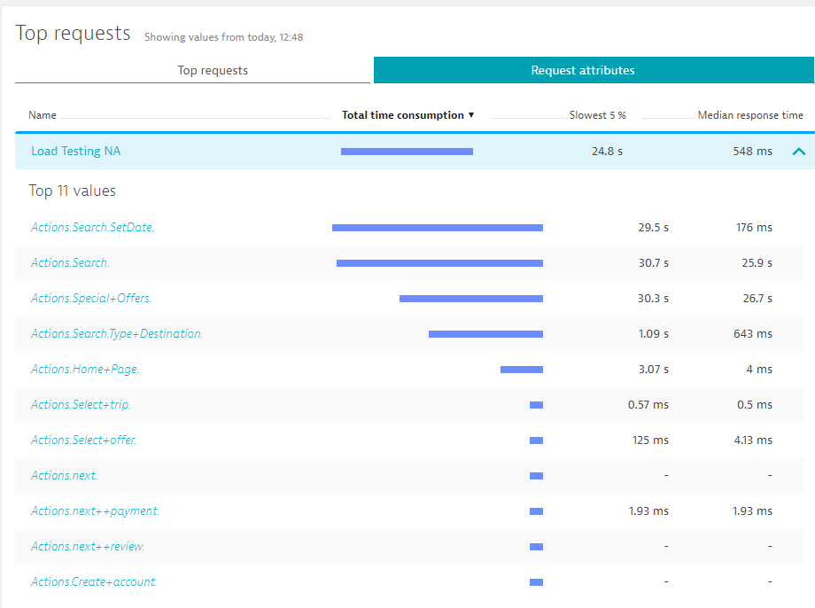
Tool Integration: Pass Test Script Context via Request Attributes
Linked!
HTTP Headers passed from Testing Tool
X-Dynatrace-Test: TSN=Actions.Search;LTN=MyTest;VU=xxx
Could theoretically be ANY HTTP Header
X-Testscript: MyTestScript
X-Testname: Actions.Homeage

Slide 10
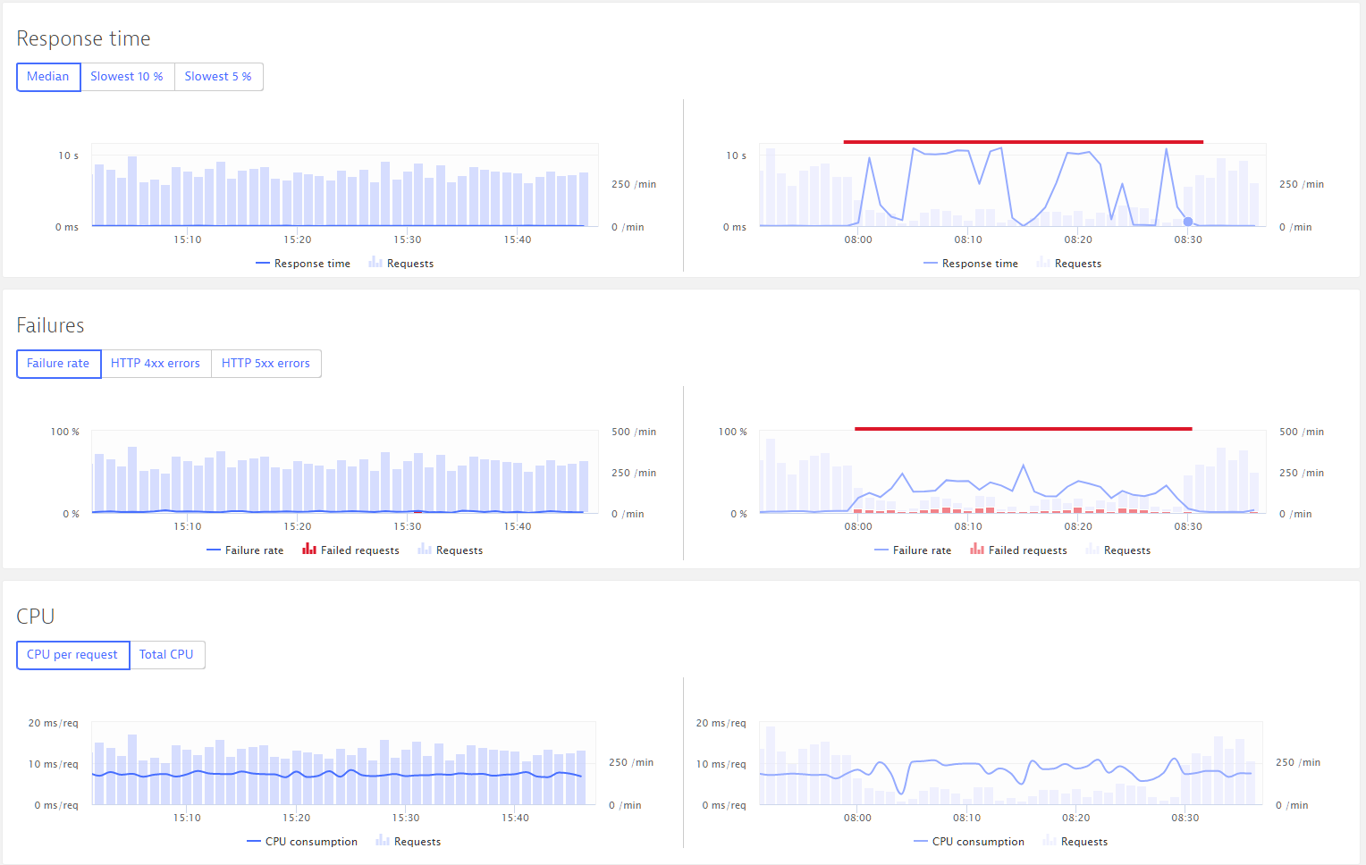
Automate Analysis: Compare Builds
Load Test #1
Load Test #2

Slide 11
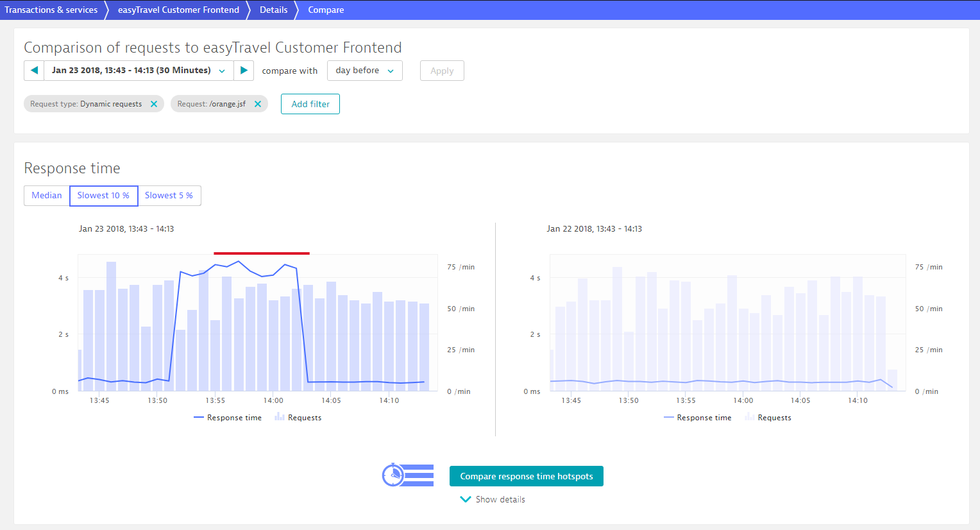
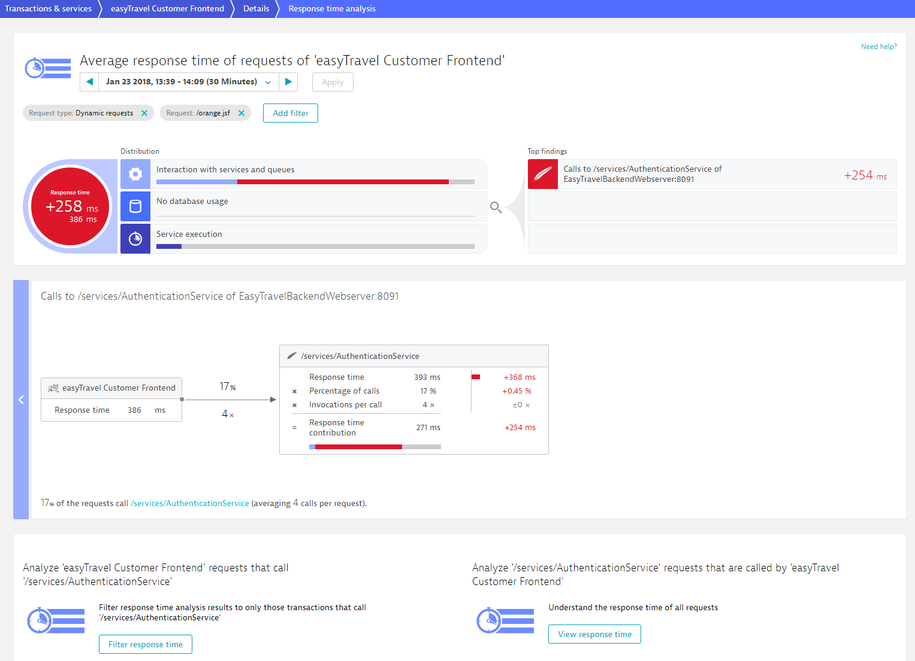
Automate Analysis: Compare Hotspots
Hotspot Analysis

Slide 12
Load Testing Integration CI Use Cases
Taken from: https://github.com/dynatrace-innovationlab/
jenkins-dynatrace-pipeline-tutorial

Slide 13
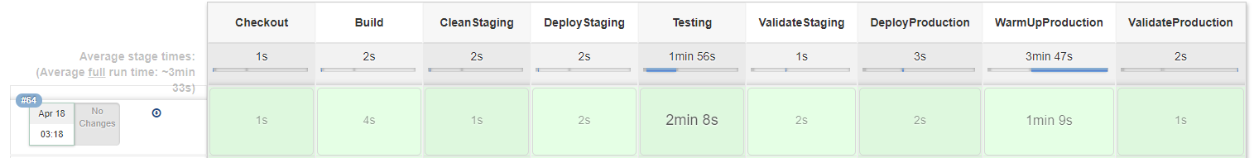


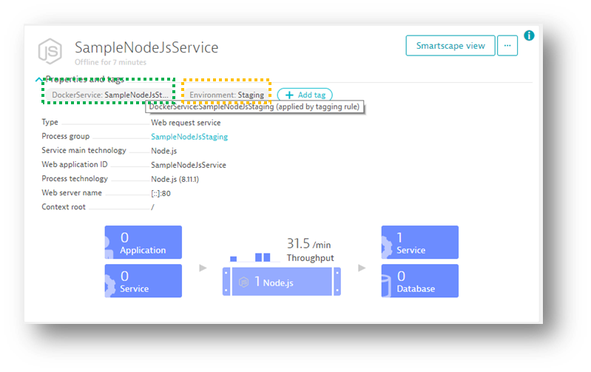
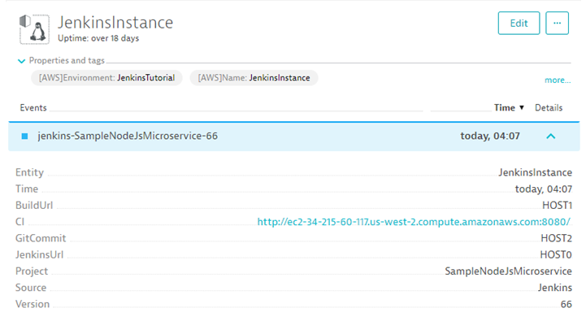
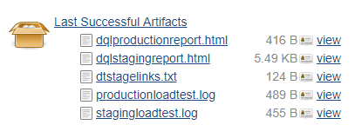
Jenkins and Dynatrace
Push Tags & Metadata
Push Events (Deploys, Tests..)
Pull data as artifacts

Slide 14
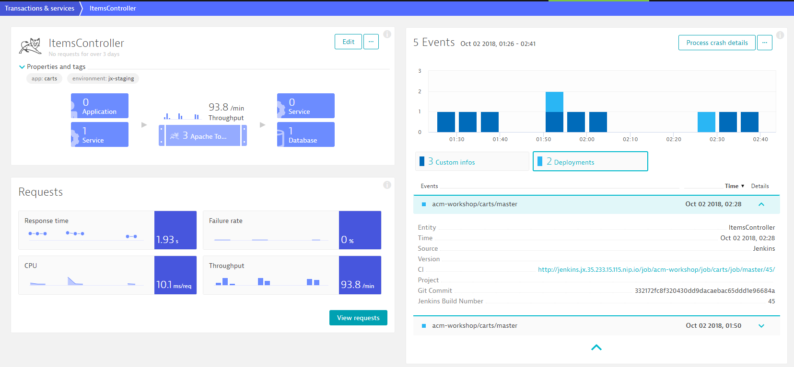
Ensure Proper Tagging & Deployment Events
See Labs 03 and 04 from Monitoring as a Service
#1 Here is the SERVICE with the specified tags
#2 And here the Deployment Event with additional information from the Jenkins Pipeline

Slide 15
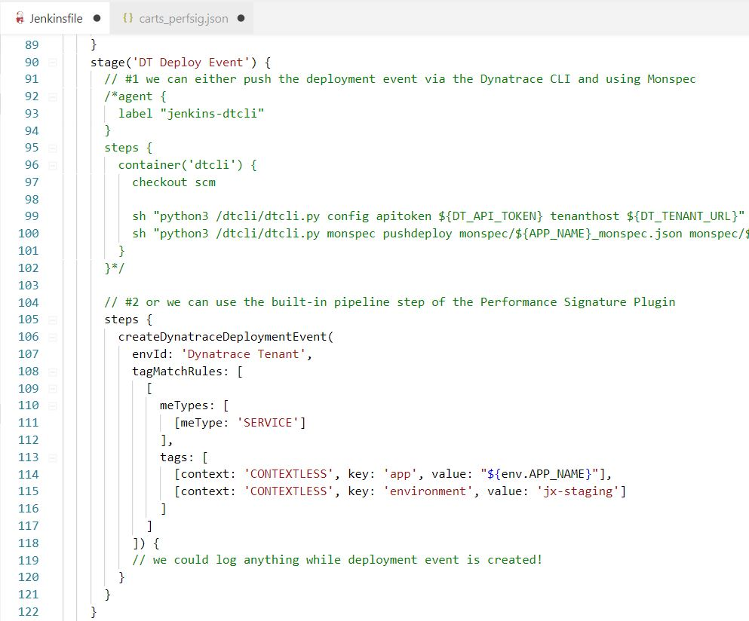
Push Load Test Start/Stop Event to Dynatrace
#1 Push an Event to this Dynatrace Tenant
#2 Define Entity Type (=SERVICE) and Tags (app:carts, environment:jx-staging)

Slide 16
Lab: Write Load Test Script
07_Performance_as_a_Self_Service
01_Write_Load_Test_Script

Slide 17
Lab: Define Request Attributes in Dynatrace
07_Performance_as_a_Self_Service
02_Define_Request_Attributes

Slide 18
Lab: Define Performance Signature
07_Performance_as_a_Self_Service
03_Define_Performance_Signature

Slide 19
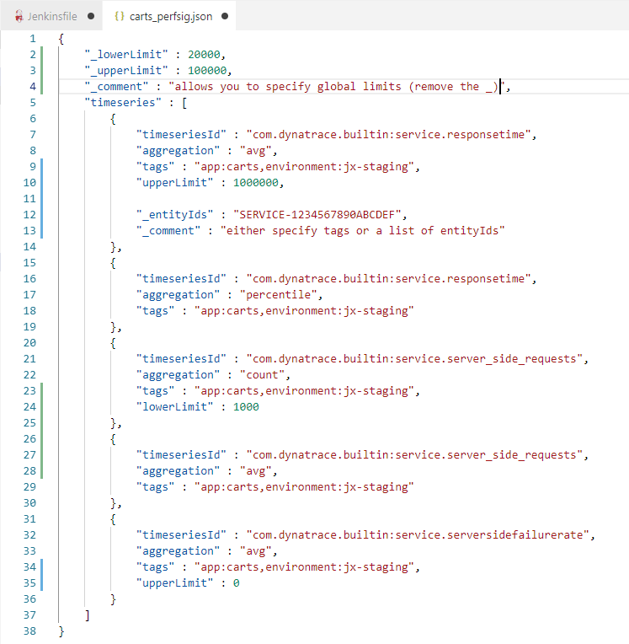
Performance Signature Definition
#1 (optional) global default limits
#2 A list of timeseries to query
#3 specify entities by tags or entityIds
#4 Fails the build if limits are exceeded

Slide 20
Lab: Define Performance Pipeline
07_Performance_as_a_Self_Service
04_Define_Performance_Pipeline

Slide 21
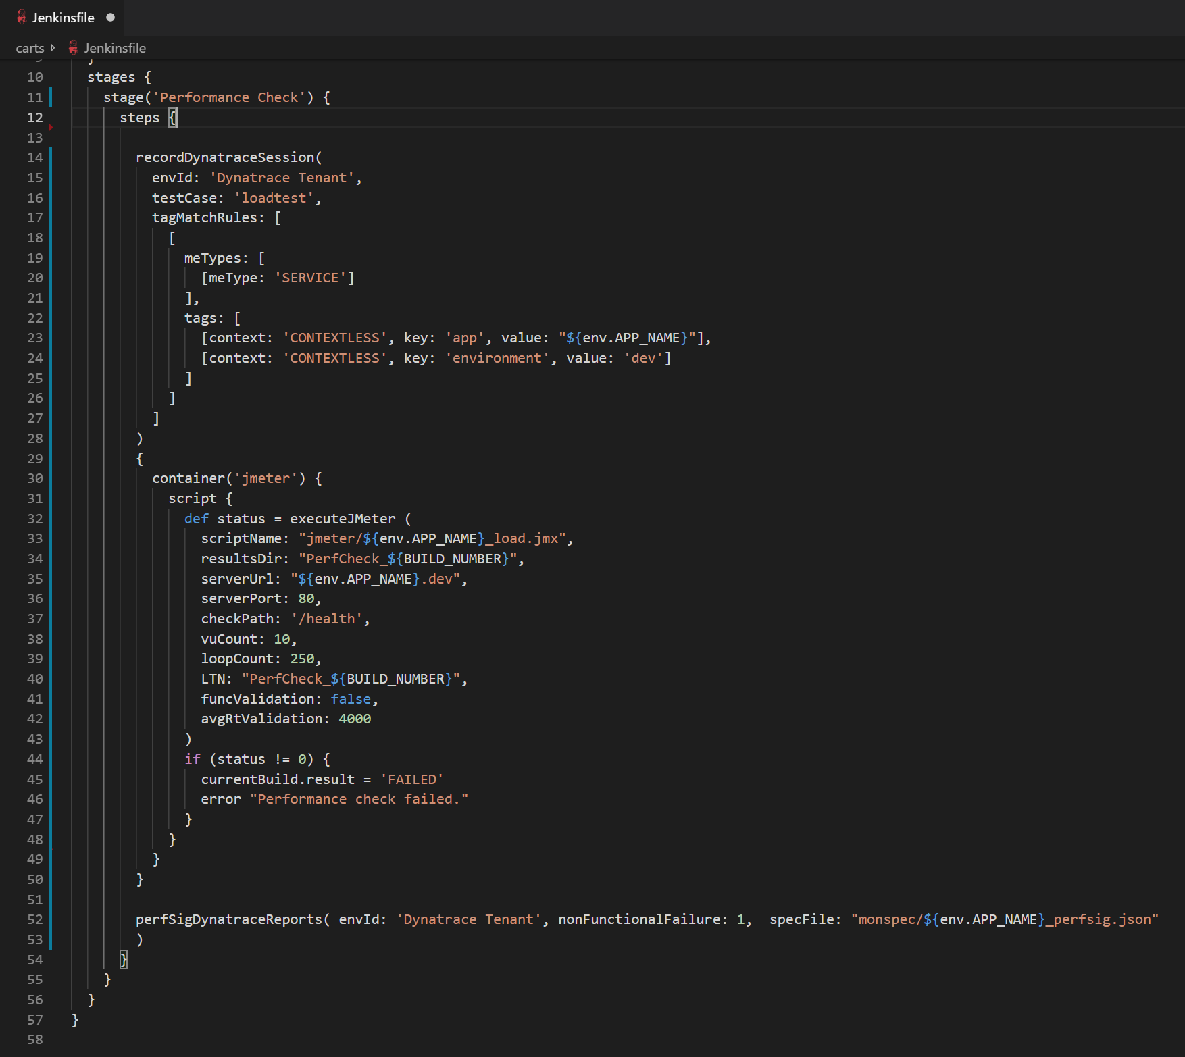
Wrap your Load Tests within a Performance Signature Validation
#1 Start Pulling Dynatrace Data back into Jenkins under “loadtest”
#2 Push Info Event to these Entities at the end of the test
#3 Run my load test, in this case a JMeter test
#4 Validate the Performance Signature Definition

Slide 22
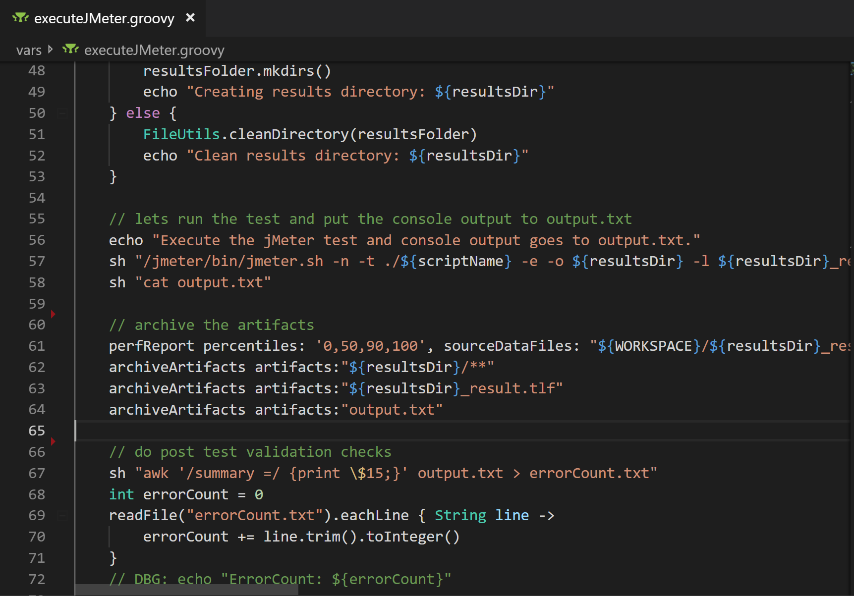
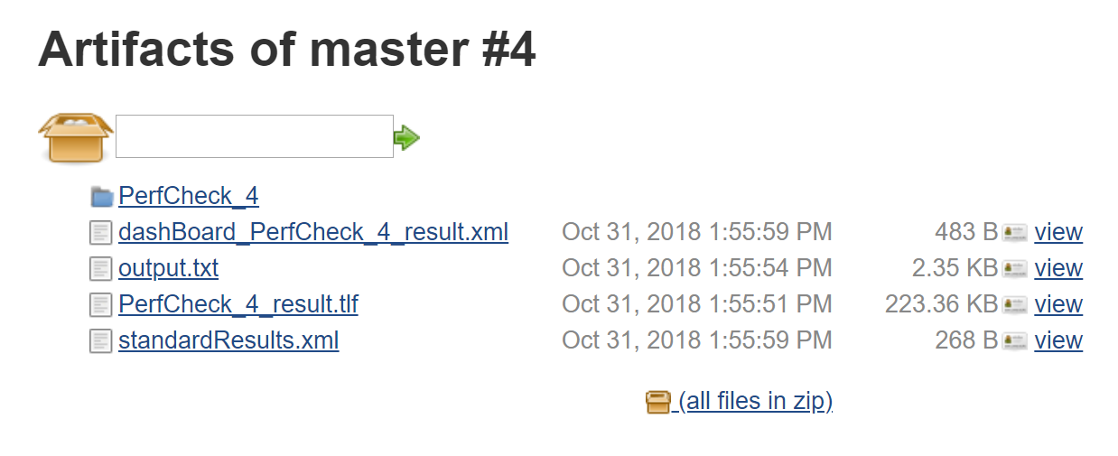
Pull Data back to Jenkins

Slide 23
Lab: Run Load Tests for Performance Validation
07_Performance_as_a_Self_Service
05_Run_Performance_Tests

Slide 24
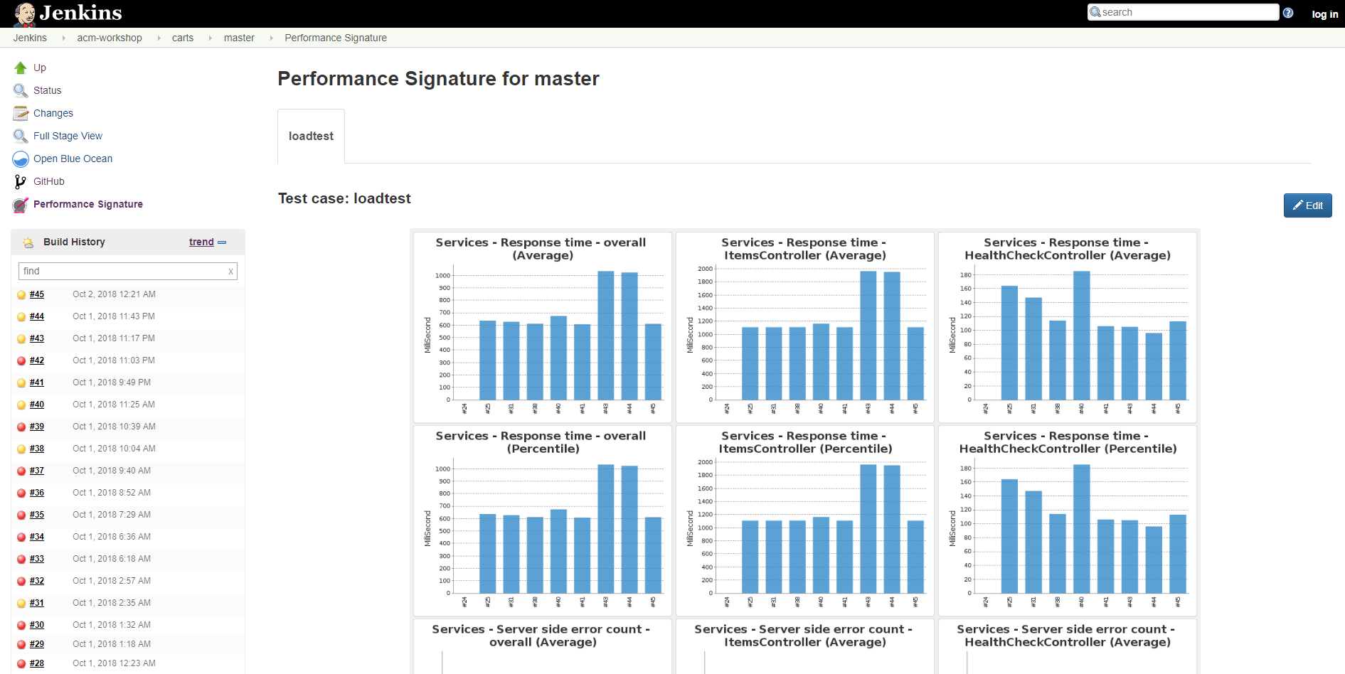
Explore Results in Jenkins
Performance Signature View
#2 Reflects the testcase name from the Pipeline
#1
#4 Add/Remove charts
#3 All metrics across builds

Slide 25
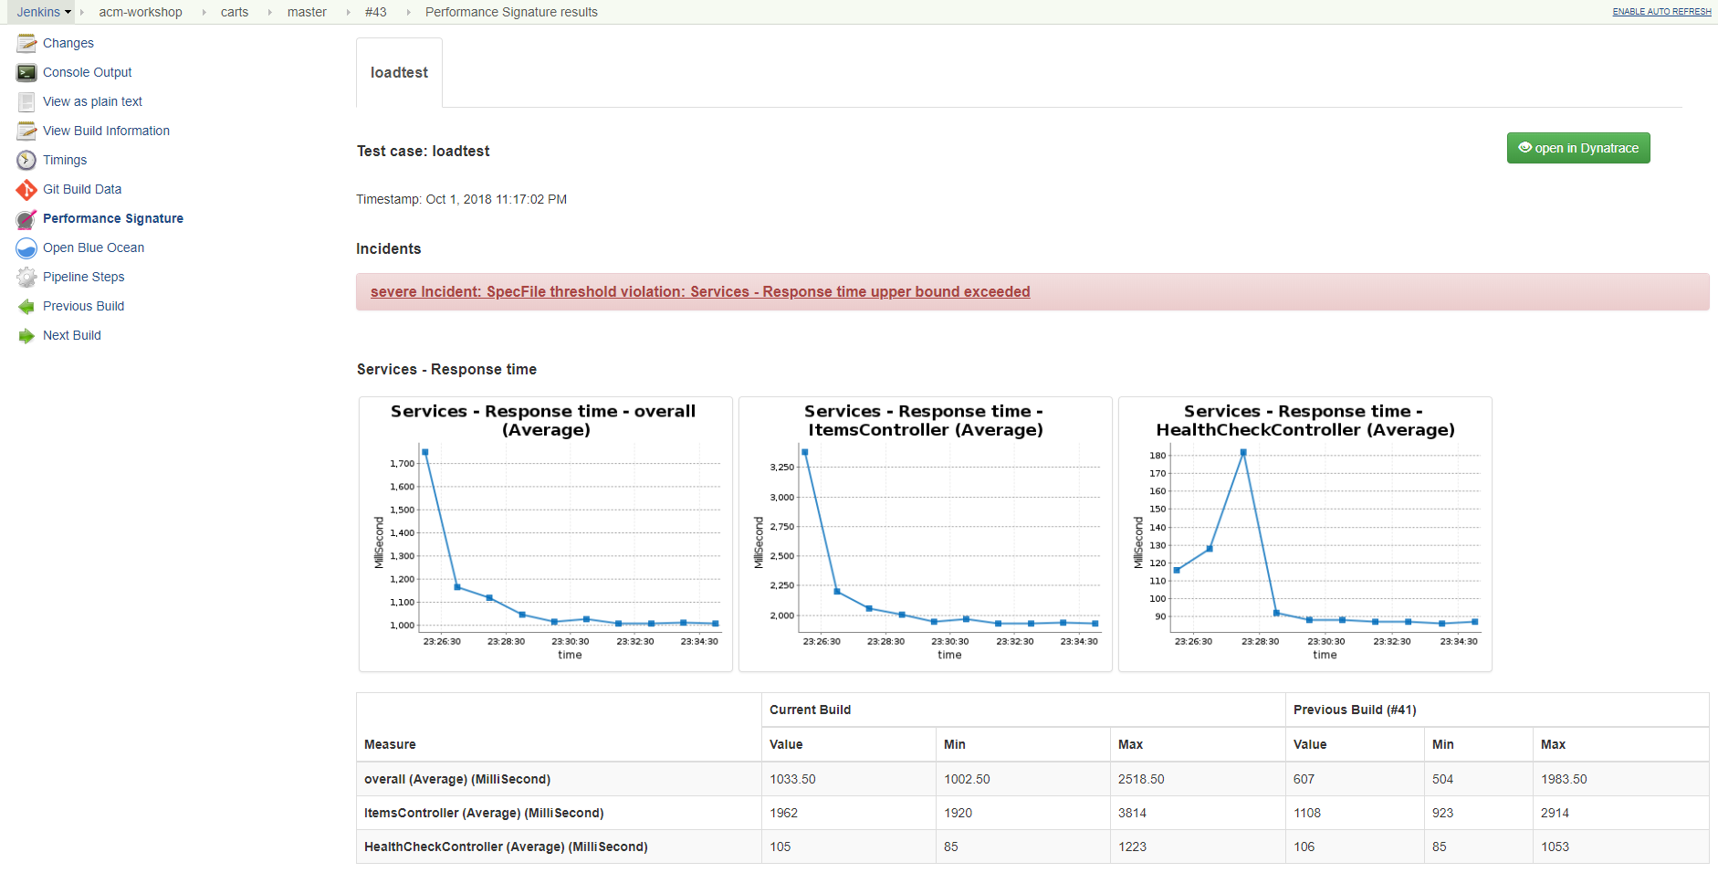
Explore Results in Jenkins
#1 Performance Signature for a specific build
#5 Open Dynatrace for this timeframe
#2 Details on Threshold Violations
#3 Timeseries data for each metric for the duration of the load test
#4 Compare with previous build

Slide 26
Lab: Analyze the Results in Dynatrace
07_Performance_as_a_Self_Service
06_Compare_Tests_in_Dynatrace

Slide 27
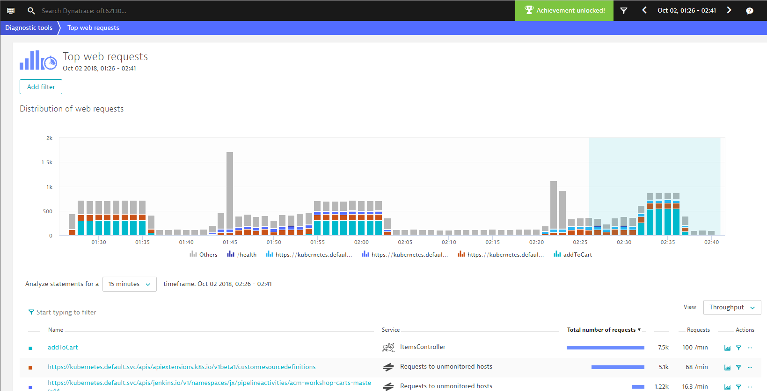
What is the difference between these builds?
#1 Opened up the correct timeframe
#2 Showing all requests in the complete environment by default

Slide 28
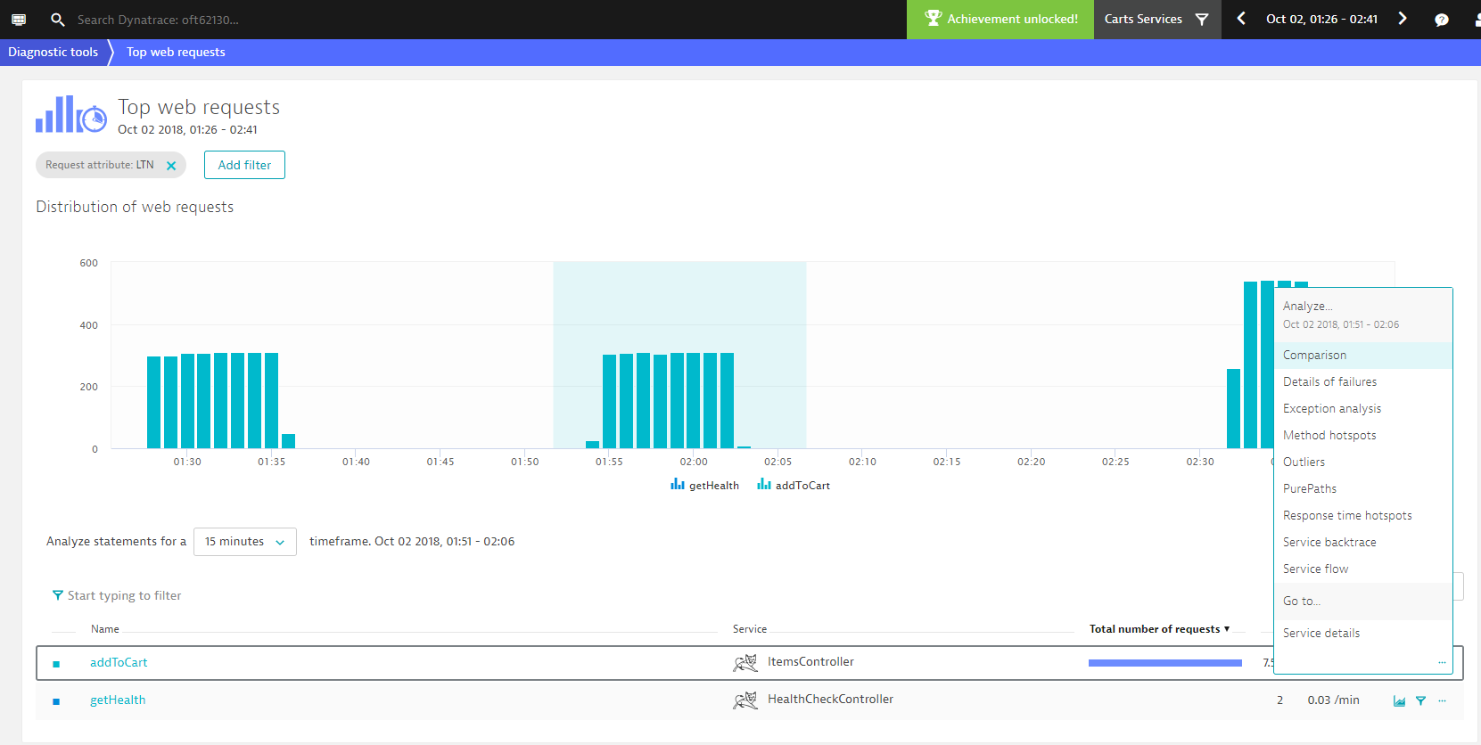
What is the difference between these builds?
#1 filter on Load Testing requests
#3 now lets compare it with a “bad build”
#2 Select the timeframe of a “good build”

Slide 29
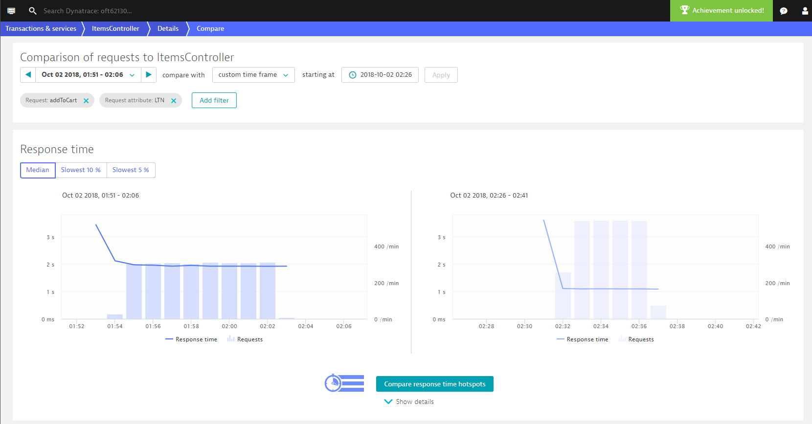
What is the difference between these builds?
#1 Select the timeframe of the “bad build”
#2 Compare response time hotspots

Slide 30
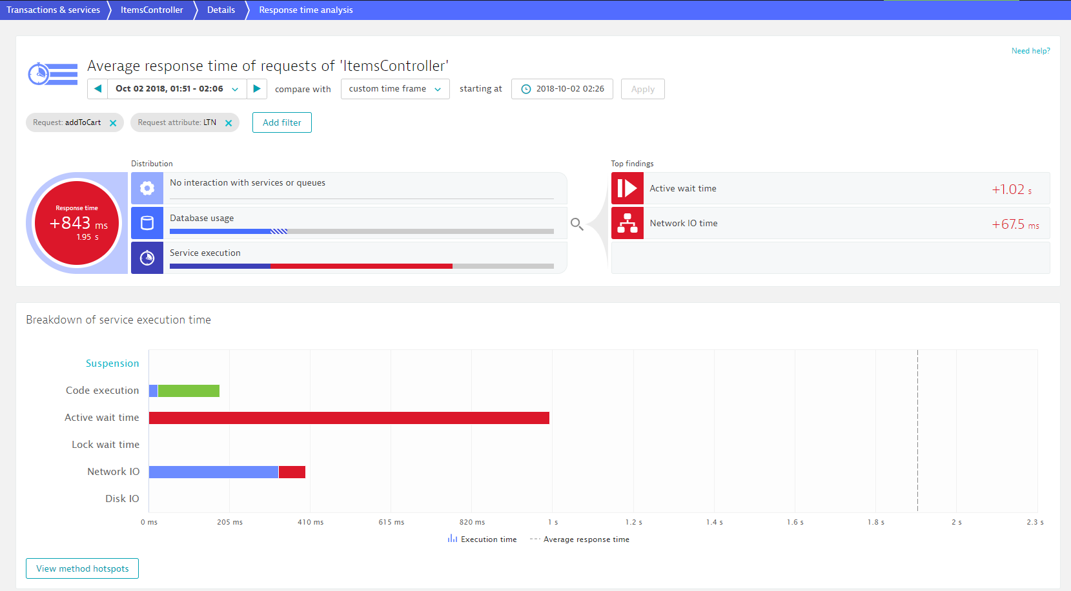
What is the difference between these builds?
#1 Top Differences between these Builds
#2 Execution Time Breakdown
#3 Lets see the methods that contribute

Slide 31
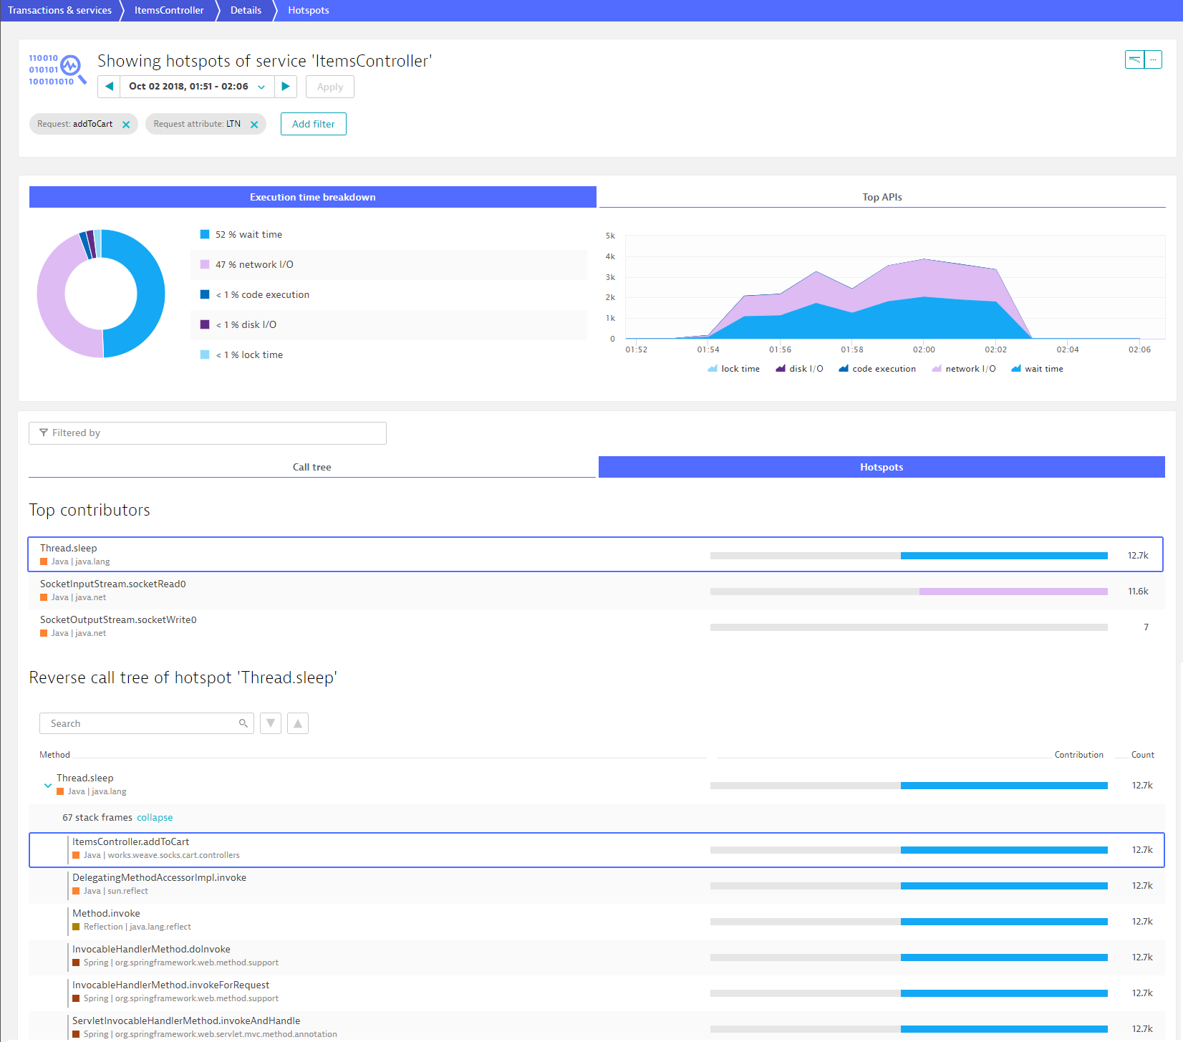
What is the difference between these builds?
#1 Top Method is sleep
#2 Executed by addToCart

Slide 32
Lab: Retry Performance Tests
07_Performance_as_a_Self_Service
07_Retry_Performance_Test

