Slide 1
Unbreakable Delivery Pipeline
ACL Detroit
November, 2018

Slide 2
Agenda
Introduction – What is the workshop about?
Labs
Check Automated Tagging Rule (dev, staging, prod)
Re-Run Pipeline and observe results
Simulate a Bad Build (Build #2)
Simulate a Good Build (Build #3)
Setup “Automated Rollback” for Production
Simulate a Bad Production Deployment (Build #4)
Summary and Recap

Slide 3
Pre-Requisites
Run through all of the labs in
Dynatrace Monitoring as a Service
Performance as a Self-Service
?
?
Useful Links
For more information about Unbreakable Pipeline read: https://www.dynatrace.com/news/blog/unbreakable-devops-pipeline-shift-left-shift-right-self-healing/

Slide 4
The BIG Picture
What we are going to do today.

Slide 5

















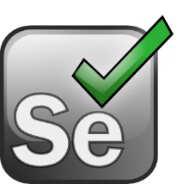










Shift-Left: Break Pipeline Earlier
Shift-Right: Tags, Deploys, Events
Dev
Perf/Test
Ops
Biz
Actionable Feedback Loops
Path to NoOps: Self-Healing, …

Slide 6
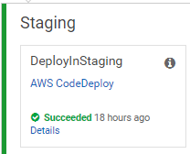
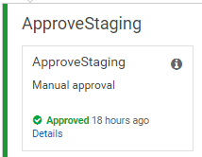
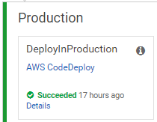
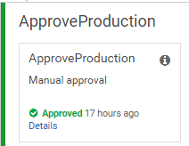




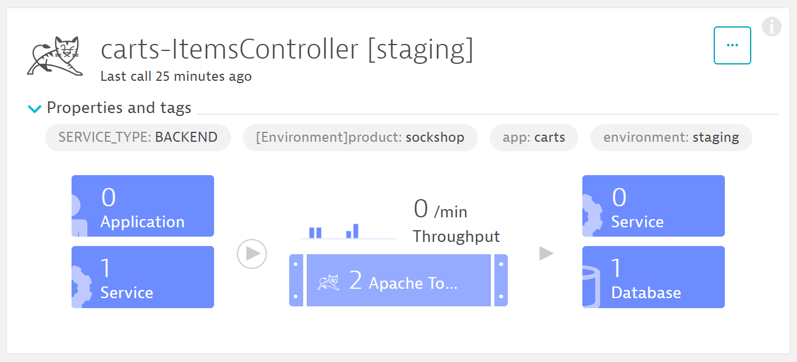
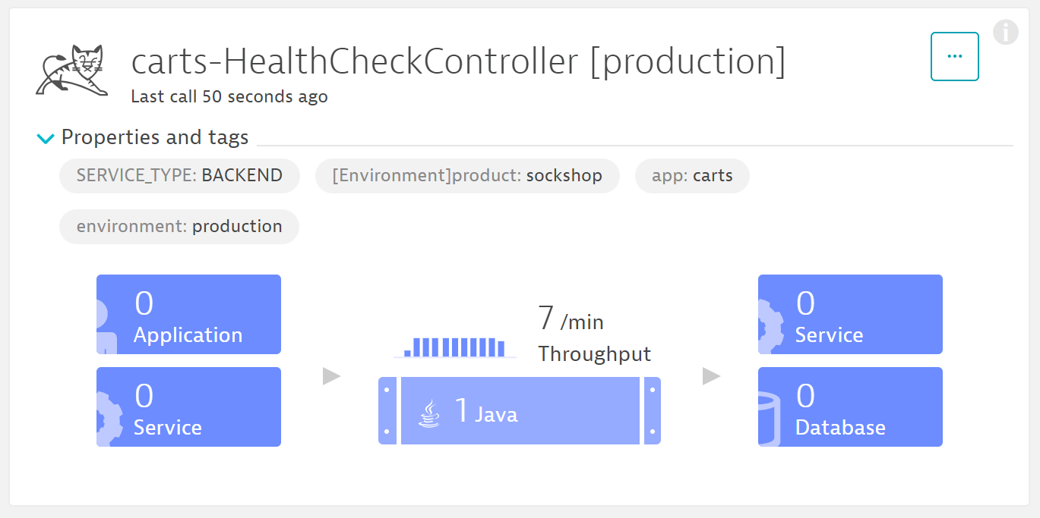

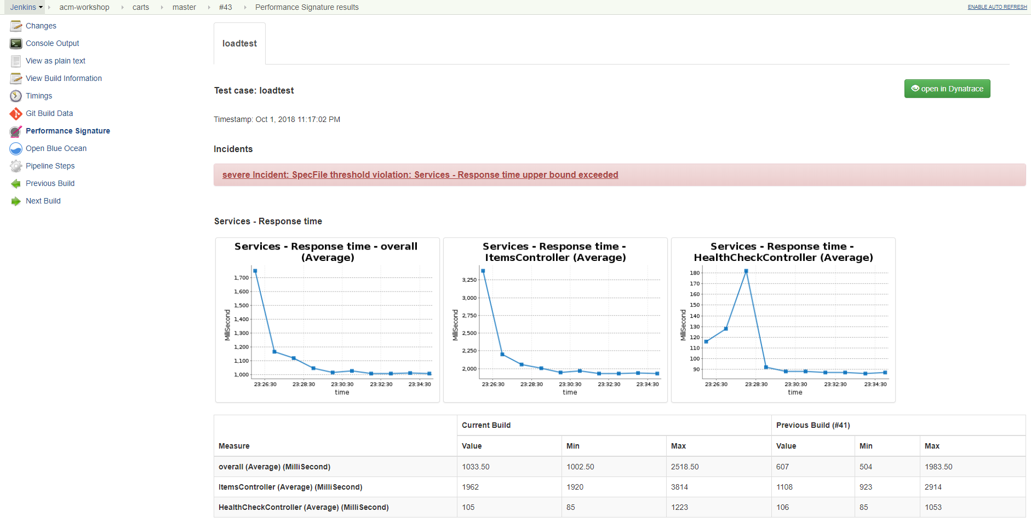
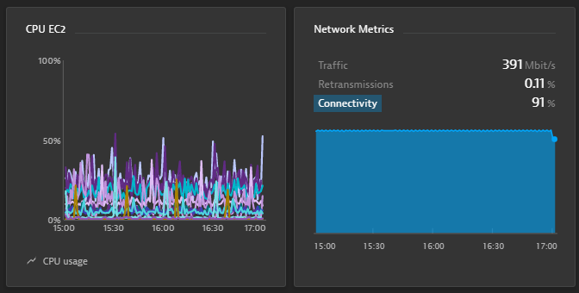
AppTeam
Users
Manual Approval
Manual Approval
Manual Rollback
(tag = staging)
(tag = production)

Slide 7
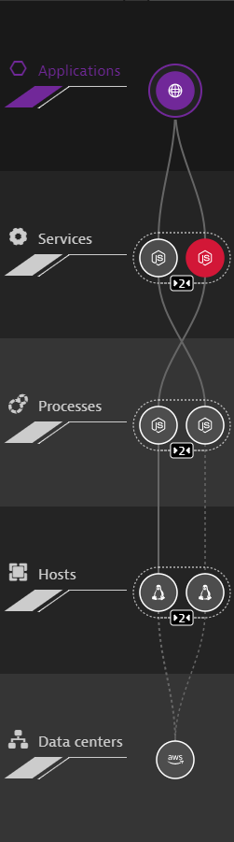
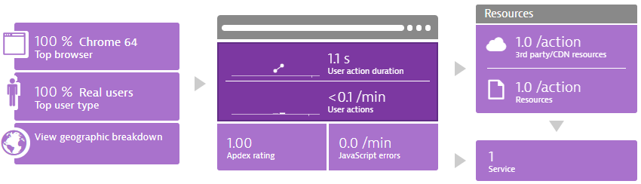
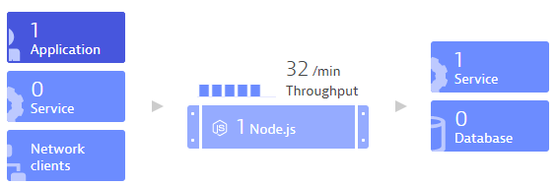
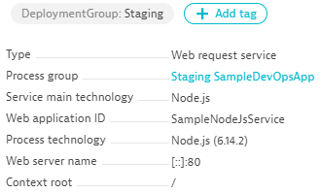

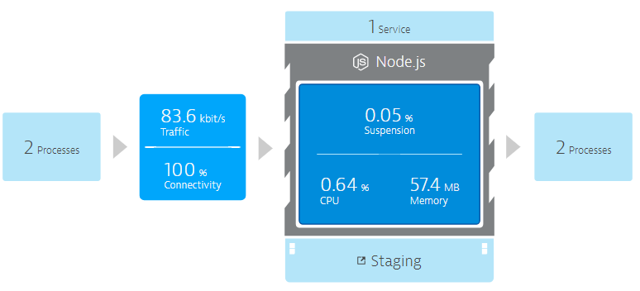
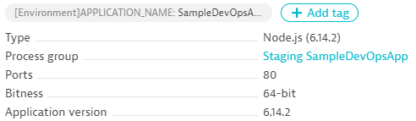

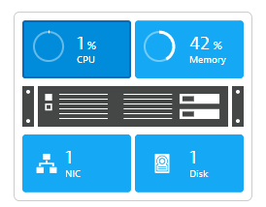
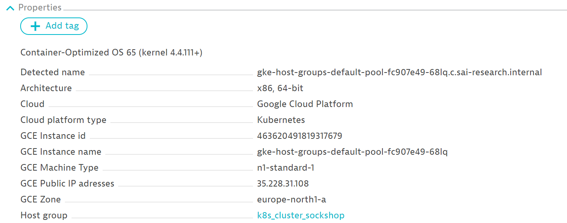
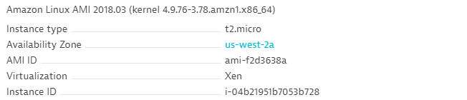
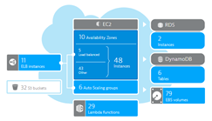
DT_TAGS=APP_NAME=Sample
DT_CUSTOM_PROPS=Staging
DT_NODE_ID=Build1
HOST_GROUP=k8s_cluster_sockshop

Slide 8
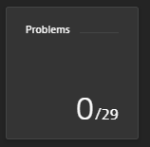
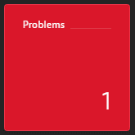

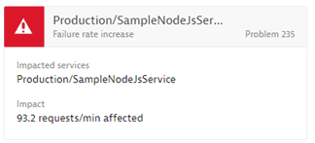
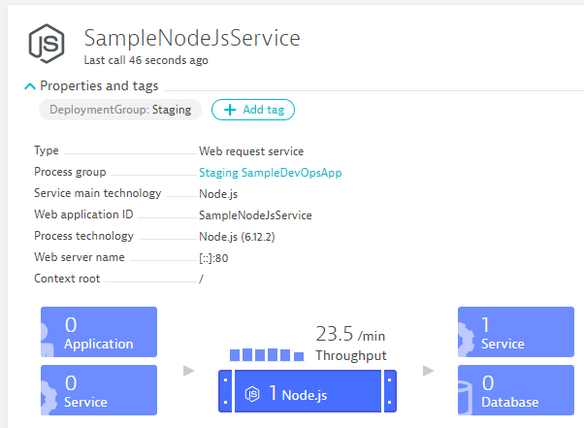
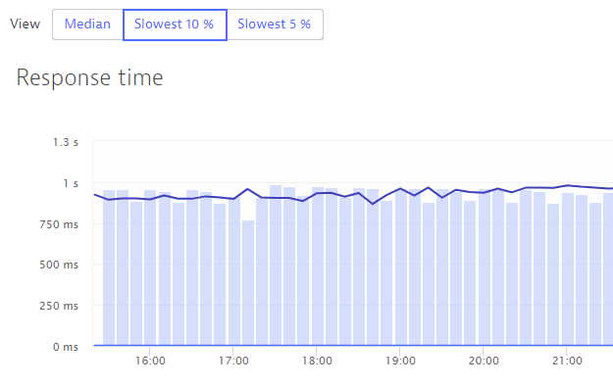
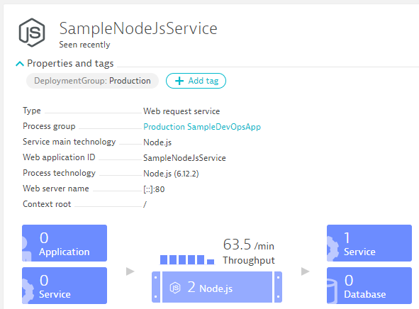
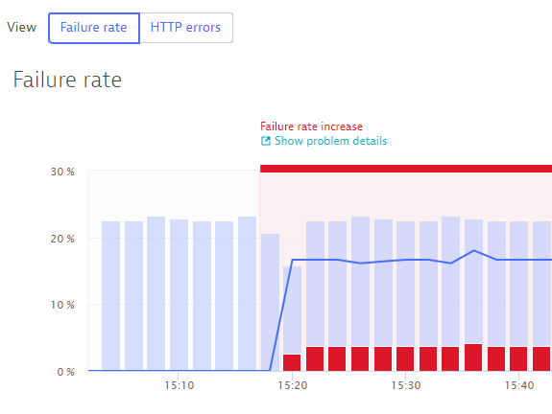

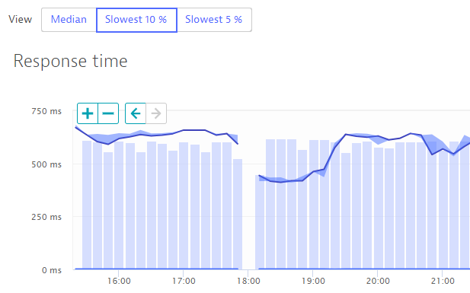
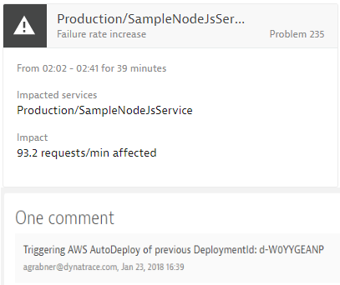
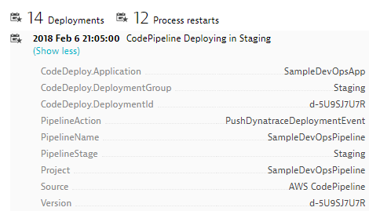
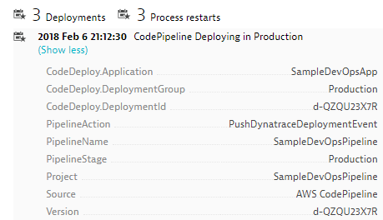
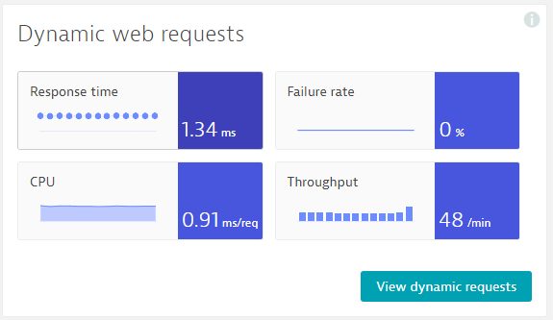
work in progress
Self-Healed
Auto-Approve!
Auto-Approve!
Auto-Reject!
Auto-Reject!
pushDynatraceDeploymentEvent
Pushes Deployment Info to Dynatrace Entities
validateBuildDynatraceWorker
Compares Builds and Approves/Rejects Pipeline
pushDynatraceDeploymentEvent
Pushes Deployment Info to Dynatrace Entities
validateBuildDynatraceWorker
Validates Production and Approves/Rejects Pipeline
Build 6
Production
handleDynatraceProblemNotification
Executes Auto-Remediating Actions, e.g: Rollback
Build 7
Production

Slide 9







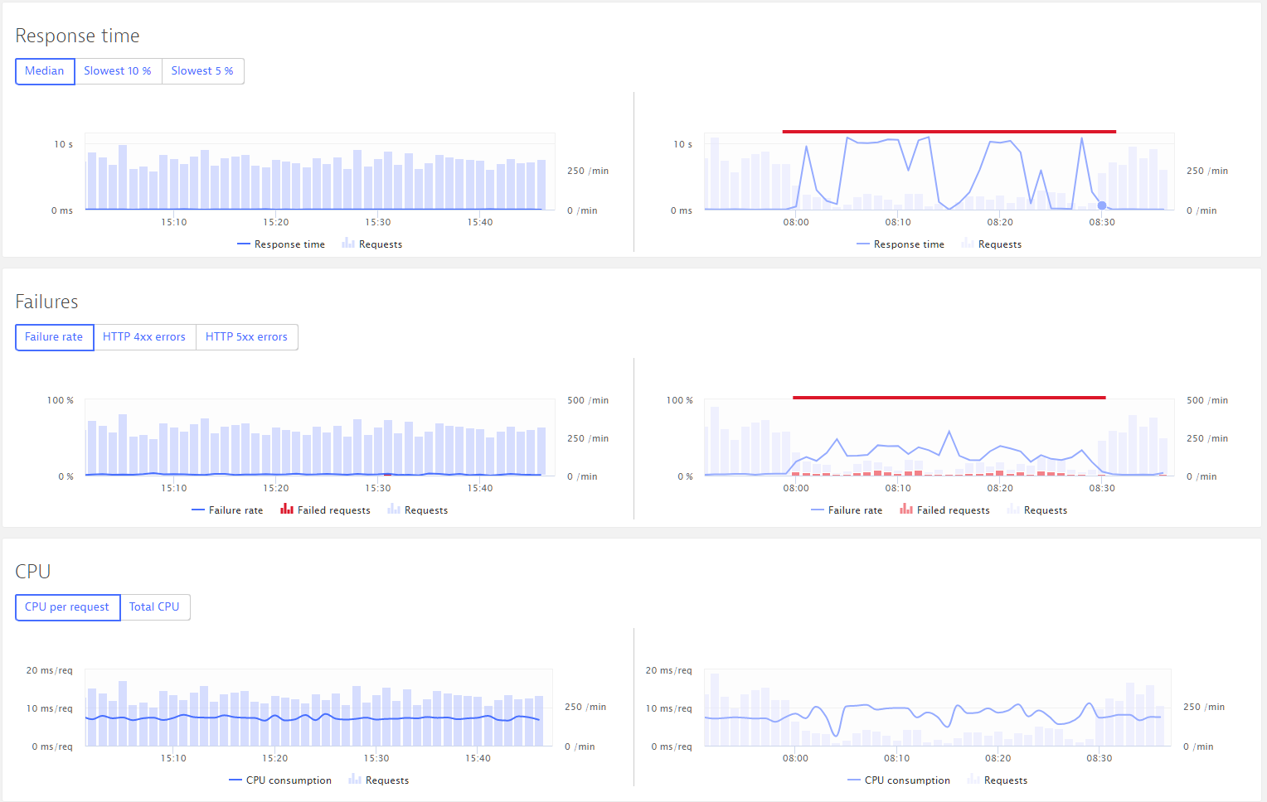
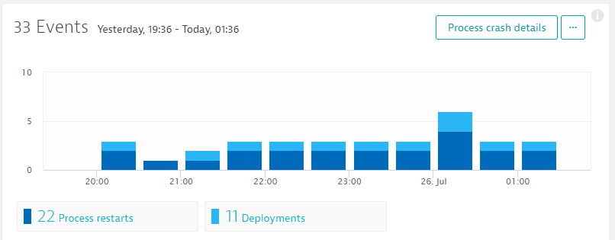
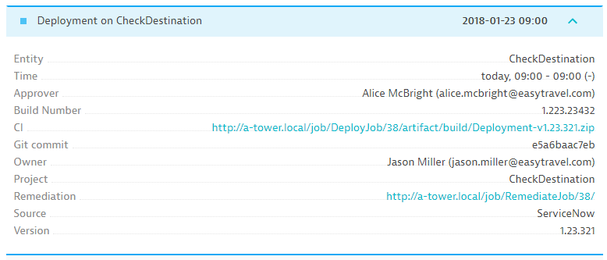
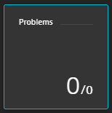

1
2
Production
4
5
Staging
Approve Staging
3
Approve Production
CI CD
CI CD
CI CD
CI CD
Pushes deployment into Dynatrace entities
Compares builds and approves / rejects pipeline
Pushes deployment info into Dynatrace entities
Validates production and approves / rejects pipeline
Build #17
Build #18
Production
Executes auto-remediating actions e.g. roll-back
Simplify DevOps complexity – automated full stack performance monitoring – see it to believe it – Dynatrace.com/trial/

Slide 10
Lab: Harden Staging Pipeline with Quality Gate
08_Unbreakable_Delivery_Pipeline
01_Harden_Staging_Pipeline_with_Quality_Gate

Slide 11
Shift-Left: Break Pipeline Earlier
Shift-Right: Tags, Deploys, Events
Dev
Perf/Test
Ops
Biz
Actionable Feedback Loops
Path to NoOps: Self-Healing, …

Slide 12
Lab: Simulate Early Pipeline Break
08_Unbreakable_Delivery_Pipeline
02_Simulate_Early_Pipeline_Break

Slide 13
Lab: Setup Self Healing for Production
08_Unbreakable_Delivery_Pipeline
03_Setup_Self_Healing_for_Production

Slide 14
Lab: Simulate a Bad Production Deployment
08_Unbreakable_Delivery_Pipeline
04_Simulate_a_Bad_Production_Deployment

