Slide 1
ACM Module - Monolith to Microservices
November, 2018

Slide 2
Outline
Introduction – What is the workshop about?
Set up TicketMonster, our monolith, on the Cloud Platform – Lab
Breaking up the Monolith
Extract the UI from the Monolith – Lab
Identify a Microservice – Lab
Identify the Domain Model of the Microservice – Lab
Deploy the Microservice – Lab
Learn and Repeat, Recap
GitHub repository for this workshop: https://github.com/dynatrace-innovationlab/monolith-to-microservices-ws
Feel free to ask questions & interact

Slide 3
Skills you gain
Set up TicketMonster
Extract the UI from the Monolith
Identify a Microservice
Identify the Domain Model of the Microservice
Deploy the Microservice
Familiarization with Cloud Platform
Deployment of Microservice
Confidence in breaking the Monolith
Persistence layer for the Microservice
(real) Microservice extracted

Slide 4
Prerequisites for Module on OpenShift
You need to bring:
Docker installed
DockerHub Account
OpenShift CLI installed
Maven installed
We will offer you:
OpenShift account on our cluster
Dynatrace tenant

Slide 5
Introduction into the Topic

Slide 6
Goal of this Module
UI
UI
Ship.
Acct.
Ship.
Acct.
DB
DB
Mgmt.
Billing
Mgmt.
Billing
DB
DB
DB
Notes:
Goal of this workshop is to break up a monolithic application – in our case the ticketmonster, a JBOSS application from our partner Red Hat – into microservices

Slide 7
Limitations of Monolithic Applications
Agility – Impact agility since rebuilding the whole application takes a decent amount of time
Scalability – Scaling a monolith happens in both directions: vertically as well as horizontally - causing unused resources
DevOps Cycle – Continuous delivery (high frequency of deployments) fails due to high build time
Availability, Fault Tolerance, and Resiliency
UI
Ship.
Acct.
Mgmt.
Billing
DB

Slide 8
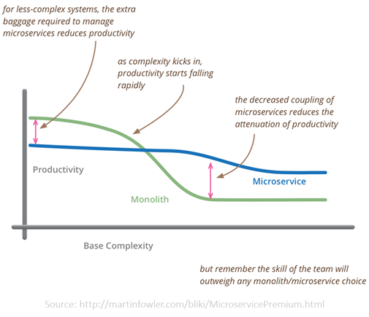
Impacts on Productivity

Slide 9
Limitations of Monoliths have given rise to Microservices
Agility - Scope changes can be done in one microservice - other micro services are not impacted from these changes
Scalability - Individual components can scale as needed
DevOps Cycle - Since each component operates independently, continuous delivery cycle reduces
UI
Ship.
Acct.
DB
DB
Mgmt.
Billing
DB
DB

Slide 10
Check Prerequisites
Make sure you have:
Docker
DockerHub Account
(Maven) maybe not necessary
OpenShift CLI
Our OpenShift cluster: https://18.207.174.41.xip.io:8443/console/ws-XX (XX… your assigned number)
- Our Dynatrace tenant: https://nbt24337.live.dynatrace.com
- Management zones, to handle the different users
Notes:
acm-workshop@ruxitlabs.com
Dynatrace1

Slide 11
Lift-and-shift TicketMonster
Overview
Create a MySQL service for monolith
Push application to OpenShift
Bind MySQL service to monolith
Instructions:
Lab: 1_Lift-and-Shift_TicketMonster
Takeaways
Familiarization with OpenShift
API
ticketmonster-db
ticketmonster-monolith
UI
Notes:
put proxy in front of monolith to enable real user monitoring
ATTENTION: disable Real-user monitoring in Dynatrace for monolith, otherwise the proxy won‘t enable real-user monitoring
How to: disable it for processgroup JBoss standalone wildfly ticket-monster-mysql-*

Slide 12
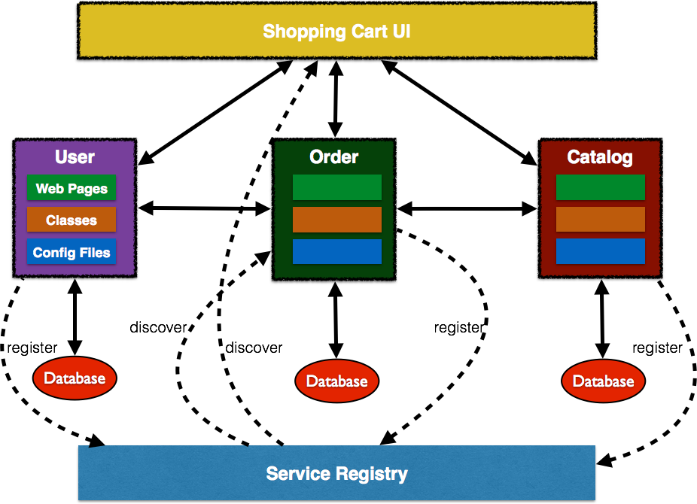
Extract the UI from the Monolith
A single application consolidating all client interactions for the monolith:
Application uses the services provided by the monolith and compose them together
(Use an API gateway or service mesh when application needs to invoke calls to several microservices, topic of separate workshop)
Works as proxy where the UI pages of different components are invoked to show the interface

Slide 13
Extract the UI from the Monolith
Overview
Rename ‘monolith‘ to ‘backend‘
Switch to tm-ui-vi
Check Proxy and ReverseProxy
Push new UI to OpenShift
Instructions:
Lab: 2_Extract_UI_From_Monolith
Takeaways
Deployment of Microservice
ticketmonster-ui-v1
API
ticketmonster-db
backend
UI

Slide 14
Generate Load on the new User Interface
Overview
Run load generator to simulate 15 user/minute
Instructions:
Lab: 3_Generate_Load_on_UI
Takeaways
Scalability of Microservice
++
ticketmonster-ui-v1
API
ticketmonster-db
mysql
backend
UI

Slide 15
Identify a Microservice
Problem: we don’t know much about our monolith:
Who is depending on us and how are they depending on us?
Whom are we depending on and how are we depending on them?
What happens within our monolith code base when it gets called?
Leverage Dynatrace to:
Get Dependency Information
Detect Service Endpoints, Usage & Behavior
Understand Service Flow per Endpoint
Finding Entry Points with CPU Sampling Data
Define Custom Service Entry Points

Slide 16
Identify a Microservice
Overview
Analyze UI and monolith
Define Custom Service Detection Rule
Instructions:
Lab: 4_Identify_a_Microservice
Takeaways
Virtually broken the monolith
ticketmonster-ui-v1
API
ticketmonster-db
backend
UI
API
orders-service

Slide 17
Identify the Domain Model of the Microservice
Data management of a decoupled Microservice:
Use an existing API of the monolith to keep data management at the monolith
(If no appropriate API is available) create a new lower-level API for the microservice (but still keep the data management at the monolith)
Do an ETL from the monolith’s database to the microservice’ database and keep both in sync
Data model shows how data is stored and entities relate to each other in the persistence layer.
Domain model describes the behavior of the solution space of a microservice’s domain and tends to focus on use case scenarios

Slide 18
The Microservice and its Domain Model
Overview
Analyze database queries of Microservice
Instructions:
Lab: 5_Domain_Model_of_Microservice
Takeaways
Persistence layer of Microservices
ticketmonster-ui-v1
API
ticketmonster-db
backend
UI
orders-db
API
orders-service

Slide 19
Refactor your Source Code
1) Extract OrdersService from the Monolith
Cut out the class containing createBooking method
Identify missing abstractions for a successful build
2) Strangle the OrdersService around the Monolith
Call the OrdersService in the business logic of the backend
3) Build the Domain Model for the Microservice
Integrate a data virtualization framework into your code base
Extend the data model to the domain model by virtualized data views

Slide 20
Deploy the Microservice
Overview
Deploy a new backend version
Create a MySQL service instance for microservice
Build microservice and push it to OpenShift
Bind MySQL service instance to microservice
Re-deploy UI to use new backend version
Instructions:
Lab: 6_Deploy_the_Microservice
Takeaways
Microservice for a specific bounded context
ticketmonster-ui-v1
API
ticketmonster-db
backend
UI
orders-db
API
orders-service

Slide 21
Summary / Recap

Slide 22
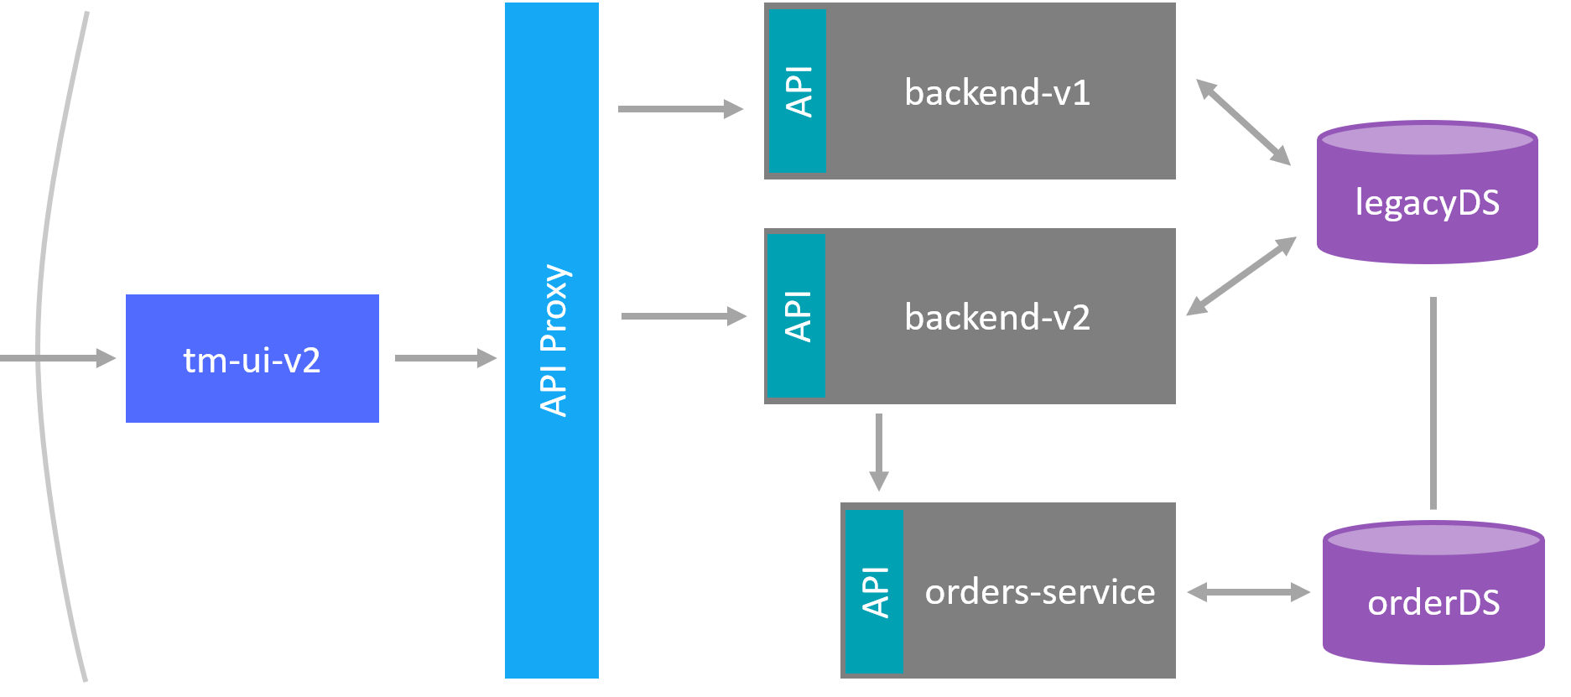
backend-v1
ticketmonster-db
API
backend-v2
ticketmonster-ui-v1
API Proxy
orders-db
API
order-service

