Slide 1
Performance as a Self Service
November, 2018

Slide 2

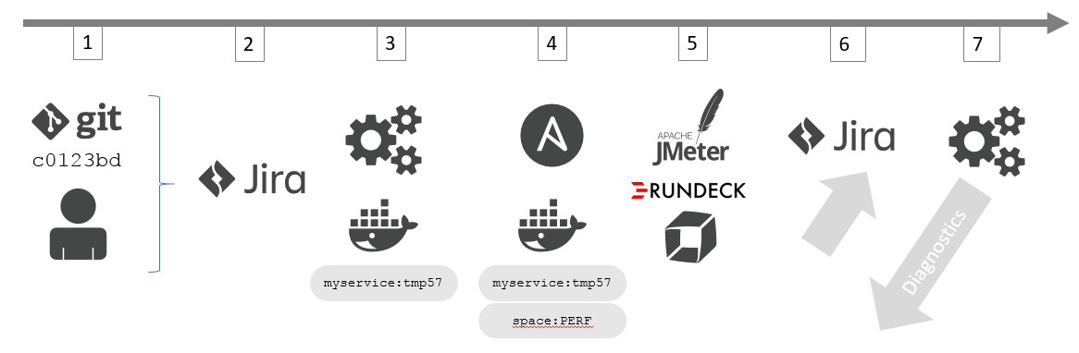

Based on - Continuous Performance as Self-Service
Mark Tomlinson

Slide 3
Performance as a Self - Service – Reference Episode
Goal:
Moving from manual sporadic execution and analysis of performance tests to a fully automated on-demand self-service model for developers. Get performance feedback early on results in better performing software that gets deployed into production.
Assumptions: Working Dynatrace environment. Existing Performance Testing Scripts that can be triggered automatically!
Sprint 1
Prepare test environment for automatically monitoring any executed performance test
Integrate Dynatrace into test environment building
Validate Load Testing Integration Option with Dynatrace
Define new load testing processes, flow & responsibilities
Have environment 0 up and running and execute first test
Sprint 2
Integrate new performance feedback workflow for application 1 release cycle
Ensure full performance testing suite integrates with Dynatrace
Validate automated execution and monitoring of performance test suite
Run diagnostics session with development
Include performance feedback lessons learned in daily standups
Sprint 3
Validate performance improvements for application 1 and hand-over self-service model to development
Validate performance improvements from previous sprint
Adjust performance feedback loop
Hand-over self-service model to engineers
Prepare for production deployment
Sprint 4
Validate performance improvements in production for application 1. Rinse, repeat and onboard next application
Validate production performance improvement
Adjust tests for next sprints based on production changes
Processes are validated for other applications as well.
Kick Off with Management
Review with Management
Notes:
Notes with more details on each Sprint
Sprint 1
- Workshop with Testbed showing how to load test a service, analyze data, request attributes, …
- Validate Pre-Requisits, e.g: Load Testing Scripts, instrumented services …
- Convert one existing testing script to add HTTP Headers
- Define Request Attributes for this service
- Execute short sample load test for validation
- Outcome: Understand how Load Testing Integration Works and validate it works based on one converted script
- Outcome 2: Select larger test suite to be converted in Sprint 2
Sprint 2
- Convert Full Test Suite
- Execute 1 Longer Load Tests
- Analyze Load Testing Results, provide a list of improvements to engineering
- Implement "Start / Stop" Load Test Event in Test Script Execution
- Define diagnostics dashboards for tested service
- Outcome: first load test run and optimization tasks passed to engineering
- Outcome 2: load test specific dashboard
Sprint 3
- Prereq: New build from engineering with fixes!
- Run Test against new build
- Analyze new test and compare with previous test. Provide feedback to engineers
- Extract key metrics of analyzed tests and define Monspec for future tests
- Re-run test and pull in Monspec data while test is running. Validate dynamic behavior and refine performance signature (timeseries+smartscape)
- Outcome: Provide Performance Feedback to engineers based on code changes
- Outcome 2: Refined Monspec to be used in future tests – fully automated while test runs
Sprint 4
- Automate Test Execution and Monspec Validation to be triggered through a single script
- Automate Test Results Report Generation based on Monspec and other data relevant for these tests. Report will have links back to dynatrace dashboards for deep dive
- Enable dev teams to run these tests on their own
- Prod/Twin Testing: Create Load Testing Scripts based on Monspec and Production Data
- Outcome: Performance as a Self-Service for engineers!
- Outcome 2: an automation process that can also be integrated into a CI/CD Pipeline!
- Outcome 3: Production-Like Testing Service

Slide 4
Outline
Introduction – What is the workshop about?
Labs
Deploy Application to be tested
Run JMeter Tests without modifications
Modify JMeter Tests & Setup Tagged Web Requests
Re-Run JMeter Tests
Deploy Build #2 and Re-Run Tests
Compare Builds in the Dynatrace UI
Use the Dynatrace REST API (CLI) to compare builds automatically
Summary

Slide 5
Pre-Requisites
Run through all of the labs in Dynatrace Monitoring as a Service
https://github.com/dynatrace-innovationlab/acl-docs/tree/master/workshop/06_Monitoring_as_a_Service
JMeter scripts are already using Dynatrace X-Dynatrace-Test tags
Follow the steps to configure the Request Attributes as described here https://www.dynatrace.com/support/help/integrations/test-automation-frameworks/how-do-i-integrate-dynatrace-into-my-load-testing-process/
Use dtcli monspec through the load test to pull LIVE metrics from the JMeter Load Test

Slide 6
Load Testing Integration Use Cases Push Metrics, Pull Metrics, Tagging, Events

Slide 7
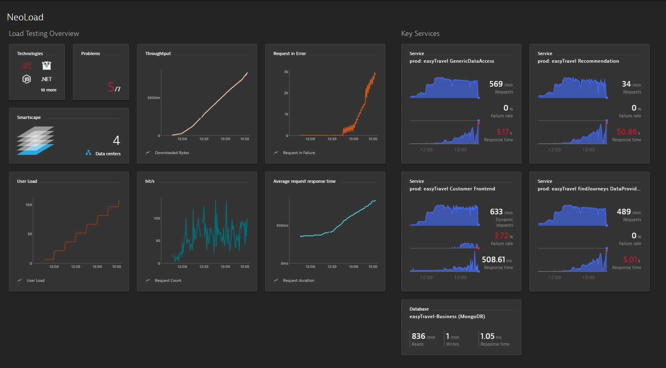
Tool Integration: Push Testing Metrics to Dynatrace
LT Metrics
Dynatrace Data
Enabled through Timeseries API

Slide 8
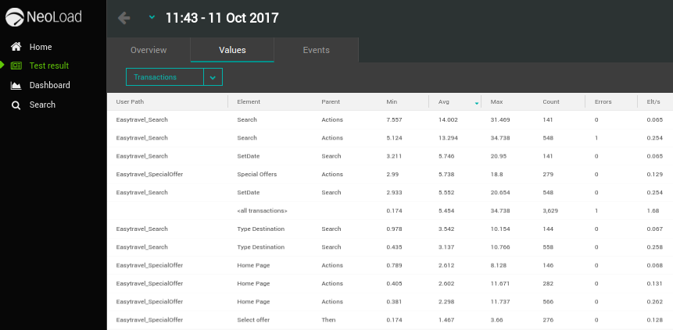
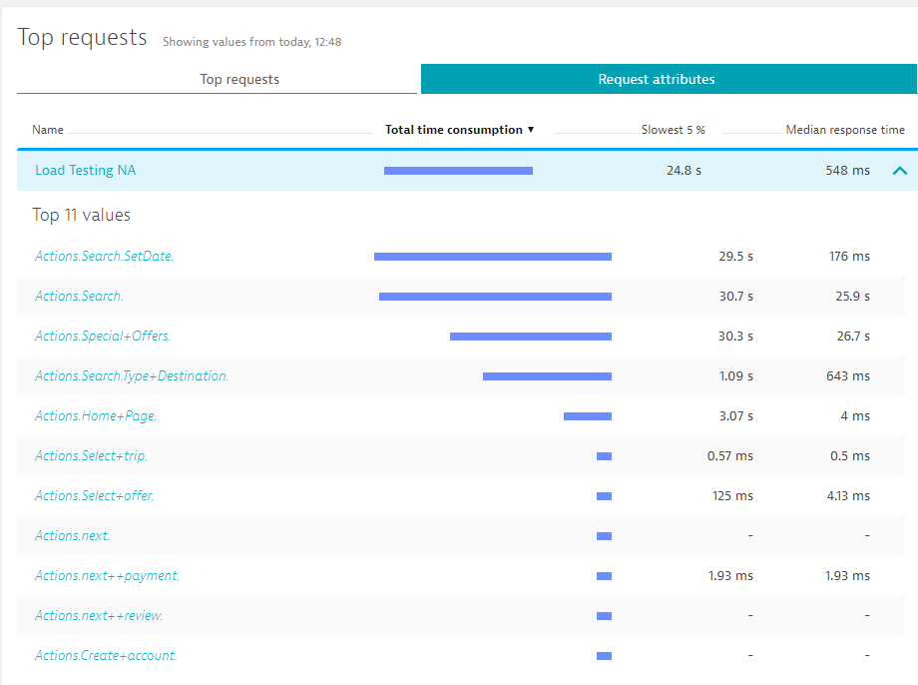
Tool Integration: Pass Test Script Context via Request Attributes
Linked!
HTTP Headers passed from Testing Tool
X-Dynatrace-Test: TSN=Actions.Search;LTN=MyTest;VU=xxx
Could theoretically be ANY HTTP Header
X-Testscript: MyTestScript
X-Testname: Actions.Homeage

Slide 9
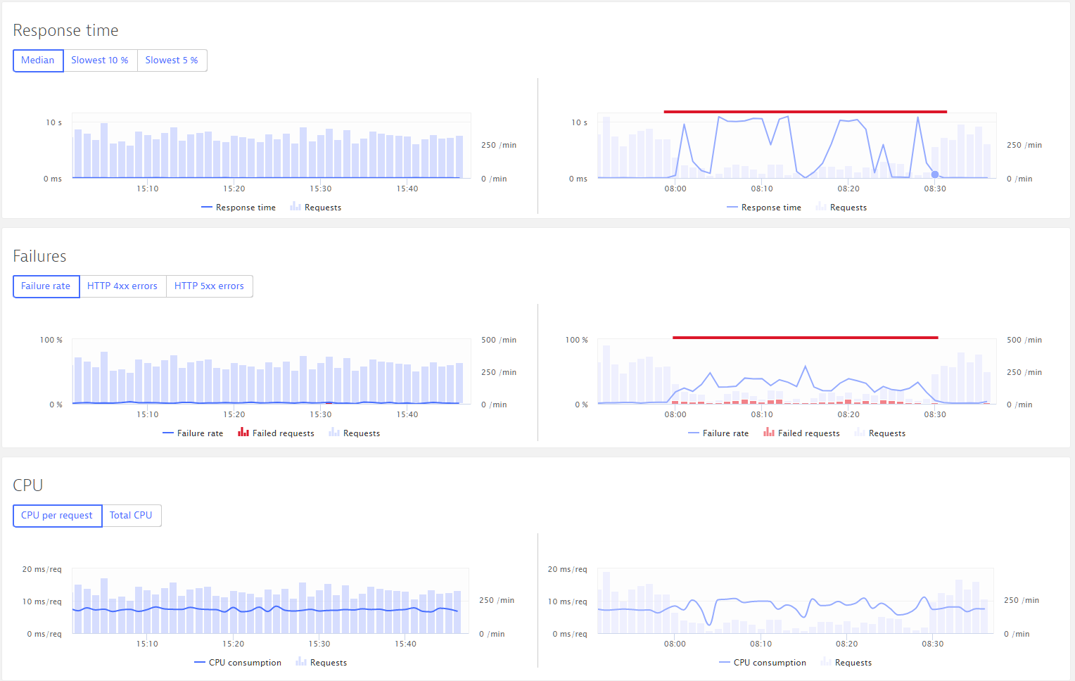
Automate Analysis: Compare Builds
Load Test #1
Load Test #2

Slide 10
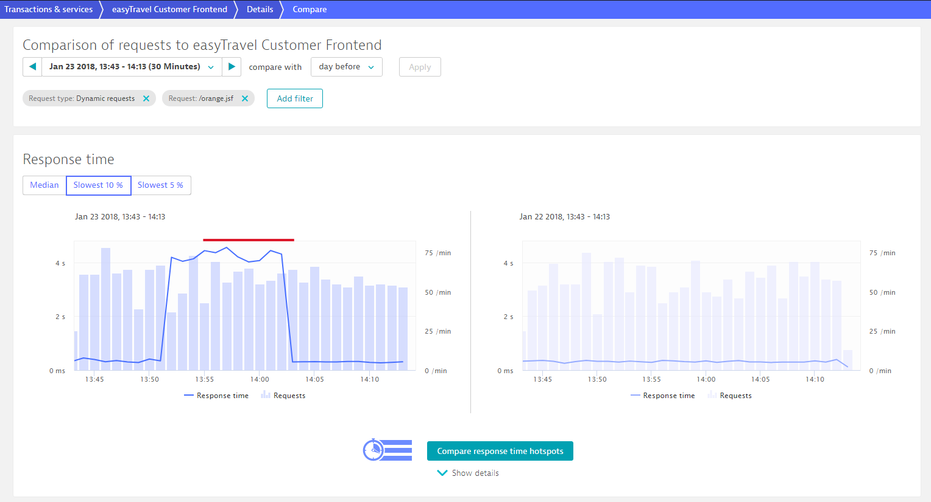
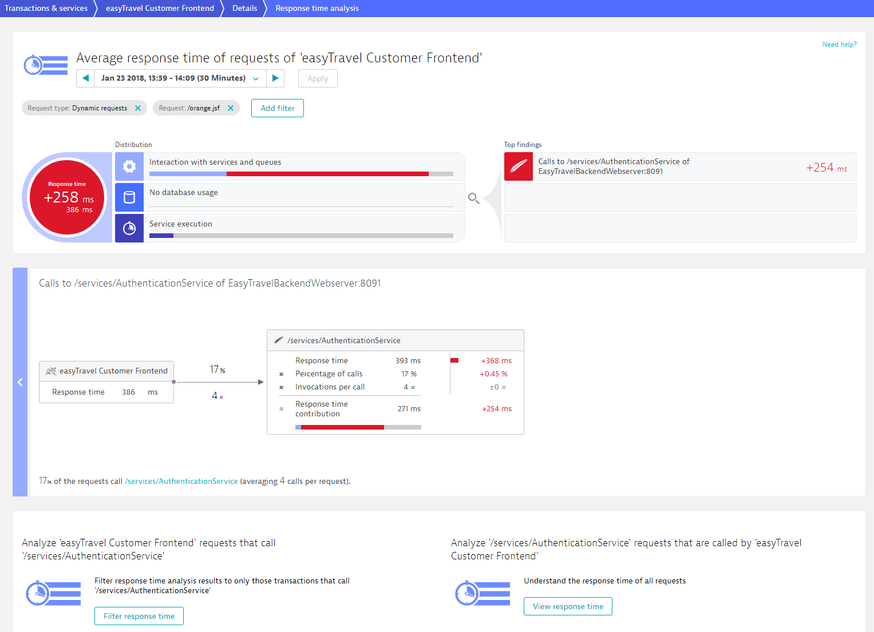
Automate Analysis: Compare Hotspots
Hotspot Analysis

Slide 11
Load Testing Integration CI Use Cases Taken from https://github.com/dynatrace-innovationlab/jenkins-dynatrace-pipeline-tutorial

Slide 12
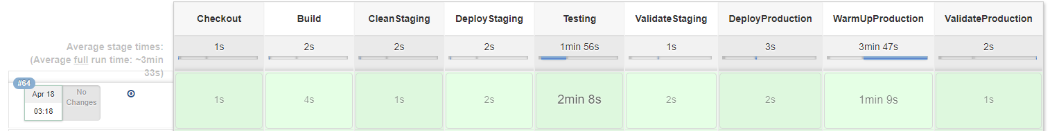


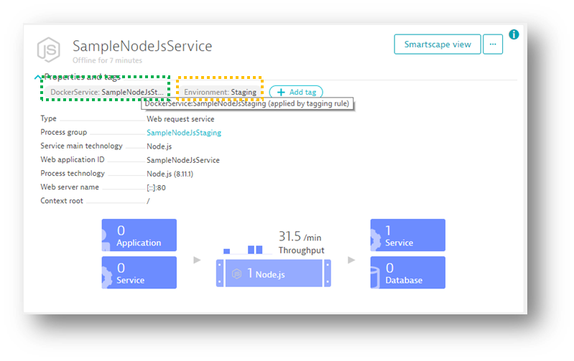
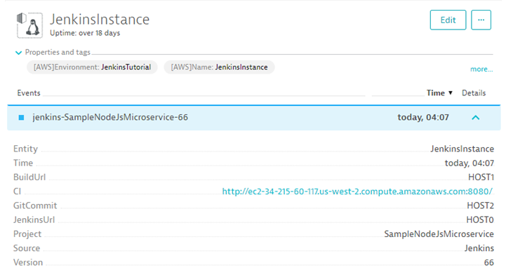
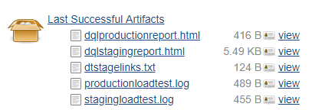
https://github.com/dynatrace-innovationlab/jenkins-dynatrace-pipeline-tutorial
Push Tags & Metadata
Push Events (Deploys, Tests..)
Pull data as artifacts

Slide 13
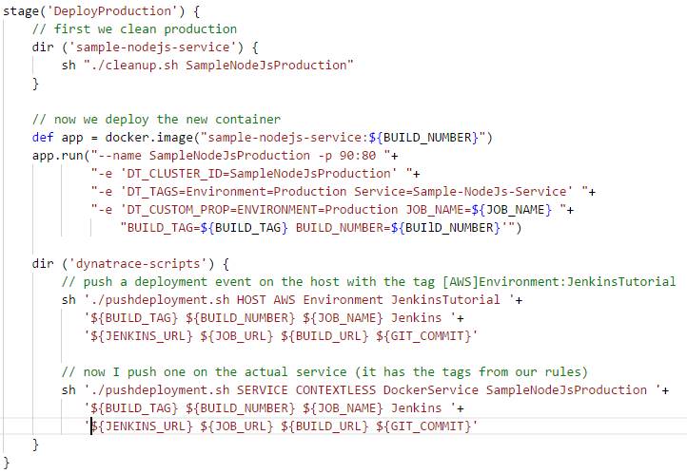
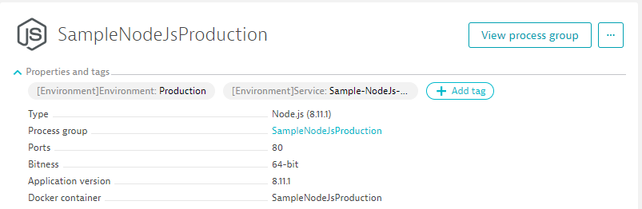
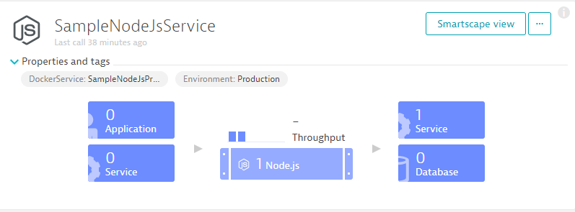
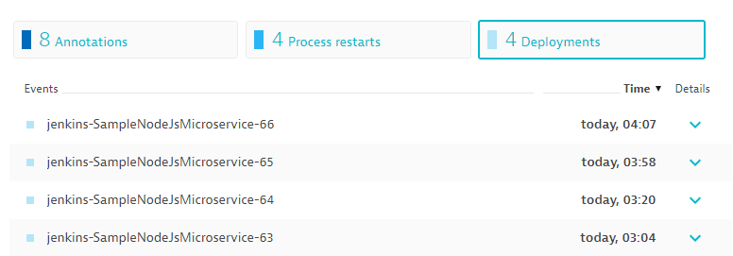
Ensure Proper Tagging & Deployment Events
Rules

Slide 14
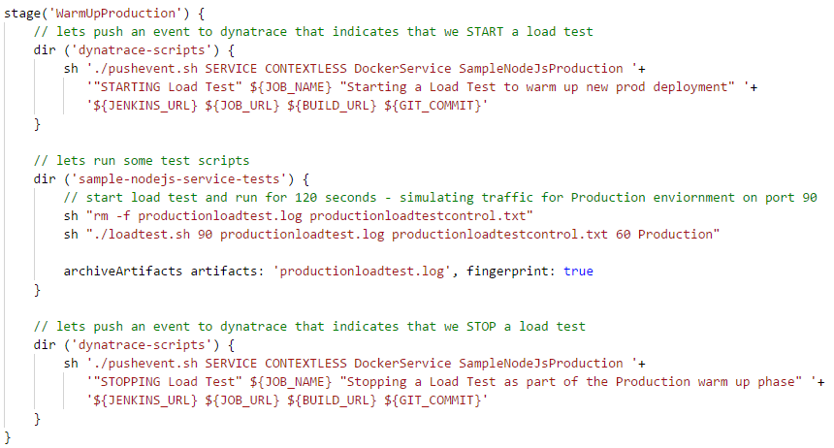
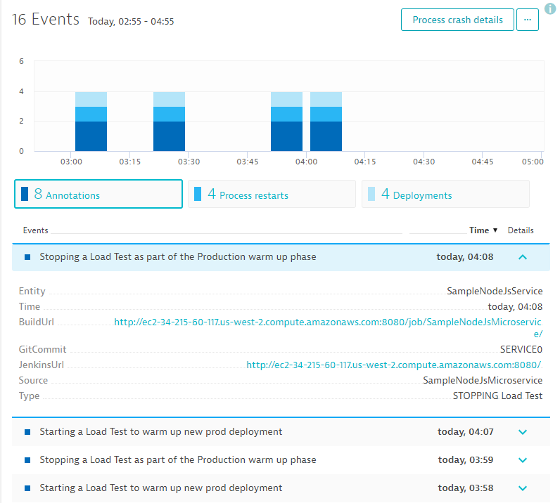
Push Load Testing Start / Stop Events to Dynatrace

Slide 15
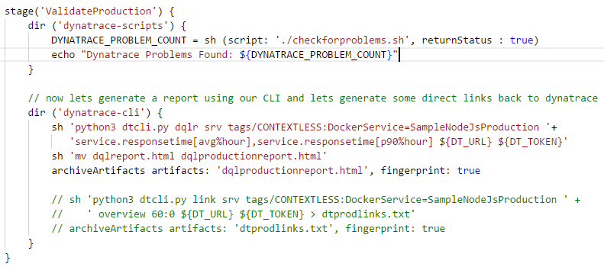
Pull Data back to Jenkins

Slide 16
Performance as a Self Service
November, 2018

