Slide 1
Blue/Green & Canary Deployments
July/August, 2018

Slide 2
Outline (for X hrs)
Introduction – What is the workshop about? (~10 min)
Deployment Strategies
Blue/Green Deployments – optional Lab (~30 min)
Canary Release – optional Lab (~30 min)
Recap (~15 min)

Slide 3
Skills you gain
TODO
TODO

Slide 4
Introduction into the Topic

Slide 5
Blue/Green Deployment I
Technique to release application in a predictable manner
Goal: reducing any downtime associated with a release
Process:
Two identical (production) environments
One of the deployments (green or blue) is live
The other is used to prepare a new release
Once it is deployed – the router can be switched
Consequently, the other environment is idle and can be used as staging environment for the next release
tm-ui-v2
backend-v1
mysql
API
Router
tm-ui-v2
backend-v2
mysql
API

Slide 6
Blue/Green Deployment II
Advantage:
Gives you a rapid way to rollback
Basic mechanism to get a hot-standby working
Challenges:
The two environments need to be as identical as possible (infrastructure as code!)
Database migrations can get challenging (database must be migrated/rolled back alongside the app deployments)
Long running transactions in one environment
Risk of destroying blue AND green environments, if it is conducted on a non-isolated infrastructure

Slide 7
(Lab 1) Blue/Green Deployment on OpenShift (with route management)
Deploy an App (Blue) | Update App and Deploy | Map Original Route to Green | Unmap Route to Blue
$ oc new-app --file=app.json --name=blue $ oc expose svc/blue --name=productionroute | $ oc new-app --file=newapp.json --name=green $ oc expose svc/green | $ oc set route-backends production blue=0 green=100 | $ oc set route-backends production green=100
Blue
Blue
Router
Blue
Router
Router
Router
Green
Green
Green
https://docs.openshift.com/container-platform/3.6/dev_guide/deployments/advanced_deployment_strategies.html

Slide 8
A/B Testing
A/B testing is NOT blue/green deployment
A/B testing is a way of testing features in your application for various reasons like usability, popularity, noticeability
Usually associated with UI parts of the app
Distinction to blue/green deployment:
A/B testing is for measuring functionality in the app
Blue/green deployment is for releasing new software safely and rolling back predictably
Technical Implementation
RUM Session Properties, e.g: every User Session knows whether it was exposed to A vs B

Slide 9
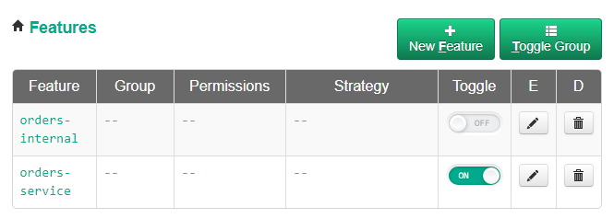
Feature Flags
Similar to A/B
But will most likely be captured from backend, e.g: through Request Attributes
Can be switched on/off from backend
Implementing feature flags introdocues technical debt that has to be dealt with in future releases

Slide 10
Canary Releases I
Technique for releasing a “canary” (i.e., new version of your application) to a small subset of users (before making it available to everybody)
Idea: The faster feedback you get, the faster you can fail the deployment, or proceed cautiously
Process:
Deploy a new version of your software (to which no users are routed)
Start routing a few selected users to it
As you gain more confidence, release it to more servers and users
tm-ui-v2
backend-v1
mysql
80%
API
Router
tm-ui-v2
backend-v2
mysql
20%
API

Slide 11
Canary Releases II
Advantage:
Ability to do capacity testing of the new version in a production environment
Rollback strategy if issues are found
Challenge:
Manage of multiple versions of an application at once
Database migrations can be challenging (different versions of a service running at the same time)

Slide 12
(Lab 2) Canary Releases on OpenShift using the OpenShift router I
Overview
Deploy a new version of an application
Expose it publicly but do not route traffic
Configure router for Canary Release
Use Dynatrace to monitor deployment
Instructions:
(1): Lab 4 of Monolith to Microservice Workshop
(2-3): See next slide
(4): Live Demo
Takeaways
Custom chart illustrating the load balancing
80%
backend-v1
mysql
API
Router
backend-v2
mysql
API
20%
orders-service

Slide 13
(Lab 2) Canary Releases on OpenShift using the OpenShift router II
Deploy an App (Blue) | Update App and Deploy | Route a fraction of the traffic to new service | Increase load over time
$ oc new-app --file=app.json --name=blue $ oc expose svc/blue --name=productionroute | $ oc new-app --file=newapp.json --name=green $ oc expose svc/green | $ oc set route-backends production blue=90 green=10 | $ oc set route-backends production blue=30 green=70
90%
30%
Blue
Blue
Blue
Router
Blue
Router
Router
Router
Green
Green
Green
10%
70%
https://docs.openshift.com/container-platform/3.6/dev_guide/deployments/advanced_deployment_strategies.html

