Slide 1
Runbook automation
July/August, 2018

Slide 2
Outline (for 3 hrs)
Introduction – What is the workshop about? (~10 min)
Identify a possible runbook for auto-remediation (~15 min)
Write a runbook for auto-remediation (~30 min)
Set up the automation platform (Ansible Tower) (~ 30 min)
Connect the automation platform with Dynatrace (~ 30 min)
Deploy a sample app and test integration (~ 30 min)
Healthy vs broken version
Automated rollback to broken version
Recap (~15 min)

Slide 3
Prerequisites
AWS account
Ansible Tower license
Clone this repo: https://github.com/dynatrace-innovationlab/remediation-ansible

Slide 4
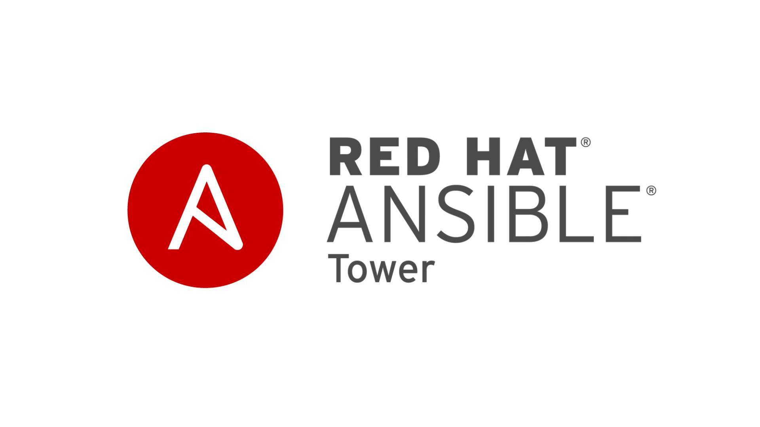

Send problem notification
Fetch additional information
Push comment
Execution remediation
Push comment

