Slide 1
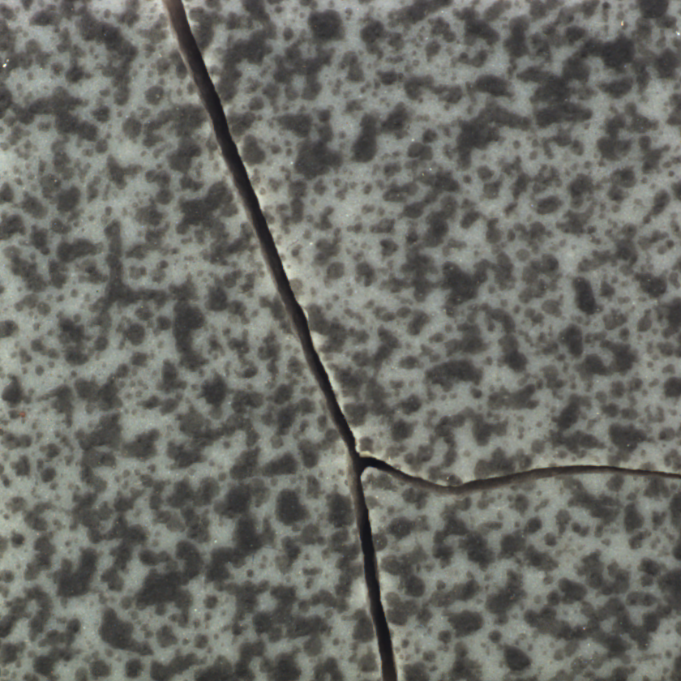
FINAL PROJECT · DSPT 0326
Industrial Surface
Defect Detection
Deep learning, Grad-CAM, and confidence-based human review
Atousa · August 2026
Notes:
Introduce the industrial inspection problem and the project scope.
The goal is binary classification: Good versus Defective, with explainability and human review.
[Sources]
Project dataset: MVTec AD Tile category; Bergmann et al., CVPR 2019.

Slide 2
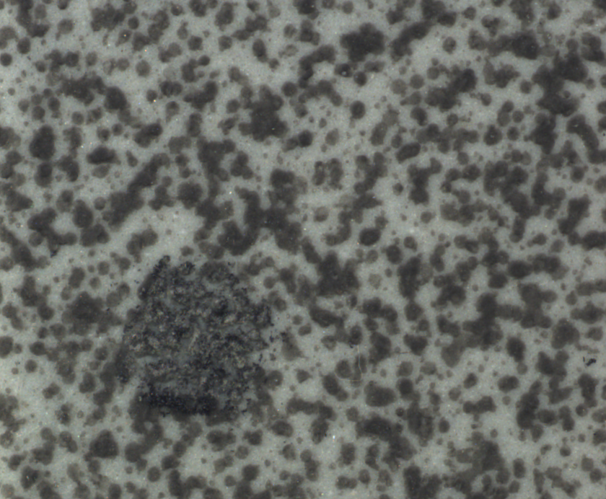
A useful inspection model must manage two asymmetric risks
Missed defects
A false negative may allow a defective product to pass inspection.
False alarms
A false positive increases manual inspection and rework cost.
Primary task: supervised binary classification
02
Notes:
Explain why accuracy alone is not enough.
Defective recall is especially important, but unnecessary review also has an operational cost.
[Sources]
Project specification and final report.

Slide 3
Leakage-safe splitting protects the final evaluation
TRAIN
VALIDATION
TEST
242 images
54 images
51 images
184 Good · 58 Defective
40 Good · 14 Defective
39 Good · 12 Defective
Parameter learning
Model + threshold selection
One locked final evaluation
• Original-image groups and SHA-256 hashes remain isolated across splits
• Augmentation is applied only to training batches
03
Notes:
The dataset was originally designed for unsupervised anomaly detection.
This project uses a documented supervised reformulation and performs all splitting before augmentation.
[Sources]
Executed notebook 01 and split manifest.

Slide 4
Transfer learning solved the small-data bottleneck
Custom CNN
Frozen MobileNetV2
Controlled fine-tuning
Reference model
ImageNet features
Last 20 layers
1
2
3
Overfit; weak ranking
Strong validation AUC
Best validation model
Fine-tuning: Adam 1e-5 · BatchNormalization frozen · EarlyStopping
04
Notes:
Connect this slide to Ammar's feedback: transfer learning was recommended because the dataset is small.
Fine-tuning was intentionally limited to reduce overfitting.
[Sources]
Instructor email feedback; executed notebooks 03 and 05.

Slide 5
Fine-tuning produced the strongest validation model
Why select fine-tuned MobileNetV2?
• 94.44% validation accuracy
• ROC-AUC 0.989
• PR-AUC 0.972
• Best validation loss 0.138
The baseline's 100% recall came from predicting nearly everything as defective.
05
Notes:
Do not interpret baseline recall in isolation; its precision and accuracy were only 25.93%.
The fine-tuned model offered the best balanced validation performance.
[Sources]
Executed training histories and milestone 3/5 validation summaries.

Slide 6
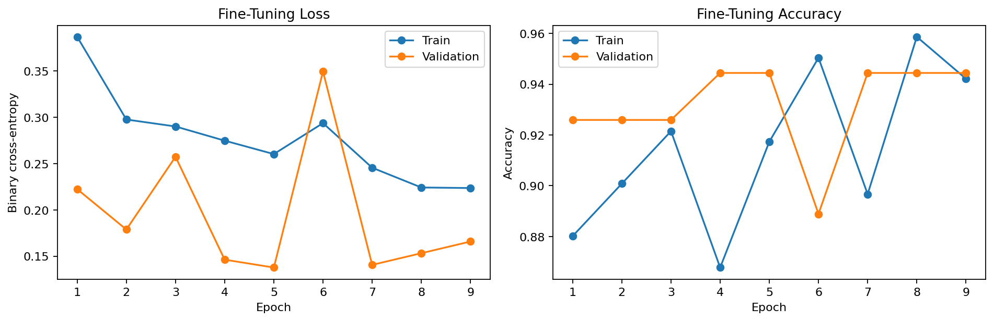
Early stopping retained epoch 5—not the final epoch
9
epochs completed
1m 56s
CPU runtime
Validation loss became volatile after the best checkpoint—expected with only 14 defective validation images.
06
Notes:
The checkpoint saved at epoch 5 is the final model.
The validation fluctuations reinforce the need for restrained claims.
[Sources]
Executed notebook 05; fine-tuning history CSV.

Slide 7
Validation fixed the operating policy before test evaluation
Selection rule: maximize F1 among thresholds with defective recall ≥ 90%
GOOD
NEEDS HUMAN REVIEW
DEFECTIVE
0
0.152666
0.439
1
100%
7.41%
0
validation defective recall
validation review rate
validation defects auto-accepted
07
Notes:
The policy was locked using validation only.
The apparent validation safety did not become a guarantee; the test slide will show the generalization gap.
[Sources]
Executed notebook 06; milestone 5 threshold summary.

Slide 8
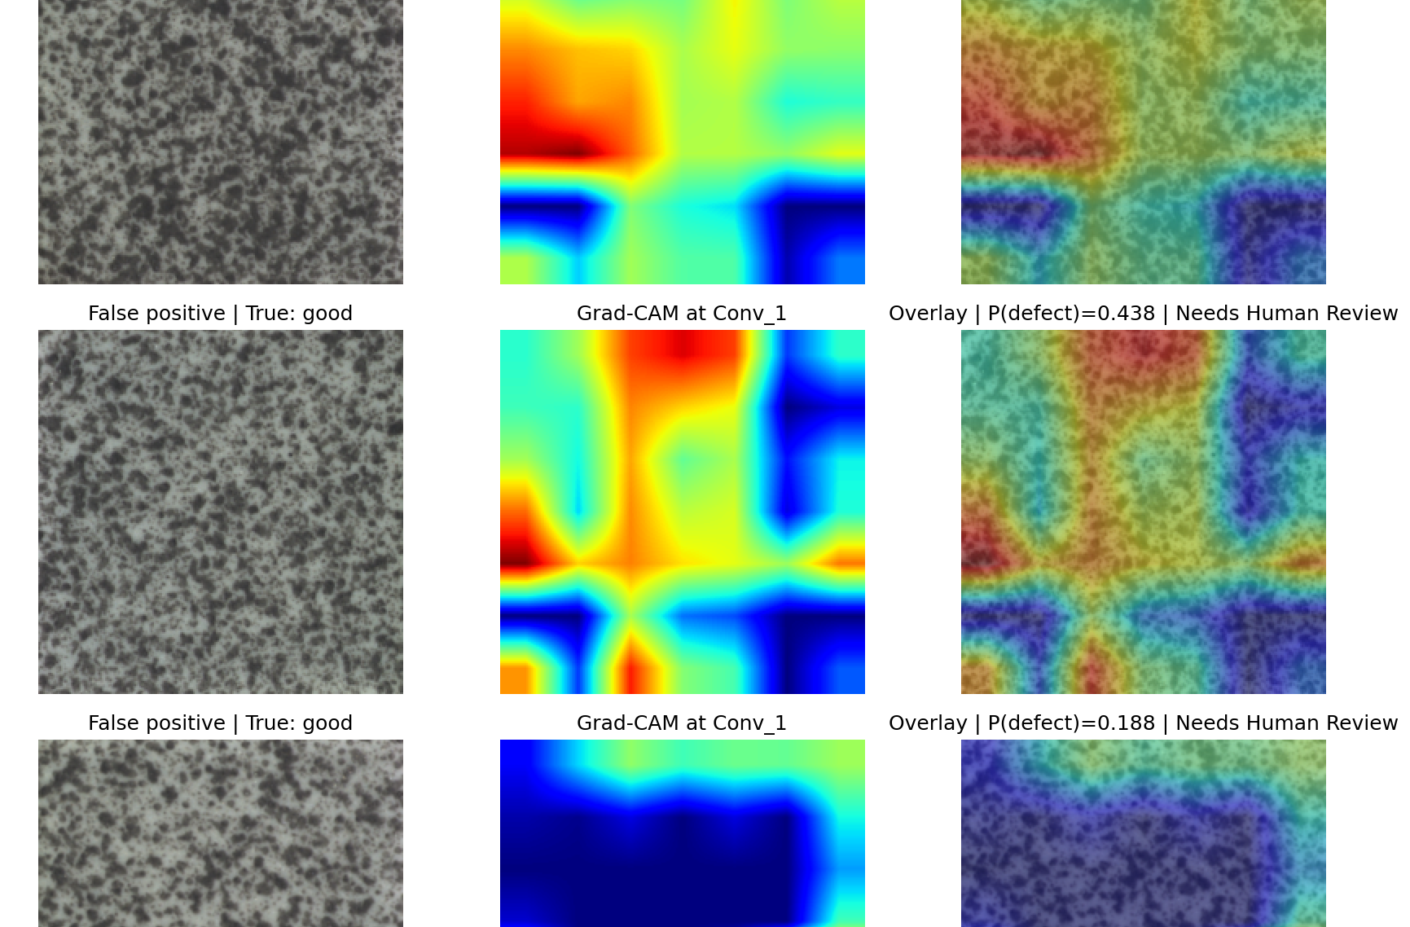
Grad-CAM reveals useful focus—and texture shortcuts
What we observed
• False positives: diffuse texture and border attention
• Review cases: inconsistent hot regions
• Low confidence: weaker or partial localization
Grad-CAM indicates gradient-based sensitivity—not causal proof.
08
Notes:
Explain the three columns: original image, heatmap, overlay.
Emphasize that Grad-CAM helps diagnose behavior but does not validate causality.
[Sources]
Executed notebook 07 and milestone 6 Grad-CAM artifacts.

Slide 9
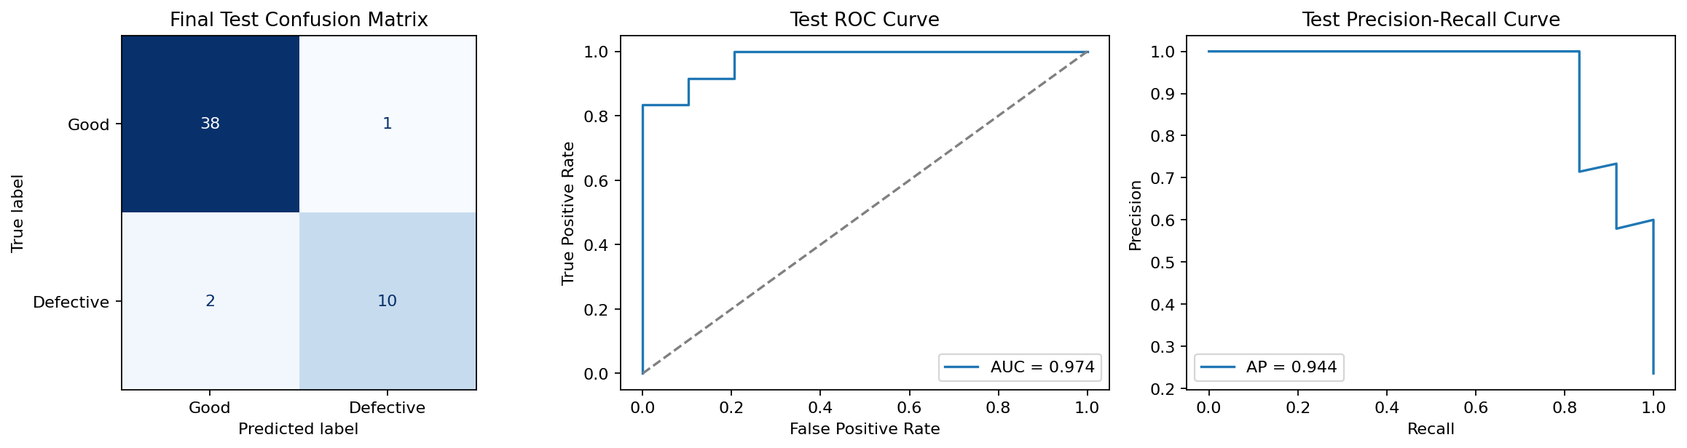
The locked test remained strong—but recall fell to 83.33%
94.12%
90.91%
accuracy
precision
83.33%
86.96%
defective recall
F1-score
ROC-AUC 0.974 · PR-AUC 0.944
09
Notes:
This was the one-time test evaluation after locking model and thresholds.
Confusion matrix: 38 TN, 1 FP, 2 FN, 10 TP.
[Sources]
Executed notebook 08; milestone 7 final test summary.

Slide 10
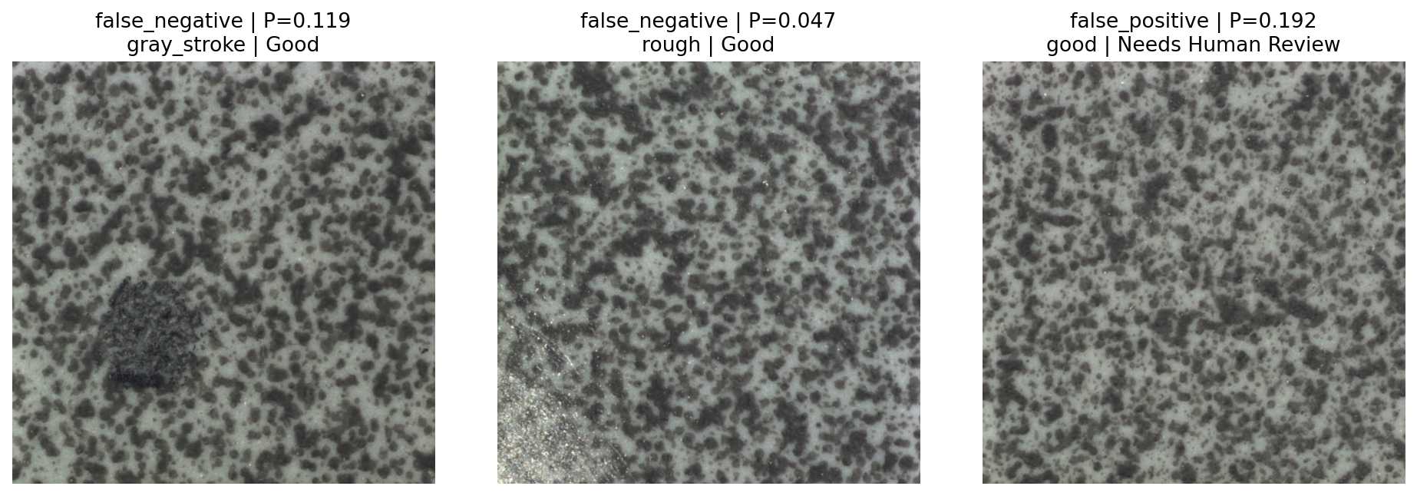
Two defects passed automatically as Good
Failure pattern
• gray_stroke: P(defect) = 0.119
• rough: P(defect) = 0.047
• one Good false alarm was sent to review
Per-defect test recall
100% crack · glue_strip · oil
50% gray_stroke · rough
Thresholds were not changed after seeing Test.
10
Notes:
This is the project's most important limitation.
The human-review policy reduced false-alarm cost but did not prevent every missed defect.
[Sources]
Executed notebook 08; final test prediction table and error figure.

Slide 11
The prototype is promising, not production-ready
What the project demonstrates
What must happen next
• Leakage-safe, reproducible supervised workflow
• Collect more gray_stroke and rough defects
• Transfer learning and controlled fine-tuning
• Create a new untouched holdout set
• Transparent thresholding and Grad-CAM diagnostics
• Calibrate risk under an explicit cost model
• Run a prospective human-in-the-loop pilot
Strong ranking performance does not eliminate the need for accountable human quality control.
11
Notes:
Close by resolving the opening tension: the model is useful, but missed defects remain the governing risk.
Invite questions about the supervised reformulation, threshold policy, and next development cycle.
[Sources]
Final report and executed project artifacts.

