Slide 1

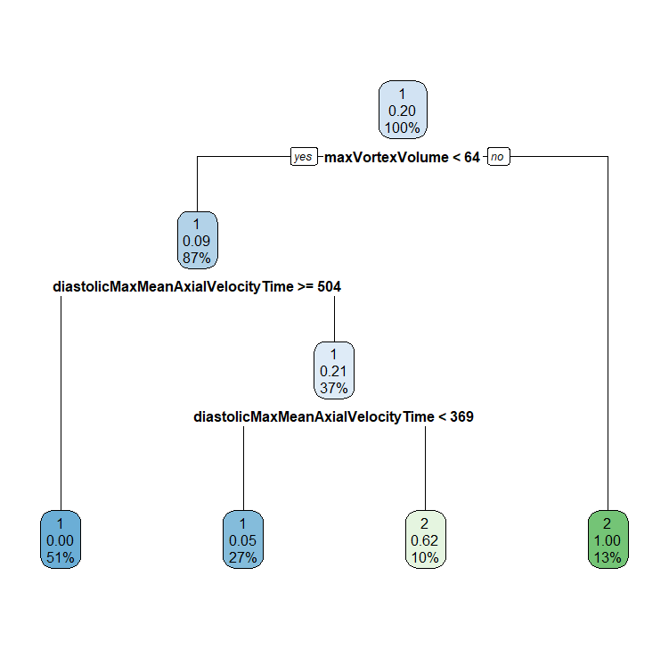
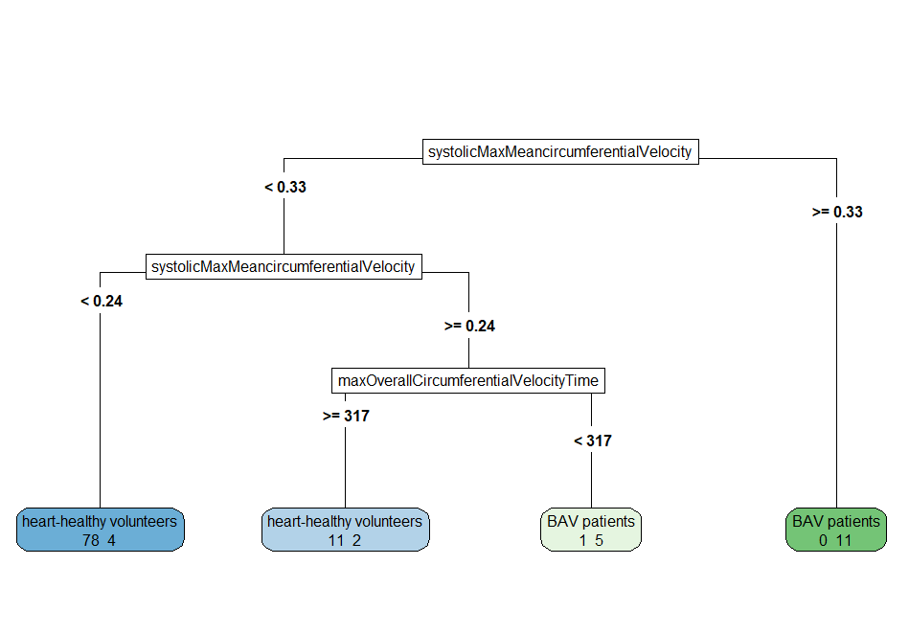
systolicMaxMean-InPlaneVelocity [m/s]
< 0.33
≥ 0.33
systolicMaxMean-InPlaneVelocity [m/s]
BAV
✔11 ✖0
< 0.24
≥ 0.24
HHV
maxOverallIn-PlaneVelocityTime [ms]
✔78 ✖4
< 317
≥ 317
BAV
HHV
✔5 ✖1
✔11 ✖2
 |  | Predicted
 |  | BAV | HHV
True | BAV | 16 | 6
 | HHV | 1 | 89
Accuracy = 93.75% Sensitivity = 72.73% Specificity = 98.89%

Slide 2
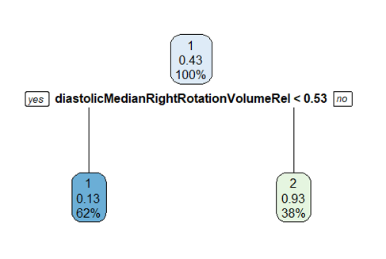

diastolicMedian- RightRotation- VolumeRel [%]
< 0.53
≥ 0.53
OHHV
BAV
✔28 ✖5
✔17 ✖2
 |  | Predicted
 |  | BAV | OHHV
True | BAV | 17 | 5
 | OHHV | 2 | 28
Accuracy = 86.54% Sensitivity = 77.27% Specificity = 93.33%
Notes:
older Healthy vs. BAV

Slide 3
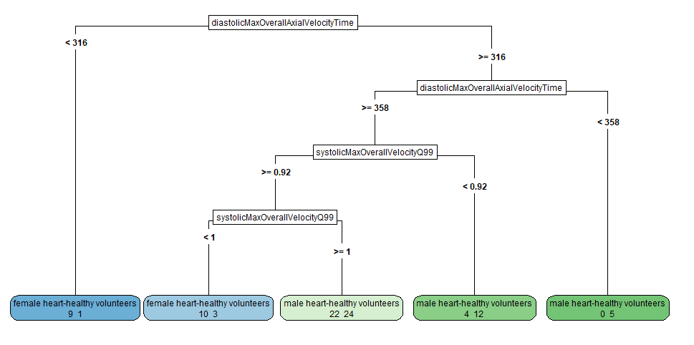

diastolicMaxOver-allThroughPlane-VelocityTime [ms]
< 316
≥ 316
female HHV
diastolicMaxOver-allThroughPlane-VelocityTime [ms]
✔9 ✖1
< 358
≥ 358
male HHV
systolicMax-OverallVelocity-Q99 [m/s]
✔5 ✖0
< 0.92
≥ 0.92
 |  | Predicted
 |  | female | male
True | female | 19 | 26
 | male | 4 | 41
male HHV
systolicMax-OverallVelocity-Q99 [m/s]
✔12 ✖4
< 1
≥ 1
Accuracy = 66.67% Sensitivity (female) = 42.22% Sensitivity (male) = 91.11%
female BAV
male HHV
✔10 ✖3
✔24 ✖22

Slide 4
(a)
classification task 1
systolicMaxMean-InPlaneVelocity [m/s]
(c)
classification task 3
< 0.33
≥ 0.33
diastolicMaxOver-allThroughPlane-VelocityTime [ms]
systolicMaxMean-InPlaneVelocity [m/s]
BAV
< 316
≥ 316
< 0.24
≥ 0.24
✔11 ✖0
HHV
maxOverallIn-PlaneVelocityTime [ms]
female HHV
diastolicMaxOver-allThroughPlane-VelocityTime [ms]
✔78 ✖4
✔9 ✖1
< 358
≥ 358
< 317
≥ 317
BAV
HHV
male HHV
systolicMax-OverallVelocity-Q99 [m/s]
✔5 ✖1
✔11 ✖2
✔5 ✖0
 |  | Predicted
 |  | BAV | HHV
True | BAV | 16 | 6
 | HHV | 1 | 89
Accuracy = 93.75% Sensitivity = 72.73% Specificity = 98.89%
< 0.92
≥ 0.92
male HHV
systolicMax-OverallVelocity-Q99 [m/s]
✔12 ✖4
< 1
≥ 1
(b)
classification task 2
 |  | Predicted
 |  | BAV | OHHV
True | BAV | 17 | 5
 | OHHV | 2 | 28
 |  | Predicted
 |  | female | male
True | female | 19 | 26
 | male | 4 | 41
diastolicMedian- RightRotation- VolumeRel [%]
female BAV
male HHV
< 0.53
≥ 0.53
✔10 ✖3
✔24 ✖22
Accuracy = 86.54% Sensitivity = 77.27% Specificity = 93.33%
Accuracy = 66.67% Sensitivity (female) = 42.22% Sensitivity (male) = 91.11%
OHHV
BAV
✔28 ✖5
✔17 ✖2

Slide 5
(a)
classification task 1
systolicMaxMean-circumferential-Velocity
(c)
classification task 3
< 0.33
≥ 0.33
diastolicMax-OverallAxial-VelocityTime
systolicMaxMean-circumferential-Velocity
BAV
< 316
≥ 316
✔11 ✖0
< 0.24
≥ 0.24
female HHV
diastolicMax-OverallAxial-VelocityTime
✔9 ✖1
< 358
≥ 358
HHV
maxOverall-Circumferential-VelocityTime
✔78 ✖4
< 317
≥ 317
male HHV
systolicMax-OverallVelocity-Q99
✔5 ✖0
< 0.92
≥ 0.92
⮕ ✔105 ✖7
BAV
HHV
✔5 ✖1
✔11 ✖2
total number of correctly (✔) and incorrectly (✖) classified subjects
male HHV
systolicMax-OverallVelocity-Q99
(b)
classification task 2
diastolicMedian- RightRotation- VolumeRel
✔12 ✖4
< 1
≥ 1
< 0.53
≥ 0.53
female BAV
male HHV
⮕ ✔60 ✖30
✔10 ✖3
✔24 ✖22
⮕ ✔45 ✖7
OHHV
BAV
✔28 ✖5
✔17 ✖2

Slide 6
A
maxVortexVolume
B
diastolicMedian- RightRotation- VolumeRel
< 64
≥ 64
< 0.53
≥ 0.53
diastolicMaxMean- PressureInVortex-Region
BAV
OHHV
BAV
✔14 ✖1
✔28 ✖5
⮕ ✔45 ✖7
✔17 ✖2
< 504
≥ 504
diastolicMaxMean- PressureInVortex-Region
HHV
C
medianDiameter
< 369
≥ 369
✔57 ✖0
< 17
≥ 17
HHV
BAV
male HHV
female HHV
✔27 ✖2
✔6 ✖5
⮕ ✔104 ✖8
✔29 ✖12
✔33 ✖16
⮕ ✔62 ✖18

