Slide 1
Final Results

Slide 2
Workflow
Hyperparameter script : holds all common tunable hyperparameters
Feature Selection : holds all the methods of Feature Selection; Outputs are csv files with selected Features and Label
Models : Contains all classifier models and options to select Feature Selection Method for data
Main : Automates all scripts and lets user select which Model user wants to work with.
here package used as required and all scripts under common Project folder.

Slide 3
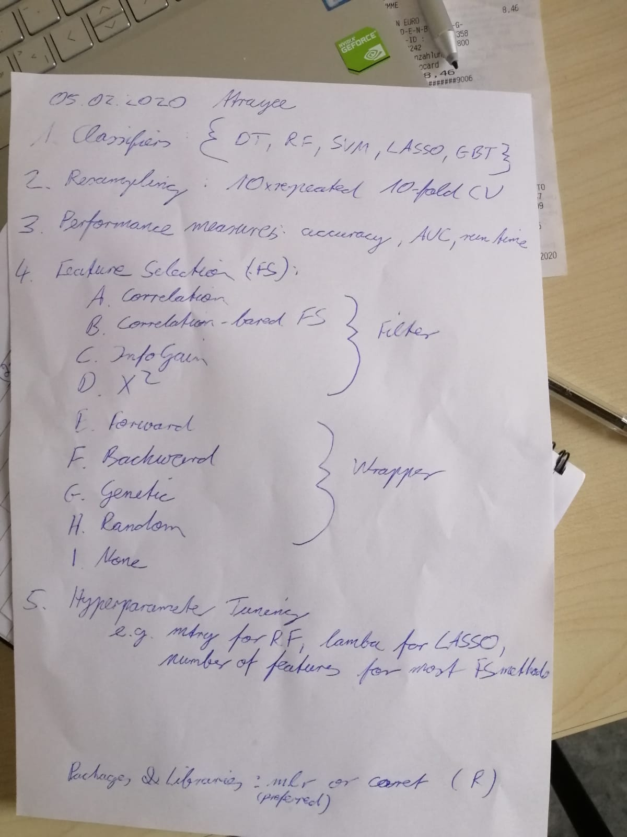
Tasks:

Slide 4
Total Counts:
95 Features after Correlation and removal of Near Zero variance
Type | Healthy | BAV | Total
Healthy v/s BAV | 90 | 22 | 112
Young v/s Old | Young: 53 Old: 37 | Young: 15 Old: 7 | Young: 68 Old: 44
Male v/s Female | Male: 45 Female: 45 | Male : 17 Female: 5 | Male: 62 Female: 50

Slide 5
Sequential Algorithm(Forward) based FS:
Model | Number of Features | Accuracy (Testing) | AUC | Kappa | Runtime (sec)
Decision Tree | 2 | 0.878 | 0.935 | 0.639 | 32.16
Random Forest | 3 | 0.939 | 0.969 | 0.796 | 74.64
SVM | 3 | 0.969 | 0.956 | 0.891 | 43.92
GBM | 3 | 0.939 | 0.962 | 0.819 | 43.77

Slide 6
No FS Methods:
Model | Number of Features | Accuracy (Testing) | AUC | Kappa | Runtime (sec)
Decision Tree | 95 | 0.818 | 0.500 | 0.246 | 3.04
Random Forest | 95 | 0.969 | 0.981 | 0.891 | 0.34
SVM | 95 | 0.969 | 0.981 | 0.891 | 0.07
GBM | 95 | 0.939 | 1.000 | 0.765 | 0.39

Slide 7
Results:Optimal Combination
Model | Features | Acc | Kappa | AUC | Time | Kappa.mean | S.D.
SVM | 3 | 0.969 | 0.901 | 0.891 | 43.92 | 0.702 | 0.400
GBM | 3 | 0.939 | 0.962 | 0.819 | 43.77 | 0.735 | 0.386
RF | 3 | 0.939 | 0.969 | 0.796 | 74.64 | 0.720 | 0.412
SVM:
"maxVortexVolume" "diastolicMaxLeftRotationVolumeRel" "systolicMaxMeanPressureInVortexRegion"
RF:
"maxVortexVolumeTime" "maxOverallCircumferentialVelocityTime" "systolicMaxMeancircumferentialVelocity"
GBM:
"maxVortexVolumeTime" "diastolicMaxVortexVolumeTime" "medianMeanPressureInVortexRegion"
Decision Tree:
"maxVortexVolume" "diastolicMaxMeanAxialVelocityTime"

Slide 8
HyperParameters
Feature Selection | HyperParameter
Chi-Sqaure | fw.perc (lower=0; upper=1)
Info Gain | fw.perc (lower=0; upper=1)
Sequential Forward | alpha=0.02
Sequential Backward | alpha=0.02
Genetic Algorithm | maxit = 10L, mu = 15L
Random Alorithm | maxit =200L
Correlation | Pearson Coefficient
fw.perc: Keep a certain percentage (perc) of features with highest importance.
alpha: Parameter of the sequential feature selection. Minimal required value of improvement difference for a forward / adding step. Default is 0.01.
mu: Parameter of the GA feature selection. Size of the parent population.
maxit: Maximal number of iterations. Note, that this is usually not equal to the number of function evaluations.

Slide 9
Visualizations

Slide 10
Healthy v/s BAV

Slide 11
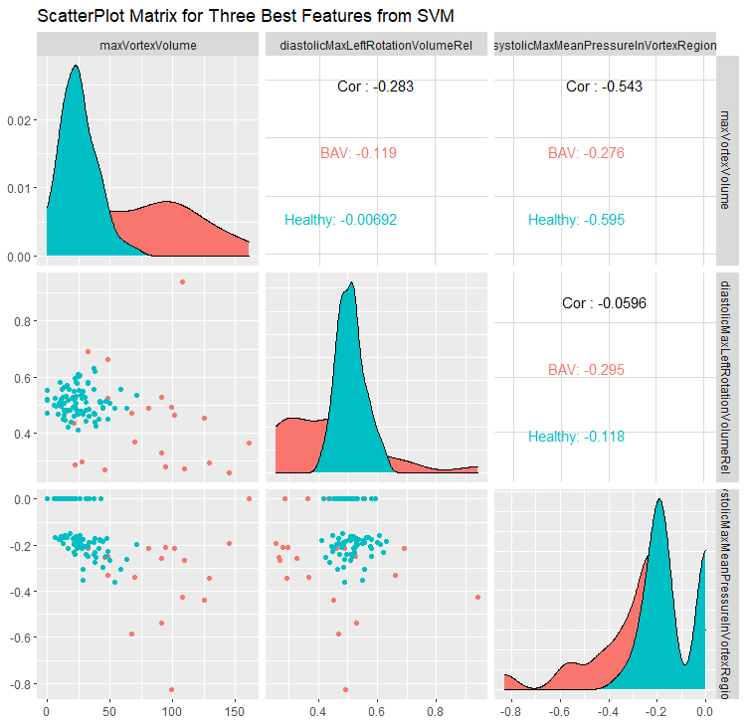
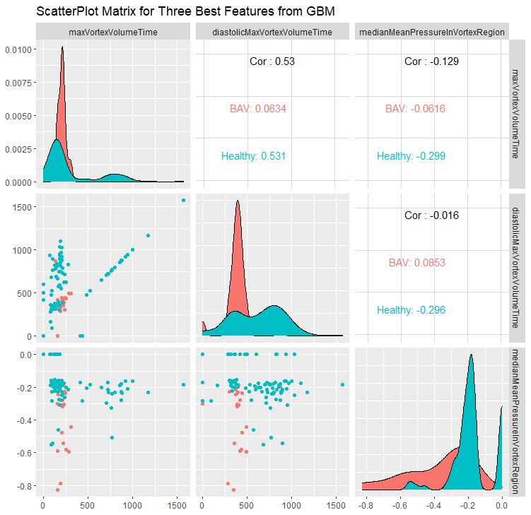
Healthy v/s BAV

Slide 12
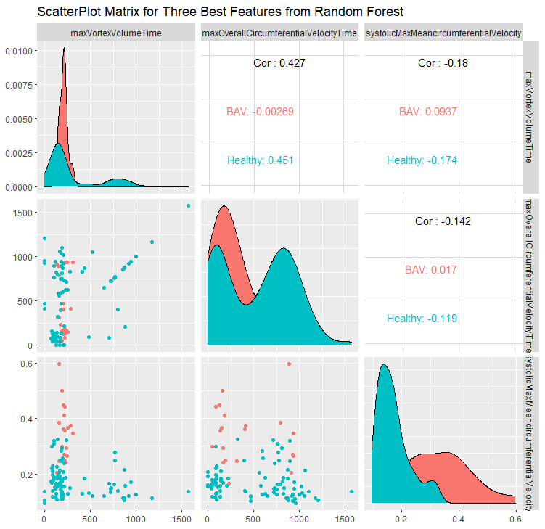
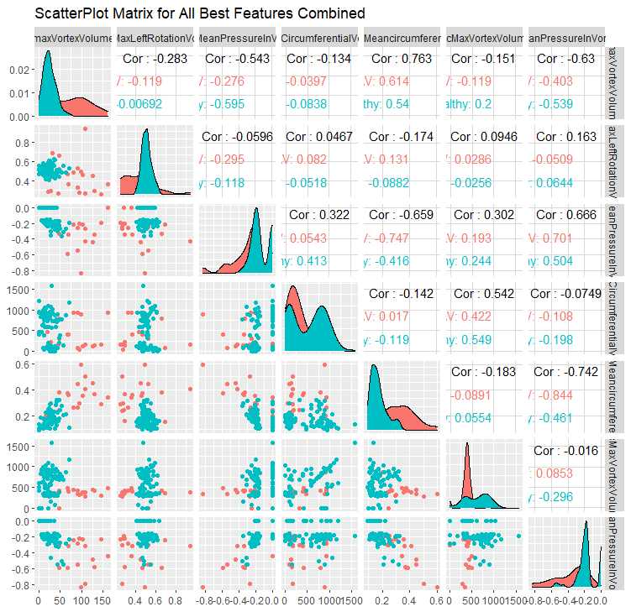
Healthy v/s BAV

Slide 13
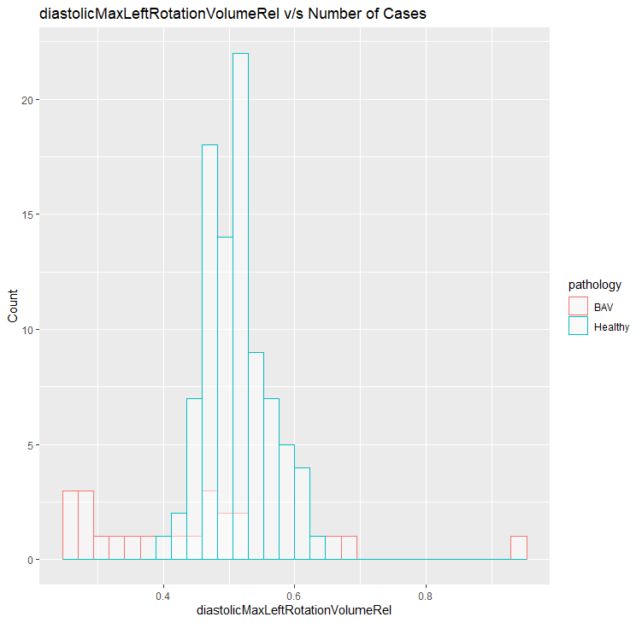
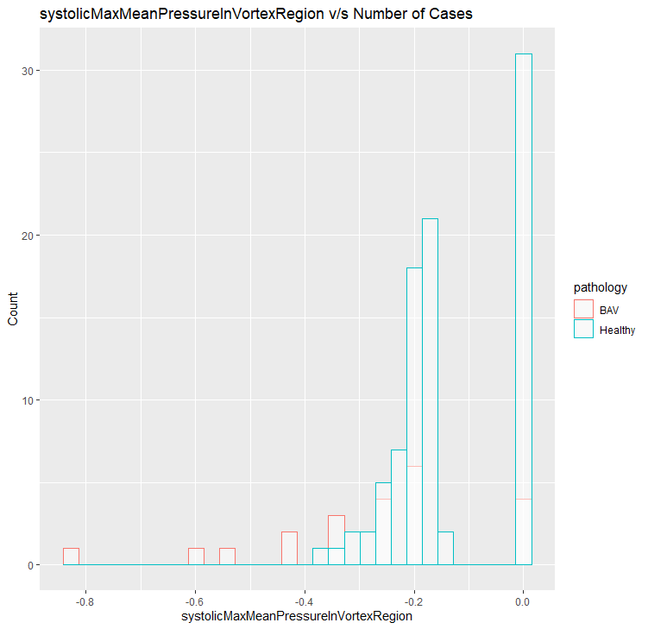
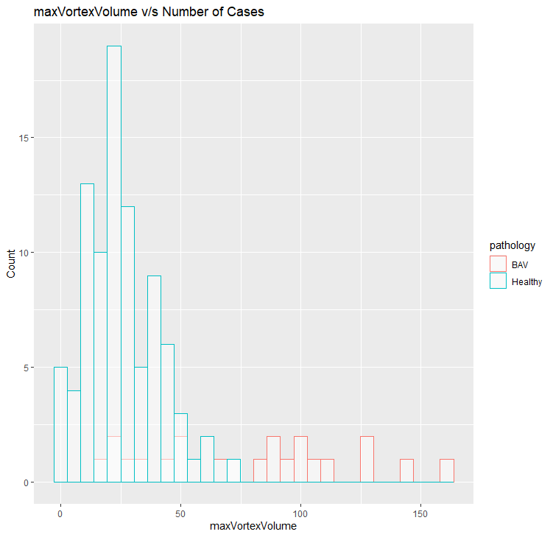
Healthy v/s BAV SVM

Slide 14
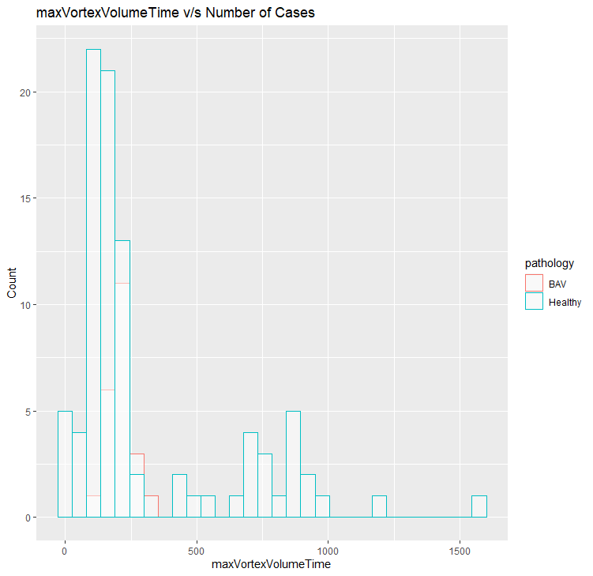
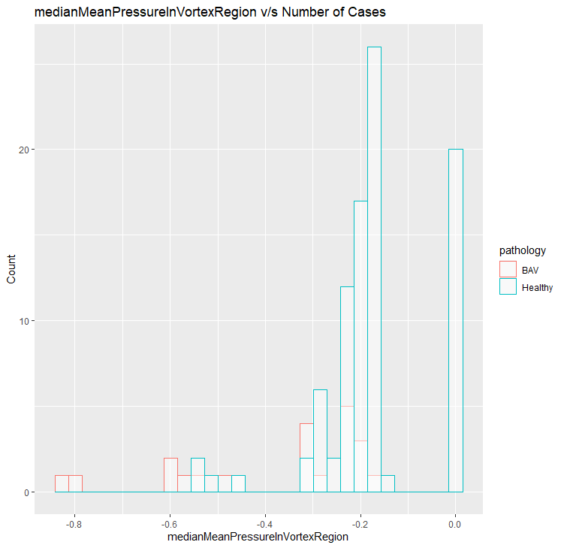
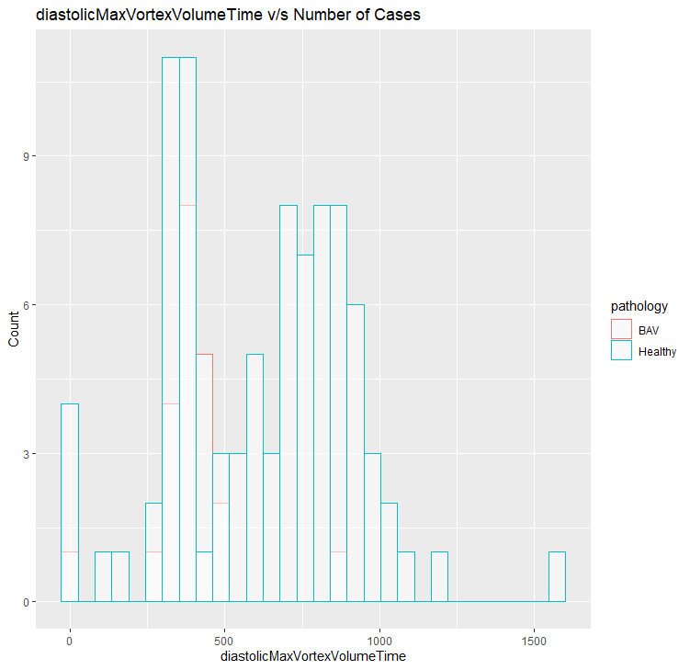
Healthy v/s BAV GBM

Slide 15
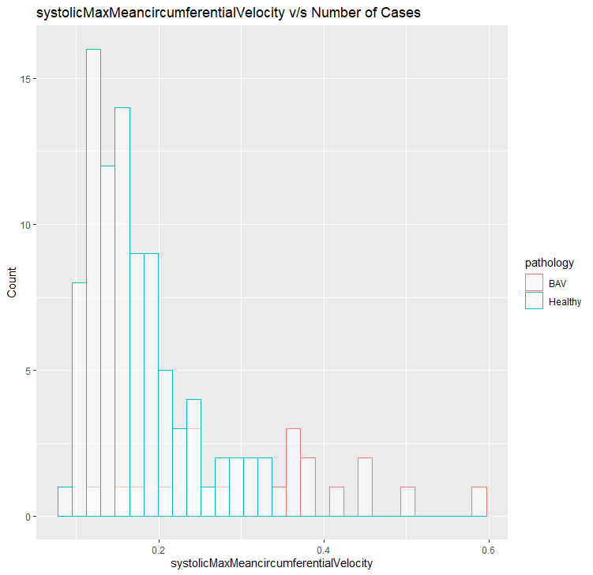
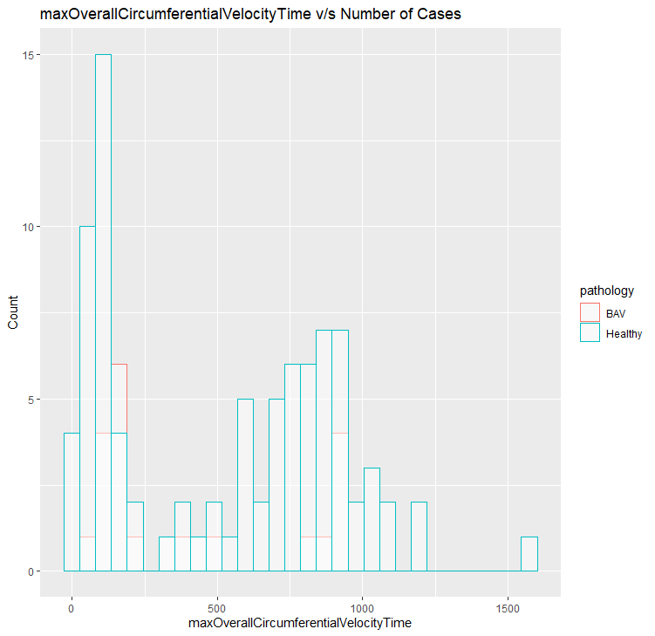
Healthy v/s BAV RF

Slide 16
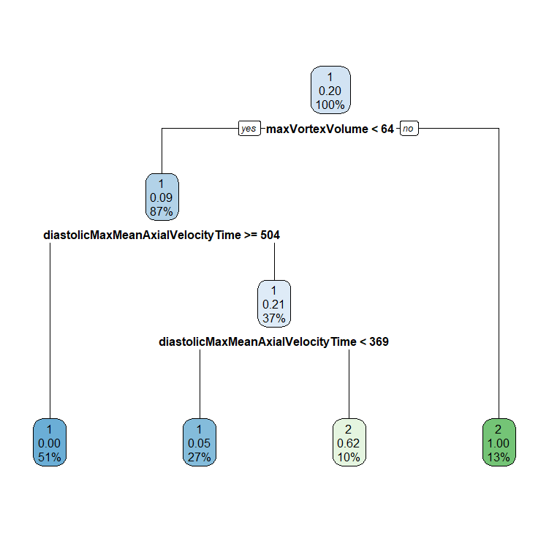
Decision Tree

Slide 17
Conclusions: Healthy v/s BAV
maxVortexVolume is an important feature as it is selected for two different Classifiers as well as it’s versions maxVortexVolumeTime is selected by the other two.
The best results are with the combination SVM and Sequential Forward Feature Selection method

Slide 18
Old Healthy v/s BAV

Slide 19
Sequential Algorithm(Forward) based FS:
Model | Number of Features | Accuracy (Testing) | AUC | Kappa | Runtime (sec)
Decision Tree | 1 | 0.800 | 0.777 | 0.571 | 14.92
Random Forest | 3 | 0.866 | 0.925 | 0.722 | 54.41
SVM | 5 | 1.000 | 1.000 | 1.000 | 23.86
GBM | 1 | 0.800 | 0.777 | 0.571 | 23.68

Slide 20
No FS Methods:
Model | Number of Features | Accuracy (Testing) | AUC | Kappa | Runtime (sec)
Decision Tree | 85 | 0.800 | 0.777 | 0.571 | 3.04
Random Forest | 85 | 0.866 | 0.768 | 0.705 | 0.34
SVM | 85 | 0.733 | 0.925 | 0.444 | 0.07
GBM | 85 | 0.866 | 0.768 | 0.705 | 0.04

Slide 21
Results:Optimal Combination
Model | Features | Acc | Kappa | AUC | Time | Kappa.mean | S.D.
RF | 3 | 0.866 | 0.925 | 0.722 | 54.41 | 0.904 | 0.201
DT | 1 | 0.800 | 0.777 | 0.571 | 14.92 | 0.754 | 0.350
GBM | 1 | 0.800 | 0.777 | 0.571 | 23.68 | 0.694 | 0.354
RF:
"maxVortexVolumeTime" "systolicMaxVortexVolume" "diastolicMedianRightRotationVolumeRel"
GBM:
"diastolicMedianRightRotationVolumeRel"
Decision Tree:
"diastolicMedianRightRotationVolumeRel"

Slide 22
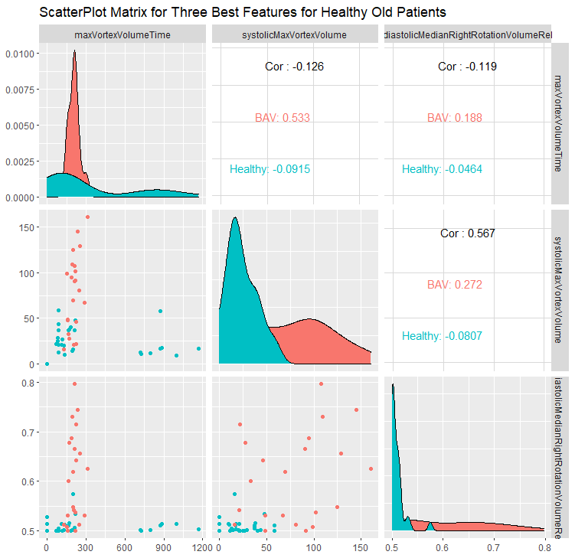
Old Healthy v/s BAV

Slide 23
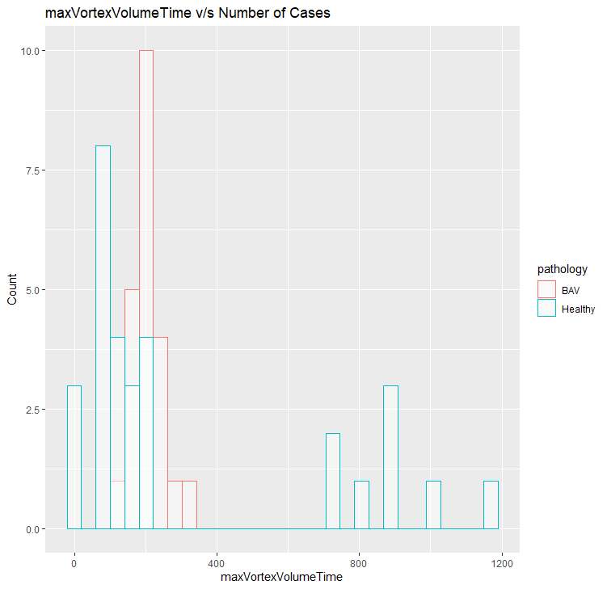
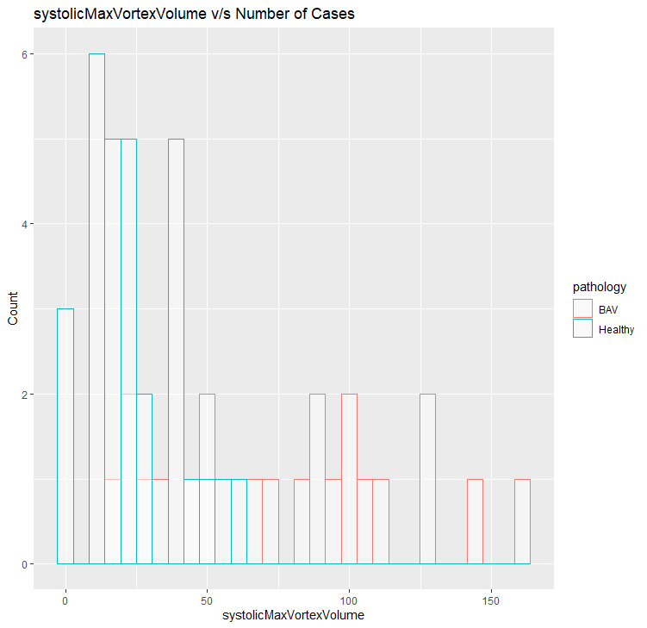
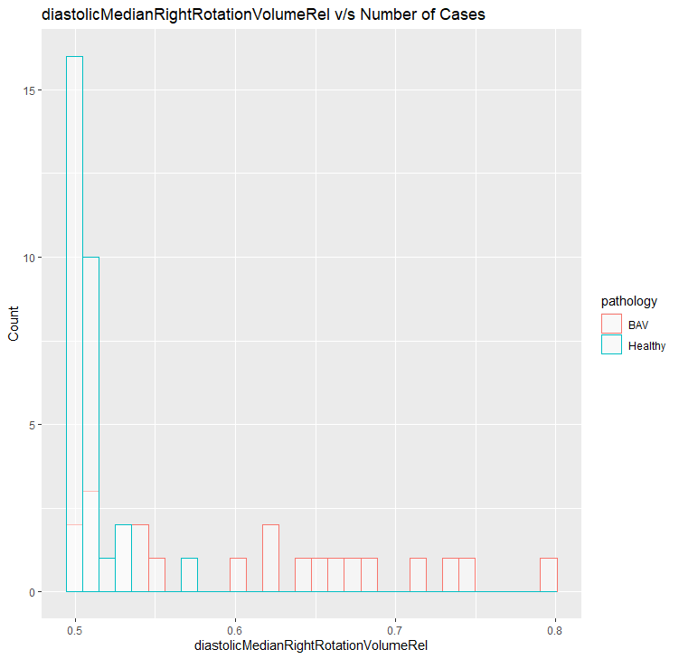
Old Healthy v/s BAV RF

Slide 24
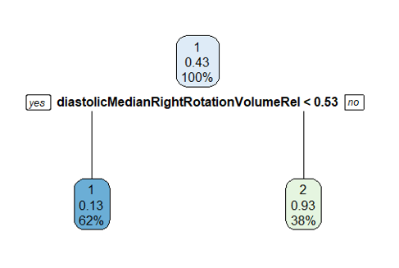
Decision Tree

Slide 25
Conclusions: Old Healthy Patients:
All misclassifications were Pathological patients being classified as Healthy.
Age ranges were from 23-74
Age feature was removed but Accuracy remained quite good.
According to the results, old Healthy patients do not have the same flow conditions as the Young Pathological ones, as Accuracy is pretty high.

Slide 26
Healthy Male v/s Healthy Female

Slide 27
Sequential Algorithm(Forward) based FS:
Model | Number of Features | Accuracy (Testing) | AUC | Kappa | Runtime (sec)
Decision Tree | 1 | 0.615 | 0.615 | 0.230 | 23.05
Random Forest | 3 | 0.653 | 0.615 | 0.307 | 85.42
SVM | 5 | 0.538 | 0.491 | 0.076 | 34.65
GBM | 4 | 0.538 | 0.535 | 0.076 | 35.54

Slide 28
No FS Methods:
Model | Number of Features | Accuracy (Testing) | AUC | Kappa | Runtime (sec)
Decision Tree | 106 | 0.500 | 0.500 | 0.000 | 3.04
Random Forest | 106 | 0.384 | 0.426 | -0.230 | 0.34
SVM | 106 | 0.384 | 0.355 | -0.230 | 0.07
GBM | 106 | 0.500 | 0.562 | 0.000 | 0.04

Slide 29
Results:Optimal Combination
Model | Features | Acc | Kappa | AUC | Time
SVM | 3 | 0.692 | 0.562 | 0.384 | 34.65
GBM | 3 | 0.692 | 0.562 | 0.384 | 35.54
DT | 2 | 0.538 | 0.553 | 0.076 | 23.05
SVM:
"maxOverallVelocity" "systolicMaxOverallVelocityQ99" "diastolicMaxOverallAxialVelocityTime"
Decision Tree:
"medianDiameter" "diastolicMaxMeanAxialVelocity"
GBM:
"maxOverallVelocity" "systolicMaxOverallVelocityQ99" "diastolicMaxOverallAxialVelocityTime""

Slide 30
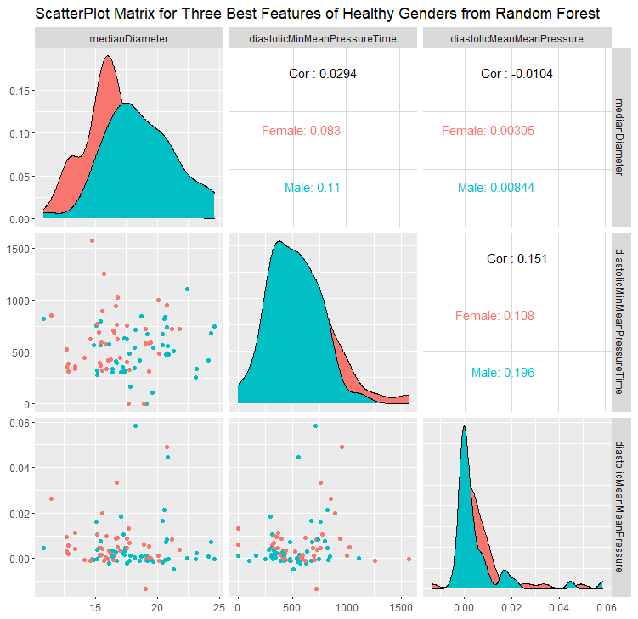
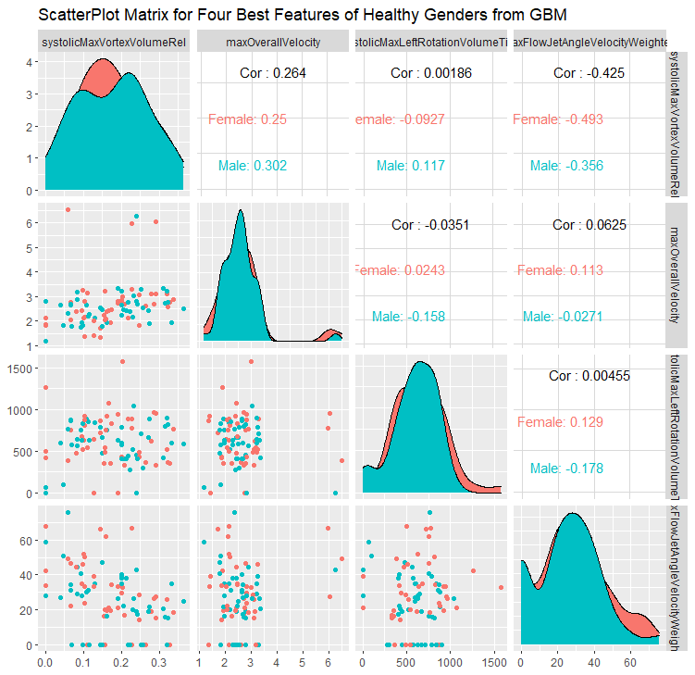
Male v/s Female

Slide 31
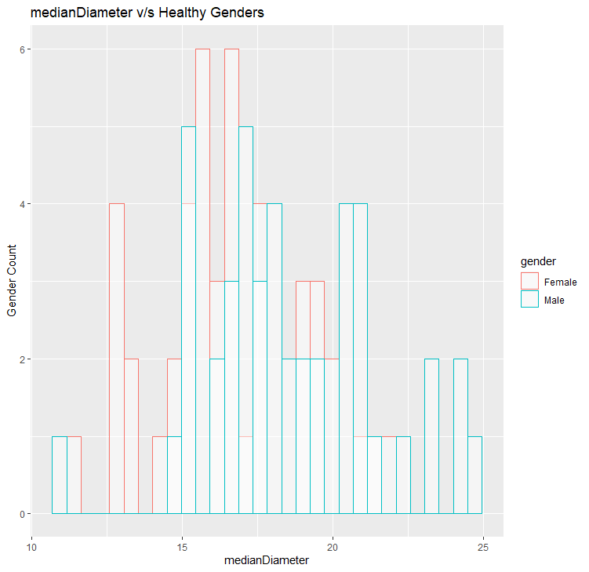
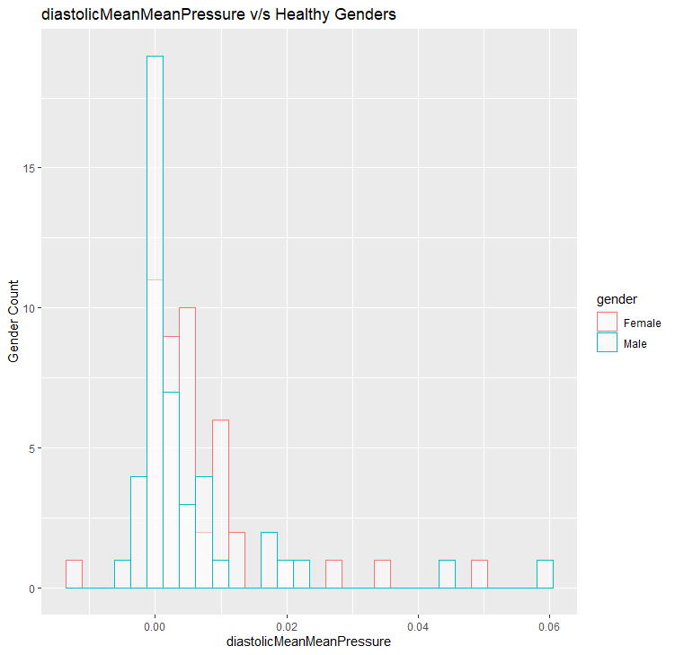
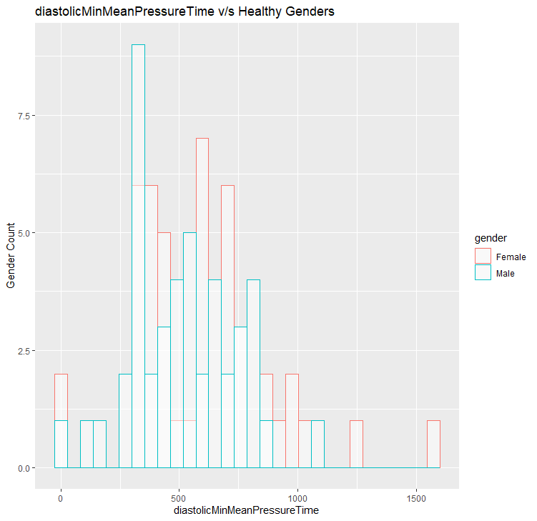
Male v/s Female RF

Slide 32
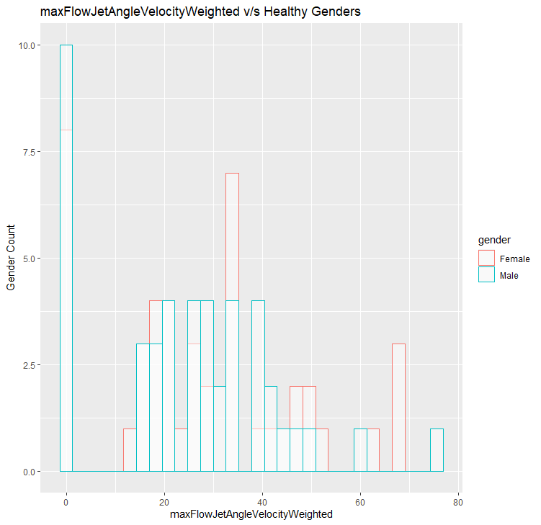
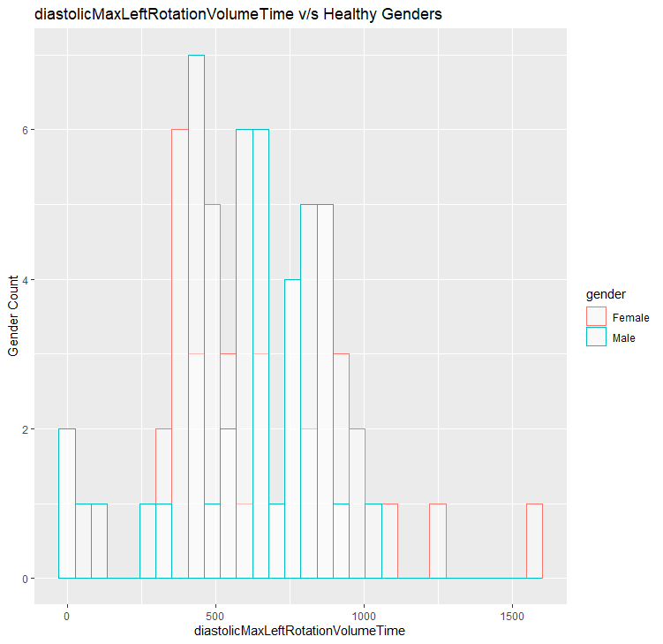
Male v/s Female GBM

Slide 33
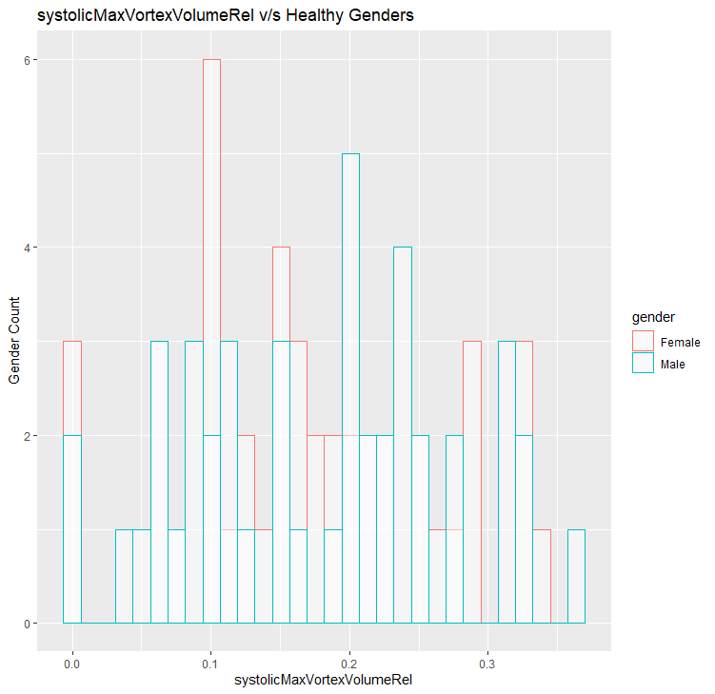
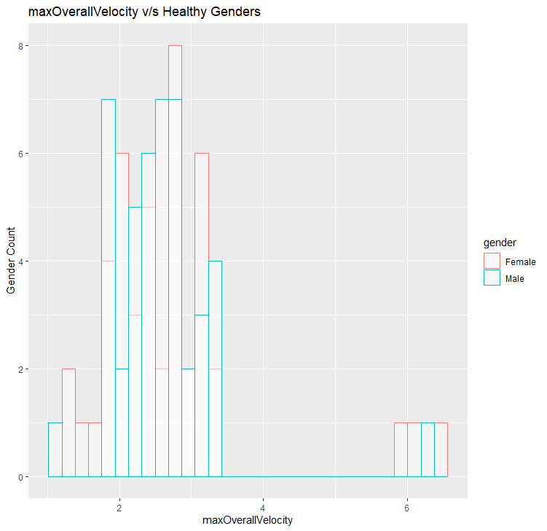
Male v/s Female GBM

Slide 34
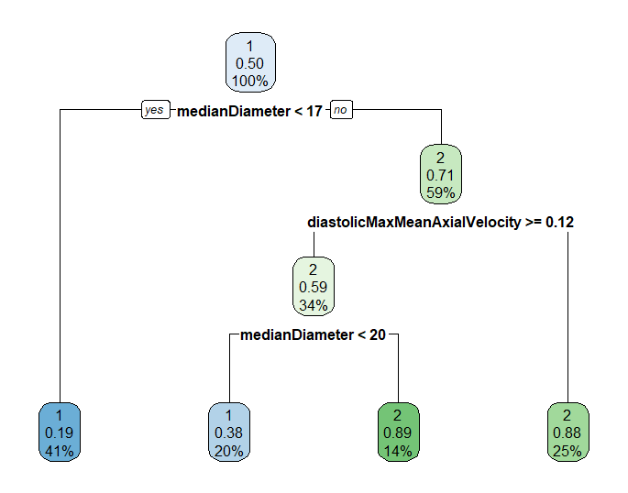
Decision Tree

Slide 35
Conclusions: Male v/s Female
The Accuracy of models is pretty low with low kappa values
The plots were for Features extracted from the following Classifier models for Sequential Forward FS methods:
Random Forest
GBM
DT
The plots also confirm the Hypothesis that the dependence of a patient being Healthy or Pathological is very low.

