Slide 1

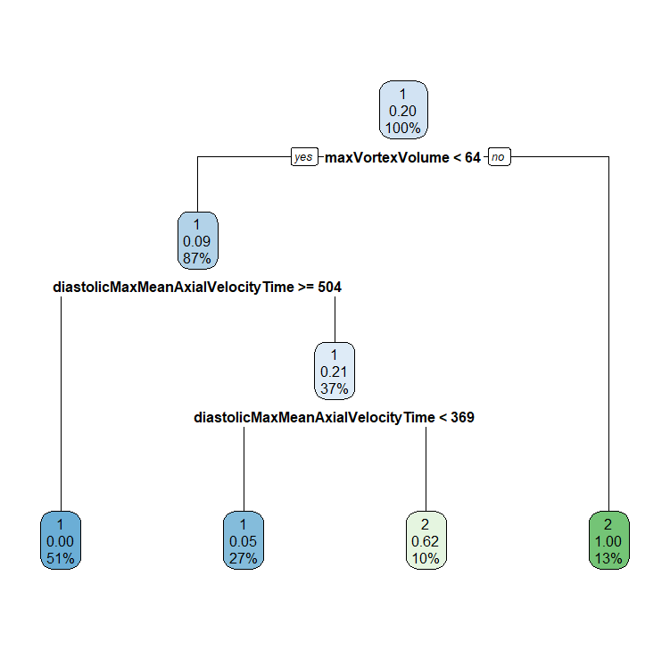
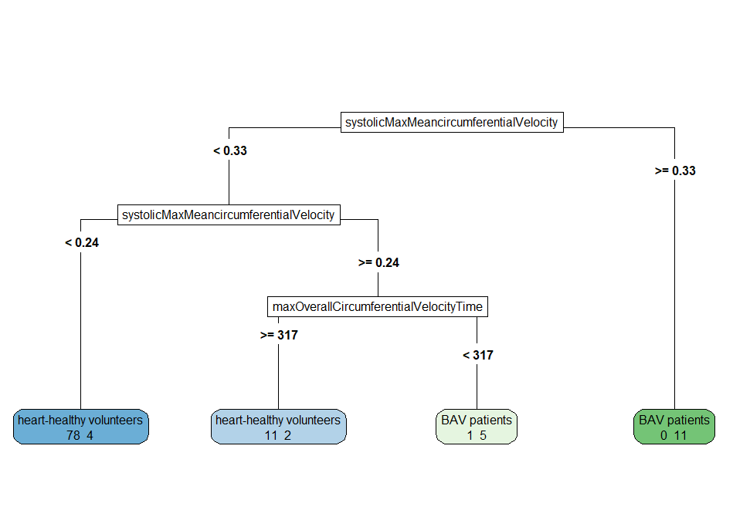
systolicMaxMean-circumferential-Velocity
< 0.33
≥ 0.33
systolicMaxMean-circumferential-Velocity
BAV
✔11 ✖0
< 0.24
≥ 0.24
HHV
maxOverall-Circumferential-VelocityTime
✔78 ✖4
< 317
≥ 317
⮕ ✔105 ✖7
BAV
HHV
✔5 ✖1
✔11 ✖2

Slide 2
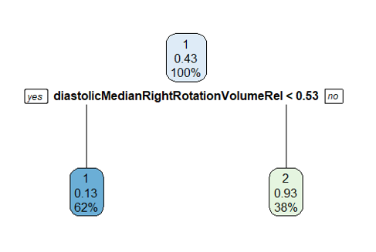

diastolicMedian- RightRotation- VolumeRel
< 0.53
≥ 0.53
OHHV
BAV
✔28 ✖5
✔17 ✖2
⮕ ✔45 ✖7
Notes:
older Healthy vs. BAV

Slide 3
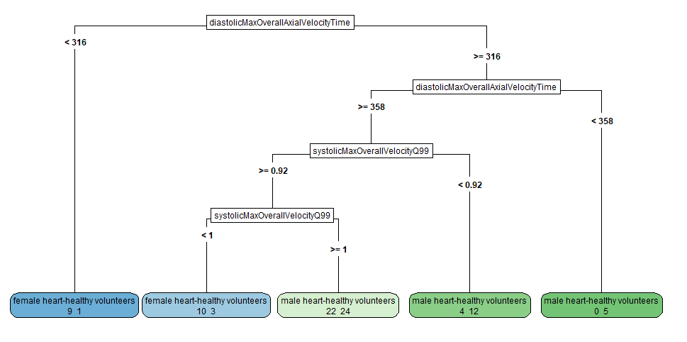

diastolicMax-OverallAxial-VelocityTime
< 316
≥ 316
female HHV
diastolicMax-OverallAxial-VelocityTime
✔9 ✖1
< 358
≥ 358
male HHV
systolicMax-OverallVelocity-Q99
✔5 ✖0
< 0.92
≥ 0.92
male HHV
systolicMax-OverallVelocity-Q99
✔12 ✖4
< 1
≥ 1
⮕ ✔60 ✖30
female BAV
male HHV
✔10 ✖3
✔24 ✖22
medianDiameter
< 17
≥ 17
male
female
✔29 ✖12
✔33 ✖16
⮕ ✔62 ✖18

Slide 4
(a)
classification task 1
systolicMaxMean-circumferential-Velocity
(c)
classification task 3
< 0.33
≥ 0.33
diastolicMax-OverallAxial-VelocityTime
systolicMaxMean-circumferential-Velocity
BAV
< 316
≥ 316
✔11 ✖0
< 0.24
≥ 0.24
female HHV
diastolicMax-OverallAxial-VelocityTime
✔9 ✖1
< 358
≥ 358
HHV
maxOverall-Circumferential-VelocityTime
✔78 ✖4
< 317
≥ 317
male HHV
systolicMax-OverallVelocity-Q99
✔5 ✖0
< 0.92
≥ 0.92
⮕ ✔105 ✖7
BAV
HHV
✔5 ✖1
✔11 ✖2
total number of correctly (✔) and incorrectly (✖) classified subjects
male HHV
systolicMax-OverallVelocity-Q99
(b)
classification task 2
diastolicMedian- RightRotation- VolumeRel
✔12 ✖4
< 1
≥ 1
< 0.53
≥ 0.53
female BAV
male HHV
⮕ ✔60 ✖30
✔10 ✖3
✔24 ✖22
⮕ ✔45 ✖7
OHHV
BAV
✔28 ✖5
✔17 ✖2

Slide 5
A
maxVortexVolume
B
diastolicMedian- RightRotation- VolumeRel
< 64
≥ 64
< 0.53
≥ 0.53
diastolicMaxMean- PressureInVortex-Region
BAV
OHHV
BAV
✔14 ✖1
✔28 ✖5
⮕ ✔45 ✖7
✔17 ✖2
< 504
≥ 504
diastolicMaxMean- PressureInVortex-Region
HHV
C
medianDiameter
< 369
≥ 369
✔57 ✖0
< 17
≥ 17
HHV
BAV
male HHV
female HHV
✔27 ✖2
✔6 ✖5
⮕ ✔104 ✖8
✔29 ✖12
✔33 ✖16
⮕ ✔62 ✖18

