Slide 1

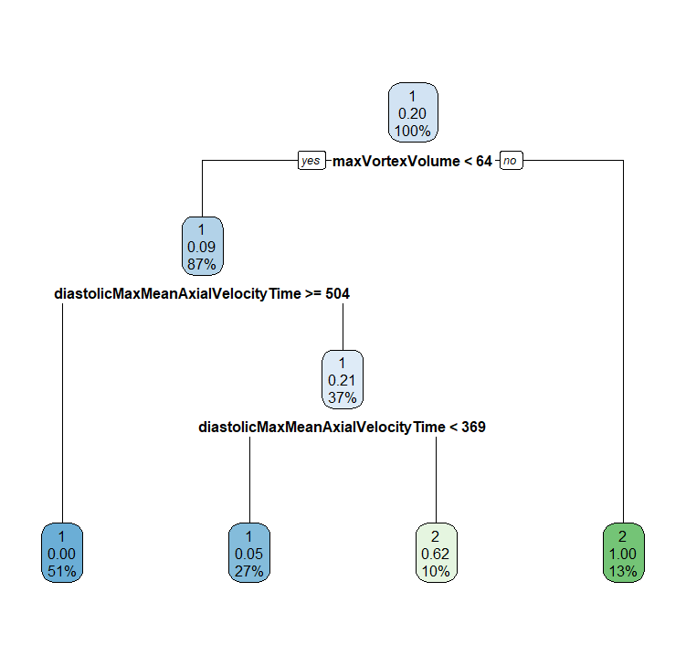
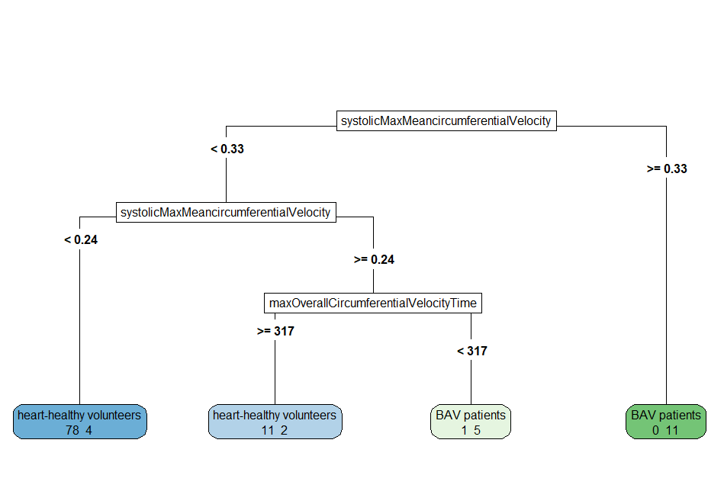
Time-to-Peak-In-Plane-Velocity [m/s]
< 0.33
≥ 0.33
Time-to-Peak-In-Plane-Velocity [m/s]
BAV
✔11 ✖0
< 0.24
≥ 0.24
HHV
Peak-Systolic-In-Plane-Mean-Velocity [ms]
✔78 ✖4
< 317
≥ 317
BAV
HHV
✔5 ✖1
✔11 ✖2
 |  | Predicted
 |  | BAV | HHV
True | BAV | 16 | 6
 | HHV | 1 | 89
Accuracy = 93.8% Sensitivity = 72.7% Specificity = 98.9%

Slide 2
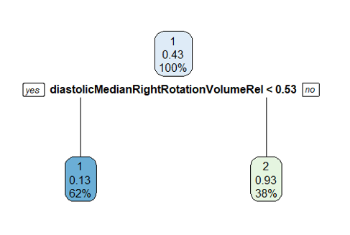

Diastolic-Median-Right-Rotation-Volume-Rel [%]
< 0.53
≥ 0.53
OHHV
BAV
✔28 ✖5
✔17 ✖2
 |  | Predicted
 |  | BAV | OHHV
True | BAV | 17 | 5
 | OHHV | 2 | 28
Accuracy = 86.5% Sensitivity = 77.3% Specificity = 93.3%
Notes:
older Healthy vs. BAV

Slide 3
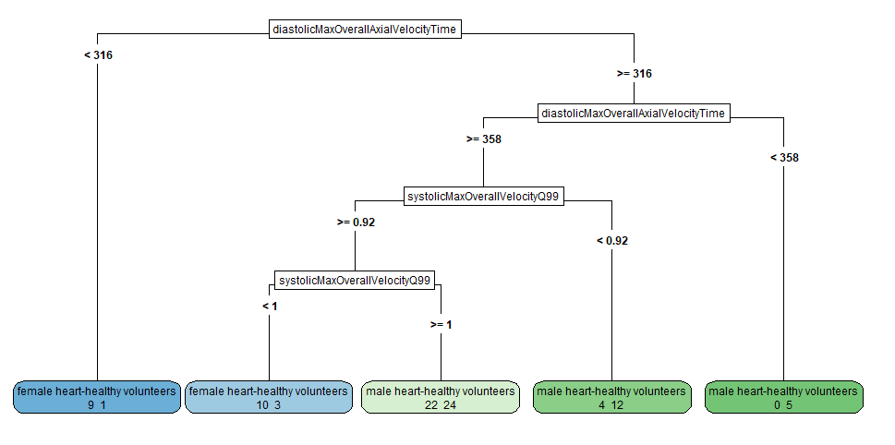

Time-to-Peak-Diastolic-Through-Plane-Velocity [ms]
< 316
≥ 316
female HHV
Time-to-Peak-Diastolic-Through-Plane-Velocity [ms]
✔9 ✖1
< 358
≥ 358
male HHV
Peak-Systolic-VelocityQ99 [m/s]
✔5 ✖0
< 0.92
≥ 0.92
 |  | Predicted
 |  | female | male
True | female | 19 | 26
 | male | 4 | 41
male HHV
Peak-Systolic-VelocityQ99 [m/s]
✔12 ✖4
< 1
≥ 1
Accuracy = 66.7% Sensitivity (female) = 42.2% Sensitivity (male) = 91.1%
female BAV
male HHV
✔10 ✖3
✔24 ✖22

Slide 4
(a)
classification task 1
Time-to-Peak-In-Plane-Velocity [m/s]
(c)
classification task 3
Accuracy = 93.8% Sensitivity = 72.7% Specificity = 98.9%
< 0.33
≥ 0.33
Time-to-Peak-Diastolic-Through-Plane-Velocity [ms]
Time-to-Peak-In-Plane-Velocity [m/s]
BAV
< 316
≥ 316
✔11 ✖0
< 0.24
≥ 0.24
female HHV
Time-to-Peak-Diastolic-Through-Plane-Velocity [ms]
HHV
Peak-Systolic-In-Plane-Mean-Velocity [ms]
✔9 ✖1
< 358
≥ 358
✔78 ✖4
 |  | Predicted
 |  | BAV | HHV
True | BAV | 16 | 6
 | HHV | 1 | 89
< 317
≥ 317
male HHV
Peak-Systolic-VelocityQ99 [m/s]
BAV
HHV
✔5 ✖0
< 0.92
≥ 0.92
✔5 ✖1
✔11 ✖2
male HHV
Peak-Systolic-VelocityQ99 [m/s]
(b)
classification task 2
✔12 ✖4
< 1
≥ 1
Diastolic-Median-Right-Rotation-Volume-Rel [%]
 |  | Predicted
 |  | BAV | OHHV
True | BAV | 17 | 5
 | OHHV | 2 | 28
 |  | Predicted
 |  | female | male
True | female | 19 | 26
 | male | 4 | 41
< 0.53
≥ 0.53
female BAV
male HHV
Accuracy = 86.5% Sensitivity = 77.3% Specificity = 93.3%
Accuracy = 66.7% Sensitivity (female) = 42.2% Sensitivity (male) = 91.1%
✔10 ✖3
✔24 ✖22
OHHV
BAV
✔28 ✖5
✔17 ✖2

Slide 5
(a)
classification task 1
systolicMaxMean-circumferential-Velocity
(c)
classification task 3
< 0.33
≥ 0.33
diastolicMax-OverallAxial-VelocityTime
systolicMaxMean-circumferential-Velocity
BAV
< 316
≥ 316
✔11 ✖0
< 0.24
≥ 0.24
female HHV
diastolicMax-OverallAxial-VelocityTime
✔9 ✖1
< 358
≥ 358
HHV
maxOverall-Circumferential-VelocityTime
✔78 ✖4
< 317
≥ 317
male HHV
systolicMax-OverallVelocity-Q99
✔5 ✖0
< 0.92
≥ 0.92
⮕ ✔105 ✖7
BAV
HHV
✔5 ✖1
✔11 ✖2
total number of correctly (✔) and incorrectly (✖) classified subjects
male HHV
systolicMax-OverallVelocity-Q99
(b)
classification task 2
diastolicMedian- RightRotation- VolumeRel
✔12 ✖4
< 1
≥ 1
< 0.53
≥ 0.53
female BAV
male HHV
⮕ ✔60 ✖30
✔10 ✖3
✔24 ✖22
⮕ ✔45 ✖7
OHHV
BAV
✔28 ✖5
✔17 ✖2

Slide 6
A
maxVortexVolume
B
diastolicMedian- RightRotation- VolumeRel
< 64
≥ 64
< 0.53
≥ 0.53
diastolicMaxMean- PressureInVortex-Region
BAV
OHHV
BAV
✔14 ✖1
✔28 ✖5
⮕ ✔45 ✖7
✔17 ✖2
< 504
≥ 504
diastolicMaxMean- PressureInVortex-Region
HHV
C
medianDiameter
< 369
≥ 369
✔57 ✖0
< 17
≥ 17
HHV
BAV
male HHV
female HHV
✔27 ✖2
✔6 ✖5
⮕ ✔104 ✖8
✔29 ✖12
✔33 ✖16
⮕ ✔62 ✖18

