Slide 1
Final Results

Slide 2
Workflow
Hyperparameter script : holds all common tunable hyperparameters
Feature Selection : holds all the methods of Feature Selection; Outputs are csv files with selected Features and Label
Models : Contains all classifier models and options to select Feature Selection Method for data
Main : Automates all scripts and lets user select which Model user wants to work with.
here package used as required and all scripts under common Project folder.

Slide 3
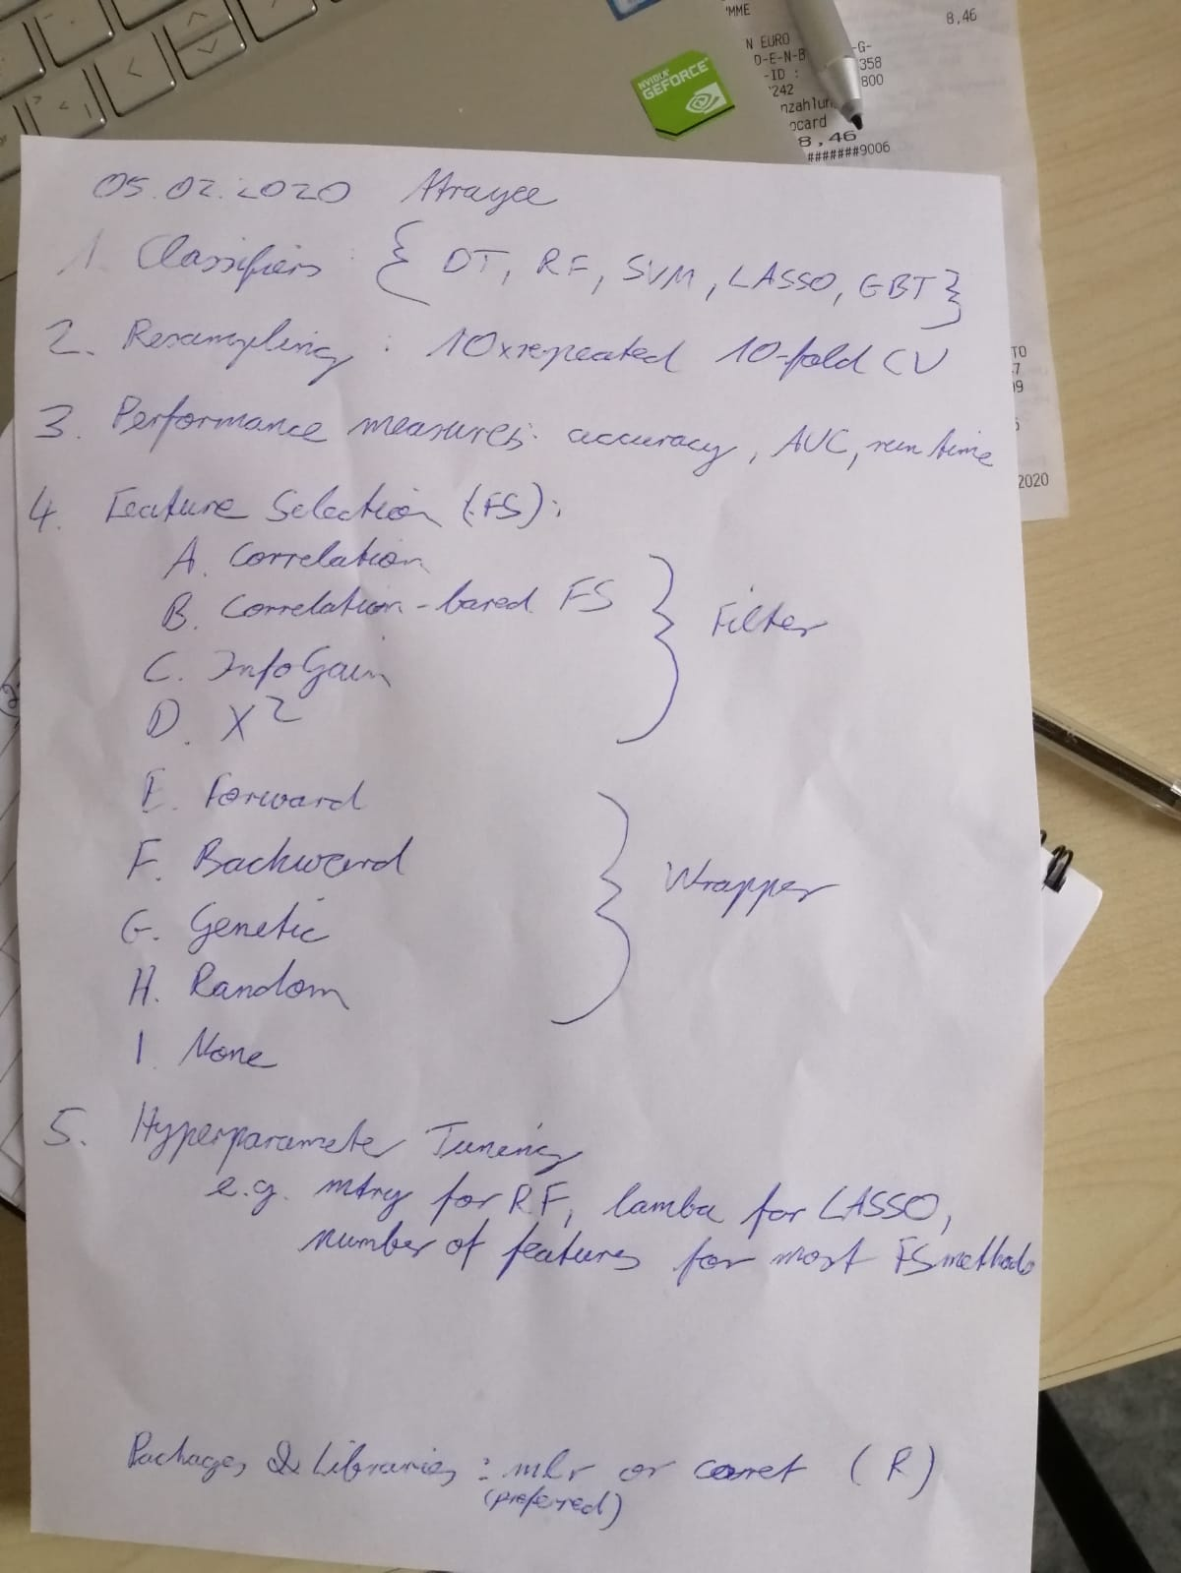
Tasks:

Slide 4
Total Counts:
95 Features after Correlation and removal of Near Zero variance
Type | Healthy | BAV | Total
Healthy v/s BAV | 90 | 22 | 112
Young v/s Old | Young: 53 Old: 37 | Young: 15 Old: 7 | Young: 68 Old: 44
Male v/s Female | Male: 45 Female: 45 | Male : 17 Female: 5 | Male: 62 Female: 50

Slide 5
Sequential Algorithm(Forward) based FS:
Model | Number of Features | Accuracy (Testing) | AUC | Kappa | Runtime (sec)
Decision Tree | 2 | 0.878 | 0.935 | 0.639 | 32.16
Random Forest | 3 | 0.939 | 0.969 | 0.796 | 74.64
SVM | 3 | 0.969 | 0.956 | 0.891 | 43.92
GBM | 3 | 0.939 | 0.962 | 0.819 | 43.77
Lasso

Slide 6
No FS Methods:
Model | Number of Features | Accuracy (Testing) | AUC | Kappa | Runtime (sec)
Decision Tree | 95 | 0.818 | 0.500 | 0.246 | 3.04
Random Forest | 95 | 0.969 | 0.981 | 0.891 | 0.34
SVM | 95 | 0.969 | 0.981 | 0.891 | 0.07
GBM | 95 | 0.939 | 1.000 | 0.765 | 0.39
Lasso | 95 | 0.909 | 0.750 | 0.620 | 0.03

Slide 7
Results:Optimal Combination
Model | Features | Acc | Kappa | AUC | Time | Kappa.mean | S.D.
SVM | 3 | 0.969 | 0.901 | 0.891 | 43.92 | 0.702 | 0.400
GBM | 3 | 0.939 | 0.962 | 0.819 | 43.77 | 0.735 | 0.386
RF | 3 | 0.939 | 0.969 | 0.796 | 74.64 | 0.720 | 0.412
SVM:
"maxVortexVolume" "diastolicMaxLeftRotationVolumeRel" "systolicMaxMeanPressureInVortexRegion"
RF:
"maxVortexVolumeTime" "maxOverallCircumferentialVelocityTime" "systolicMaxMeancircumferentialVelocity"
GBM:
"maxVortexVolumeTime" "diastolicMaxVortexVolumeTime" "medianMeanPressureInVortexRegion"
Decision Tree:
"maxVortexVolume" "diastolicMaxMeanAxialVelocityTime"

Slide 8
Visualizations

Slide 9
Healthy v/s BAV

Slide 10
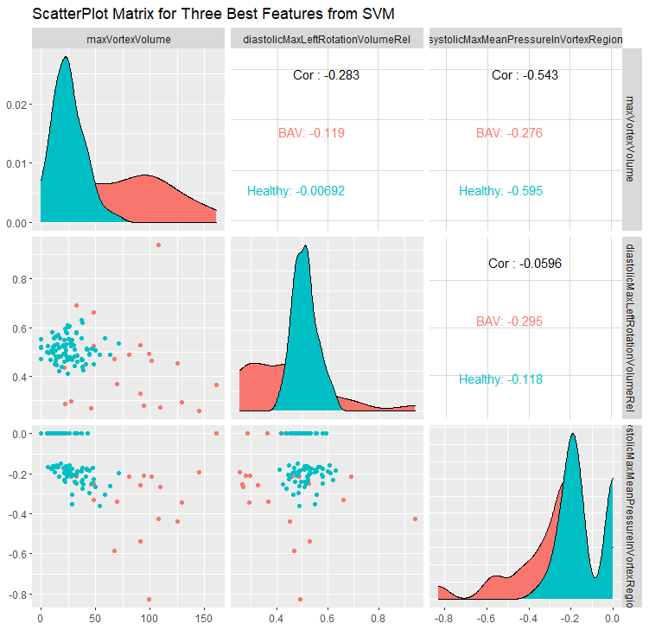
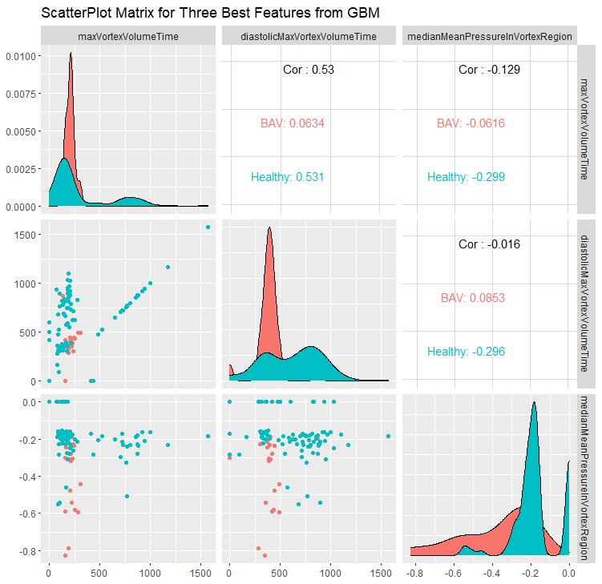
Healthy v/s BAV

Slide 11
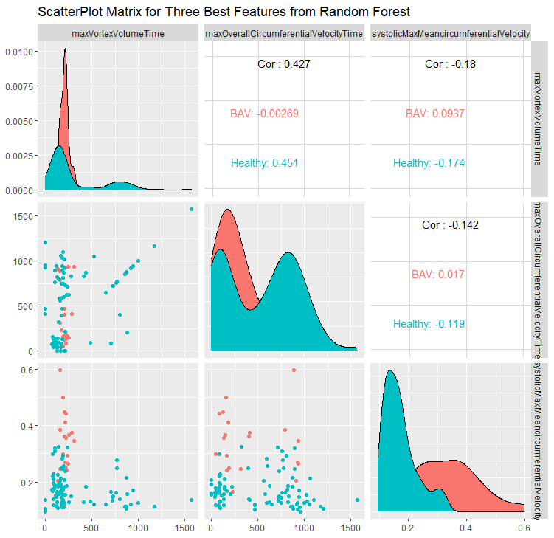
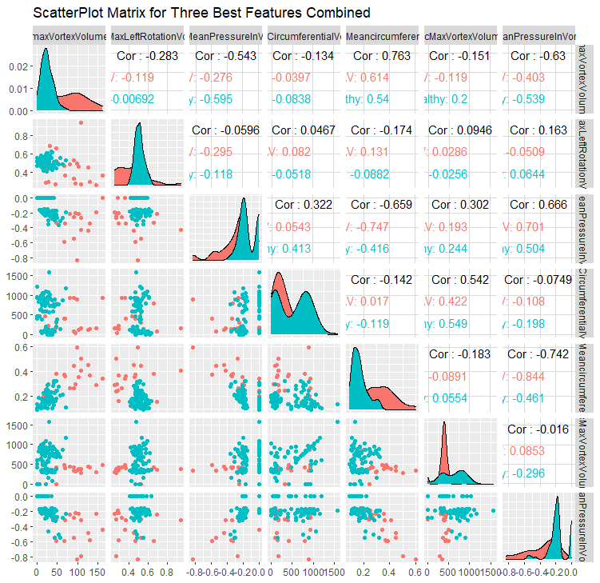
Healthy v/s BAV

Slide 12
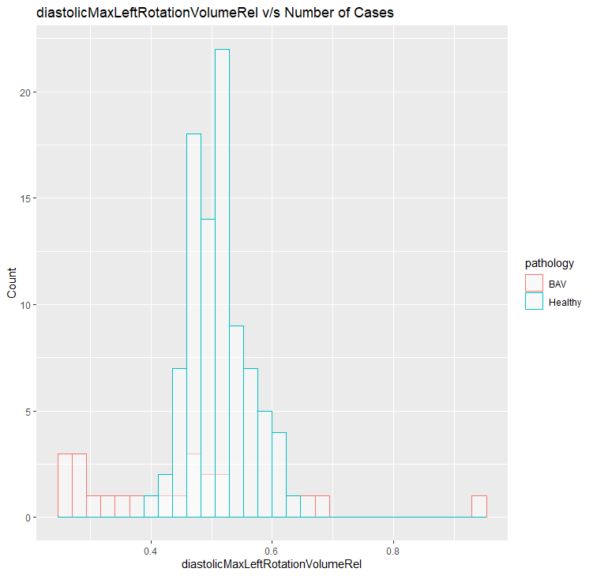
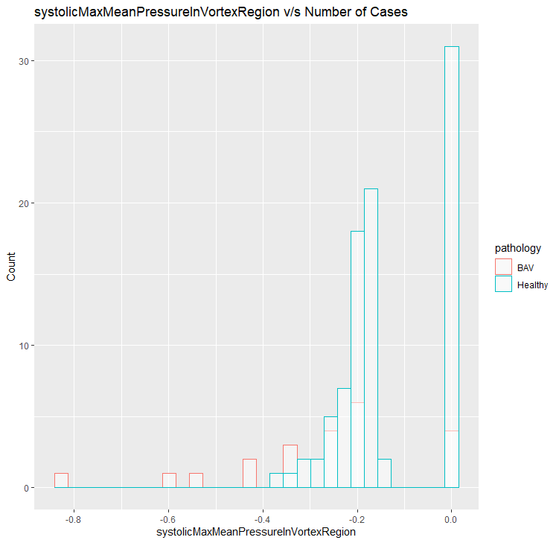
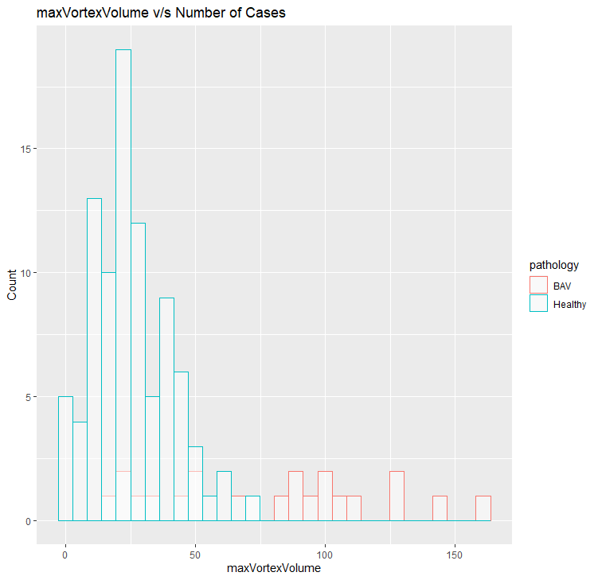
Healthy v/s BAV SVM

Slide 13
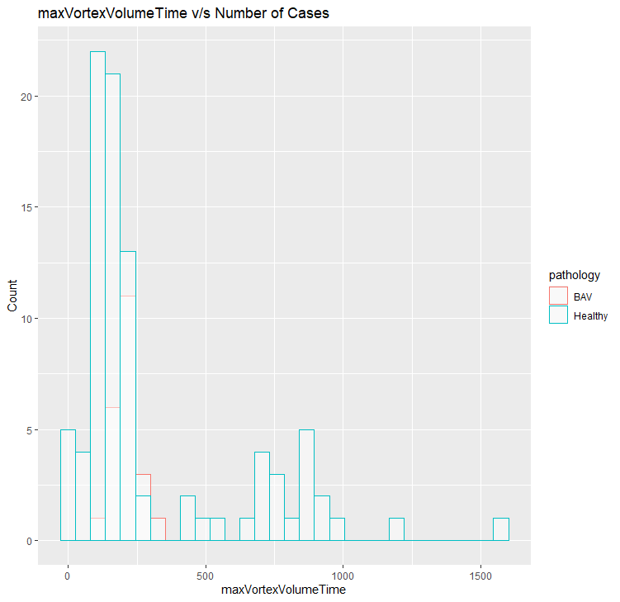
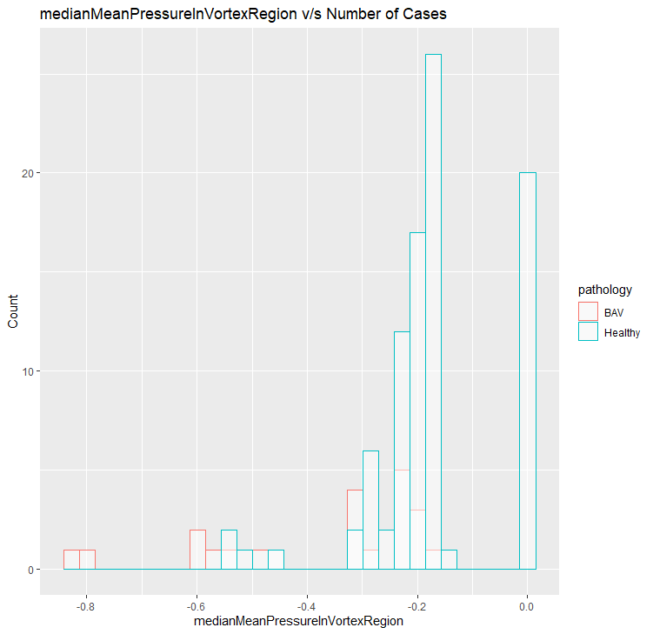
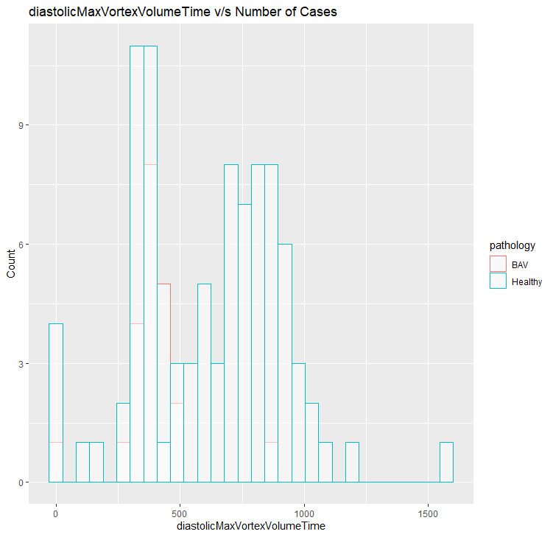
Healthy v/s BAV GBM

Slide 14
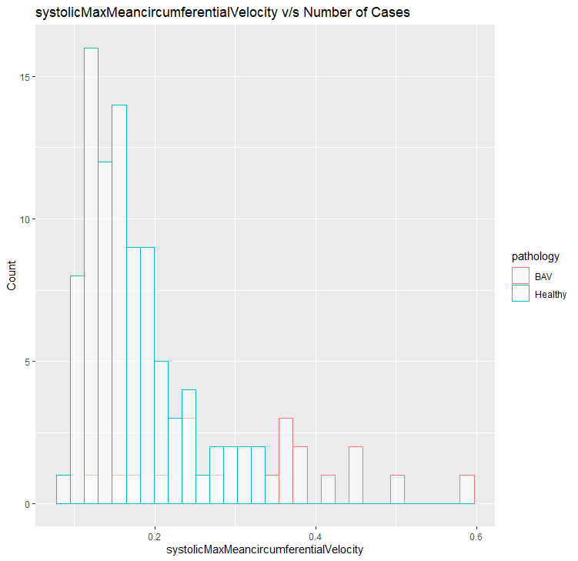
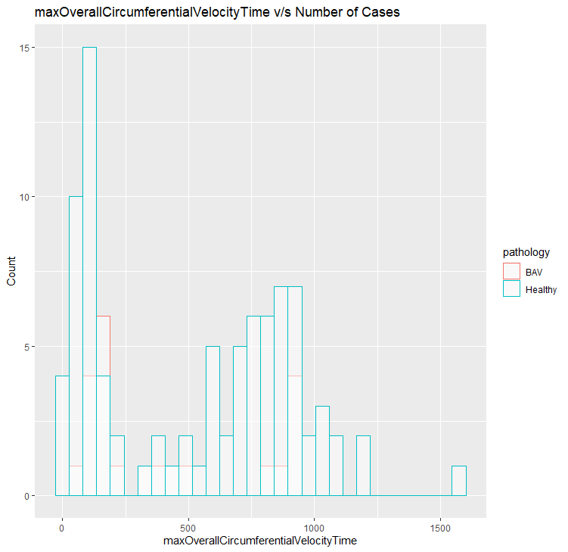
Healthy v/s BAV RF

Slide 15
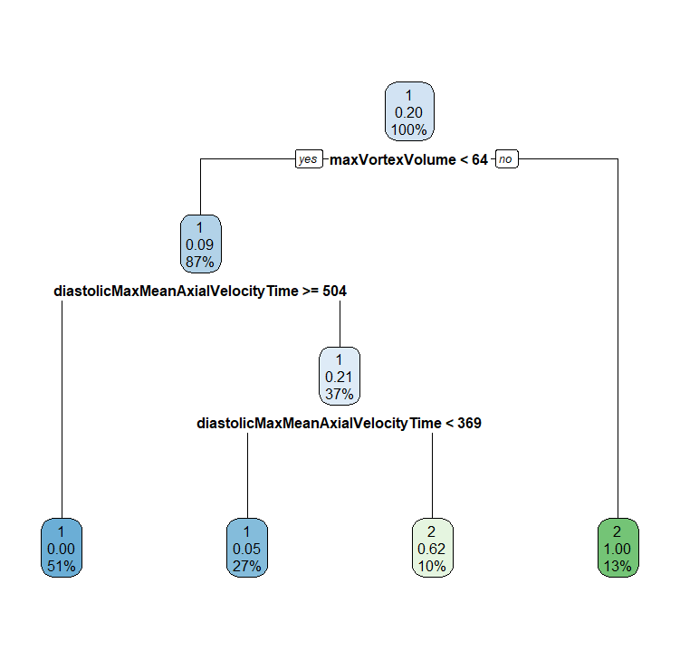
Decision Tree

Slide 16
Conclusions: Healthy v/s BAV
maxVortexVolume is an important feature as it is selected for two different Classifiers as well as it’s versions maxVortexVolumeTime is selected by the other two.
The best results are with the combination SVM and Sequential Forward Feature Selection method

Slide 17
Old Healthy v/s BAV

Slide 18
Sequential Algorithm(Forward) based FS:
Model | Number of Features | Accuracy (Testing) | AUC | Kappa | Runtime (sec)
Decision Tree | 1 | 0.800 | 0.777 | 0.571 | 14.92
Random Forest | 3 | 0.866 | 0.925 | 0.722 | 54.41
SVM | 5 | 1.000 | 1.000 | 1.000 | 23.86
GBM | 1 | 0.800 | 0.777 | 0.571 | 23.68
Lasso

Slide 19
No FS Methods:
Model | Number of Features | Accuracy (Testing) | AUC | Kappa | Runtime (sec)
Decision Tree | 85 | 0.800 | 0.777 | 0.571 | 3.04
Random Forest | 85 | 0.866 | 0.768 | 0.705 | 0.34
SVM | 85 | 0.733 | 0.925 | 0.444 | 0.07
GBM | 85 | 0.866 | 0.768 | 0.705 | 0.04
Lasso | 85 | 0.933 | 0.917 | 0.857 | 0.03

Slide 20
Results:Optimal Combination
Model | Features | Acc | Kappa | AUC | Time | Kappa.mean | S.D.
RF | 3 | 0.866 | 0.925 | 0.722 | 54.41 | 0.904 | 0.201
DT | 1 | 0.800 | 0.777 | 0.571 | 14.92 | 0.754 | 0.350
GBM | 1 | 0.800 | 0.777 | 0.571 | 23.68 | 0.694 | 0.354
RF:
"maxVortexVolumeTime" "systolicMaxVortexVolume" "diastolicMedianRightRotationVolumeRel"
GBM:
"diastolicMedianRightRotationVolumeRel"
Decision Tree:
"diastolicMedianRightRotationVolumeRel"

Slide 21
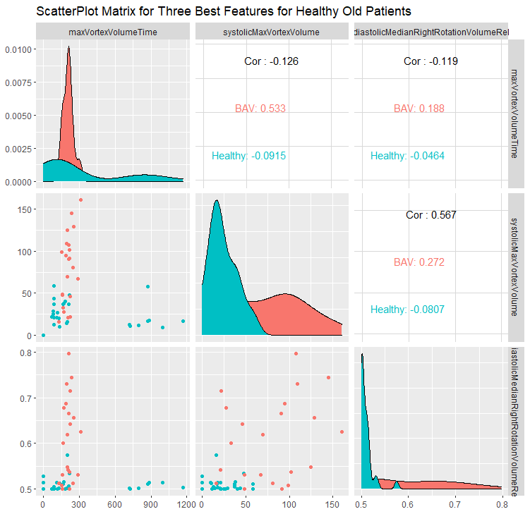
Healthy v/s BAV

Slide 22
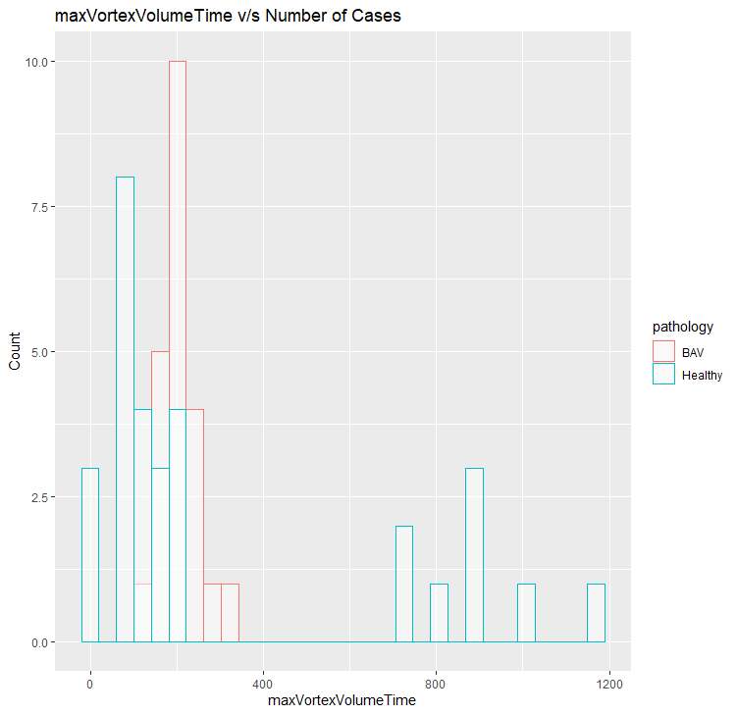
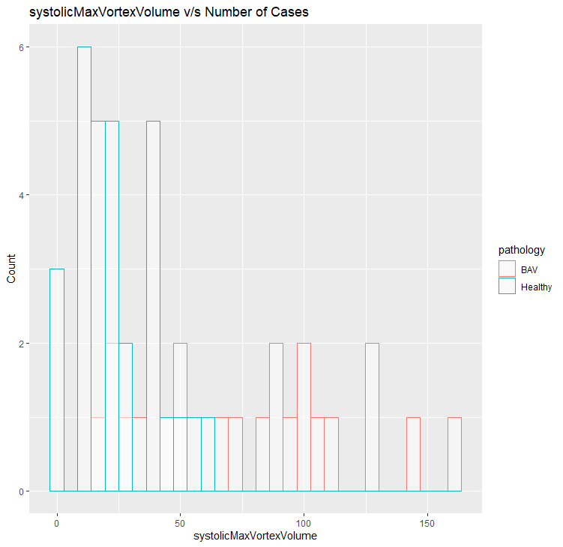
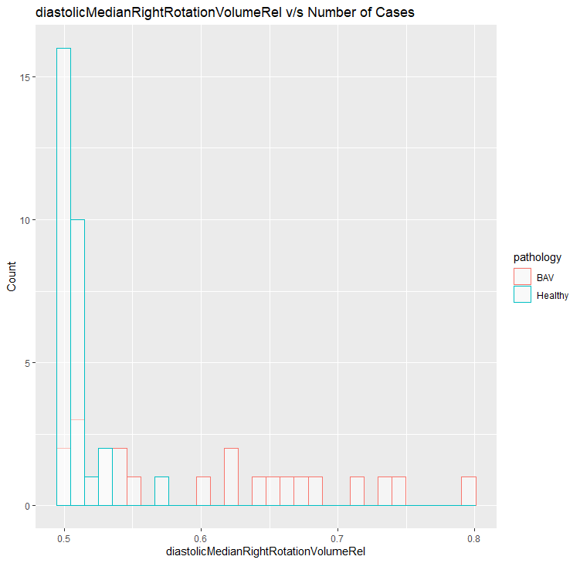
Healthy v/s BAV RF

Slide 23
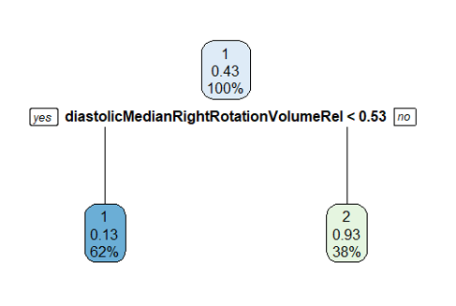
Decision Tree

Slide 24
Conclusions: Old Healthy Patients:
All misclassifications were Pathological patients being classified as Healthy.
Age ranges were from 23-74
Age feature was removed but Accuracy remained quite good.
According to the results, old Healthy patients do not have the same flow conditions as the Young Pathological ones, as Accuracy is pretty high.

Slide 25
Healthy Male v/s Healthy Female

Slide 26
Sequential Algorithm(Forward) based FS:
Model | Number of Features | Accuracy (Testing) | AUC | Kappa | Runtime (sec)
Decision Tree | 1 | 0.615 | 0.615 | 0.230 | 23.05
Random Forest | 3 | 0.653 | 0.615 | 0.307 | 85.42
SVM | 5 | 0.538 | 0.491 | 0.076 | 34.65
GBM | 4 | 0.538 | 0.535 | 0.076 | 35.54
Lasso

Slide 27
No FS Methods:
Model | Number of Features | Accuracy (Testing) | AUC | Kappa | Runtime (sec)
Decision Tree | 106 | 0.500 | 0.500 | 0.000 | 3.04
Random Forest | 106 | 0.384 | 0.426 | -0.230 | 0.34
SVM | 106 | 0.384 | 0.355 | -0.230 | 0.07
GBM | 106 | 0.500 | 0.562 | 0.000 | 0.04
Lasso | 106 | 0.615 | 0.615 | 0.230 | 0.03

Slide 28
Results:Optimal Combination
Model | Features | Acc | Kappa | AUC | Time | Kappa.mean | S.D.
RF | 3 | 0.653 | 0.615 | 0.307 | 85.42 | 0.211 | 0.170
DT | 1 | 0.615 | 0.615 | 0.230 | 23.05 | 0.324 | 0.365
GBM | 4 | 0.538 | 0.535 | 0.076 | 35.54 | 0.502 | 0.358
RF:
"medianDiameter" "diastolicMinMeanPressureTime" "diastolicMeanMeanPressure"
Decision Tree:
"medianDiameter"
GBM:
"systolicMaxVortexVolumeRel" "maxOverallVelocity" "diastolicMaxLeftRotationVolumeTime"
"maxFlowJetAngleVelocityWeighted"

Slide 29
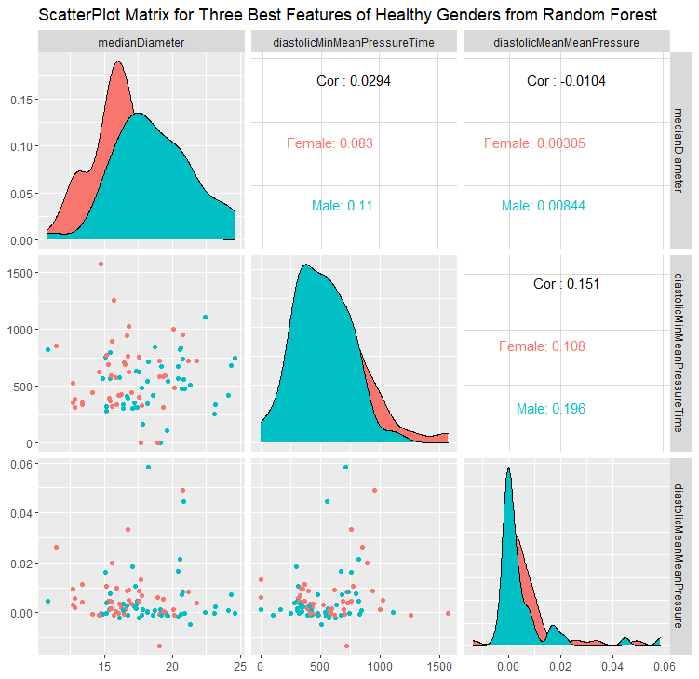
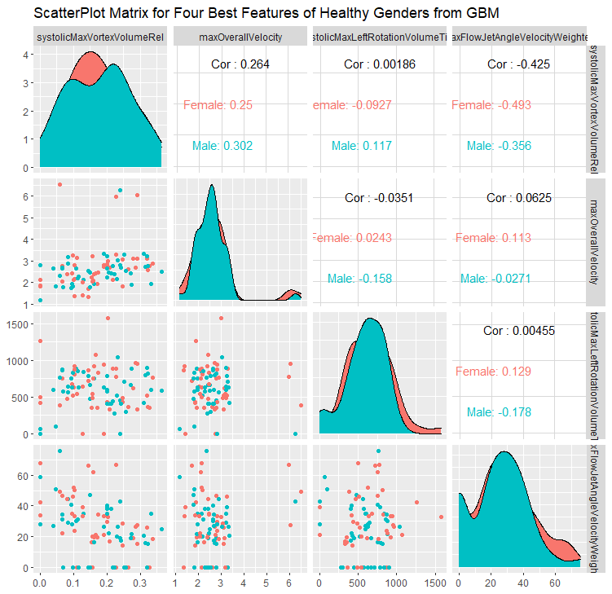
Healthy v/s BAV

Slide 30
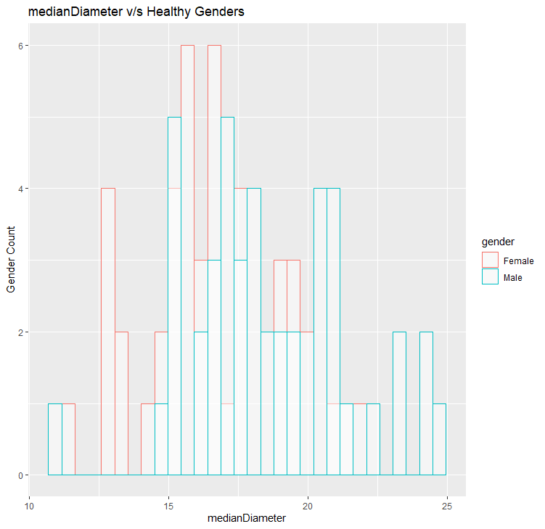
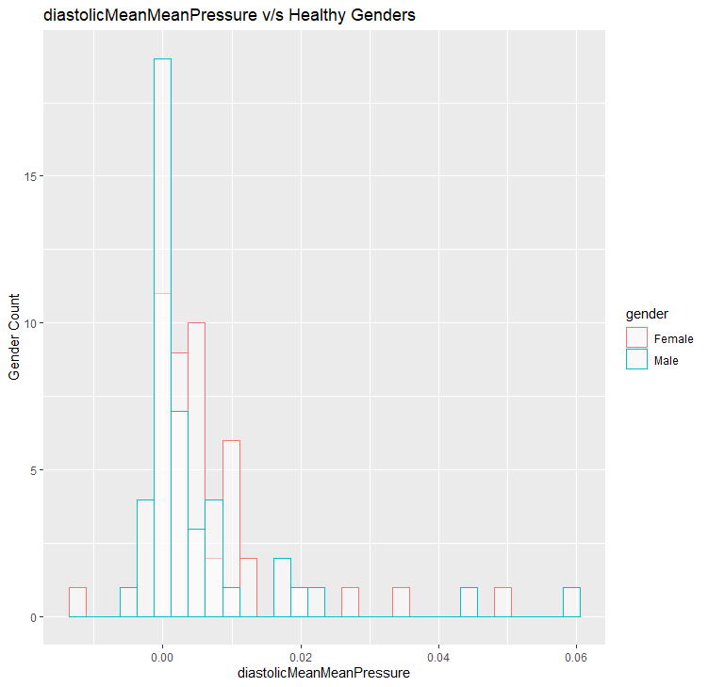
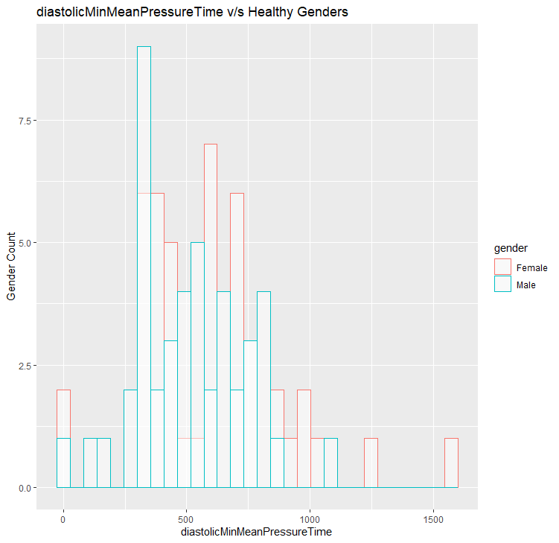
Healthy v/s BAV RF

Slide 31
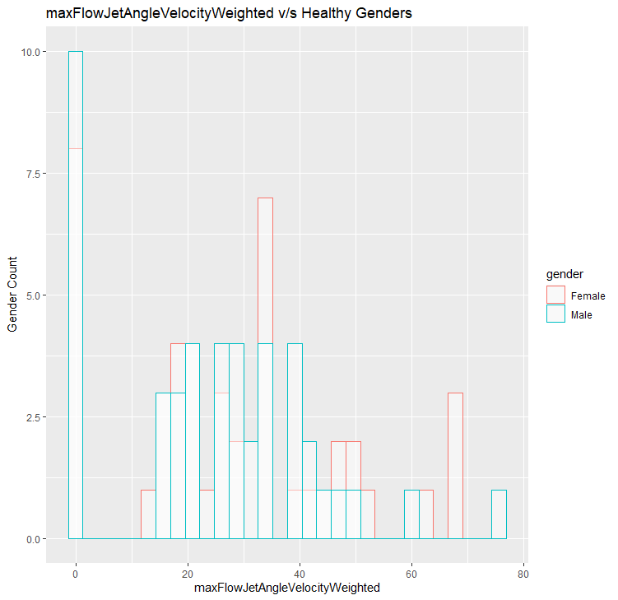
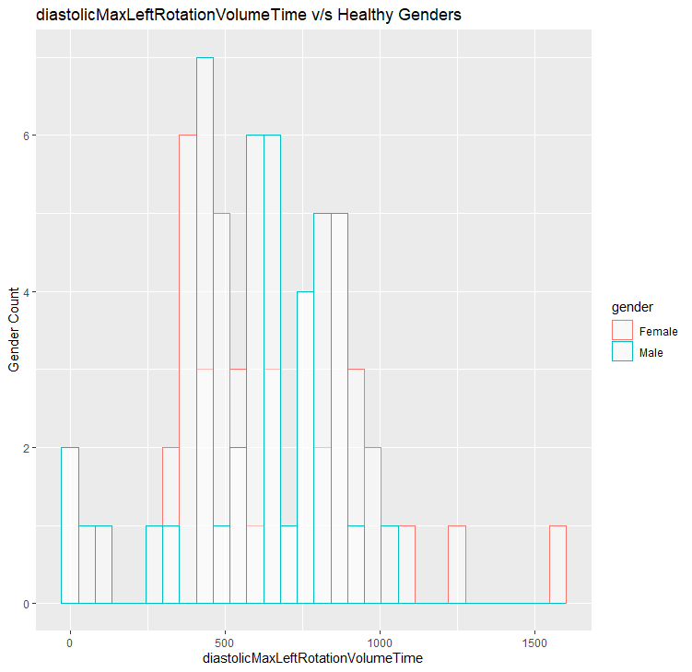
Healthy v/s BAV GBM

Slide 32
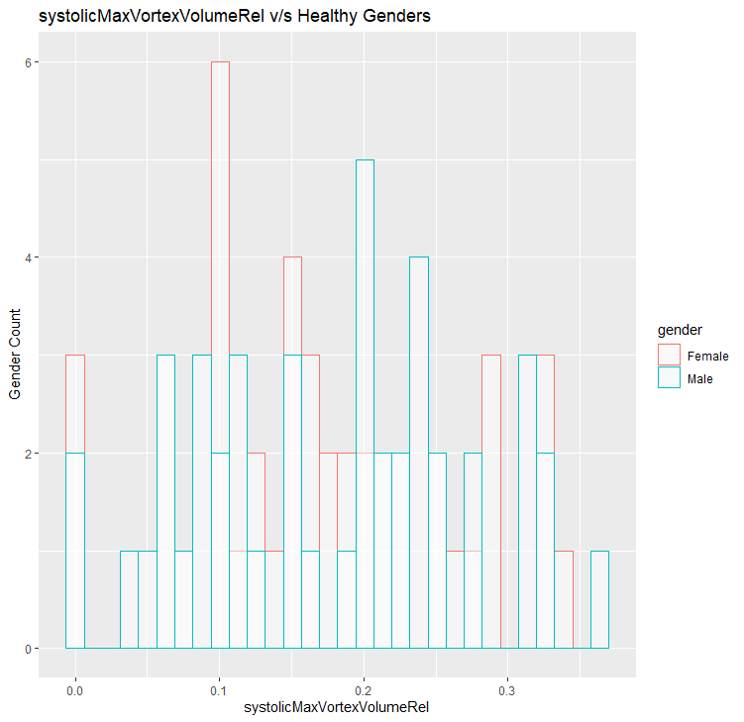
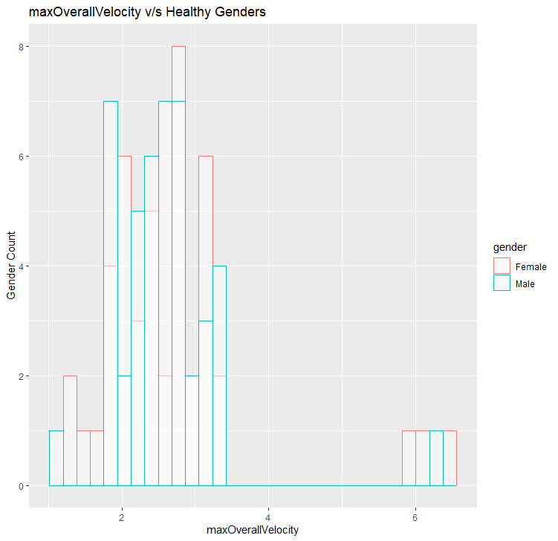
Healthy v/s BAV GBM

Slide 33
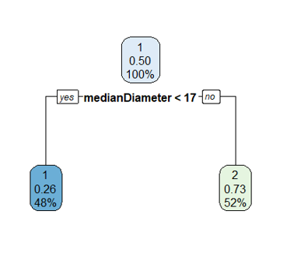
Decision Tree

Slide 34
Conclusions: Male v/s Female
The Accuracy of models is pretty low with low kappa values
The plots were for Features extracted from the following Classifier models for Sequential Forward FS methods:
Random Forest
GBM
DT
The plots also confirm the Hypothesis that the dependence of a patient being Healthy or Pathological is very low.

