Slide 1

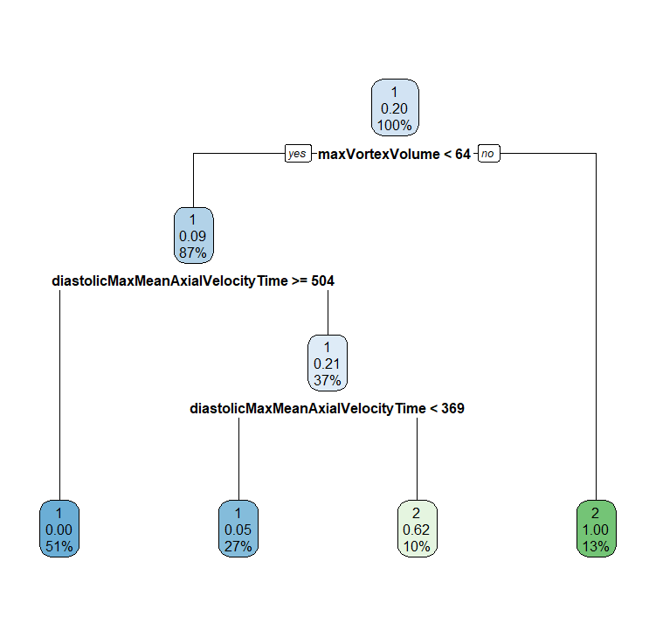
maxVortexVolume
< 64
≥ 64
diastolicMaxMean- PressureInVortex-Region
BAV
✔14 ✖1
< 504
≥ 504
diastolicMaxMean- PressureInVortex-Region
HHV
< 369
≥ 369
✔57 ✖0
HHV
BAV
⮕ ✔104 ✖8
✔27 ✖2
✔6 ✖5

Slide 2
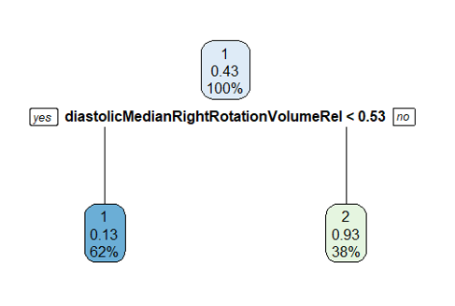
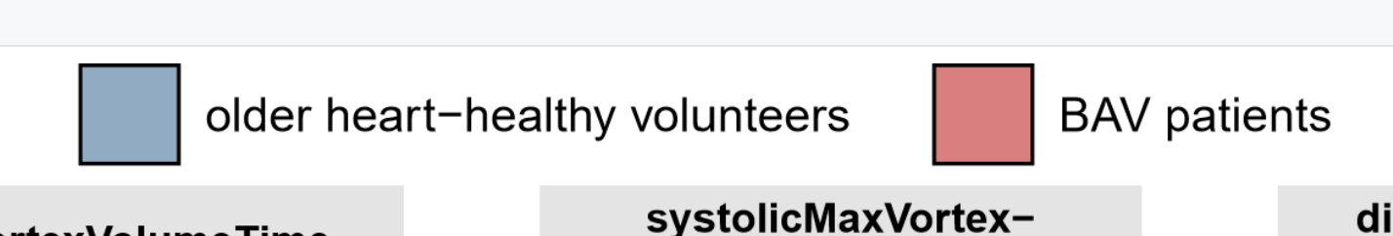
diastolicMedian- RightRotation- VolumeRel
< 0.53
≥ 0.53
OHHV
BAV
✔28 ✖5
✔17 ✖2
⮕ ✔45 ✖7
Notes:
older Healthy vs. BAV

Slide 3
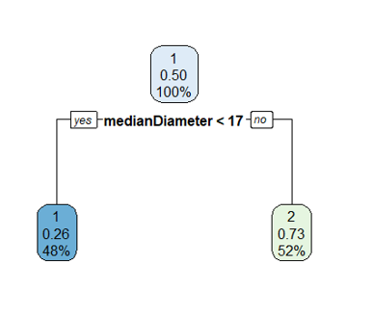

medianDiameter
< 17
≥ 17
male
female
✔29 ✖12
✔33 ✖16
⮕ ✔62 ✖18

Slide 4
A
maxVortexVolume
B
diastolicMedian- RightRotation- VolumeRel
< 64
≥ 64
< 0.53
≥ 0.53
diastolicMaxMean- PressureInVortex-Region
BAV
OHHV
BAV
✔14 ✖1
✔28 ✖5
⮕ ✔45 ✖7
✔17 ✖2
< 504
≥ 504
diastolicMaxMean- PressureInVortex-Region
HHV
C
medianDiameter
< 369
≥ 369
✔57 ✖0
< 17
≥ 17
HHV
BAV
male HHV
female HHV
✔27 ✖2
✔6 ✖5
⮕ ✔104 ✖8
✔29 ✖12
✔33 ✖16
⮕ ✔62 ✖18

