Slide 1
Presentation from Tableau
File created on: 4/11/2020 7:04:52 PM

Slide 2
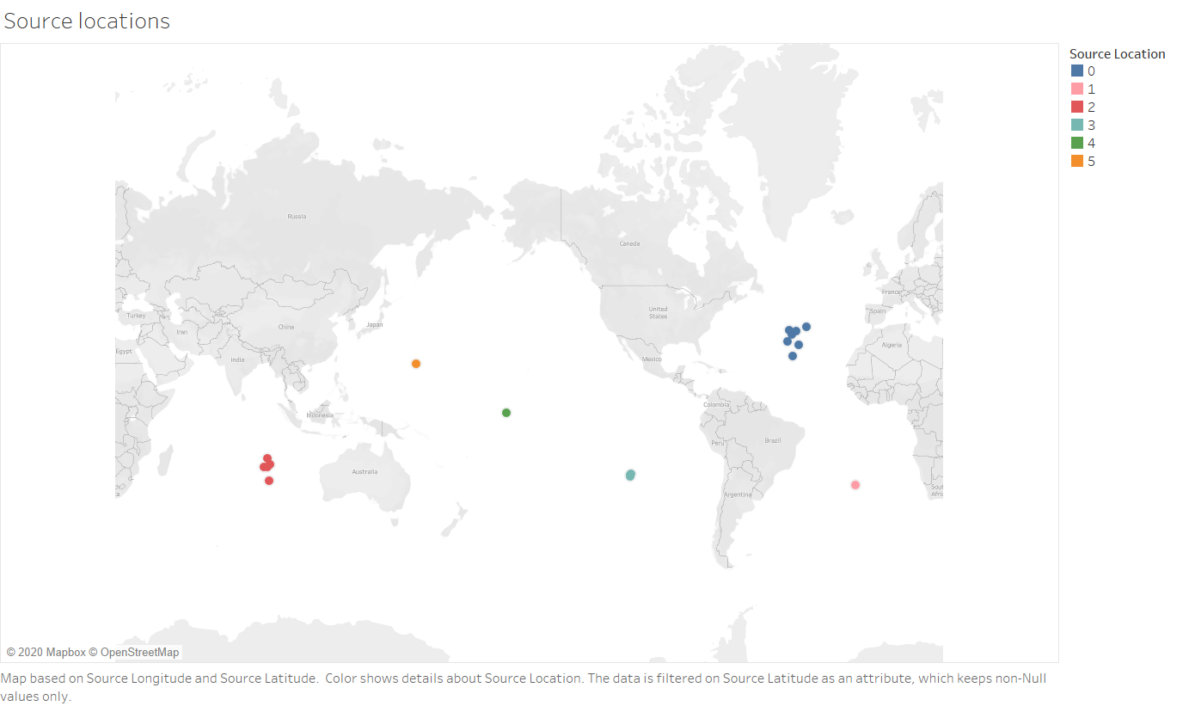

Slide 3
