Slide 1
VAST Meeting 2
15-04-2020

Slide 2
Data Analysis
Worked on Template and Graph Data
Divided all data based on 5 channels:
Communication
Procurement
Co-Authorship
Demographic
Travel
The Channels with highest datapoints were:
Demographic
Communication
Travel (almost 10 times less than the other 2)

Slide 3
Communication Channel
For Template:
Source IDs, Target IDs, Time, Source and Target Locations with some NA values
No Latitude, Longitude Information
All Weights = 1
Weights, Lat/Long were removed
For Graph:
Source IDs, Target IDs, Time, Source and Target Locations with some NA values and Source and Target Latitudes/Longitudes with a some NA
All Weights = 1
Weights were removed

Slide 4
Demographic Channel
For Template:
Source IDs, Target IDs, Time, Weights
No Source or Target Locations ,Latitude, Longitude Information
All columns with NA values were removed
Weights contain both Income and Expense categories.
The categories were filtered based on Source and Target IDs and the NodeIDs given in Demographic.csv
After extraction, number of:
Income Categories -> 3
Expense Categories -> 27 (including 1 common category (Personal Tax) with Incomes)
Weights represent money spent or received on/from each category
Range of Weights -> 2: 200000

Slide 5
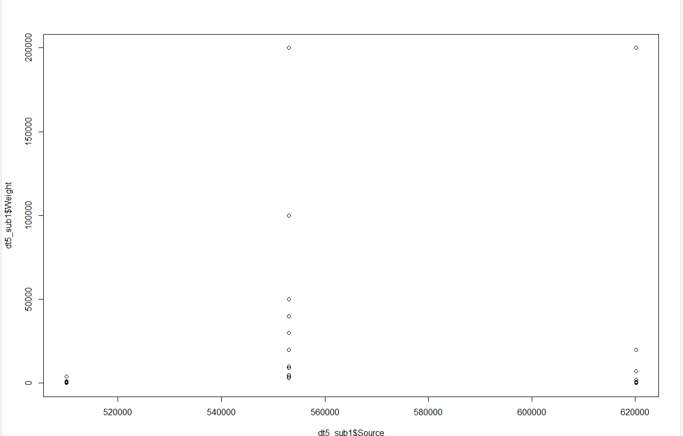
Income Categories (Source) v/s Weight (Money) Template:
Notes:
1st points: Gifts; 2nd points : Money Income Before Taxes; 3rd points: Personal Taxes

Slide 6
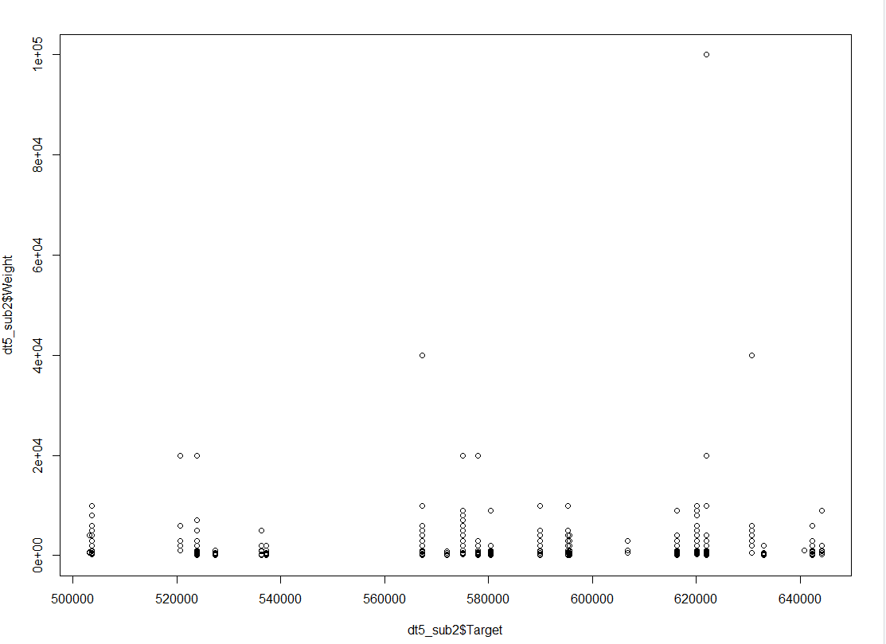
Expense Categories (Target) v/s Weight (Money) Template:
Notes:
503218(Natural Gas) 503701(Miscellaneous)
520660(Healthcare) 523927(Restaurants) 527449 (Alcohol) 536346(Home Maintenance) 537281(HouseKeeping)
567195 (Personal insurance and pensions) 571970(Reading) 575030 (Transportation) 577992 (Education)
580426 (Telephone services) 589943(Lodging away from home) 595298(Groceries) 595581(Donations)
606730(Entertainment) 616315(Apparel and services)
620120(Personal taxes) 621924(Mortgage payments) 630626(Rented dwellings) 632961(Personal care products and services)
640784(Tobacco) 642329(Household operations) 644226(Property taxes)

Slide 7
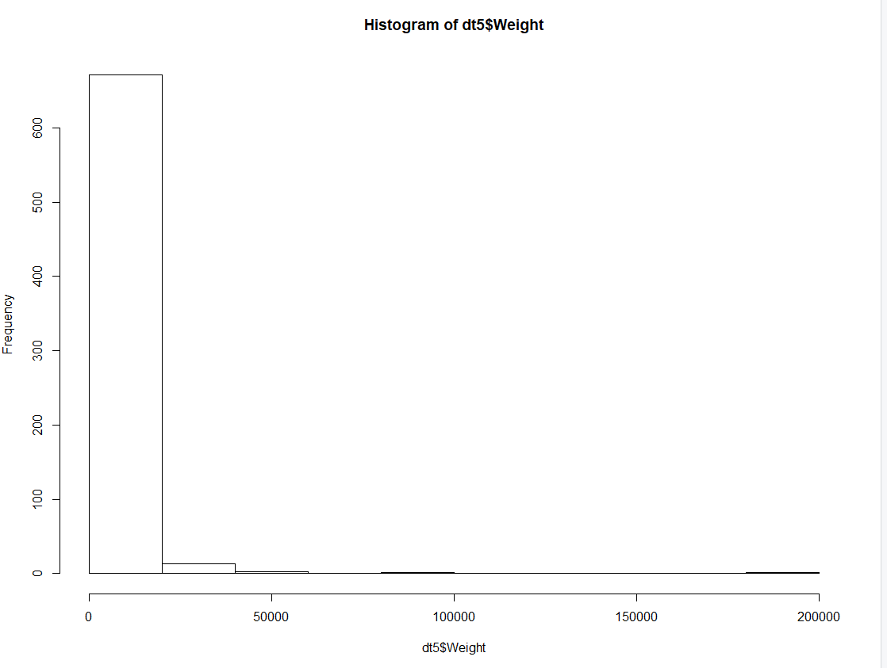
Weight Distribution Template:

Slide 8
Demographic Channel
For Graphs:
Source IDs, Target IDs, Time, Weights
No Source or Target Locations ,Latitude, Longitude Information
All columns with NA values were removed
Weights contain both Income and Expense categories.
The categories were filtered based on Source and Target IDs and the NodeIDs given in Demographic.csv
After extraction, number of:
Income Categories -> 3
Expense Categories -> 27 (including 1 common category (Personal Tax) with Incomes)
Weights represent money spent or received on/from each category
Range of Weights -> 0.46-900735

Slide 9
Income Categories (Source) v/s Weight (Money) Graph 1:
Notes:
1st points: Gifts; 2nd points : Money Income Before Taxes; 3rd points: Personal Taxes

Slide 10
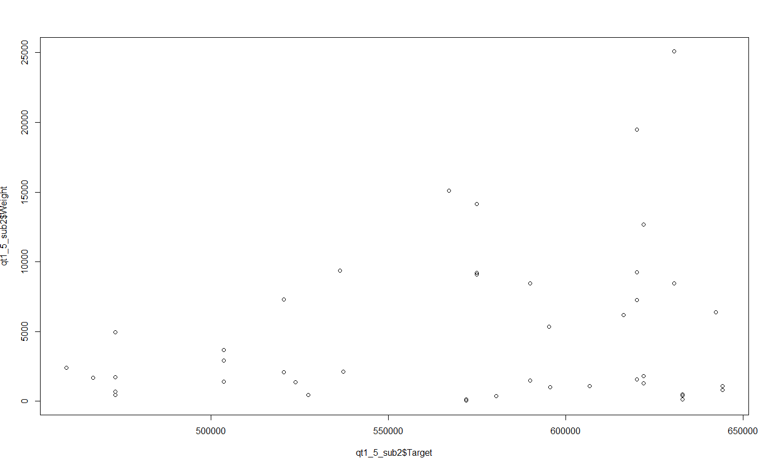
Expense Categories (Target) v/s Weight (Money) Graph1:

Slide 11
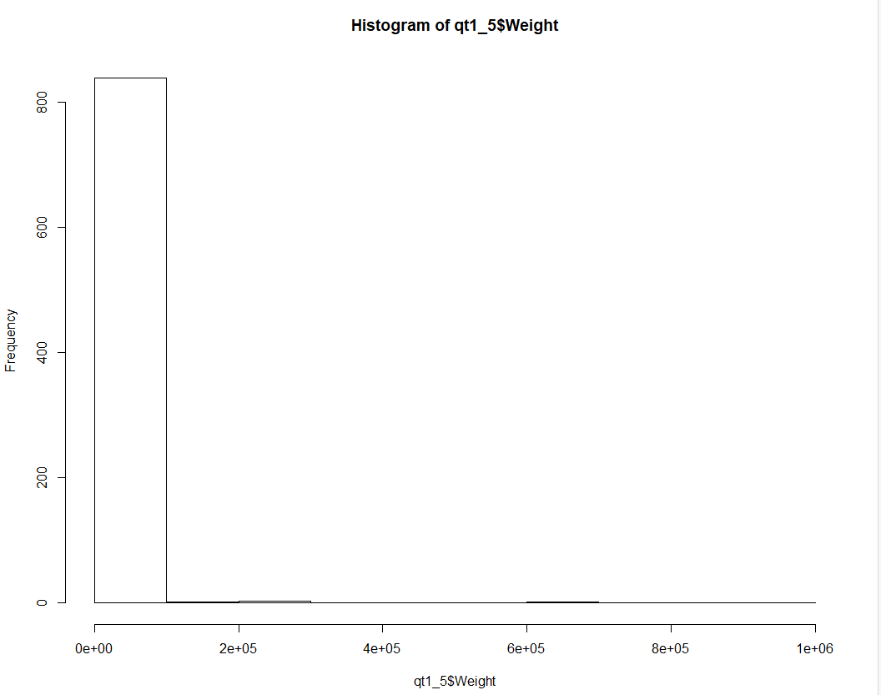
Weight Distribution Graph 1:
Notes:
How to normalise the weights for each channel?

Slide 12
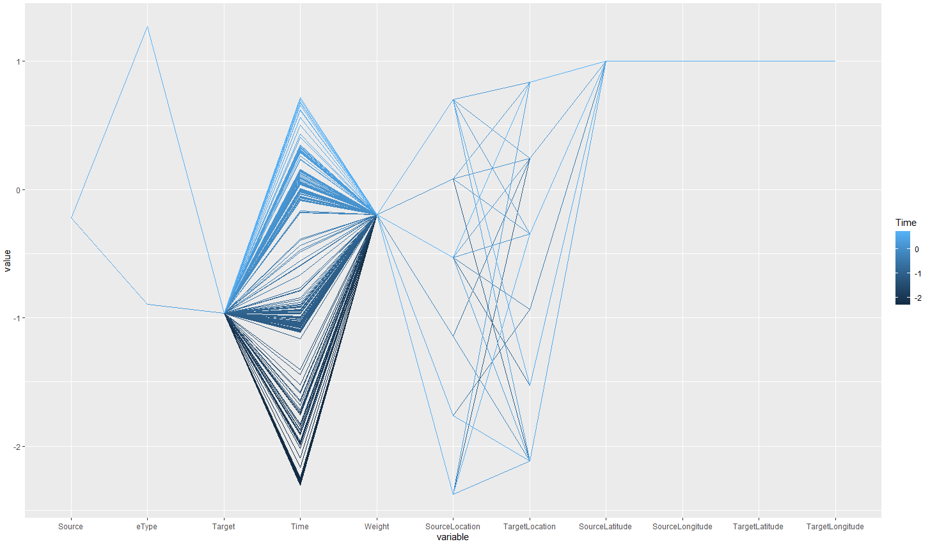
Parallel Coordinates Template:

Slide 13
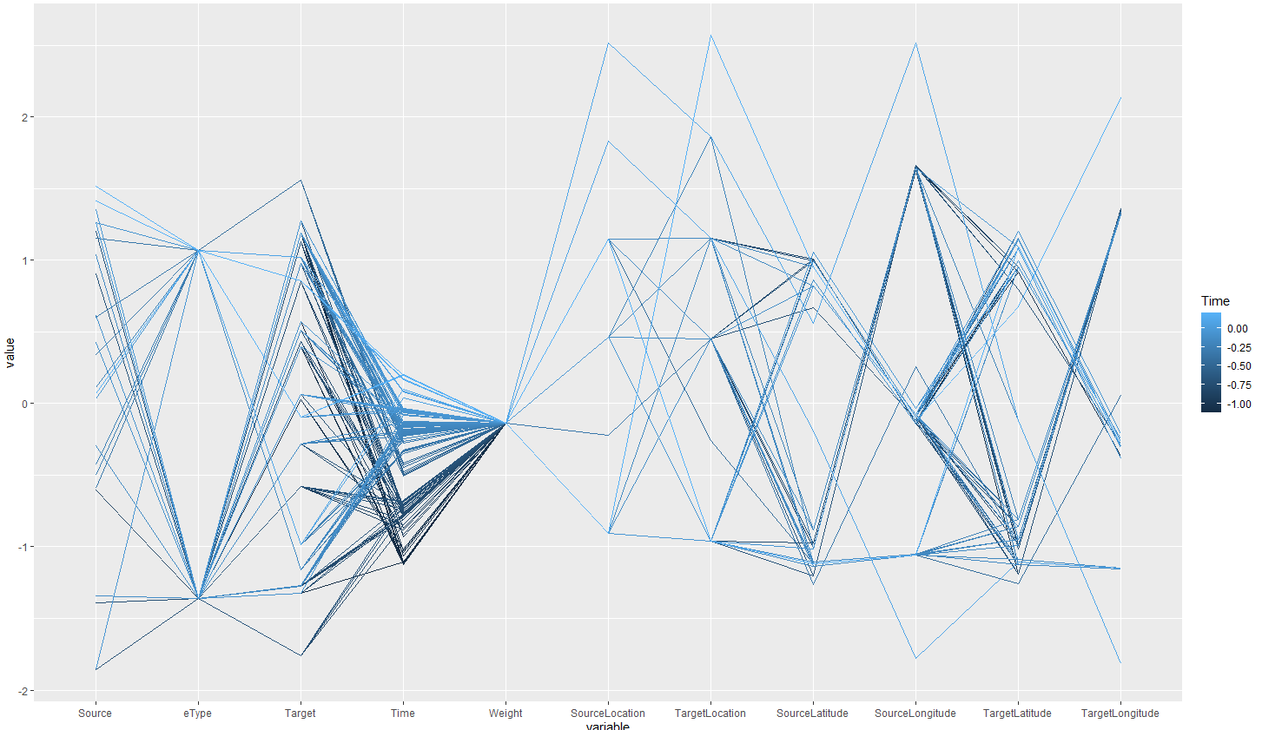
Parallel Coordinates Graph1:

Slide 14
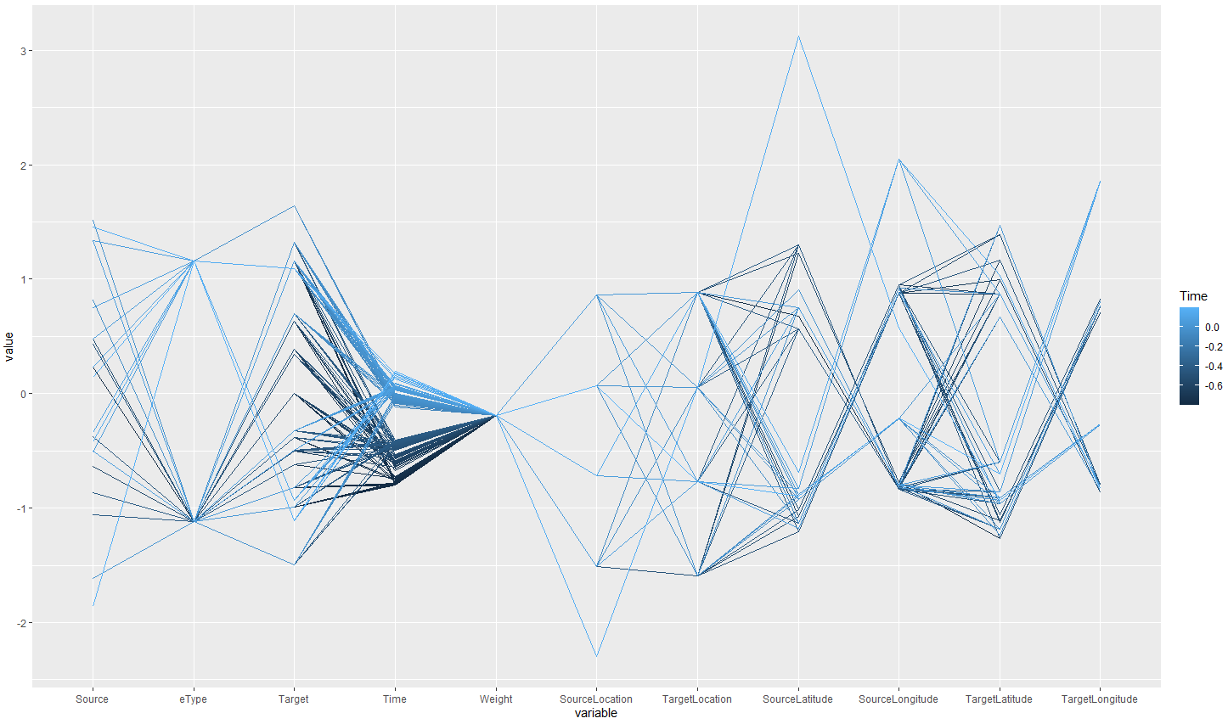
Parallel Coordinates Graph2:

Slide 15
Doubts
How to normalise the weights?
The Travel data is very ambiguous
How to compare 2 graphs
Should we create the parallel coordinates for each channel separately?

