Slide 1

VAST Challenge 2020
Mini-Challenge 1
Supervisor: Prof. Dr.-Ing. Bernhard Preim
Dr.-Ing. Monique Meuschke
M.Sc. Uli Niemann
Presenter: Seyed Behnam Beladi
Atrayee Neog
Xiongjun Wang (Cecilia)

Slide 2
Agenda
Introduction
Data and Tasks
Methodology
Task 1
Task 2
Task 3
Task 4
Results and Discussion
Conclusion

Slide 3
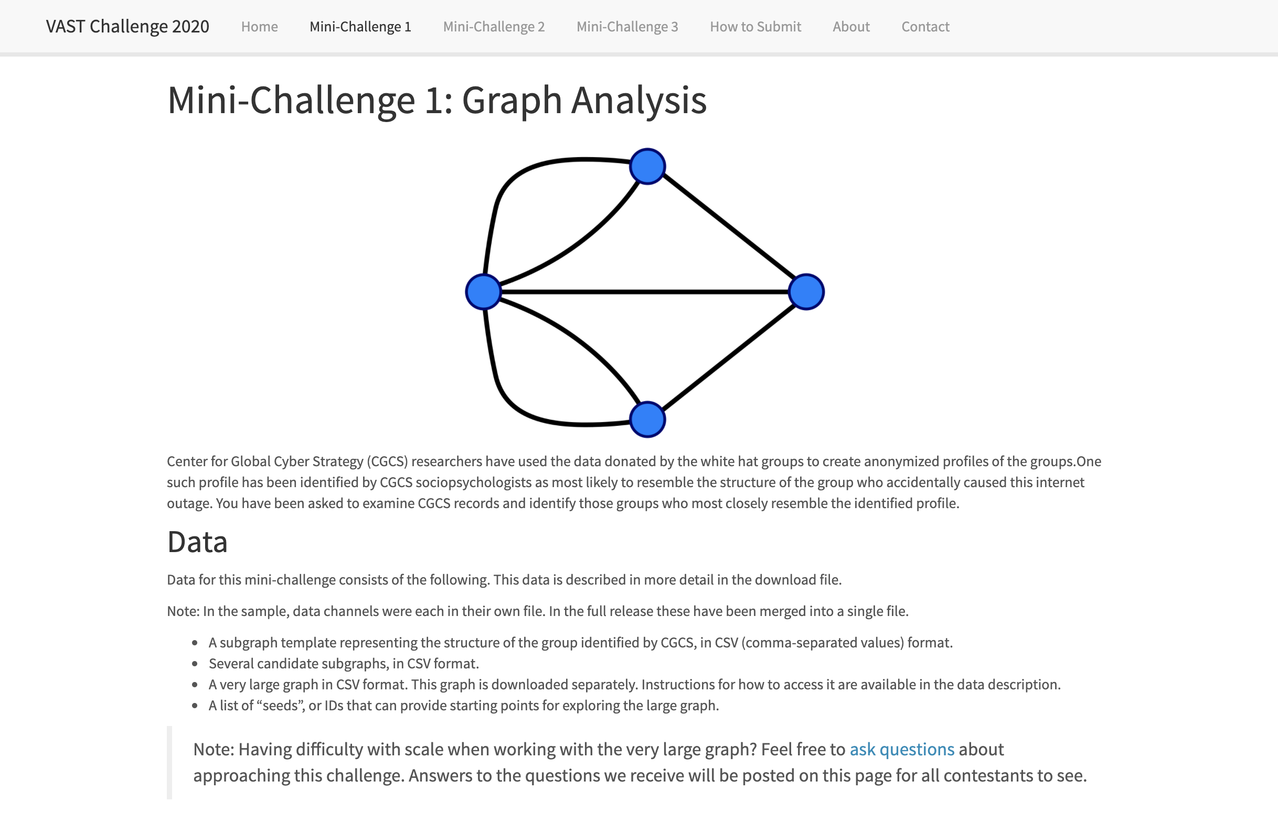
Introduction

Slide 4
Data Overview
A subgraph Template representing the structure of the group identified by CGCS;
5 candidate subgraphs are provided for comparison to the template;
3 Seed graphs are supplied as starting points for task2;
The BIG graph with 123,892,863 records, and uncompressed size of 6.2 GB;
Other supplement files:
GraphData-Nodetypes.csv
Template-Nodetypes.csv
DemographicCategories.csv
NodeTypeDescriptions.csv

Slide 5
Data Understanding
Channel Name | eType | Representation | Source | Target | Weight | Time | Location | Notable points
Communications (Phone and Email) | 0 & 1 | Direct connections between two persons | Person | Person | Always 1 | Yes | Some | Phone and email channels not clear
Procurement | 2 & 3 | Buying and selling an item | Person | Product | Value of the product | Yes | No | Each sale has a corresponding purchase at the same time
Co-authorship | 4 | Publication of scientific or technical articles | Person (Author) | Publication | Fraction of the authors | Yes (negative) | No | Date must be ignored (not relevant)
Demographics | 5 | Spending characteristics of a person | Person/ Category | Category/ Person | Money spent/ received | Yes (31536000) | No | 29 categories (spend/receive)
Travel | 6 | Connecting people with locations | Person | Location | Length of trip (days) | Yes (trip starts) | Yes | Some weights are negative

Slide 6
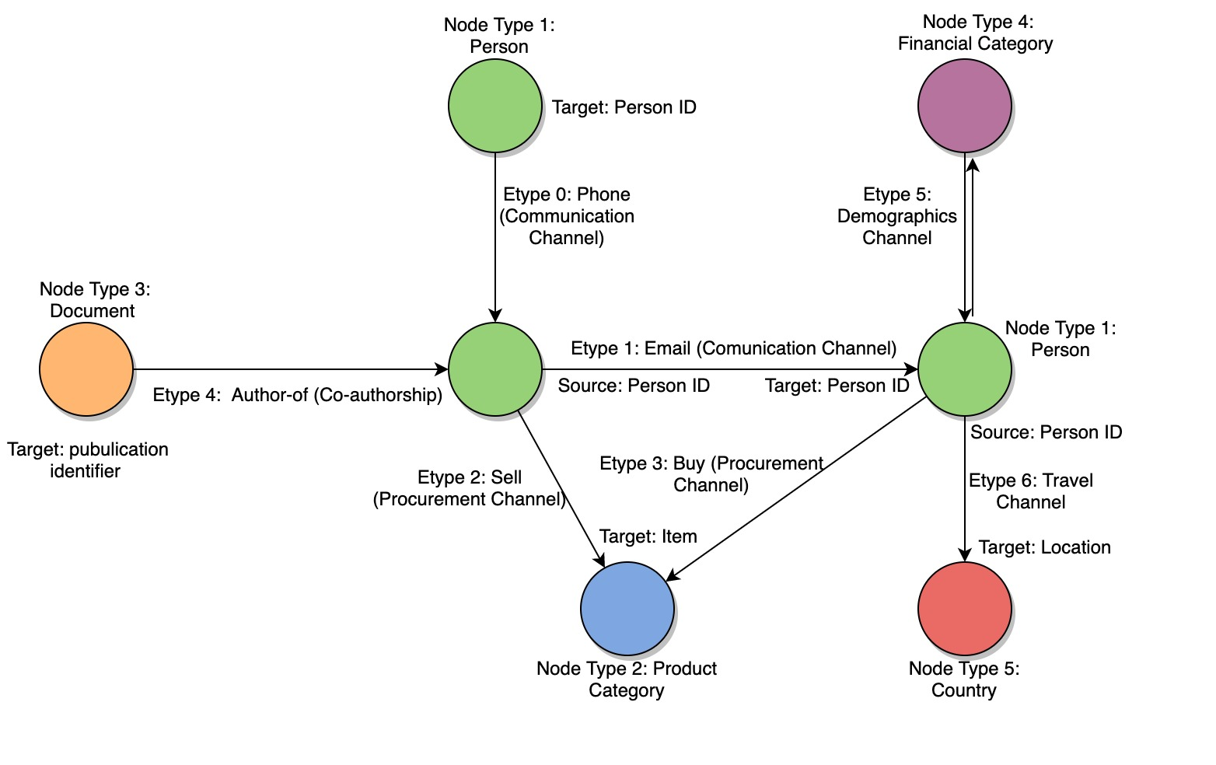
Data Understanding

Slide 7
Our Tasks

