Slide 1
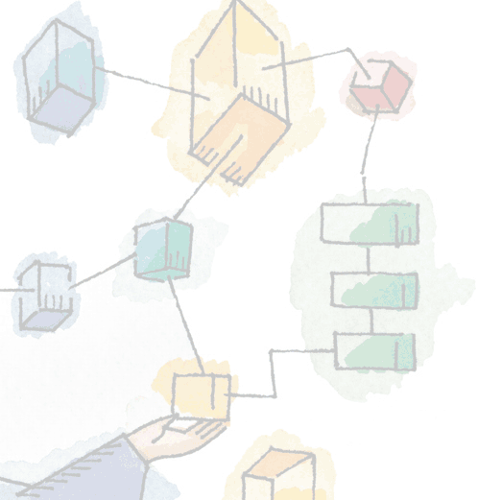
Chapter 11 I/O Management and Disk Scheduling
Operating Systems: Internals and Design Principles, 6/E William Stallings
Notes:
These slides are intended to help a teacher develop a presentation. This PowerPoint covers the entire chapter and includes too many slides for a single delivery. Professors are encouraged to adapt this presentation in ways which are best suited for their students and environment.

Slide 2
Roadmap
I/O Devices
Disk Scheduling
Raid
Notes:
Beginning with a brief discussion of I/O devices and the organization of the I/O functions.
Next examine operating system design issues, including design objectives, and the way in which the I/O function can be structured.
Then I/O buffering is examined;
The next sections of the chapter are devoted to magnetic disk I/O.
We begin by developing a model of disk I/O performance and then examine several techniques that can be used to enhance performance.

Slide 3
Categories of I/O Devices
Difficult area of OS design
Difficult to develop a consistent solution due to a wide variety of devices and applications
Three Categories:
Human readable
Machine readable
Communications

Slide 4
Human readable
Devices used to communicate with the user
Printers and terminals
Video display
Keyboard
Mouse etc
Notes:
Suitable for communicating with the computer user.
Examples include printers and terminals, the latter consisting of video display, keyboard, and perhaps other devices such as a mouse.

Slide 5
Machine readable
Used to communicate with electronic equipment
Disk drives
USB keys
Sensors
Controllers
Notes:
Suitable for communicating with electronic equipment.
Examples are disk drives, USB keys, sensors, controllers, and actuators.

Slide 6
Communication
Used to communicate with remote devices
Digital line drivers
Modems
Notes:
Suitable for communicating with remote devices.
Examples are digital line drivers and modems.

Slide 7
Differences in I/O Devices
Devices differ in a number of areas
Data Rate
Application
Complexity of Control
Unit of Transfer
Data Representation
Error Conditions
Notes:
Each of these are covered in subsequent slides
This diversity makes a uniform and consistent approach to I/O, both from the point of view of the operating system and from the point of view of user processes, difficult to achieve.

Slide 8
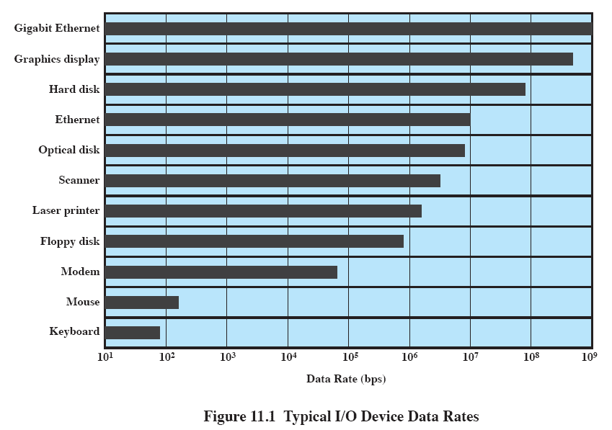
Data Rate
May be massive difference between the data transfer rates of devices
Notes:
There may be differences of several orders of magnitude between the data transfer rates.

Slide 9
Application
Disk used to store files requires file management software
Disk used to store virtual memory pages needs special hardware and software to support it
Terminal used by system administrator may have a higher priority
Notes:
The use to which a device is put has an influence on the software and policies in the operating system and supporting utilities.
Examples:
disk used for files requires the support of file management software.
disk used as a backing store for pages in a virtual memory scheme depends on the use of virtual memory hardware and software.
These applications have an impact on disk scheduling algorithms.
Another example, a terminal may be used by an ordinary user or a system administrator.
implying different privilege levels and perhaps different priorities in the operating system.

Slide 10
Complexity of control
A printer requires a relatively simple control interface.
A disk is much more complex.
Notes:
A printer requires a relatively simple control interface while a disk is much more complex.
This complexity is filtered to some extent by the complexity of the I/O module that controls the device.

Slide 11
Unit of transfer
Data may be transferred as
a stream of bytes or characters (e.g., terminal I/O)
or in larger blocks (e.g., disk I/O).
Notes:
Data may be transferred as a stream of bytes or characters (e.g., terminal I/O) or in larger blocks (e.g., disk I/O).

Slide 12
Data representation
Different data encoding schemes are used by different devices,
including differences in character code and parity conventions.
Notes:
Different data encoding schemes are used by different devices, including differences in character code and parity conventions.

Slide 13
Error Conditions
The nature of errors differ widely from one device to another.
Aspects include:
the way in which they are reported,
their consequences,
the available range of responses
Notes:
The nature of errors, the way in which they are reported, their consequences, and the available range of responses differ widely from one device to another.

Slide 14
Roadmap
I/O Devices
Disk Scheduling
Raid
Notes:
Over the last 40 years, the increase in the speed of processors and main memory has far outstripped that for disk access, with processor and main memory speeds increasing by about two orders of magnitude compared to one order of magnitude for disk.
The result is that disks are currently at least four orders of magnitude slower than main memory.
Thus, the performance of disk storage subsystem is of vital concern.
In this section, we highlight some of the key issues and look at the most important approaches.

Slide 15
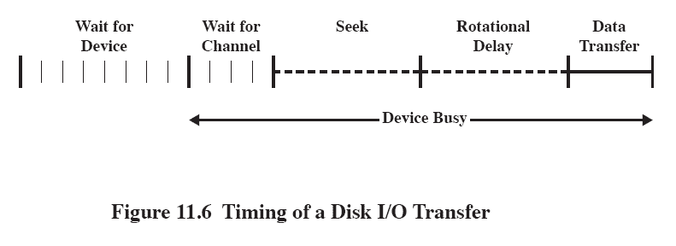
Disk Performance Parameters
The actual details of disk I/O operation depend on many things
A general timing diagram of disk I/O transfer is shown here.
Notes:
The actual details of disk I/O operation depend on the computer system, the operating system, and the nature of the I/O channel and disk controller hardware.
A general timing diagram of disk I/O transfer is shown in Figure 11.6.

Slide 16
Positioning the Read/Write Heads
When the disk drive is operating, the disk is rotating at constant speed.
Track selection involves moving the head in a movable-head system or electronically selecting one head on a fixed-head system.
Notes:
When the disk drive is operating, the disk is rotating at constant speed.
To read or write, the head must be positioned at the desired track and at the beginning of the desired sector on that track.
Track selection involves moving the head in a movable-head system or electronically selecting one head on a fixed-head system.

Slide 17
Disk Performance Parameters
Access Time is the sum of:
Seek time: The time it takes to position the head at the desired track
Rotational delay or rotational latency: The time its takes for the beginning of the sector to reach the head
Transfer Time is the time taken to transfer the data.
Notes:
Access Time is the sum of
Seek Time is the time it takes to position the head at the track.
Rotational delay is the time it takes for the beginning of the sector to reach the head
Once the head is in position, the read or write operation is then performed as the sector moves under the head;
this is the data transfer portion of the operation; the time required for the transfer is the transfer time.

Slide 18
Disk Scheduling Policies
To compare various schemes, consider a disk head is initially located at track 100.
assume a disk with 200 tracks and that the disk request queue has random requests in it.
The requested tracks, in the order received by the disk scheduler, are
55, 58, 39, 18, 90, 160, 150, 38, 184.

Slide 19
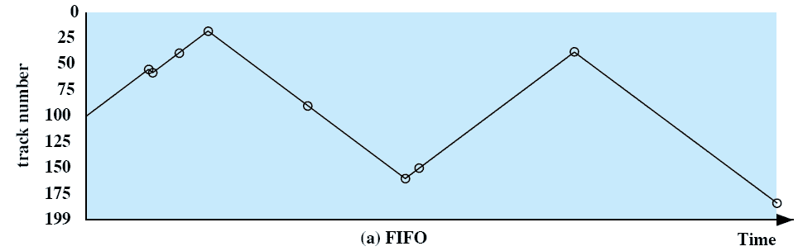
First-in, first-out (FIFO)
Process request sequentially
Fair to all processes
Approaches random scheduling in performance if there are many processes
Notes:
Movie icon jumps to animation at http://gaia.ecs.csus.edu/%7ezhangd/oscal/DiskApplet.html
The simplest form of scheduling is first-in-first-out (FIFO) scheduling, which processes items from the queue in sequential order.
This strategy has the advantage of being fair, because every request is honored and the requests are honored in the order received.
This figure illustrates the disk arm movement with FIFO.
This graph is generated directly from the data in Table 11.2a.
As can be seen, the disk accesses are in the same order as the requests were originally received.
With FIFO, if there are only a few processes that require access and if many of the requests are to clustered file sectors, then we can hope for good performance.
But, this technique will often approximate random scheduling in performance, if there are many processes competing for the disk.

Slide 20
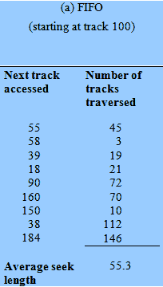
First-in, first-out (FIFO)
55, 58, 39, 18, 90, 160, 150, 38, 184.
Notes:
Movie icon jumps to animation at http://gaia.ecs.csus.edu/%7ezhangd/oscal/DiskApplet.html
The simplest form of scheduling is first-in-first-out (FIFO) scheduling, which processes items from the queue in sequential order.
This strategy has the advantage of being fair, because every request is honored and the requests are honored in the order received.
This figure illustrates the disk arm movement with FIFO.
This graph is generated directly from the data in Table 11.2a.
As can be seen, the disk accesses are in the same order as the requests were originally received.
With FIFO, if there are only a few processes that require access and if many of the requests are to clustered file sectors, then we can hope for good performance.
But, this technique will often approximate random scheduling in performance, if there are many processes competing for the disk.

Slide 21
Example
Given the following track requests in the disk queue, compute for the Total Head Movement (THM) of the read/write head:
95, 180, 34, 119, 11, 123, 62, 64
Consider that the read/write head is positioned at location 50.
Assume a disk with 200 tracks
Notes:
With a system based on priority (PRI), the control of the scheduling is outside the control of disk management software.
This is not intended to optimize disk utilization but to meet other objectives within the operating system.
Often short batch jobs and interactive jobs are given higher priority than longer jobs that require longer computation.
This allows a lot of short jobs to be flushed through the system quickly and may provide good interactive response time.
However, longer jobs may have to wait excessively long times.
Furthermore, such a policy could lead to countermeasures on the part of users, who split their jobs into smaller pieces to beat the system.
This type of policy tends to be poor for database systems.

Slide 22
Priority
Goal is not to optimize disk use but to meet other objectives
Short batch jobs may have higher priority
Provide good interactive response time
Longer jobs may have to wait an excessively long time
A poor policy for database systems
Notes:
With a system based on priority (PRI), the control of the scheduling is outside the control of disk management software.
This is not intended to optimize disk utilization but to meet other objectives within the operating system.
Often short batch jobs and interactive jobs are given higher priority than longer jobs that require longer computation.
This allows a lot of short jobs to be flushed through the system quickly and may provide good interactive response time.
However, longer jobs may have to wait excessively long times.
Furthermore, such a policy could lead to countermeasures on the part of users, who split their jobs into smaller pieces to beat the system.
This type of policy tends to be poor for database systems.

Slide 23
Last-in, first-out
Good for transaction processing systems
The device is given to the most recent user so there should be little arm movement
Possibility of starvation since a job may never regain the head of the line
Notes:
In transaction processing systems, giving the device to the most recent user should result in little or no arm movement for moving through a sequential file.

Slide 24
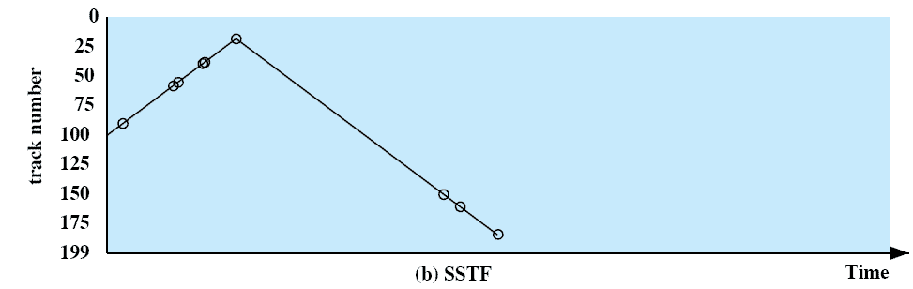
Shortest Service Time First
Select the disk I/O request that requires the least movement of the disk arm from its current position
Always choose the minimum seek time
Notes:
Select the disk I/O request that requires the least movement of the disk arm from its current position.
Thus, we always choose to incur the minimum seek time.
Always choosing the minimum seek time does not guarantee that the average seek time over a number of arm movements will be minimum.
However, this should provide better performance than FIFO.
Because the arm can move in two directions, a random tie-breaking algorithm may be used to resolve cases of equal distances.

Slide 25
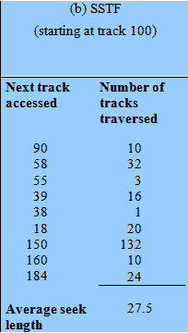
Shortest Service Time First
55, 58, 39, 18, 90, 160, 150, 38, 184.
Notes:
Select the disk I/O request that requires the least movement of the disk arm from its current position.
Thus, we always choose to incur the minimum seek time.
Always choosing the minimum seek time does not guarantee that the average seek time over a number of arm movements will be minimum.
However, this should provide better performance than FIFO.
Because the arm can move in two directions, a random tie-breaking algorithm may be used to resolve cases of equal distances.

Slide 26
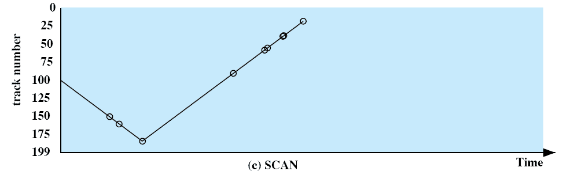
SCAN
Arm moves in one direction only, satisfying all outstanding requests until it reaches the last track in that direction then the direction is reversed
Notes:
With SCAN, the arm is required to move in one direction only, satisfying all outstanding requests en route, until it reaches the last track in that direction or until there are no more requests in that direction.
The service direction is then reversed and the scan proceeds in the opposite direction, again picking up all requests in order.
This latter refinement is sometimes referred to as the LOOK policy.
The SCAN policy favors jobs whose requests are for tracks nearest to both innermost and outermost tracks and favors the latest-arriving jobs.

Slide 27
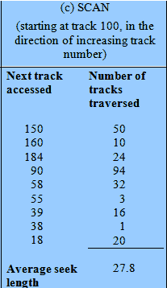
SCAN
55, 58, 39, 18, 90, 160, 150, 38, 184.
Notes:
With SCAN, the arm is required to move in one direction only, satisfying all outstanding requests en route, until it reaches the last track in that direction or until there are no more requests in that direction.
The service direction is then reversed and the scan proceeds in the opposite direction, again picking up all requests in order.
This latter refinement is sometimes referred to as the LOOK policy.
The SCAN policy favors jobs whose requests are for tracks nearest to both innermost and outermost tracks and favors the latest-arriving jobs.

Slide 28
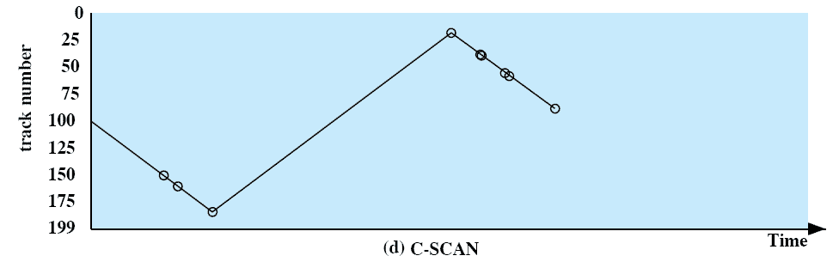
C-SCAN
Restricts scanning to one direction only
When the last track has been visited in one direction, the arm is returned to the opposite end of the disk and the scan begins again
Notes:
The C-SCAN (circular SCAN) policy restricts scanning to one direction only.
Thus, when the last track has been visited in one direction, the arm is returned to the opposite end of the disk and the scan begins again.
This reduces the maximum delay experienced by new requests.

Slide 29
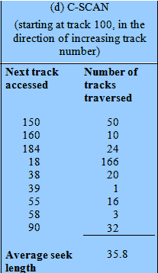
C-SCAN
55, 58, 39, 18, 90, 160, 150, 38, 184.
Notes:
The C-SCAN (circular SCAN) policy restricts scanning to one direction only.
Thus, when the last track has been visited in one direction, the arm is returned to the opposite end of the disk and the scan begins again.
This reduces the maximum delay experienced by new requests.

Slide 30
N-step-SCAN
Segments the disk request queue into subqueues of length N
Subqueues are processed one at a time, using SCAN
New requests added to other queue when queue is processed
Notes:
The N-step-SCAN policy segments the disk request queue into subqueues of length N.
Subqueues are processed one at a time, using SCAN.
While a queue is being processed, new requests must be added to some other queue.
If fewer than N requests are available at the end of a scan, then all of them are processed with the next scan.

Slide 31
FSCAN
Two subqueues
When a scan begins, all of the requests are in one of the queues, with the other empty.
All new requests are put into the other queue.
Service of new requests is deferred until all of the old requests have been processed.
Notes:
FSCAN is a policy that uses two subqueues.
When a scan begins, all of the requests are in one of the queues, with the other empty.
During the scan, all new requests are put into the other queue.
Thus, service of new requests is deferred until all of the old requests have been processed.

Slide 32
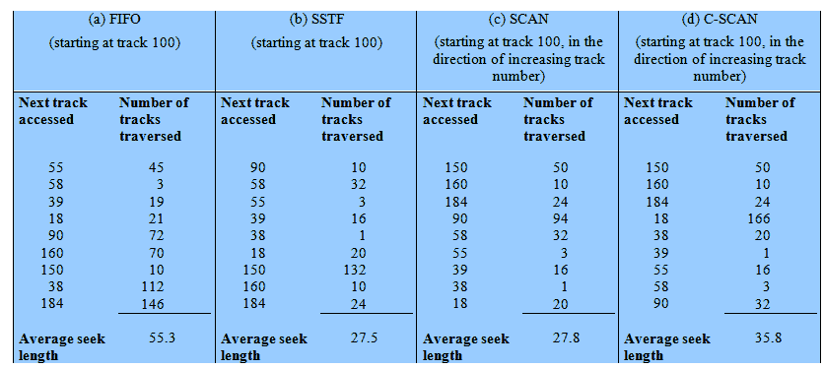
Performance Compared
Comparison of Disk Scheduling Algorithms
Notes:
T

Slide 33
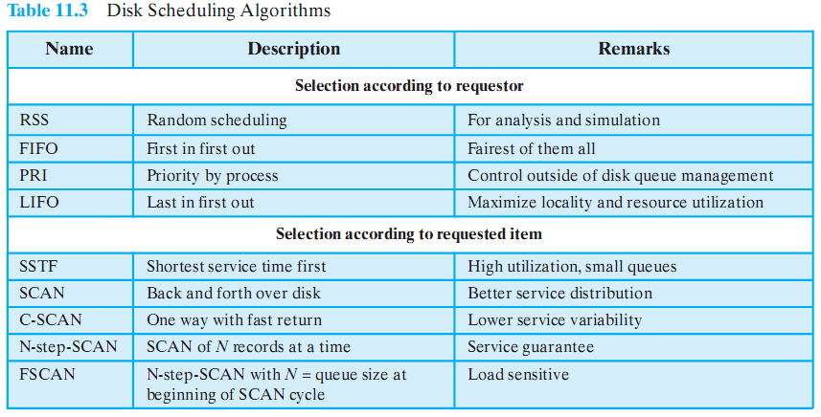
Disk Scheduling Algorithms

Slide 34
Roadmap
I/O Devices
Disk Scheduling
Raid

Slide 35
Multiple Disks
Disk I/O performance may be increased by spreading the operation over multiple read/write heads
Or multiple disks
Disk failures can be recovered if parity information is stored
Notes:
With multiple disks, separate I/O requests can be handled in parallel, as long as the data required reside on separate disks.
Also, a single I/O request can be executed in parallel if the block of data to be accessed is distributed across multiple disks.

Slide 36
RAID
Redundant Array of Independent Disks
Set of physical disk drives viewed by the operating system as a single logical drive
Data are distributed across the physical drives of an array
Redundant disk capacity is used to store parity information which provides recoverability from disk failure
Notes:
Movie icon links to animation at: http://gaia.ecs.csus.edu/%7ezhangd/oscal/RAIDFiles/RAID.htm
The RAID scheme consists of seven levels, zero through six.
These levels do not imply a hierarchical relationship but designate different design architectures that share three common characteristics:
1. RAID is a set of physical disk drives viewed by the operating system as a single logical drive.
2. Data are distributed across the physical drives of an array in a scheme known as striping, described subsequently.
3. Redundant disk capacity is used to store parity information, which guarantees data recoverability in case of a disk failure.

Slide 37
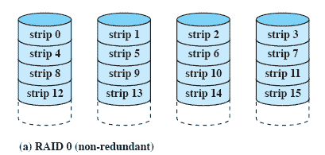
RAID 0 - Stripped
Not a true RAID – no redundancy
Disk failure is catastrophic
Very fast due to parallel read/write
Notes:
RAID level 0 is not a true member of the RAID family, because it does not include redundancy.
The advantage of this layout is that if a single I/O request consists of multiple logically contiguous strips, then up to n strips for that request can be handled in parallel, greatly reducing the I/O transfer time.

Slide 38
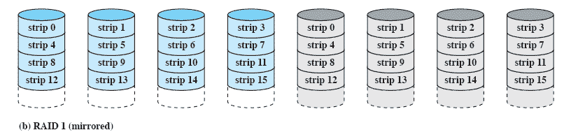
RAID 1 - Mirrored
Redundancy through duplication instead of parity.
Read requests can made in parallel.
Simple recovery from disk failure
Notes:
each logical strip is mapped to two separate physical disks so that every disk in the array has a mirror disk that contains the same data.
A read request can be serviced by either of the two disks that contains the requested data, whichever one involves the minimum seek time plus rotational latency.
A write request requires that both corresponding strips be updated, but this can be done in parallel.
Thus, the write performance is dictated by the slower of the two writes
Recovery from a failure is simple.
When a drive fails, the data may still be accessed from the second drive.

Slide 39
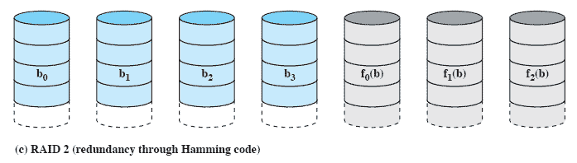
RAID 2 (Using Hamming code)
Synchronised disk rotation
Data stripping is used (extremely small)
Hamming code used to correct single bit errors and detect double-bit errors
Notes:
In a parallel access array, all member disks participate in the execution of every I/O request.
Typically, the spindles of the individual drives are synchronized so that each disk head is in the same position on each disk at any given time.
As in the other RAID schemes, data striping is used.
In the case of RAID 2 and 3, the strips are very small, often as small as a single byte or word.
With RAID 2, an error-correcting code is calculated across corresponding bits on each data disk, and the bits of the code are stored in the corresponding bit positions on multiple parity disks.
Typically, a Hamming code is used, which is able to correct single-bit errors and detect double-bit errors.

Slide 40
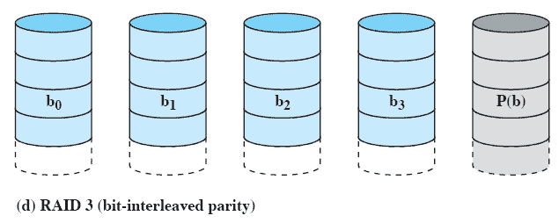
RAID 3 bit-interleaved parity
Similar to RAID-2 but uses all parity bits stored on a single drive
Notes:
RAID 3 is organized in a similar fashion to RAID 2.
The difference is that RAID 3 requires only a single redundant disk, no matter how large the disk array.
RAID 3 employs parallel access, with data distributed in small strips.
Instead of an error-correcting code, a simple parity bit is computed for the set of individual bits in the same position on all of the data disks.

Slide 41
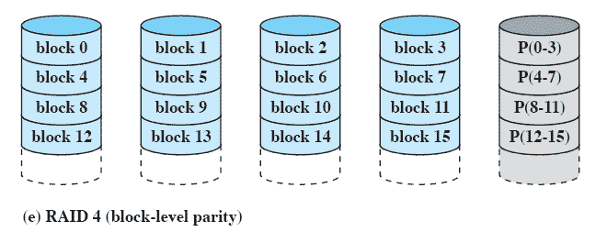
RAID 4 Block-level parity
A bit-by-bit parity strip is calculated across corresponding strips on each data disk
The parity bits are stored in the corresponding strip on the parity disk.
Notes:
A bit-by-bit parity strip is calculated across corresponding strips on each data disk,
and the parity bits are stored in the corresponding strip on the parity disk.

Slide 42
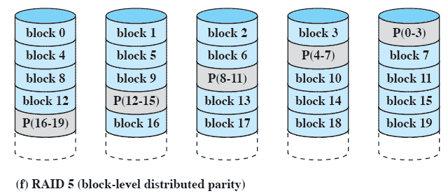
RAID 5 Block-level Distributed parity
Similar to RAID-4 but distributing the parity bits across all drives
Notes:
RAID 5 is organized in a similar fashion to RAID 4.
RAID 5 distributes the parity strips across all disks.
A typical allocation is a round-robin scheme
For an n-disk array, the parity strip is on a different disk for the first n stripes, and the pattern then repeats.
The distribution of parity strips across all drives avoids the potential I/O bottleneck of the single parity disk found in RAID 4.

Slide 43
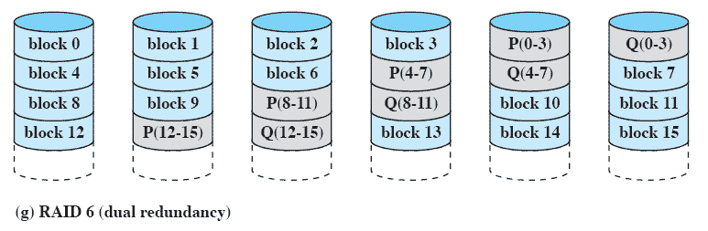
RAID 6 Dual Redundancy
Two different parity calculations are carried out
stored in separate blocks on different disks.
Can recover from two disks failing
Notes:
Two different parity calculations are carried out and stored in separate blocks on different disks.
Thus, a RAID 6 array whose user data require N disks consists of N+2 disks.
P and Q are two different data check algorithms.
One of the two is the exclusive-OR calculation used in RAID 4 and 5.
The other is an independent data check algorithm.
This makes it possible to regenerate data even if two disks containing user data fail.

