Slide 1
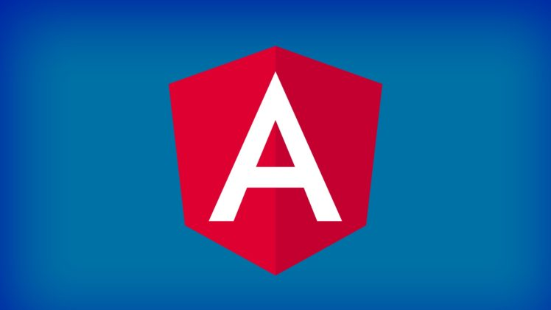
An Introduction to Angular

Slide 2
What is Angular & Why Angular?
Angular is a platform and framework that makes it easy to build applications in HTML and TypeScript.
Angular combines declarative templates, dependency injection, end to end tooling, and integrated best practices to solve development challenges.
Angular empowers developers to build applications that live on the web, mobile, or the desktop.

Slide 3
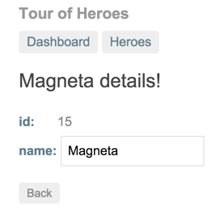
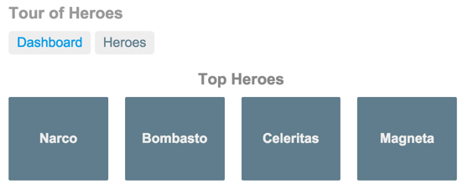
Tutorial: Tour of Heroes
The Tour of Heroes tutorial covers the fundamentals of Angular.

Slide 4
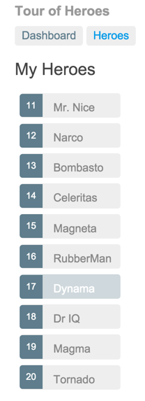
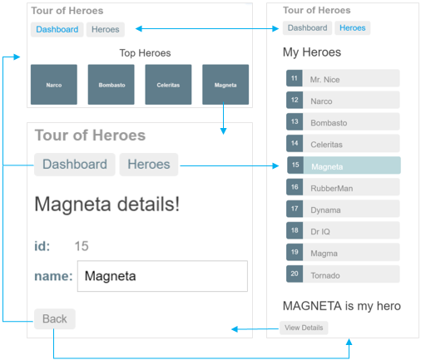

Slide 5
Introduction to modules
Angular apps are modular and Angular has its own modularity system called NgModules.
They can contain components, service providers, and other code files whose scope is defined by the containing NgModule.
They can import functionality that is exported from other NgModules, and export selected functionality for use by other NgModules.
Every Angular app has at least one NgModule class, the root module, which is conventionally named AppModule and resides in a file named app.module.ts. You launch your app by bootstrapping the root NgModule.
While a small application might have only one NgModule, most apps have many more feature modules. The rootNgModule for an app is so named because it can include child NgModules in a hierarchy of any depth.

Slide 6
An NgModule is defined by a class decorated with @NgModule(). The @NgModule() decorator is a function that takes a single metadata object, whose properties describe the module. The most important properties are as follows -
declarations: The components, directives, and pipes that belong to this NgModule.
exports: The subset of declarations that should be visible and usable in the component templates of other NgModules.
imports: Other modules whose exported classes are needed by component templates declared in thisNgModule.
providers: Creators of services that this NgModule contributes to the global collection of services; they become accessible in all parts of the app. in HTML and TypeScript.
bootstrap: The main application view, called the root component, which hosts all other app views. Only the root NgModule should set the bootstrap property.

Slide 7
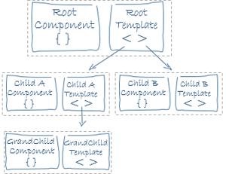
Introduction to components
A component controls a patch of screen called a view.
Angular creates, updates, and destroys components as the user moves through the application using lifecycle hooks.
The @Component decorator identifies the class immediately below it as a component class, and specifies its metadata.
You define a component's view with its companion template. A template is a form of HTML that tells Angular how to render the component.
Views are typically arranged hierarchically, allowing you to modify or show and hide entire UI sections or pages as a unit. The template immediately associated with a component defines that component's host view. The component can also define a view hierarchy, which contains embedded views, hosted by other components.

Slide 8
Lifecycle sequence
Hook | Purpose and Timing
ngOnChanges() | Respond when Angular (re)sets data-bound input properties. The method receives a SimpleChanges object of current and previous property values. Called before ngOnInit() and whenever one or more data-bound input properties change.
ngOnInit() | Initialize the directive/component after Angular first displays the data-bound properties and sets the directive/component's input properties. Called once, after the first ngOnChanges().
ngDoCheck() | Detect and act upon changes that Angular can't or won't detect on its own. Called during every change detection run, immediately after ngOnChanges()and ngOnInit().
ngAfterContentInit() | Respond after Angular projects external content into the component's view / the view that a directive is in. Called once after the first ngDoCheck().
ngAfterContentChecked() | Respond after Angular checks the content projected into the directive/component. Called after the ngAfterContentInit() and every subsequent ngDoCheck().
ngAfterViewInit() | Respond after Angular initializes the component's views and child views / the view that a directive is in. Called once after the first ngAfterContentChecked().
ngAfterViewChecked() | Respond after Angular checks the component's views and child views / the view that a directive is in. Called after the ngAfterViewInit() and every subsequent ngAfterContentChecked().
ngOnDestroy() | Cleanup just before Angular destroys the directive/component. Unsubscribe Observables and detach event handlers to avoid memory leaks. Called just before Angular destroys the directive/component.

Slide 9
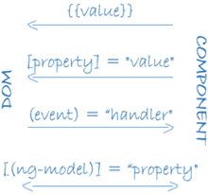
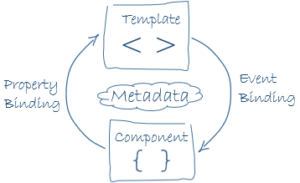
Data Binding
Angular supports two-way data binding, a mechanism for coordinating the parts of a template with the parts of a component. Add binding markup to the template HTML to tell Angular how to connect both sides.
The following diagram shows the four forms of data binding markup. Each form has a direction: to the DOM, from the DOM, or both.
Angular processes all data bindings once for each JavaScript event cycle, from the root of the application component tree through all child components.

Slide 10
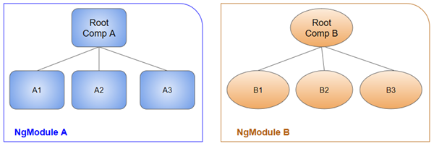
NgModules and components
NgModules provide a compilation context for their components. A root NgModule always has a root component that is created during bootstrap, but any NgModule can include any number of additional components, which can be loaded through the router or created through the template. The components that belong to an NgModule share a compilation context.

Slide 11
Routing & Navigation
The Angular Router enables navigation from one view to the next as users perform application tasks.
A routed Angular application has one singleton instance of the Router service. When the browser's URL changes, that router looks for a corresponding Route from which it can determine the component to display.
<base href>
Most routing applications should add a <base> element to the index.html as the first child in the <head> tag to tell the router how to compose navigation URLs.
Router imports
The Angular Router is an optional service that presents a particular component view for a given URL. It is not part of the Angular core. It is in its own library package, @angular/router. Import what you need from it as you would from any other Angular package.

Slide 12
Configuration
A router has no routes until you configure it. The following example creates five route definitions, configures the router via the RouterModule.forRoot() method, and adds the result to the AppModule's imports array.
Router outlet
The RouterOutlet is a directive from the router library that is used like a component. It acts as a placeholder that marks the spot in the template where the router should display the components for that outlet.
Router links
Now you have routes configured and a place to render them, but how do you navigate? The URL could arrive directly from the browser address bar. But most of the time you navigate as a result of some user action such as the click of an anchor tag.

Slide 13
Pipes
Angular pipes let you declare display-value transformations in your template HTML.
A class with the @Pipe decorator defines a function that transforms input values to output values for display in a view.
Angular defines various pipes, such as the date pipe and currency pipe; for a complete list, see the Pipes API list. You can also define new pipes.
To specify a value transformation in an HTML template, use the pipe operator (|).

Slide 14
Introduction to services
Service is a broad category encompassing any value, function, or feature that an app needs. A service is typically a class with a narrow, well-defined purpose. It should do something specific and do it well.
Angular distinguishes components from services to increase modularity and reusability. By separating a component's view-related functionality from other kinds of processing, you can make your component classes lean and efficient.
A component can delegate certain tasks to services, such as fetching data from the server, validating user input, or logging directly to the console.
By defining such processing tasks in an injectable service class, you make those tasks available to any component. You can also make your app more adaptable by injecting different providers of the same kind of service, as appropriate in different circumstances.

Slide 15

Dependency injection (DI)
DI is wired into the Angular framework and used everywhere to provide new components with the services or other things they need. Components consume services; that is, you can inject a service into a component, giving the component access to that service class.
Use the @Injectable() decorator to indicate that a component or other class (such as another service, a pipe, or an NgModule) has a dependency.

Slide 16
The injector is the main mechanism. Angular creates an application-wide injector for you during the bootstrap process, and additional injectors as needed. You don't have to create injectors.
An injector creates dependencies, and maintains a container of dependency instances that it reuses if possible.
A provider is an object that tells an injector how to obtain or create a dependency.
For any dependency that you need in your app, you must register a provider with the app's injector, so that the injector can use the provider to create new instances. For a service, the provider is typically the service class itself.
A dependency doesn't have to be a service—it could be a function, for example, or a value.

Slide 17
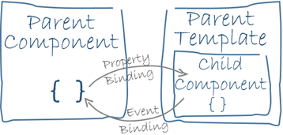
Component Interaction
Data binding plays an important role in communication between a template and its component, and is also important for communication between parent and child components.
Pass data from parent to child
Using @input binding
Using @input setter
Using ngOnChanges()
Parent listens for child event
Using @output event emitter
Using @ViewChild() call
Parent and children communicate via a service

Slide 18
HttpClient
Most front-end applications communicate with backend services over the HTTP protocol. The HttpClient in @angular/common/http offers a simplified client HTTP API for Angular applications. Additional benefits of HttpClient include testability features, typed request and response objects, request and response interception, Observable apis, and streamlined error handling.
Before you can use the HttpClient, you need to import the Angular HttpClientModule.
Having imported HttpClientModule into the AppModule, you can inject the HttpClient into an application class.
Applications often request JSON data from the server.
Because the service method returns an Observable of configuration data, the component subscribes to the method's return value. The subscription callback copies the data fields into the component's config object, which is data-bound in the component template for display.

