Slide 1
Smoothing in NLP
Page 1

Slide 2
Smoothing
To keep a language model from assigning zero probability to these unseen events, we’ll have to shave off a bit of probability mass from some more frequent events and give it to the events we’ve never seen.
This modification is called smoothing or discounting.
Add-1 smoothing,
Add-k smoothing,
Backoff, and Kneser-Ney smoothing.
Page 2

Slide 3
Add-one Smoothing
For unigrams:
Add 1 to every word (type) count
Normalize by N (tokens) /(N (tokens) +V (types))
Smoothed count (adjusted for additions to N) is
⎜ci +1⎟
⎝ ⎠
⎞ N
⎛
N +V
Normalize by N to get the new unigram probability:
_{p}*₌ ci +1
i
N +V
_{P(z | xy) ≈} C( xyz ) + 1
C( xy) + V
_{P(z | xy) ≈} C( xyz ) + δ
Add delta smoothing
C( xy) + δV
Page 3

Slide 4
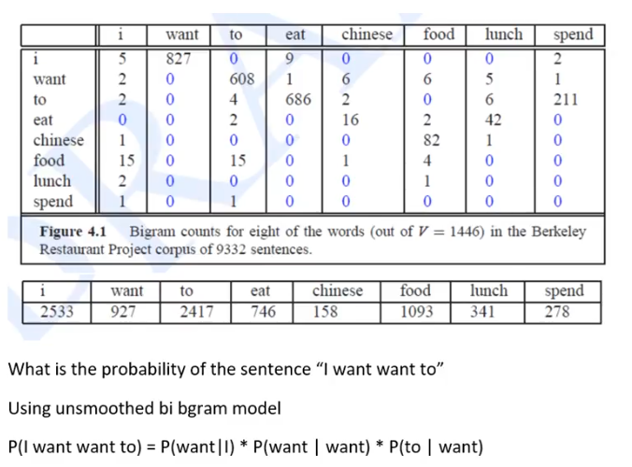

Slide 5
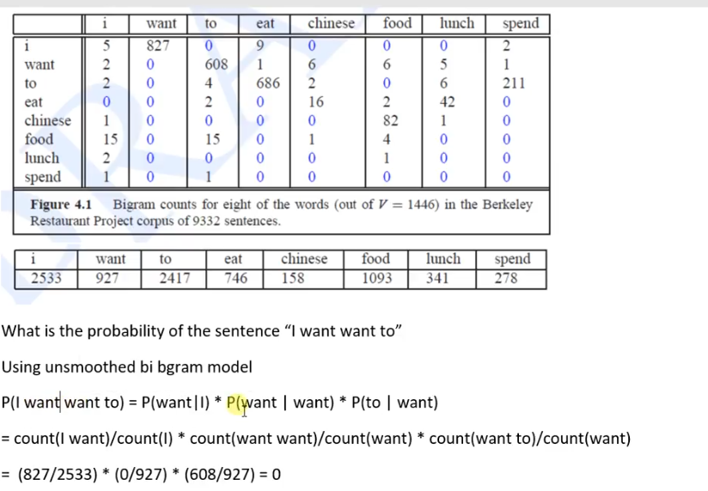

Slide 6
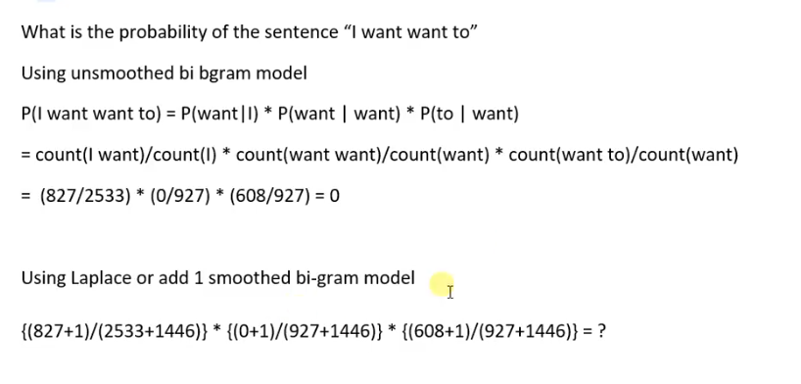

Slide 7
can you tell me about any good cantonese restaurants close by
mid priced thai food is what i’m looking for tell me about chez panisse
Berkeley Restaurant Project Sentences
can you give me a listing of the kinds of food that are available
i’m looking for a good place to eat breakfast when is caffe venezia open during the day
9/24/2019
4

Slide 8
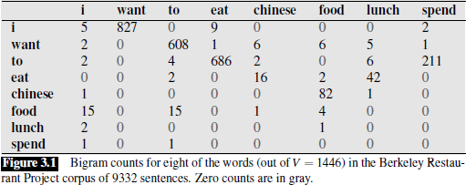

Slide 9
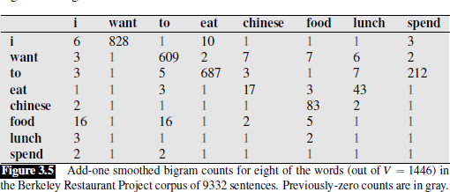

Slide 10
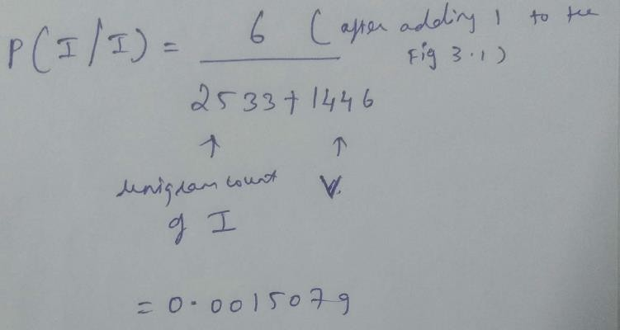

Slide 11
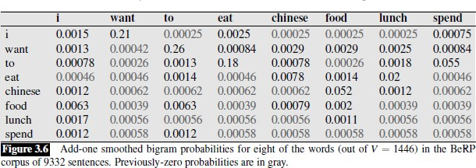

Slide 12

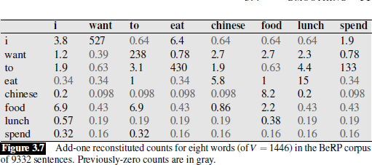

Slide 13
Note that add-one smoothing has made a very big change to the counts. C(want|to) changed from 608 to 238!
We can see this in probability space as well: P(to|want) decreases from .66 in the unsmoothed case to .26 in the smoothed case.

