Slide 1
Inheritance
DAT
TA
Presented
By
L.Atri Datta Ravi Tez
Assistant Professor
Department of CSE

Slide 2
Declaration of an Arrays
DAT
TA
Declaration of an array without initialization:
You can declare an array without initializing it with values, but you need to specify the type and size later:
// Declare an array of integers
int[] myarray;
// initialize the array with a size of 5
myarray = new int[5];

Slide 3
Declaration of an Arrays
DAT
TA
Declaring and initializing an array
You can declare and initialize an array in a single line by specifying the elements:
// Declare and initialize an array of integers
Int[] myarray = {1, 2, 3, 4, 5};
Specifying the Array Size
You can declare an array and initialize it later by specifying its size:
// Declare an array of integers with a size of 5 int[] myarray = new int[5];

Slide 4
Declaration of an Arrays
DAT
TA
Multi-Dimensional Arrays
Java also supports multi-dimensional arrays. Here’s an example of a two-dimensional array:
// Declare and initialize a 2D array
Int[][] matrix = { {1, 2, 3}, {4, 5, 6}, {7, 8, 9} };

Slide 5
Arrays
DAT
TA
Storage of array in computer memory
Arrays in java are stored as contiguous blocks of memory. Each element’s address can be computed from the base address of the array and its index. Java handles memory management for arrays through garbage collection.
Accessing elements of arrays
Elements are accessed using their index, with indices starting from 0:
Int value = arr[2]; // accesses the third element of the array arr[0] = 10; // sets the first element to 10

Slide 6
Arrays
DAT
TA
Assigning array to another array
In java, assigning one array to another does not copy the elements but rather copies the reference:
Int[] arr1 = {1, 2, 3}; int[] arr2 = arr1; // arr2 now refers to the same array as arr1
To copy the contents, use system.Arraycopy or arrays.Copyof:
Int[] arr2 = arrays.Copyof(arr1, arr1.Length);

Slide 7
Arrays
DAT
TA
Operations on array elements
Common operations include:
Traversal: using a loop to visit each element.Javacopy code
For (int i = 0; i < arr.Length; i++) { system.Out.Println(arr[i]); }
Insertion: inserting elements is not directly supported in fixed-size arrays; you'd need to create a new array or use a list.
Deletion: similar to insertion, you’d generally need to create a new array.
Updating: changing the value at a specific index

Slide 8
Arrays
DAT
TA
Dynamic change of array size
Java arrays are fixed in size. For dynamic resizing, use collections like arraylist: import java.Util.Arraylist;
arraylist<integer> list = new arraylist<>();
list.Add(10);
list.Add(20);

Slide 9
Arrays
DAT
TA
Sorting of arrays
Java provides built-in methods to sort arrays via the arrays class:
Import java.Util.Arrays; int[] arr = {5, 3, 8, 1};
arrays.Sort(arr); // sorts the array in ascending order

Slide 10
Arrays
DAT
TA
Search for values in arrays
Java's arrays class includes search methods:
Linear search: use arrays.Binarysearch for sorted arrays
Int index = arrays.Binarysearch(arr, 3); // finds the index of value 3
Class arrays
Arrays can be used within classes to store collections of objects:

Slide 11
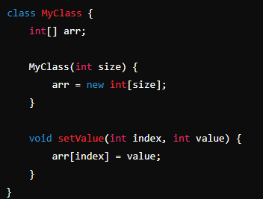
Arrays
DAT
TA

Slide 12
Arrays
DAT
TA
Two-dimensional arrays
A two-dimensional array is an array of arrays, useful for representing matrices:
Int[][] matrix = new int[3][4]; // A 3x4 matrix
matrix[1][2] = 7; // sets the value at row 1, column 2 to 7

Slide 13
Arrays
DAT
TA
Arrays of varying lengths
In java, arrays of varying lengths are called "jagged arrays" or "ragged arrays." They are arrays of arrays where each sub-array can have a different length:
Int[][] jaggedarray = new int[3][];
jaggedarray[0] = new int[2];
jaggedarray[1] = new int[3];
jaggedarray[2] = new int[4];

Slide 14
Arrays
DAT
TA
Three-dimensional arrays
A three-dimensional array is an array of arrays of arrays, often used for complex data structures like 3D matrices:
Int[][][] threedarray = new int[3][4][5]; // A 3x4x5 3D array
Threedarray[0][1][2] = 10; // sets a value at a specific position
Arrays as vectors
In java, the vector class is a dynamic array implementation:
Import java.Util.Vector; vector<integer> vector = new vector<>(); vector.Add(10); vector.Add(20);

Slide 15
Inheritance
DAT
TA
Inheritance in java is a mechanism in which one object acquires all the properties and behaviors of a parent object.
The idea behind inheritance in java is that you can create new classes that are built upon existing classes. When you inherit from an existing class, you can reuse methods and fields of the parent class. Moreover, you can add new methods and fields in your current class also.
Inheritance represents the is-a relationship which is also known as a parent-child relationship.

Slide 16
Inheritance
DAT
TA
For method overriding (so runtime polymorphism can be achieved).
For code reusability.
Class: a class is a group of objects which have common properties. It is a template or blueprint from which objects are created.
Sub class/child class: subclass is a class which inherits the other class. It is also called a derived class, extended class, or child class.
Super class/parent class: superclass is the class from where a subclass inherits the features. It is also called a base class or a parent class.

Slide 17
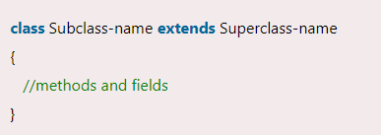
Inheritance
DAT
TA

Slide 18
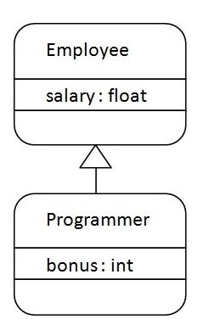
Extend Keyword
DAT
TA
The extends keyword indicates that you are making a new class that derives from an existing class.
The meaning of "extends" is to increase the functionality.

Slide 19
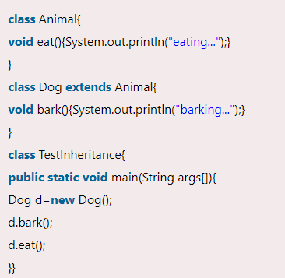
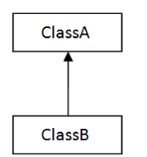
Types of Inheritance
DAT
TA
Single Inheritance:-When a class inherits another class, it is known as a single inheritance.

Slide 20
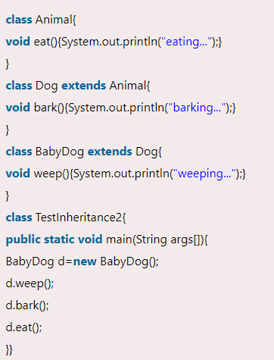
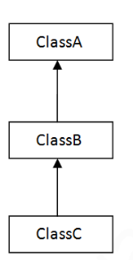
Types of Inheritance
DAT
TA
Multilevel Inheritance:-When There Is A Chain Of Inheritance, It Is Known As Multilevel Inheritance.

Slide 21
Types of Inheritance
DAT
TA
Hierarchical Inheritance:-When two or more classes inherits a single class, it is known as hierarchical inheritance.
In the example given below, dog and cat classes inherits the animal class, so there is hierarchical inheritance.

Slide 22
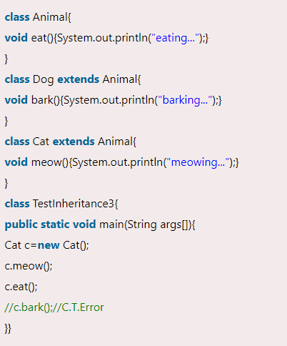
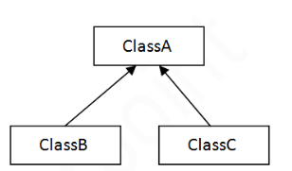
Types of Inheritance
DAT
TA

Slide 23
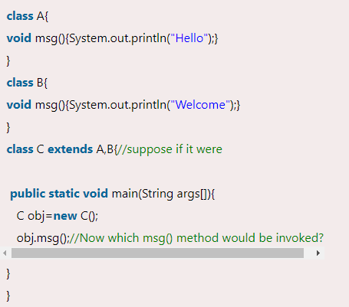
Types of Inheritance
DAT
TA
Why multiple inheritance is not supported in java
Consider A scenario where A, B, and C are three classes. The C class inherits A and B classes. If A and B classes have the same method and you call it from child class object, there will be ambiguity to call the method of A or B class.
Since compile-time errors are better than runtime errors, java renders compile-time error if you inherit 2 classes. So whether you have same method or different, there will be compile time error.

Slide 24
Inhibiting Inheritance of Class Using Final
DAT
TA
The final keyword is final that is we cannot change.
We can use final keywords for variables, methods, and class.
If we use the final keyword for the inheritance that is if we declare any method with the final keyword in the base class so the implementation of the final method will be the same as in derived class.
We can declare the final method in any subclass for which we want that if any other class extends this subclass.

Slide 25
Inhibiting Inheritance of Class Using Final
DAT
TA
The final keyword is final that is we cannot change.
We can use final keywords for variables, methods, and class.
If we use the final keyword for the inheritance that is if we declare any method with the final keyword in the base class so the implementation of the final method will be the same as in derived class.
We can declare the final method in any subclass for which we want that if any other class extends this subclass.

Slide 26
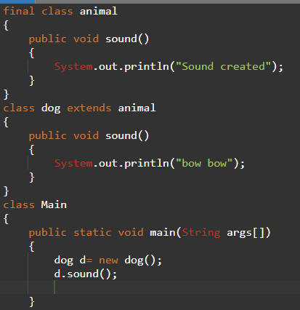
Inhibiting Inheritance of Class Using Final
DAT
TA

Slide 27
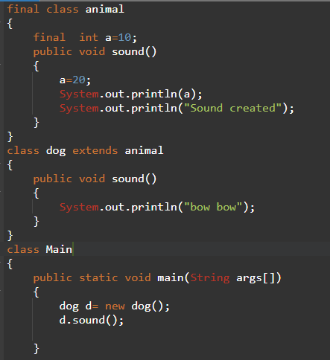
Inhibiting Inheritance of Class Using Variable Final
DAT
TA

Slide 28
Access Control of Inheritance
DAT
TA
Public access: members (methods and properties) declared as public are accessible from anywhere.
In the context of inheritance, public members of a parent class can be accessed by any subclass and also by any other class that has an instance of the subclass.

Slide 29
Access Control of Inheritance
DAT
TA
Protected access: members declared as protected are accessible within the class in which they are declared and by any subclass derived from that class.
Protected members are not accessible from outside these classes, making them suitable for scenarios where a class needs to expose some functionality to its subclasses but keep it hidden from other parts of the program.

Slide 30
Access Control of Inheritance
DAT
TA
Private access: members declared as private are only accessible within the class that declares them.
Private members cannot be accessed directly by subclasses.
However, subclasses can access private members through public or protected methods of the parent class if such methods are provided.

Slide 31
Access Control of Inheritance
DAT
TA
Package-private or default access: in some languages like java, if no access modifier is specified, members have package-private access by default.
This means they are accessible to other classes in the same package but not to classes in different packages.

Slide 32
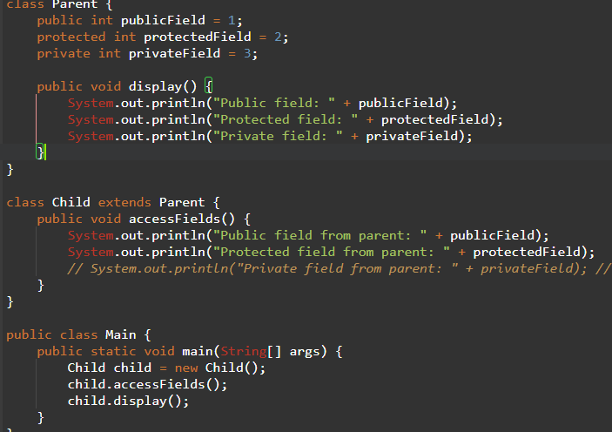
Access Control of Inheritance
DAT
TA

Slide 33
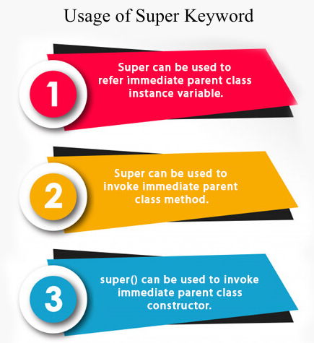
Super Class
DAT
TA
The super keyword in java is a reference variable which is used to refer immediate parent class object.
Whenever you create the instance of subclass, an instance of parent class is created implicitly which is referred by super reference variable.

Slide 34
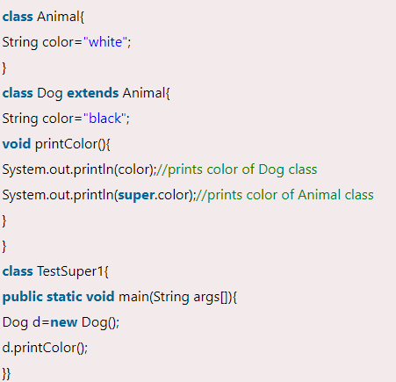
Super Class
DAT
TA
We can use super keyword to access the data member or field of parent class. It is used if parent class and child class have same fields.

Slide 35
Super Class-Variable
DAT
TA
We can use super keyword to access the data member or field of parent class. It is used if parent class and child class have same fields.
Animal and Dog both classes have a common property color. If we print color
Animal and Dog both classes have a common property color. If we print color property, it will print the color of current class by default. To access the parent property, we need to use super keyword.

Slide 36
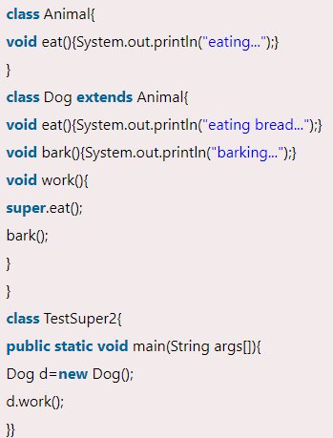
Super Class-Method
DAT
TA
The super keyword can also be used to invoke parent class method. It should be used if subclass contains the same method as parent class. In other words, it is used if method is overridden
Animal and Dog both classes have eat() method if we call eat() method from Dog class, it will call the eat() method of Dog class by default because priority is given to local.

Slide 37
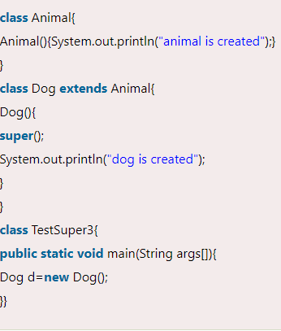
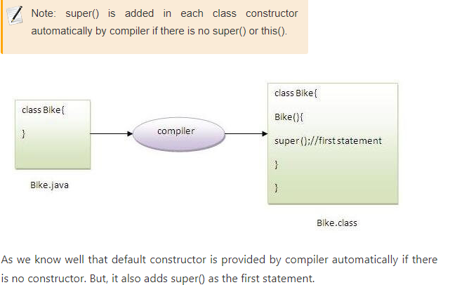
Super Class-Constructor
DAT
TA
The super keyword can also be used to invoke the parent class constructor. Let's see a simple

Slide 38
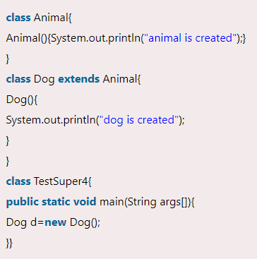
Super Class-Constructor
DAT
TA
The super keyword can also be used to invoke the parent class constructor. Let's see a simple

Slide 39
Method Overriding
DAT
TA
If subclass (child class) has the same method as declared in the parent class, it is known as method overriding in java.
In other words, if a subclass provides the specific implementation of the method that has been declared by one of its parent class, it is known as method overriding.
Usage of Java Method Overriding
Method overriding is used to provide the specific implementation of a method which is already provided by its superclass.
Method overriding is used for runtime polymorphism

Slide 40
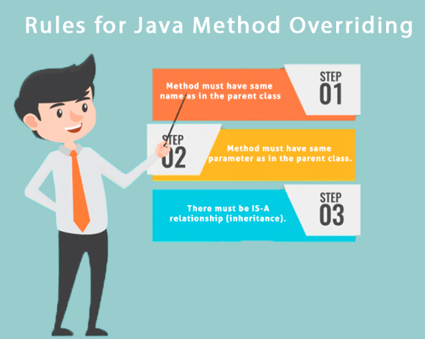
Rules for method Overriding
DAT
TA

Slide 41
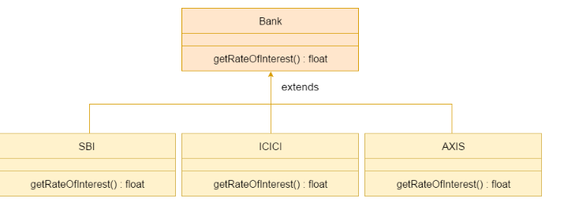
Method Overriding
DAT
TA
Consider a scenario where bank is a class that provides functionality to get the rate of interest. However, the rate of interest varies according to banks
. For example, SBI, ICICI and AXIS banks could provide 8%, 7%, and 9% rate of interest.

Slide 42
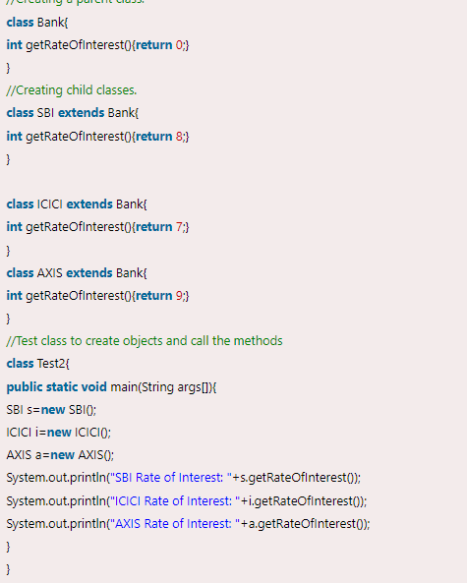
Method Overriding
DAT
TA

Slide 43
Abstract Classes and Methods
DAT
TA
Abstraction is a process of hiding the implementation details and showing only functionality to the user.
Another way, it shows only essential things to the user and hides the internal details, for example, sending sms where you type the text and send the message. You don't know the internal processing about the message delivery.
There are two ways to achieve abstraction in java
Abstract class (0 to 100%)
Interface (100%)

Slide 44
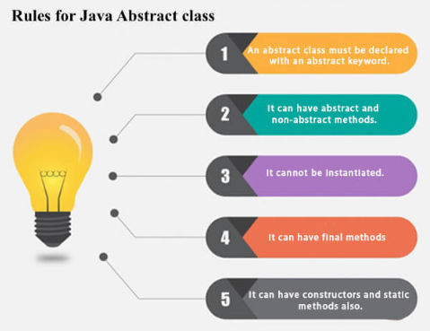
Abstract Classes and Methods
DAT
TA

Slide 45
Abstract Classes and Methods
DAT
TA
Abstract Method:-A method which is declared as abstract and does not have implementation is known as an abstract method.
Abstract void printstatus();//no method body and abstract

Slide 46
Abstract Classes and Methods
DAT
TA
Abstract Method:-A method which is declared as abstract and does not have implementation is known as an abstract method.
Abstract void printstatus();//no method body and abstract

Slide 47
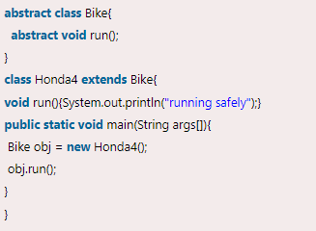
Abstract Classes and Methods
DAT
TA
In this example, bike is an abstract class that contains only one abstract method run. Its implementation is provided by the honda class.

Slide 48
Constructor in Inheritance
DAT
TA
A class in java can inherit traits and behaviors from another class thanks to the robust inheritance system.
Constructors are essential for initializing objects and maintaining the correct operation of the class hierarchy when dealing with inheritance

Slide 49
Constructor in Inheritance
DAT
TA
The constructor is the unique process responsible for initialising the class object.
The new keyword generates an object with the same name as the main class when it is called.
Inheritance is the process of building a subclass in java that gets properties and methods from a superclass.
The superclass constructor is called right away upon the creation of a subclass, guaranteeing that the inherited properties are initialised correctly.

Slide 50
Constructor in Inheritance
DAT
TA
Constructor chaining
A constructor can invoke another constructor in the same class or a superclass, a feature known as constructor chaining. This guarantees that, in the case of inheritance, the constructors of every class in the hierarchy-from the top superclass to the instantiated subclass-are called.

Slide 51
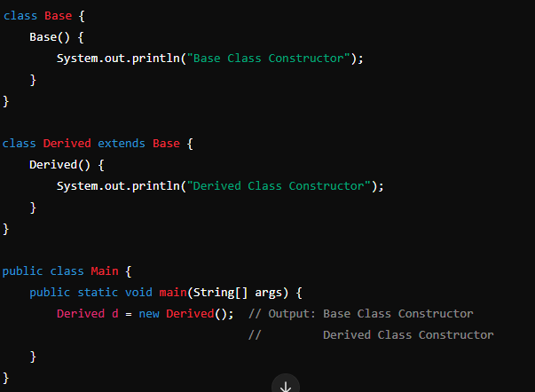
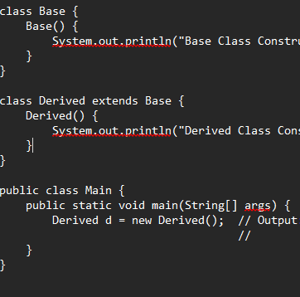
Constructor in Inheritance
DAT
TA

Slide 52
Interface
DAT
TA
An interface in java is a blueprint of a class. It has static constants and abstract methods.
The interface in java is a mechanism to achieve abstraction. There can be only abstract methods in the java interface, not method body. It is used to achieve abstraction and multiple inheritance in java.
Java interface also represents the is-a relationship.

Slide 53
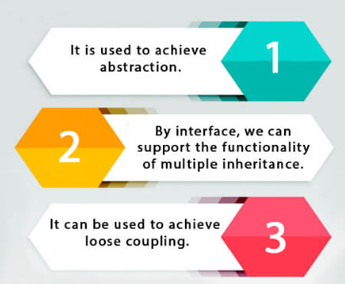
Why use Java Interface
DAT
TA
There are mainly three reasons to use interface

Slide 54
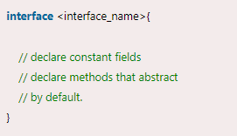
Declare an Interface
DAT
TA
An interface is declared by using the interface keyword.
It provides total abstraction; means all the methods in an interface are declared with the empty body, and all the fields are public, static and final by default.
A class that implements an interface must implement all the methods declared in the interface.

Slide 55
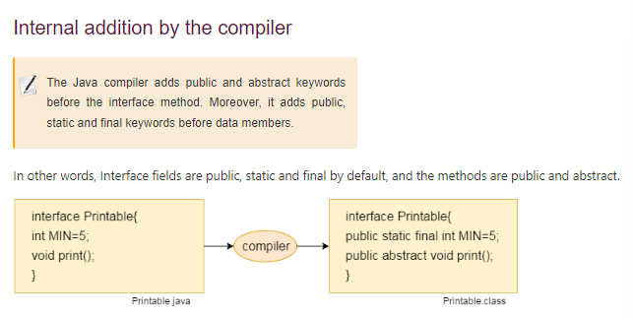
Declare an Interface
DAT
TA

Slide 56

Multiple Inheritance
DAT
TA
A class can implement multiple interfaces by listing them separated by commas in the class declaration.
The class must provide concrete implementations for all the abstract methods declared in the interfaces.
The classes "myclass" and "interface1", "interface2", and "interface3" can now inherit and implement methods from other interfaces.

Slide 57
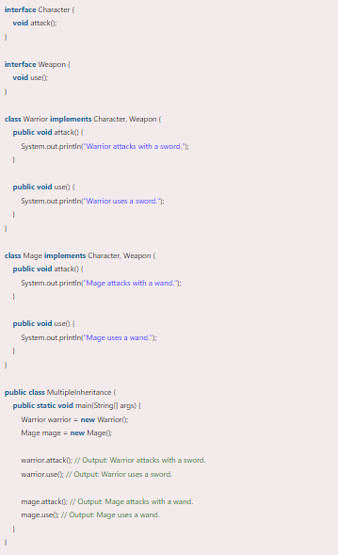
Multiple Inheritance
DAT
TA
Imagine that you and I are creating a game with a variety of characters, such as warriors and magicians. We also carry a variety of weaponry, including swords and wands. Although we want to keep character kinds and weapon types apart, we also want our characters to be able to utilize weapons. The following is how multiple inheritances through interfaces may help us do this:

Slide 58
Nested Interfaces
DAT
TA
An interface, i.E., declared within another interface or class, is known as a nested interface.
The nested interfaces are used to group related interfaces so that they can be easy to maintain.
The nested interface must be referred to by the outer interface or class.
It can't be accessed directly.

Slide 59
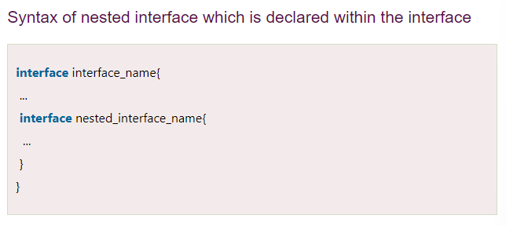
Nested Interfaces
DAT
TA
The nested interface must be public if it is declared inside the interface, but it can have any access modifier if declared within the class.
Nested interfaces are declared static

Slide 60
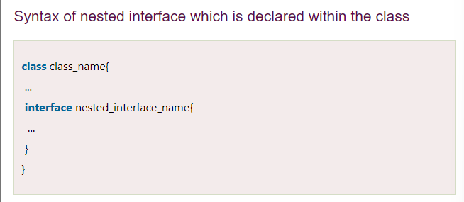
Nested Interfaces
DAT
TA

Slide 61
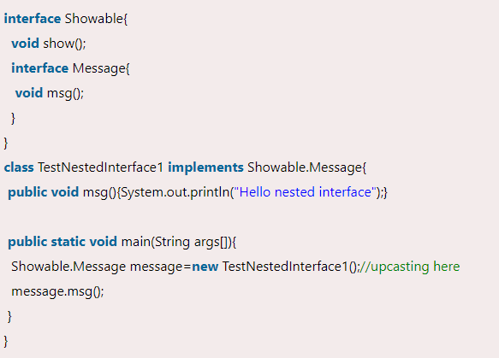
Nested Interfaces
DAT
TA
Nested interface which is declared within the interface

Slide 62
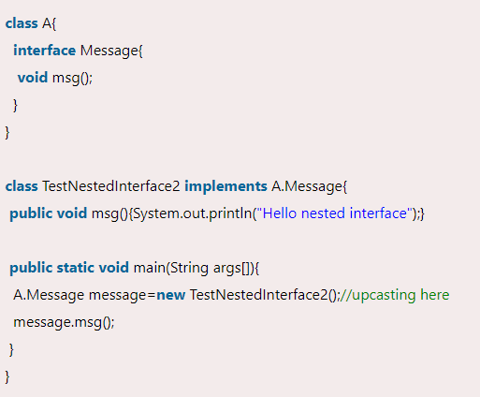
Nested Interfaces
DAT
TA
Nested interface which is declared within the class

Slide 63
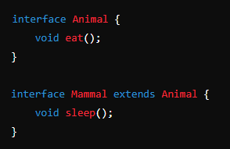
Inheritance of Interfaces
DAT
TA
Single Interface Inheritance
An interface can extend another interface. This means it inherits the abstract methods of the parent interface.
The child interface can add more methods or provide default implementations.

Slide 64
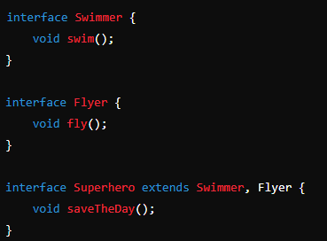
Inheritance of Interfaces
DAT
TA
Multiple Interface Inheritance
A single interface can extend multiple interfaces. This allows the new interface to inherit the methods from all its parent interfaces.

Slide 65
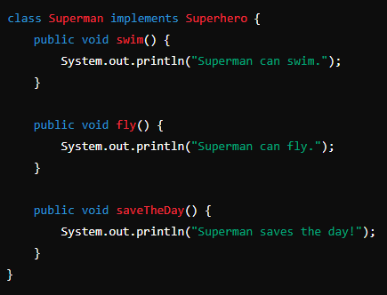
Inheritance of Interfaces
DAT
TA
Implemented by Class
A class can implement multiple interfaces, thereby inheriting and providing concrete implementations for all the methods from those interfaces.

Slide 66
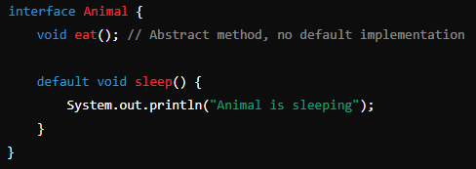
Default Methods in Interfaces
DAT
TA
Default Implementation
A default method is defined in an interface using the default keyword.
It provides a method body, so classes that implement the interface don't have to provide their own implementation unless they choose to override it.

Slide 67
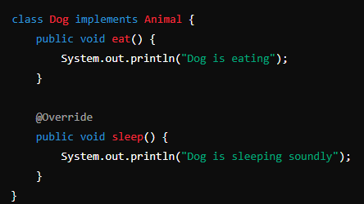
Default Methods in Interfaces
DAT
TA
Overriding Default Methods
Classes that implement the interface can override default methods to provide a specific implementation.

Slide 68
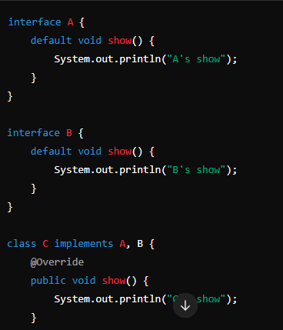
Default Methods in Interfaces
DAT
TA
Multiple Inheritance and Default Methods
When a class implements multiple interfaces that have default methods with the same signature, the class must override the method to resolve the ambiguity.

Slide 69
Static Methods in Interfaces
DAT
TA
Static methods in interfaces are defined using the static keyword, and they must have a method body.
They are called using the interface name, not through instances of implementing classes.
Calling static methods:
Static methods in interfaces are invoked using the interface name, not by creating instances of classes that implement the interface.

Slide 70
Static Methods in Interfaces
DAT
TA
Static Methods Vs Default Methods
Static methods: belong to the interface itself and cannot be overridden by implementing classes.
Default methods: provide a default implementation for methods in an interface that can be overridden by implementing classes.
No access to instance data:
Static methods in interfaces cannot access instance data or instance methods directly. They operate only on static data and methods of the interface.

Slide 71
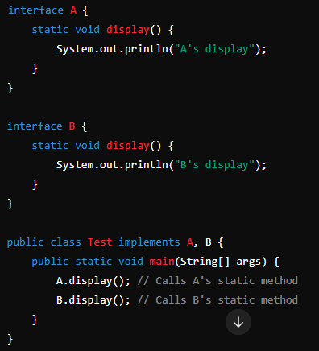
Static Methods in Interfaces
DAT
TA
Static methods cannot be overridden:
Static methods in interfaces cannot be overridden by implementing classes. Each interface maintains its own version of the static method.

Slide 72
Functional Interface
DAT
TA
An interface that contains exactly one abstract method is known as functional interface.
It can have any number of default, static methods but can contain only one abstract method.
It can also declare methods of object class.
Functional interface is also known as single abstract method interfaces or SAM interfaces.

Slide 73
Functional Interface
DAT
TA
Invalid functional interface
A functional interface can extends another interface only when it does not have any abstract method.
Java 8 introduced several standard functional interfaces in the java.Util.Function package, such as:predicate<t>: represents a predicate (boolean-valued function) of one argument. Method: boolean test(t t).
Function<t, r>: represents a function that accepts one argument and produces a result. Method: R apply(t t).

Slide 74
Functional Interface
DAT
TA
Consumer<t>: represents an operation that accepts a single input argument and returns no result. Method: void accept(t t).
Supplier<t>: represents a supplier of results. Method: T get().
Unaryoperator<t>: represents an operation on a single operand that produces a result of the same type. Method: T apply(t t).
Binaryoperator<t>: represents an operation on two operands of the same type that produces a result of the same type. Method: T apply(t t1, T t2).

