Slide 1
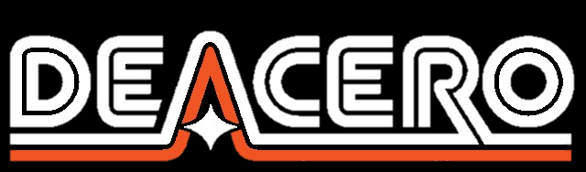
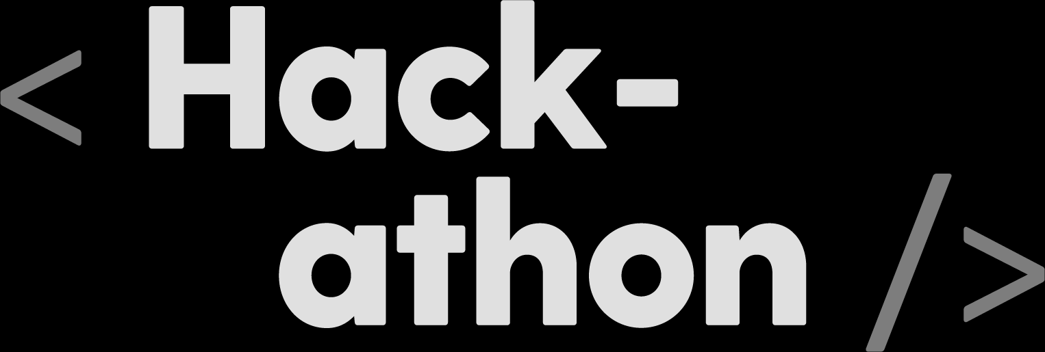
Identification and Classification - Scrap Materials and Hazards
Jojo’s Analytics

Slide 2
Visual Identification and Classification of Scarp Materials
Chosen Challenge: Unwanted Materials and Ferrous Scrap Classification
Short Description: We suggest to implement two vision systems.
1.-: The first one will identify multiple desirable materials, count them and get an estimated weight, and be able to give an estimated cost for that batch.
2.-: The second one will operate all the risk materials idetified by the first one, and it will analyze hazard labels, to give a safe indicator for its manipulation

Slide 3
PROCESS
Scrap Unload
Scrap Mounting
Scrap Recognition
Hazard Separation
Hazard Identification
Purchase Sell Value Estimation
Received scrap is unloaded and prepared to be identified
The scarp received is sectioned in sets of a predefined volume to be treated
The system identifies valuable, and hazardous materials, getting an estimated weight
When detected, hazardous material is carried over to the Hazard Management System
The Hazard Management System identifies the risk of the object by locating the hazard label
After all the materials have been recognized, we calculate an approximated sell value based on amount of categories present on the scrap

Slide 4
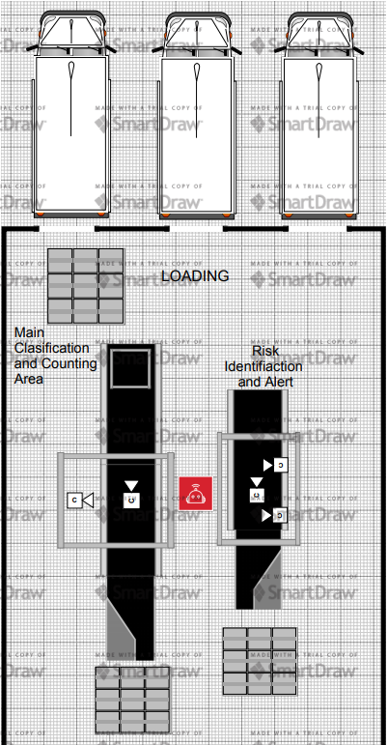
Design Concept
We propose two conveyors to be able to implement this systems.
One being the one in charge of image recognition.
The other in charge of hazard management by recognition of the hazard labels.

Slide 5

Visual Identification and Classification of Scarp Materials
Our solution was born due to the existing difficulty to correctly classify and value received scrap.
And taking into consideration the correct manage of hazardous materials

Slide 6
01
INNOVATION AND CREATIVITY

Slide 7
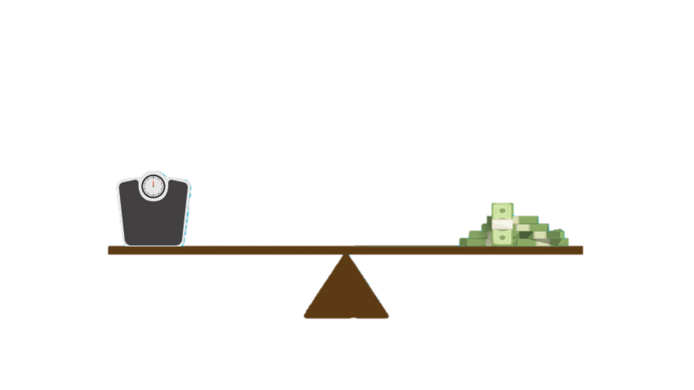
Purchase Confirmation System
We suggest to use the visual recognition system to identify, count, and measure the different materials present on the scrap.
With such values, calculate an estimated weight of the batch with a scale. Thus, the user will be able to observe an estimated total weight and cost for the previously-received batch.
Does it match the initial statement?
Source: University of Michigan

Slide 8
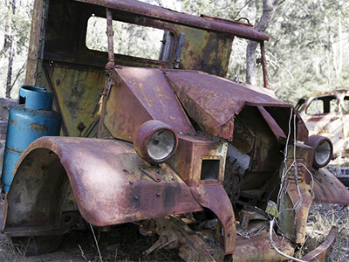
Hazard Management System
We segmented our recognition system in two parts:
Object Recognition: As mentioned before, the first one will identify valuable materials, but also being able to identify hazardous materials based on their topology (propane gas tanks, batteries).
Hazard Management: Once we identify this materials present on the line; an external agent will transport this materials to the Hazardous Management Line

Slide 9
02
USABILITY

Slide 10
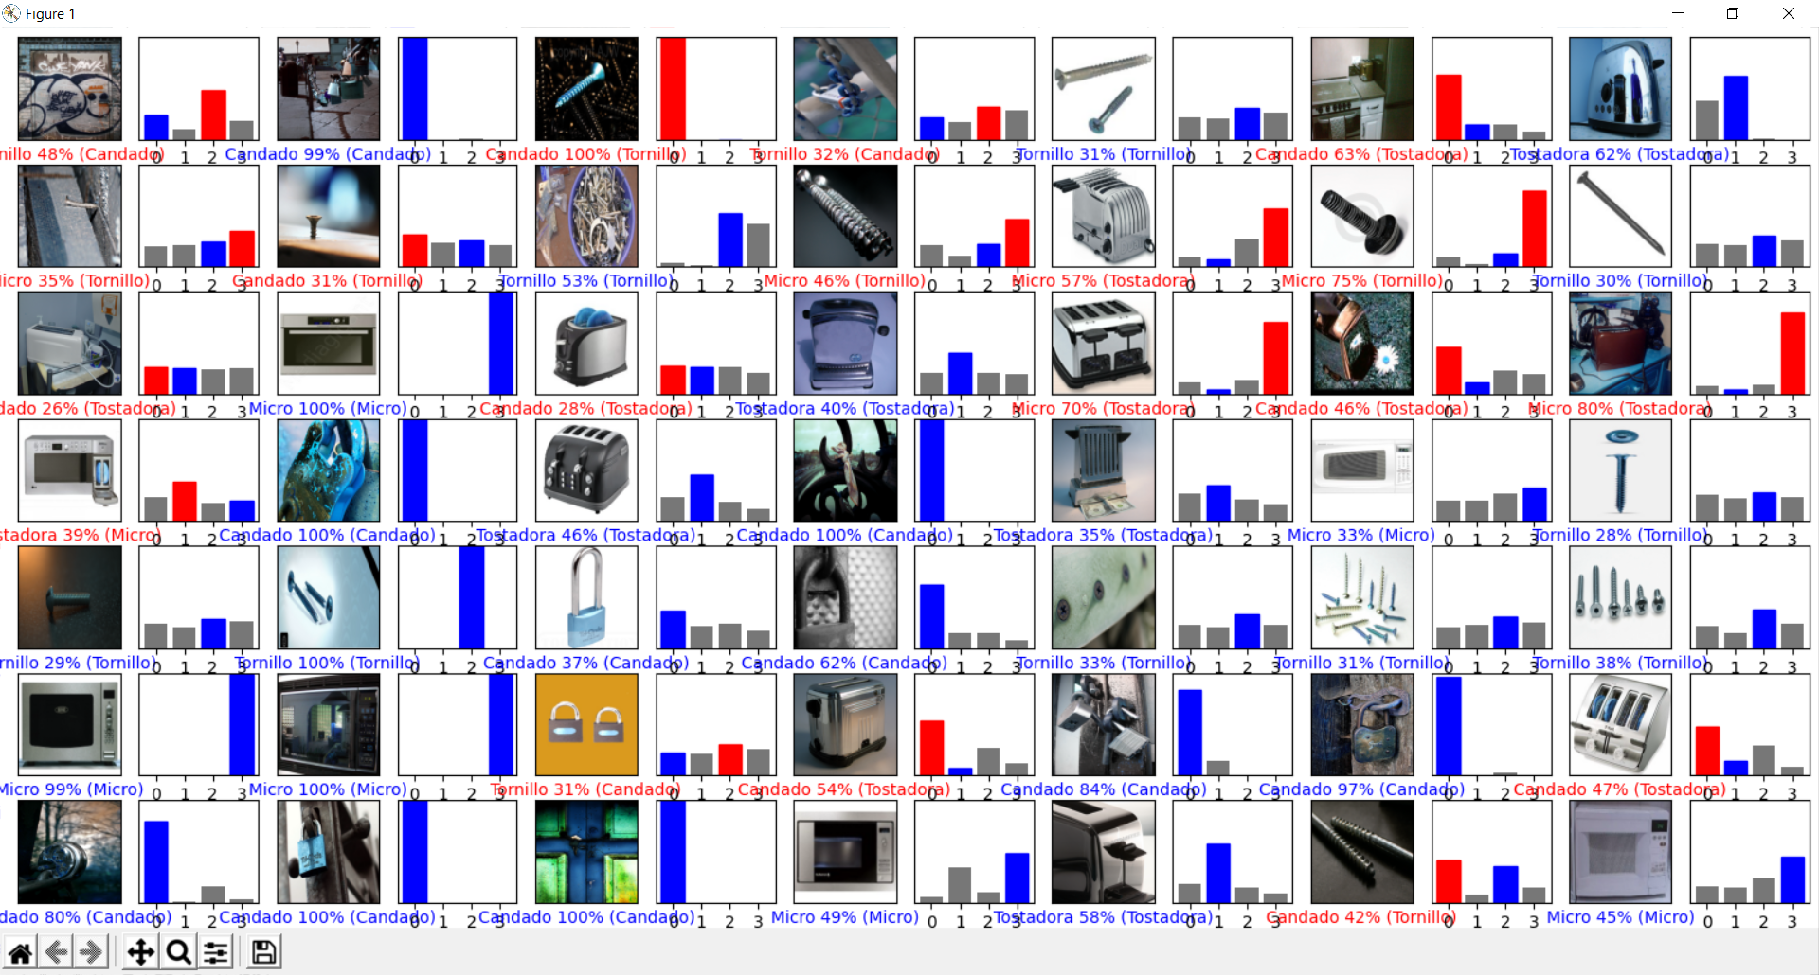
Recognition Feedback - UI
Our model has the ability to output a figure that contains the input image all present categories on database, indicating with blue the one chosen by the system, showing also its degree of cernainty.
On the other hand mistakenly identified materials are indicated with red.
All other categories are indicated with grey.

Slide 11
Scalable Vision System
Our model has the possibility to be resizeable just by tuning a few specific values, this allow us to increase the range of recognition or decrease it if we want a more agile process.

Slide 12
03
SOLUTION

Slide 13
CNN Results
The algorithm relies heavily on the data provided.
Given the color similarity between metals, the Network needs a vast amount of images to learn other topologic factors.

Slide 14
04
EXECUTION AND PROJECTION

Slide 15
Simple and User Friendly
The developed UI allows the user to visually verify when specific objects are present within each section been recognized
Vision systems are modular and independent with no need for frequent calibration
Scrap requires minimal to no contact by humans, and hence the risks are substantially reduced

Slide 16
Continuous Improvement
This challenge being highly complex, and with multiple possible solutions, has a lot of improvement area.
For this reason, we want to share different implementations that could be modularly implemented together with this solution, improving the future results significantly.

Slide 17
Continuous Imptovement
Magnetic Station
Hazard Transport
Multiple Camera Feed
Database Optimization
We suggest to use this station to quickly separate ferrous material.
Implement Robotic Arm, or Overhead Crane (conveyor-to-conveyor).
Have multiple cameras on stations, to be able to detect 3D space and objects, with more precision.
Object Detection Boxes
Implement object detection with framework like YOLO, will be a good improvement for UI experience.
Use reinforcement learning to broaden the system's capabilities.

Slide 18
Conclusion
We decided to take this approach in an attempt to solve one of the main problems when dealing with scrap metal.
Technologies nowadays implement different sensors that benefit from the intrinsic properties of each material. Nonetheless, we considered security to be one of the most important problematics to be first addressed.
We want to thank the company and the staff who organized this event, for allowing us not only to get an insight of daily tasks that engineers might face, but also helping us realize about our strenghts and weaknesses. It was an amazing event. Looking forward to meeting you again soon.

