Slide 1

Re-drawing Public Elementary School District for racial-integration in Durham, NC
Xinchun(Atsushi) Hu
Yuncong(Joe) Zuo

Slide 2
Persistent racial segregation in elementary schools in Durham
Motivation
Approach and Model
Preliminary findings
Fairness evaluation
Brown vs Board of Education
Racial composition in elementary schools in Durham, NC
All elementary school age students: ~ 21000 total in 2010 census
~31.8% White students
~20.2% Hispanic students
~40.9% Black students
School Name | Student Percentage
C C S Paulding Elementary | 82.3% Black
Lakewood Elementary | 47.1% Hispanic
Magnum Elementary | 68.7% White
Notes:
Details for second bullet point, generation/segregation instead of school quality; paint a picture

Slide 3
Children learn better under integrated environment
School grading process can be trapped in so-called Simpson’s Paradox
School grades will have further implication on public perception and funding on the elementary schools
Why racial integration should be encouraged
Motivation
Approach and Model
Preliminary findings
Fairness evaluation
 | Student Below Poverty line | Proficiency Ratio | Student Above Poverty Line | Proficiency Ratio | Overall Proficiency ratio | Grade
School 1 | 90% | 50% | 10% | 90% | 54% | D
School 2 | 5% | 40% | 95% | 80% | 78% | B
Notes:
Details for second bullet point, generation/segregation instead of school quality; paint a picture

Slide 4
Hypothetical vs Actual
Percentage of Black Students in Durham
Motivation
Approach and Model
Preliminary findings
Fairness evaluation
Notes:
Details for second bullet point, generation/segregation instead of school quality; paint a picture

Slide 5
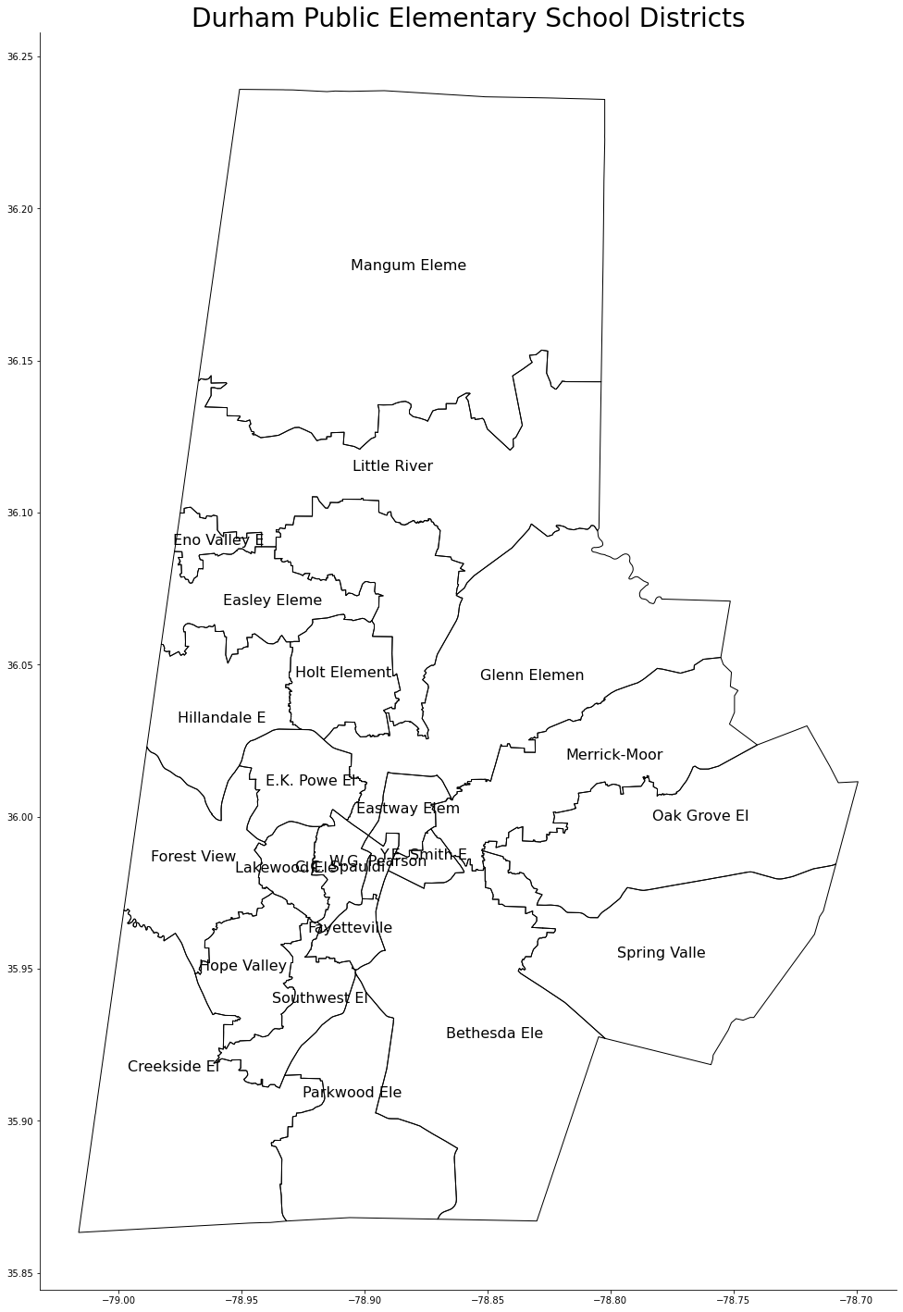
Which school to go?
Motivation
Approach and Model
Preliminary findings
Fairness evaluation
Notes:
Details for second bullet point, generation/segregation instead of school quality; paint a picture

Slide 6
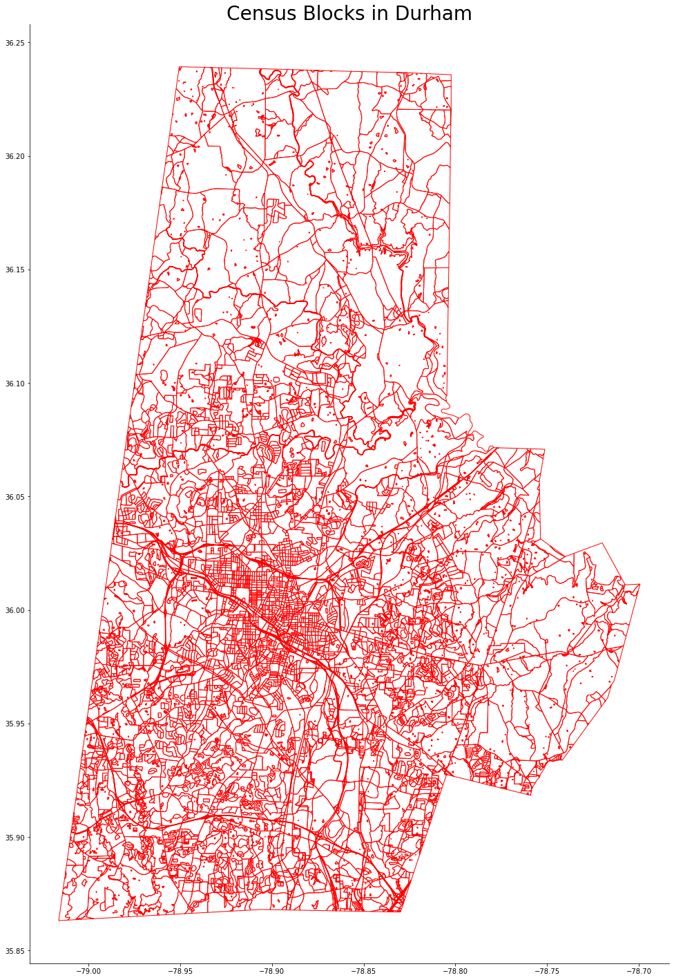
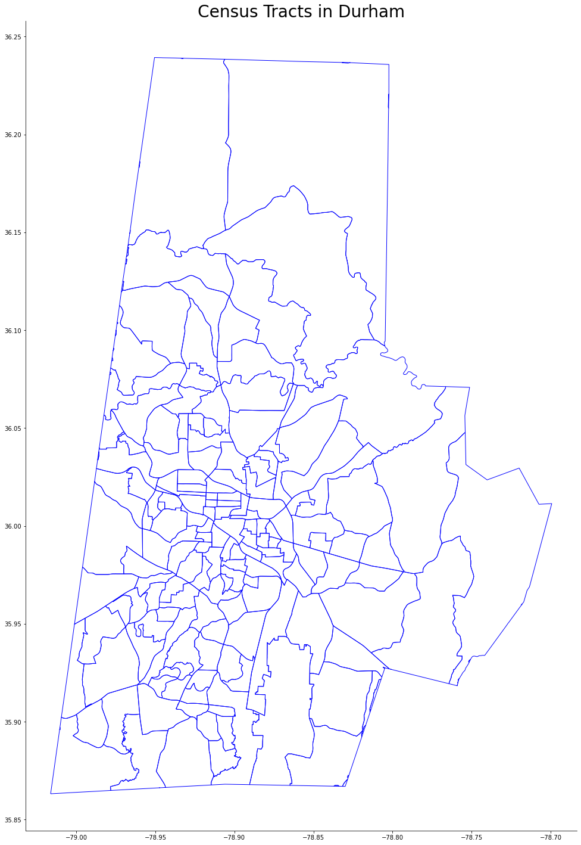
Which school to go?
Motivation
Approach and Model
Preliminary findings
Fairness evaluation
Notes:
Details for second bullet point, generation/segregation instead of school quality; paint a picture

Slide 7
Assumptions
All students of elementary school age go to a public school
Students of the same race from the same block go to the same school
There is an upper limit on travel time of each student
School capacity can be expanded up to 10% compared to current enrollment data
Motivation
Approach and Model
Preliminary findings
Fairness evaluation
Notes:
Details for second bullet point, generation/segregation instead of school quality; paint a picture

Slide 8
Parameters
The number of students of each race in each block
The capacity limit C_j at each public school j
Expansion from current enrollment is necessary
Distance between each block and each school
The travel time limit t_i for each block i
Certain blocks may have to travel more than some other blocks
Benchmark racial composition: p_k for each race k
Motivation
Approach and Model
Preliminary findings
Fairness evaluation
Notes:
Details for second bullet point, generation/segregation instead of school quality; paint a picture

Slide 9
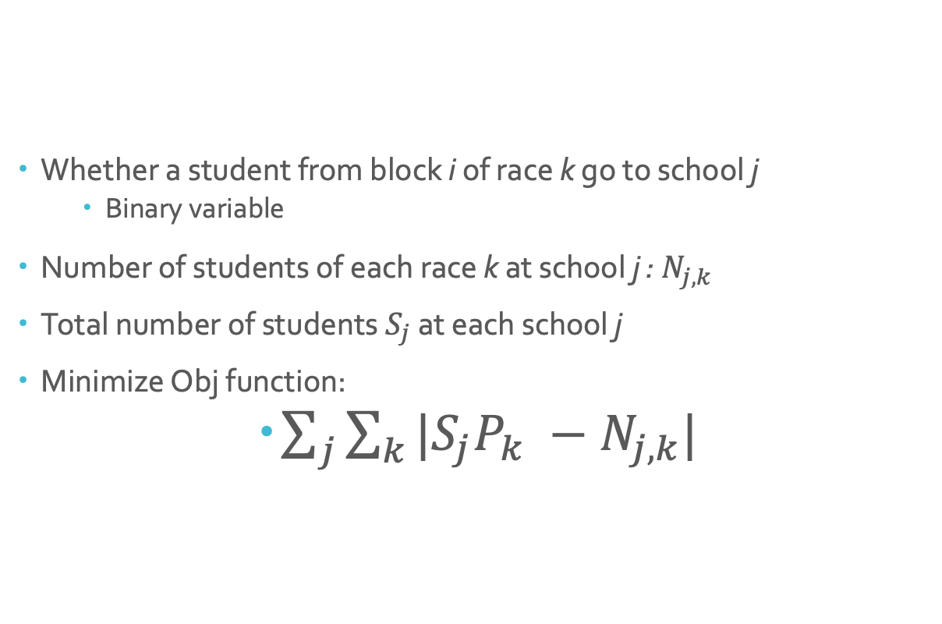
Variables
Whether a student from block i of race k go to school j
Binary variable
Number of students of each race k at school j : $N_{j,k}$
Total number of students $S_{j}$ at each school j
Minimize Obj function:
$\sum_{j}{\sum_{k}{|S_{j}P_{k} −N_{j,k}|}}$
Motivation
Approach and Model
Preliminary findings
Fairness evaluation
Notes:
Details for second bullet point, generation/segregation instead of school quality; paint a picture

Slide 10
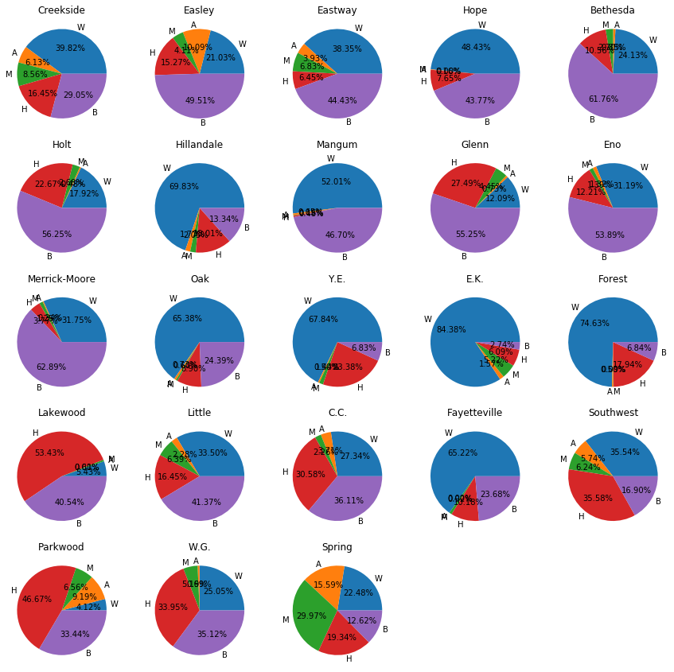
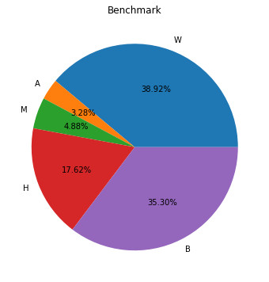
Preliminary Findings
We have generated all the data inputs and run our model
Large number of blocks makes the computation very expensive
Reduce to less granular geographic areas such as block groups
Motivation
Approach and Model
Preliminary findings
Fairness evaluation
Notes:
Details for second bullet point, generation/segregation instead of school quality; paint a picture

Slide 11
How to understand the results?
If we want to make racial composition to the benchmark composition as much as possible, it may not be fair to all students
Some students will travel longer than others
Neighbors may end up in different schools
We quantitatively evaluate the fairness
Travel time for each racial groups
Statistics about school allocation of students in each block
Motivation
Approach and Model
Preliminary findings
Fairness evaluation
Notes:
Details for second bullet point, generation/segregation instead of school quality; paint a picture

