Slide 1
What makes a school “good” ?
PRUV2020, Atsushi Hu
Mentor: Prof Gregory Herschlag

Slide 2
In 1954, schools in the U.S. officially desegregated after
Brown vs Board of Education.
However, de facto segregation is still legal, and there are many schools that are still segregated.
Motivation
Issues with current grading
Relative performance
In North Carolina
Private schools: expensive, attract wealthier children
Generational and societal wealth gaps may mean that wealthier children tend to me White
Notes:
Details for second bullet point, generation/segregation instead of school quality; paint a picture

Slide 3
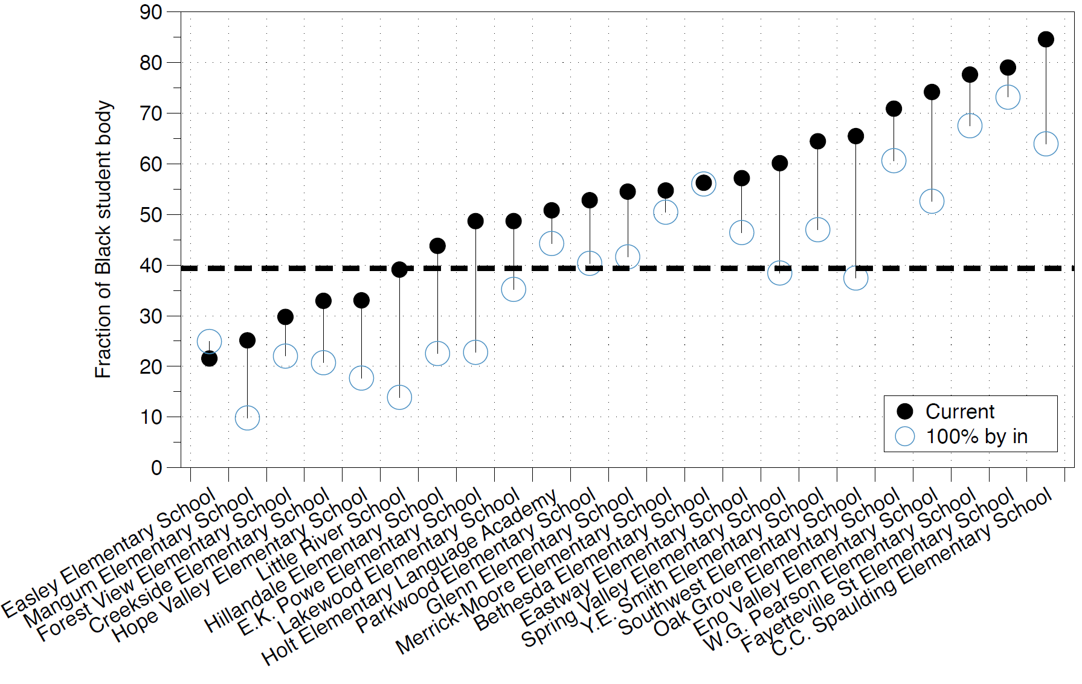
What would ethnicity compositions in each school look like if every student goes to the public school based on geographic assignment?
Motivation
Approach to regrade
Relative performance

Slide 4
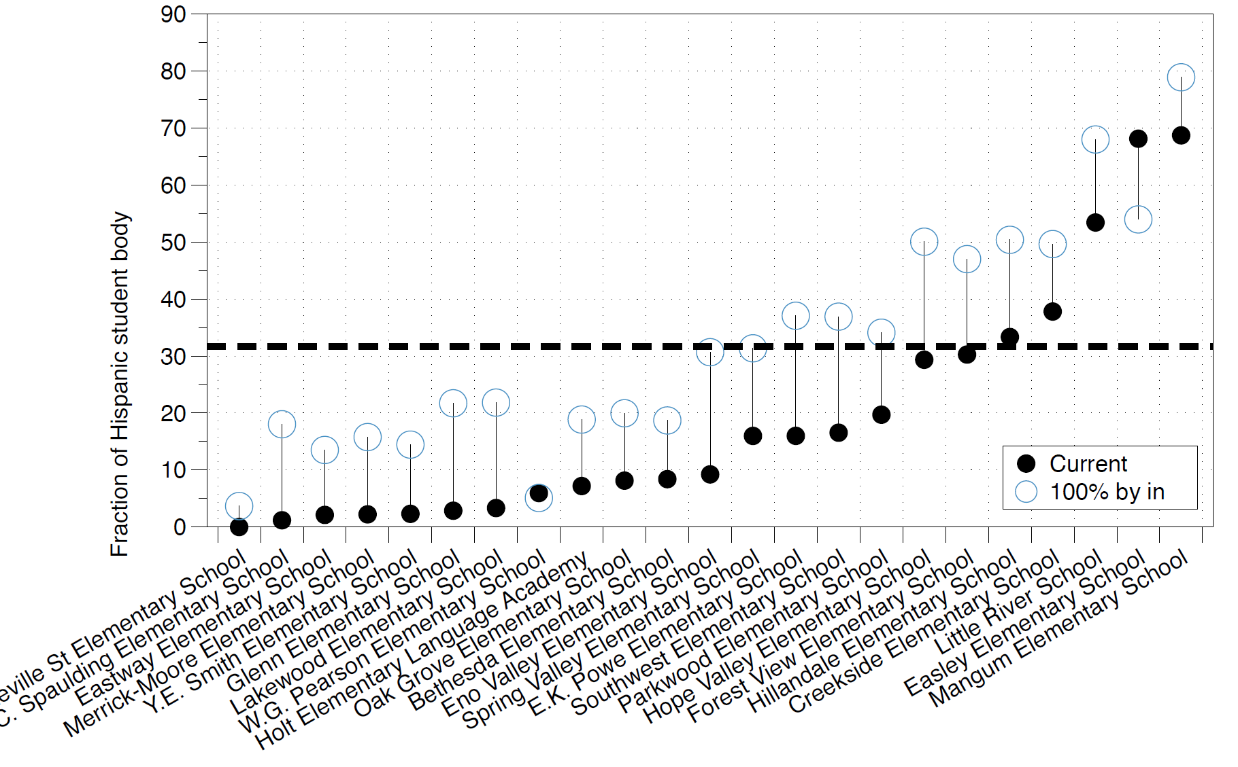
What would ethnicity compositions in each school look like if every student goes to the public school based on geographic assignment?
Motivation
Approach to regrade
Relative performance
White

Slide 5
Motivation
Approach to regrade
Relative performance
Disadvantaged black children learn better in well-integrated classrooms.
---James S. Coleman
Equality Educational Opportunity

Slide 6
In North Carolina
Private schools: expensive, attract wealthier children
Generational and societal wealth gaps may mean that wealthier children tend to me White
In selective schools can curate classes, must public schools must take everyone, then Simpson’s Paradox arises.
Motivation
Issues with current grading
Relative performance
 | Student Below Poverty line | Proficiency Ratio | Student Above Poverty Line | Proficiency Ratio | Overall Proficiency ratio | Grade
School 1 | 90% | 50% | 10% | 90% | 54% | D
School 2 | 5% | 40% | 95% | 80% | 78% | B
Notes:
Details for second bullet point, generation/segregation instead of school quality; paint a picture

Slide 7
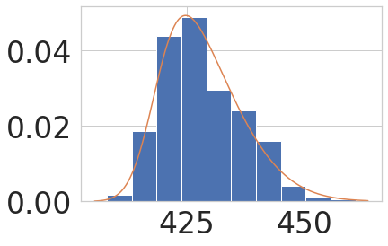
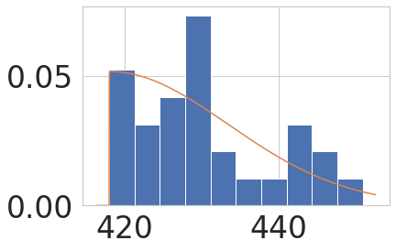
First attempt:: For each group, approximate the PDF of student performance of each school in each test and compare it to the Durham performance
How to compare the performance
Insufficient data
Motivation
Approach to regrade
Relative performance
Score distribution of Durham
Score distribution of some school
Notes:
-Show that we are looking for more nuanced way of grouping in the future; ask opinions on grouping

Slide 8
Motivation
Approach to regrade
Relative performance
To break down Simpson’s paradox,
we break the student into different subgroups,
and we want to quantify the performance of
each subgroup at each school..

Slide 9
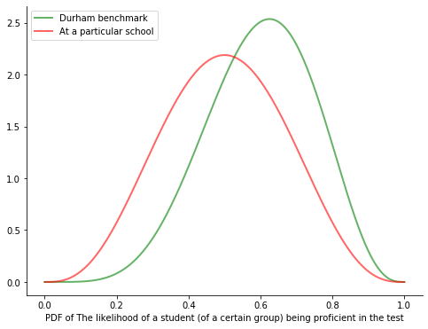
Direct Comparison of standard statistical measures:
for each group, approximate the PDF of student performance of each school in each test and compare it to the Durham performance
How to compare the performance
Insufficient data
New Approach: Bayesian Stats to estimate the proficiency rate
Motivation
Approach to regrade
Relative performance
J-divergence X Difference in EV
Notes:
-Show that we are looking for more nuanced way of grouping in the future; ask opinions on grouping

Slide 10
To break down Simpson’s paradox, we break the student into different subgroups, and we want to quantify the performance of each subgroup at each school..
Step 1: At each school, for each ethnicity group, find the number of students being proficient in each test
Step 2: Estimate the chance of being proficient (proficiency ratio) using a Bayesian approach to account for the limited number of data
Step 3: Compare the proficiency ratio to that of NC
Step 4: Rank the schools based on the relative performance for each ethnicity group
Motivation
Approach to regrade
Relative performance

Slide 11
Rank for Black students | Schools
1 | Pearsontown ( C )
2 | Hillandale ( C )
3 | Mangum (A + NG)
4 | R N Harris ( C )
5 | Bethesda ( D )
Rank for White students | Schools
1 | Forest View ( C )
2 | Creekside ( C )
3 | Club Boulevard ( C )
4 | Pearsontown ( C )
5 | Easley ( C )
Motivation
Approach to regrade
Relative performance
Rank for Hispanic students | Schools
1 | Easley ( C )
2 | Club Boulevard ( C )
3 | Creekside ( C )
4 | Glenn (F)
5 | Hope Valley ( C )
Averaged ranks of schools | Schools
1 | Creekside ( C )
2 | Club Boulevard ( C ）
3 | Easley （ C )
4 | Forest View ( C )
5 | Mangum (A+NG)

Slide 12

However, ethnicity is not the only factor we need to consider.
Income is also an important factor
Motivation
Approach to regrade
Relative performance
Within the same ethnicity group, each student has a chance of being proficient $p$, which only depends on income
If income is discrete :
However, $p$ is a continuous, increasing function of the income $p\left(I\right)$
 | Poor | p | Rich | p | Weighted avg of p
School 1 | 90% | 50% | 10% | 90% | 54%
NC | 50% | 50% | 50% | 90% | 70%

Slide 13
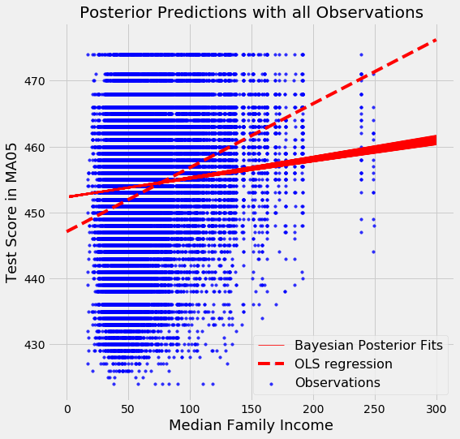
What if we just use Linear Regression?
Motivation
Approach to regrade
Relative performance

Slide 14
Conclusion:
1: The current school grading system is biased and is impacted by who goes to the school.
2: The current school grading system may affect people’s perception about certain schools negatively.
3: The perception may further contribute to the segregation in Durham schools.

Slide 15
Thank You!

