Slide 1
Python Implementation of DES

Slide 2
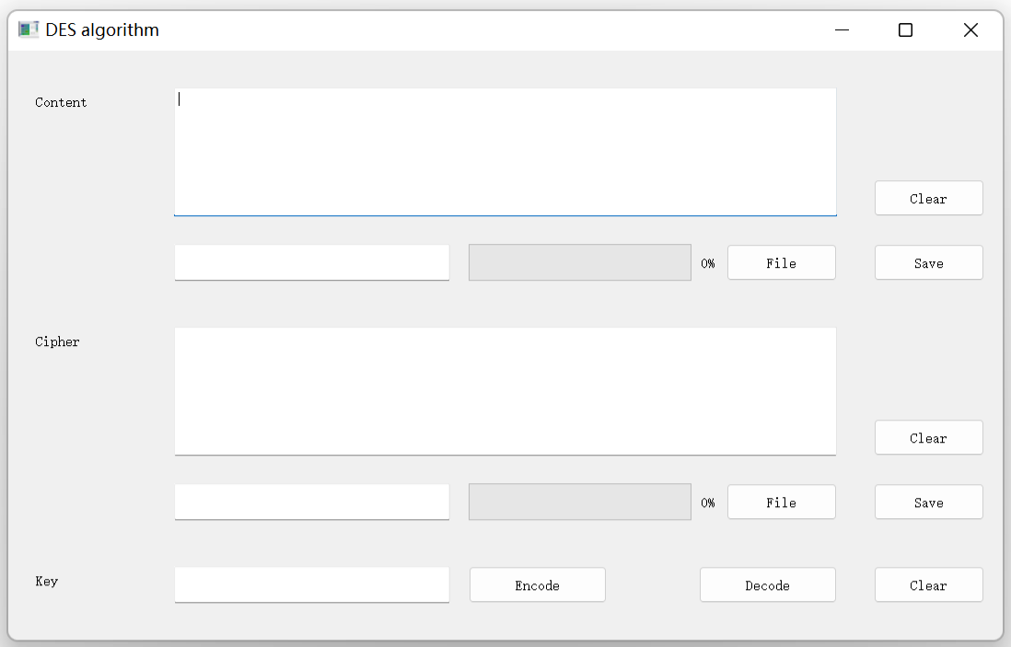
Overall Function Demonstration
1. Content Edit/Display Area
5. Clear Content Button
2. Content Path Edit/Display Area
6. Save Content Button
7. Select Content Button
3. Cipher Edit/Display Area
8. Select Cipher Button
9. Clear Cipher Button
4. Cipher Path Edit/Display Area
10. Save Cipher Button
11. Clear All Button
12. Key Input Area
14. Decode Button
13. Encode Button

Slide 3
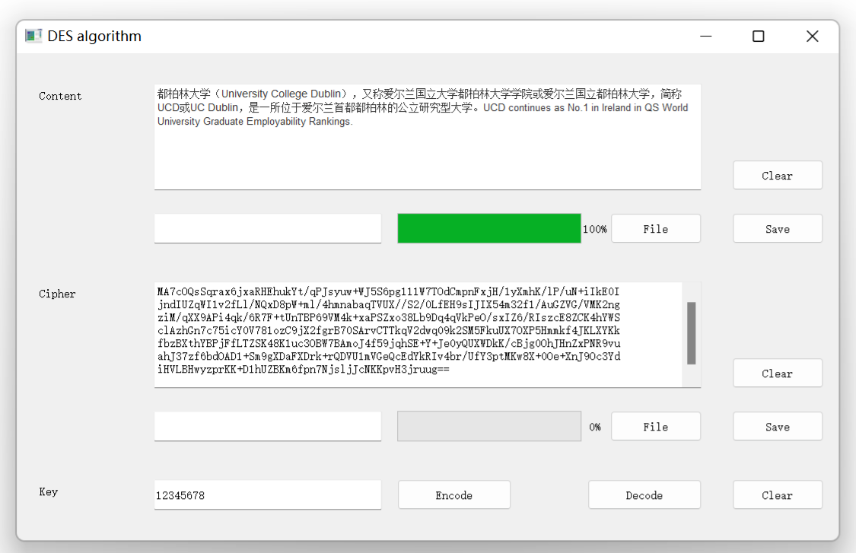
Encryption of Plain Text
First, type or copy some text
Progress bar
Encrypted Text
Second, type or copy the key
Finally, click the encode button

Slide 4
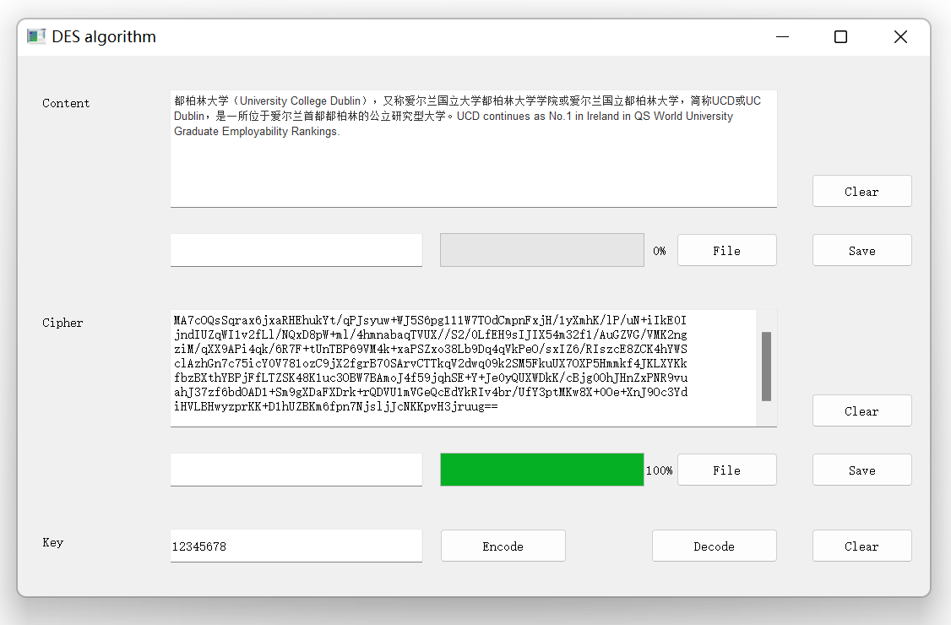
Decryption of Plain Text
Decrypted Text
First, Input Encrypted Text
Progress bar
Second, type or copy the key
Finally, click the decode button

Slide 5
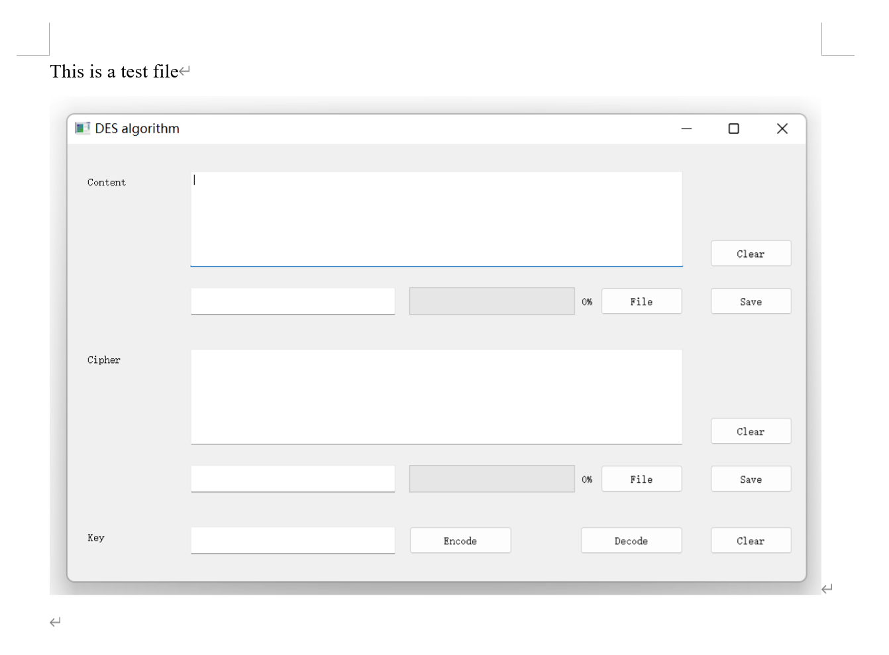
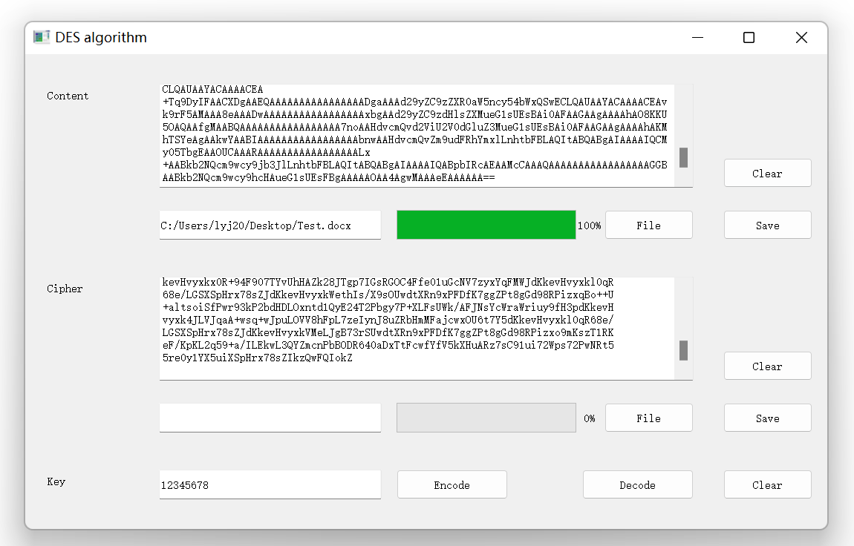
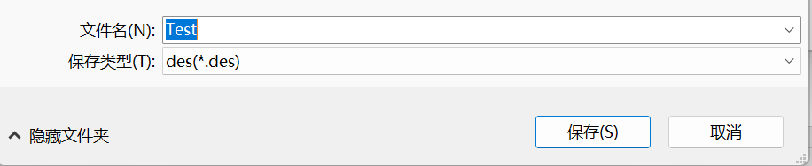
Encryption of File
Example of input file
First, click the file button to select file
Second, type or copy the key
Finally, click the save button
Thirdly, click the decode button

Slide 6
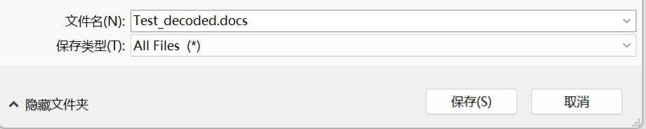
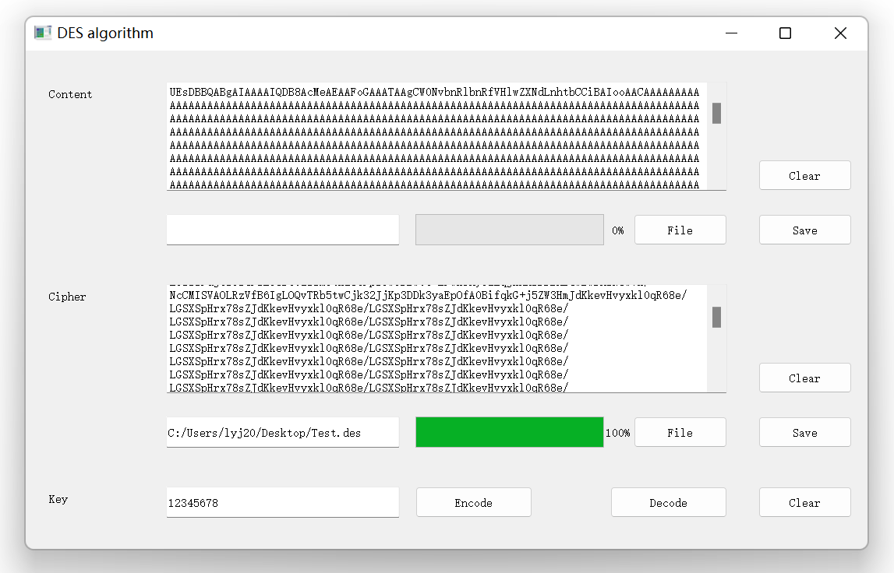
Decryption of File
Example of output file
Finally, click the save button
First, click the file button to select cipher file
Second, type or copy the key
Thirdly, click the decode button

Slide 7
Diagram of Text
Shown in GUI
File
Base64 String
Binary String
DES
Key
Cipher File
Base64 String
Binary String
Shown in GUI

Slide 8
Diagram of File
Shown in GUI
Plain Text
Binary String
DES
Key
Base64 String
Binary String
Shown in GUI

