Slide 1
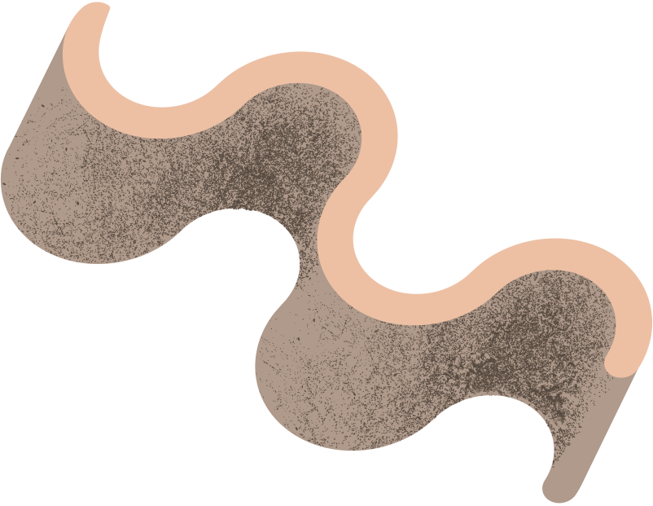
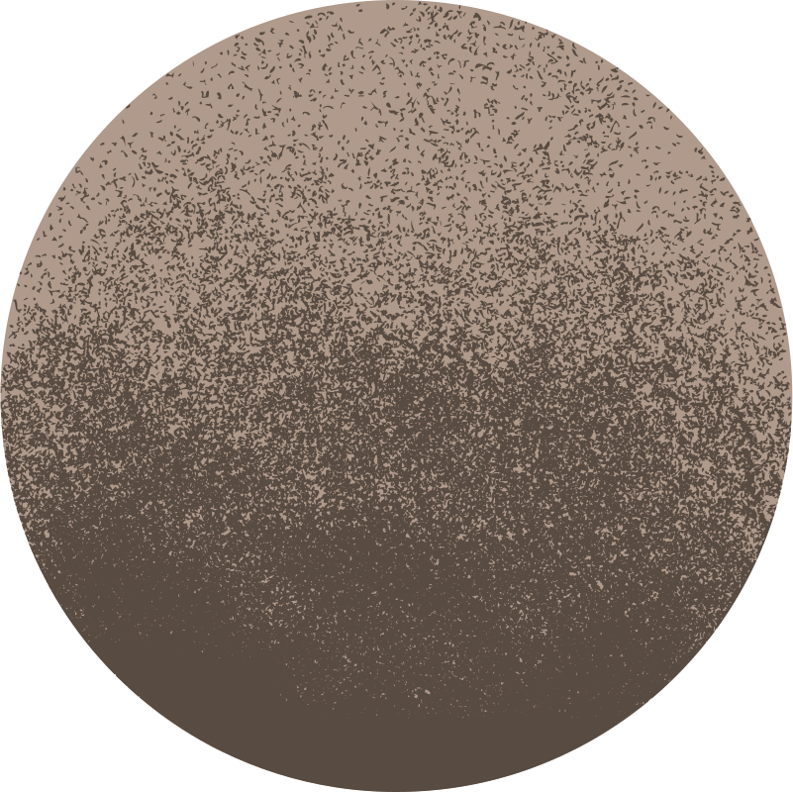


INTERACTIVE SPECTROGRAPHIC MODELING AND AI CLASSIFICATION OF BIRD CALLS
Made by Atta Ur Rahman
2024122

Slide 2
PROBLEM STATEMENT
Bird calls are important indicators of biodiversity and ecosystem health
Manual identification of bird species from audio is:
Time-consuming
Inconsistent
Requires expert knowledge
Existing tools mostly focus on classification
Limited visual insight into bird call structures
Need: A system that combines visual analysis + AI classification

Slide 3
PROJECT OBJECTIVES
Preprocess bird call audio data
Extract meaningful audio features
Visualize bird calls using interactive 3D spectrograms
Classify bird species using machine learning
Provide a simple and user-friendly interface

Slide 4



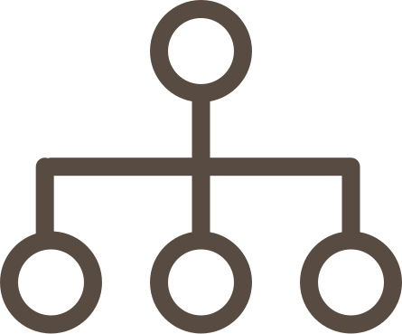

METHODOLOGY OVERVIEW
Audio Preprocessing
3D Visualization
Web Interface (Streamlit)
Feature Extraction
Machine Learning Classification

Slide 5

PREPROCESSING & FEATURE EXTRACTION
01
02
03
PREPROCESSING
FEATURE EXTRACTION
LIBRARIES
Normalization
Noise reduction
Silence trimming
Resampling to 22,050 Hz
Optional segmentation
Spectrograms
MFCCs
Chromagrams
Spectral contrast
Librosa, NumPy, Pandas, streamlit, plotly

Slide 6

3D VISUALIZATION
BIRD CALLS VISUALIZED AS 3D SPECTROGRAMS
TOOLS USED:
Matplotlib – static plots
Plotly – interactive (zoom, rotate, hover)
AXES REPRESENTATION:
X-axis: Time
Y-axis: Frequency
Z-axis: Amplitude

Slide 7
RESULTS, LIMITATIONS & FUTURE WORK
Key Results
Successful 3D visualization of bird calls
Species-specific acoustic patterns observed
Functional AI-based classifier implemented
Limitations
Synthetic data may not reflect real-world complexity
Small dataset size
High computation for large audio files
Future Work
Use real-world datasets (Xeno-canto)
Deep learning models (CNNs)
Real-time audio processing
Improved noise reduction

Slide 8
THANK
YOU
Any Questions?

