Slide 1
PROJECT NAME: Europe
PROJECT LOCATION: Serbia
Weekly Performance Report

Slide 2
Achievement Summary:
Total no of Accounts
25
Total Posts
307
Total Reach
5526
Total Likes
41
Total Friends
65
Total Comments
4
Total Video views
000
Total no of Groups Joined
000

Slide 3
MONTH: Oct 13
PROFILE URL | Followers Initial | Followers Now | Total Reach | Total Posts
https://x.com/ivanristic5b9q | 4 | 8 | 2206 | 21
https://x.com/Tijanalazic09 | 7 | 9 | 443 | 21
https://x.com/JovanLukacf | 3 | 3 | 396 | 18
https://x.com/MilenaVukovic09 | 0 | 0 | 105 | 15
https://x.com/BojanaBabic78 | 1 | 2 | 88 | 15
https://x.com/KristijanJvnrq | 0 | 1 | 84 | 12
https://x.com/filip52o4 | 1 | 2 | 298 | 9
https://x.com/milaantic7p | 3 | 6 | 309 | 12
https://x.com/dusansimic90 | 2 | 3 | 47 | 12
https://x.com/stefankos88 | 2 | 2 | 110 | 15
https://x.com/jovanaa90a | 4 | 4 | 55 | 13
https://x.com/anai2gt | 2 | 2 | 29 | 9
https://x.com/SloaneMercchv | 4 | 8 | 119 | 12
https://x.com/BriarCallo9jc | 2 | 3 | 323 | 12

Slide 4
MONTH: Oct 13
PROFILE URL | Followers Initial | Followers Now | Total Reach | Total Posts
https://x.com/LaurelBecktw | 1 | 1 | 412 | 12
https://x.com/MarloweQuijq1 | 0 | 1 | 113 | 12
https://x.com/MatthewThods | 2 | 3 | 47 | 15
https://x.com/ArthurRogeco | 1 | 1 | 42 | 12
https://x.com/DanielJoneepgl | 0 | 0 | 34 | 12
https://x.com/AmandaMartmqan | 1 | 1 | 53 | 18
https://x.com/JamesCartevq | 1 | 1 | 23 | 12
https://x.com/WilliamJohrp | 1 | 4 | 30 | 9
https://x.com/kostic5wif | 0 | 0 | 0 | 3
https://x.com/dunjaj78 | 0 | 0 | 0 | 2
https://x.com/majalazic7890 | 0 | 0 | 0 | 4

Slide 5
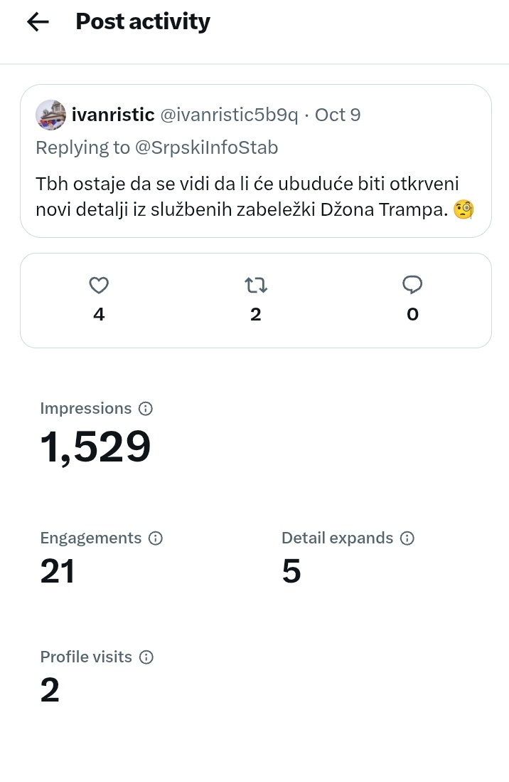
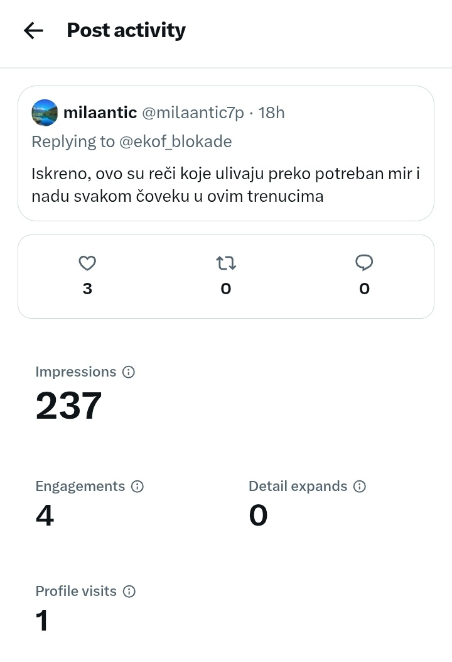
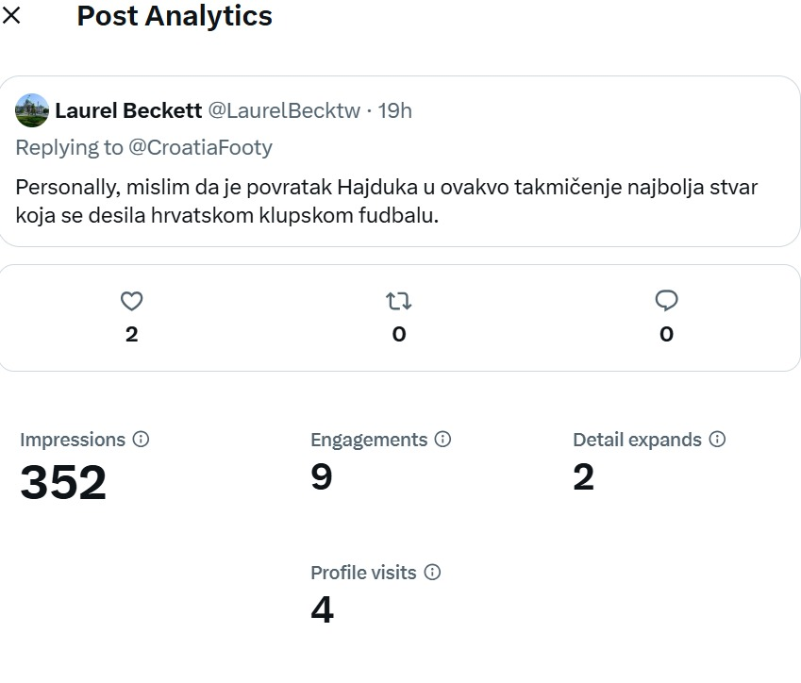
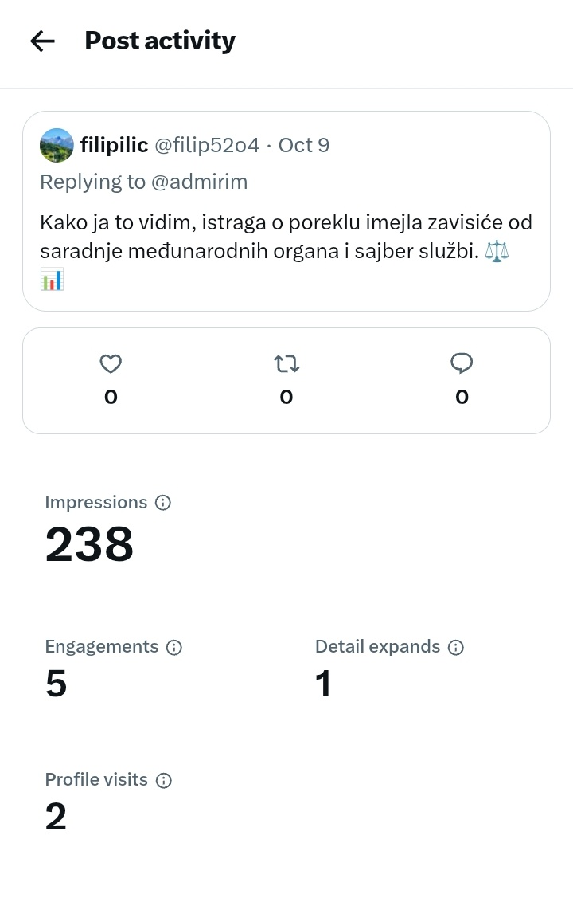
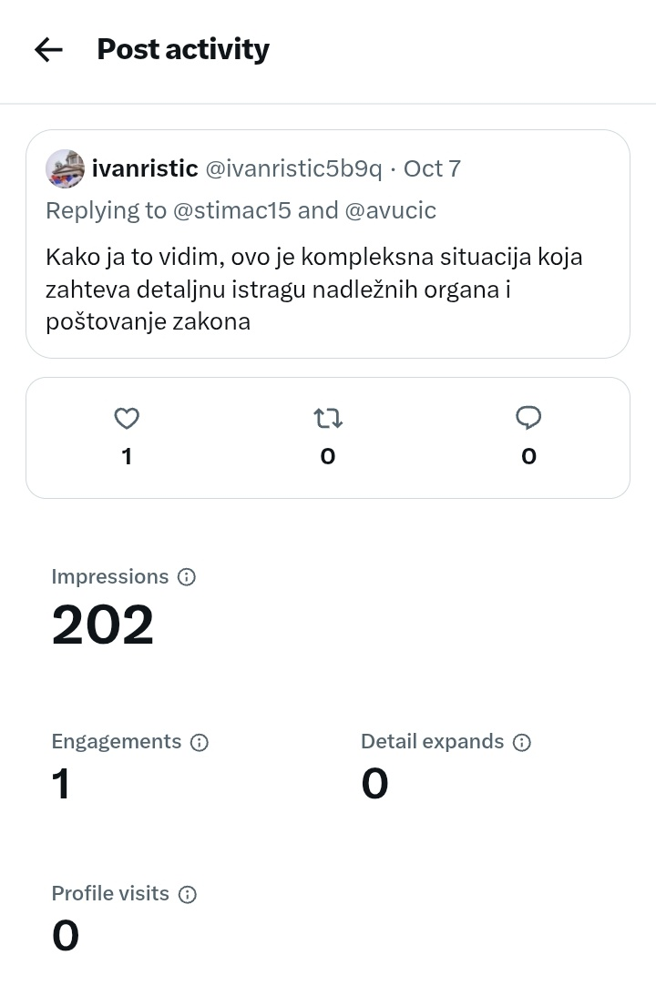
SCREENSHOTS OF ACHIEVEMENT

Slide 6
Achievements
SCREENHOTS OF ACHIEVEMENT
This post is about the UEFA Champions League / European football preview post regarding the historic European campaign match between Hajduk Split and Ajax Amsterdam.it received 352 views and 2 likes .
This post is a political-historical quote post leveraging Donald Trump's statement on Nikola Tesla to boost national pride and engagement around Serbia's legacy.it received 1529 views and 4 likes .
This post is an opposition-driven attack post targeting Aleksandar Vučić over claims of corruption, callousness, and lack of empathy toward a grieving parent.it received 202 views and 1 likes .
This post is a campaign reassurance and voter mobilization post aimed at reassuring citizens about economic stability and urging them to vote on October 26th.it received 237 views and 3 likes .
This post is a breaking news security report covering a false bomb threat by a named Serbian militia demanding Kosovo's recognition and the ongoing anti-terrorism investigation 238 views .

