Slide 1
Game and Go
By: Justin Kim
Theodore Okamura
Nicholas Ray

Slide 2
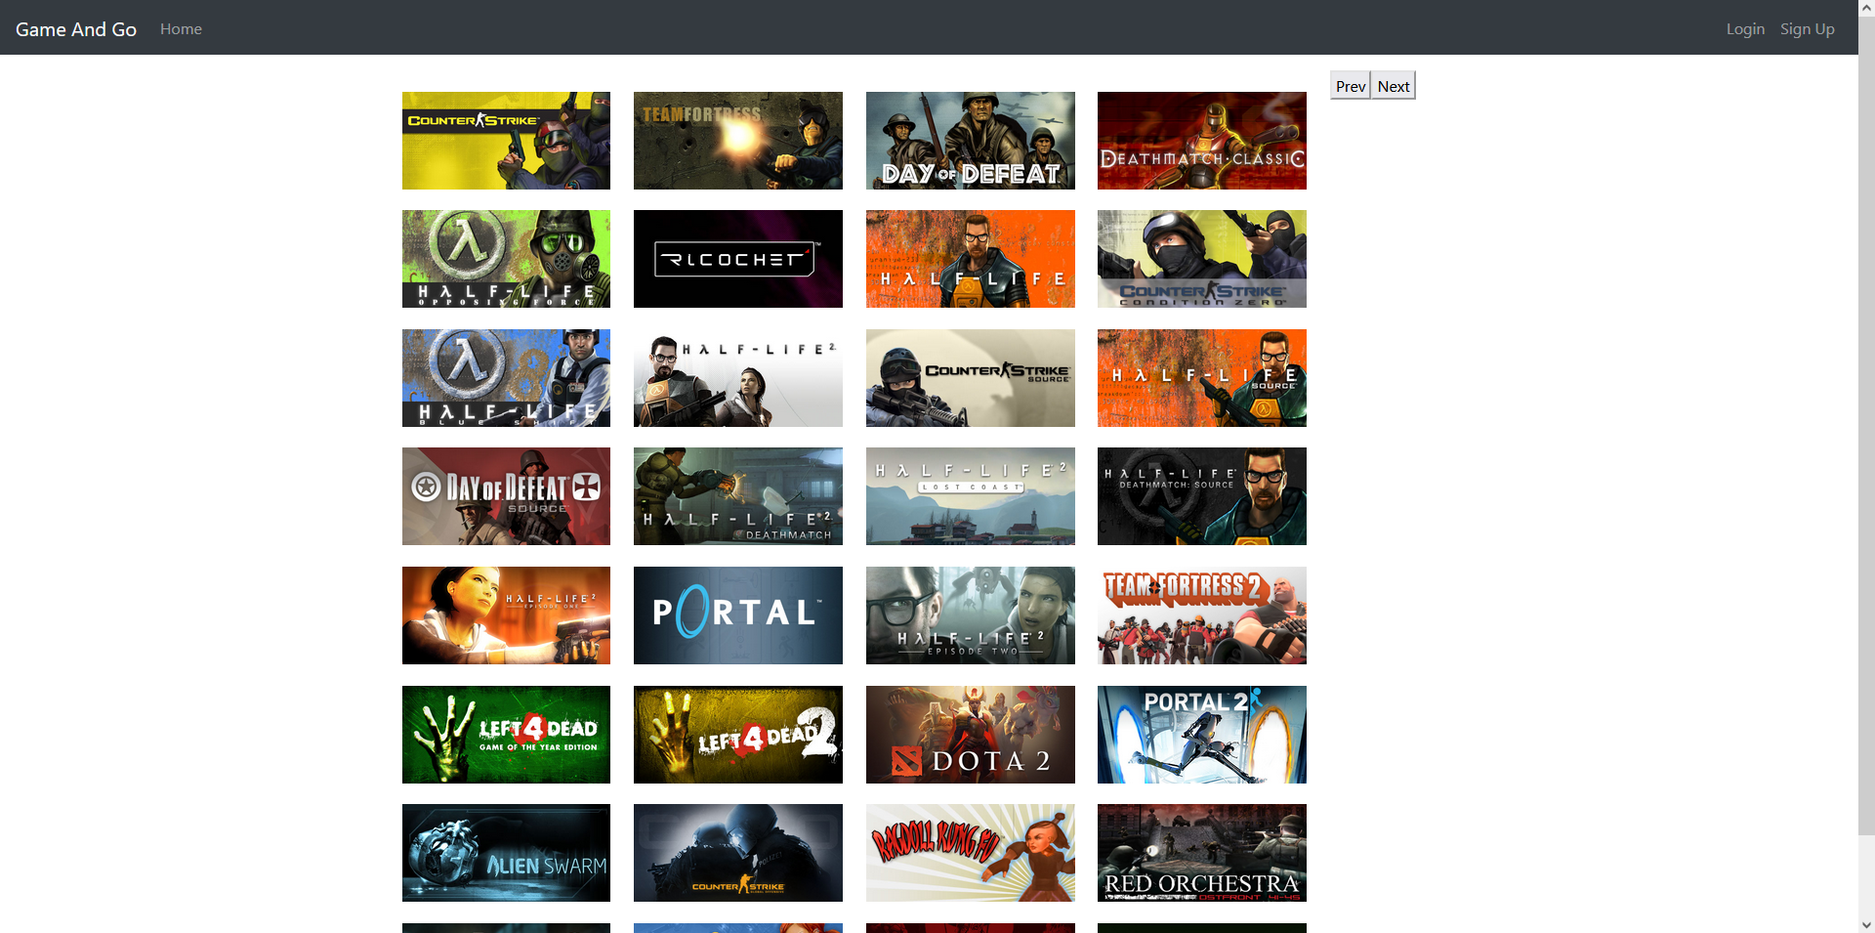
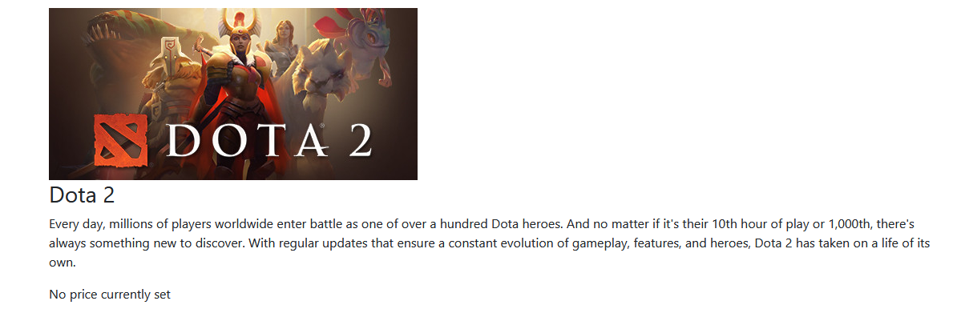
Non user case 1: Browse catalog of games
When the non user first comes to our website they are greeted with our entire library and a log in or sign up button in the top right.
For this case they have the ability to go through seemingly endless options and have the option to click on any game that piques their interest and they will be shown information about that game.
Image of random game info

Slide 3
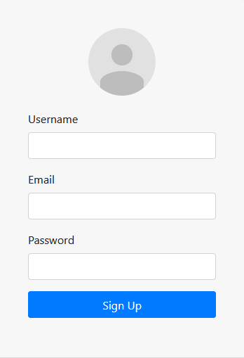
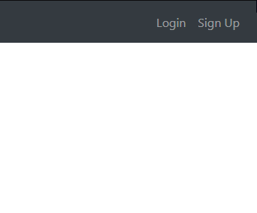
Non user case 2: Register for the website
When the non user first comes to our website they are greeted with our entire library and a log in or sign up button in the top right.
For this case we will chose the sign up option which then prompts the user to input their username, email, and password. Once everything is submitted, they are fully registered to move into becoming a registered user.
Notes:
When the non user first comes to our website they are greeted with our entire library and a log in or sign up button in the top right.
For this case we will chose the sign up option which then prompts the user to input their username, email, and password. Once everything is submitted, they are fully registered to move into becoming a registered user.

Slide 4
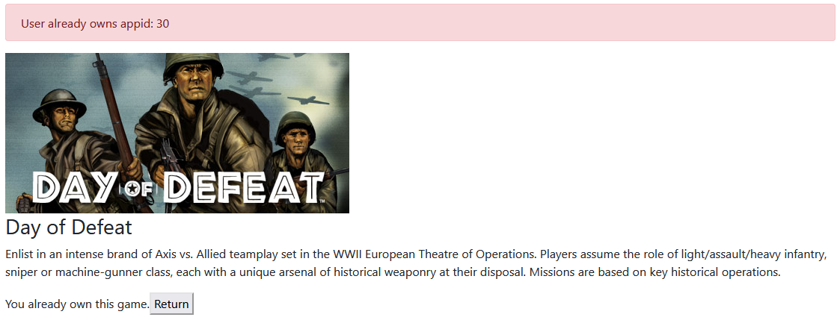
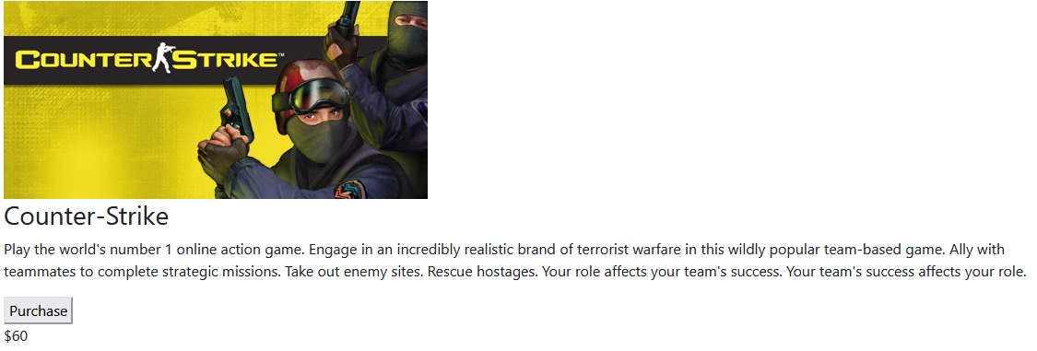
Registered user case 1: Purchase 3 games
Once the non-user has signed in, they are now a registered user and possess the ability to purchase a number of games we offer from our library
One feature of our website is the error that shows when a registered user attempts to purchase a game that they already own. For instance if you have a game open in two tabs and purchase it, then try to purchase it again in the second tab, it shows you that you have already purchased this game!

Slide 5
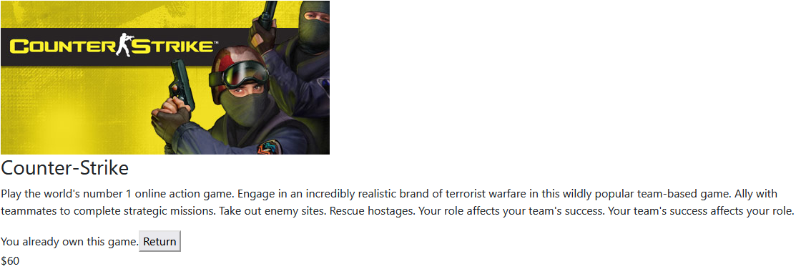
Registered user case 2: Return 2 games
If a registered user wants to return a game they own, they have two options.
They can navigate through the storefront to find the game and click on it from there to return it.
They also have the luxury of going to the “My Games” tab and returning the games from there.

Slide 6
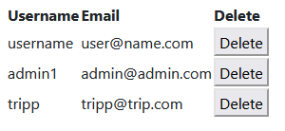
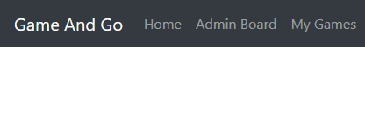
Website admin case 1: Remove users from registration list
When a website admin logs in they will immediately have access to a new button at the top called “Admin Board.”
This will list all the active users of the site and they have the ability to remove any users for any given reason, such as an error when registering or misuse of the website.

Slide 7
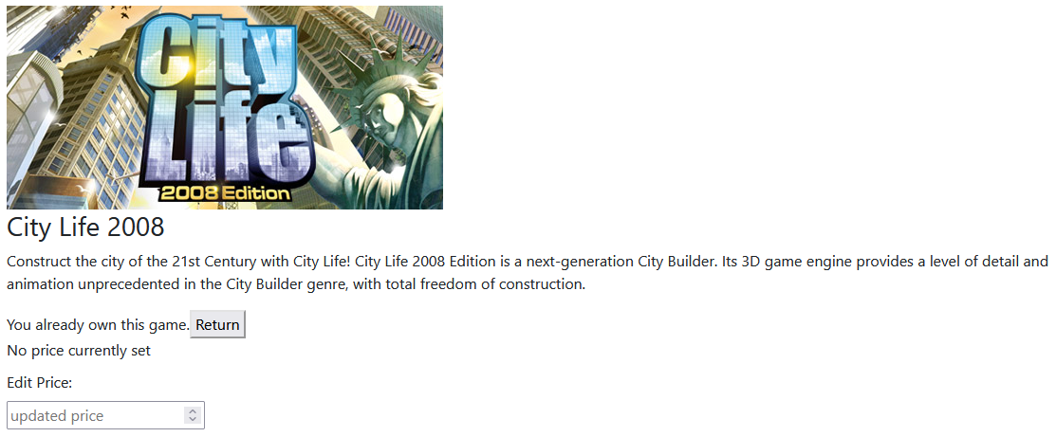
Website admin case 2: Edit pricing
When a website admin is logged in they can look through the store front just as any other user, however when they click on a game they are able to adjust the price of that game right then and there.

