Slide 1

Ali Robotics Team - UAE Information AI Chatbot
Robotics Competition Entry | Grades 5-8
Tagline: Building the Future, One Robot at a Time
Repository: https://github.com/Attari-Home/ai-chatbot-ali
Analysis Date: October 4, 2025
Author: Automated Analysis
Notes:
Introduction: This presentation analyzes the Ali Robotics Team's UAE Information AI Chatbot project. Agenda: Project overview, architecture, code structure, data model, DevOps, and recommendations.

Slide 2
Executive Summary
• Purpose: AI chatbot providing real-time UAE information for tourists, transport, events, and emergencies
• Target Users: Tourists and residents seeking UAE information
• Core Value: Comprehensive, multilingual information system with PictoBlox AI integration
• Current Status: Competition entry project (submission deadline: September 20, 2025)
Technology Stack: Angular 17, TypeScript, Tailwind CSS, PictoBlox AI
Notes:
The project is a robotics competition entry focused on creating an AI-powered information system for UAE visitors. It integrates modern web technologies with AI capabilities.

Slide 3
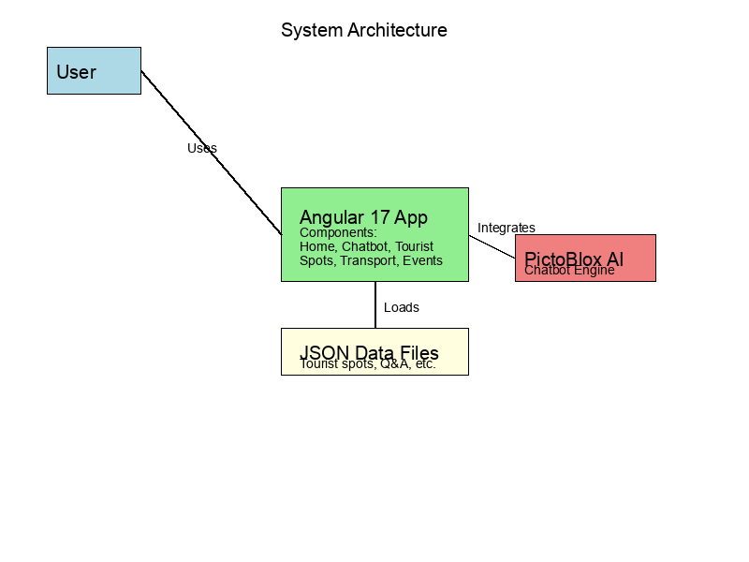
System Architecture
• Frontend: Angular 17 single-page application with component-based architecture
• AI Integration: PictoBlox AI engine for chatbot functionality
• Data Layer: Static JSON files for tourist spots, events, and Q&A data
• Key Components: User interface, data services, AI processing pipeline
Notes:
The architecture shows a client-side Angular application that loads JSON data and integrates with PictoBlox AI for intelligent responses. No backend server is required.

Slide 4
Key Modules & Code Structure
• Core Services (7 services): Meta, Performance, Theme, Content Import, Image Optimization, Privacy, Sitemap
• Feature Components (9 features): Home, Chatbot, Tourist Spots, Transport, Events, Emergency, About, Team, Contact
• Assets: Data files (10 JSON files), i18n (3 languages), Images
• Total: 34 TypeScript files, 4,004 lines of code
Sample Code (App Component):
import { Component } from '@angular/core';
@Component({
selector: 'app-root',
template: '<router-outlet></router-outlet>'
})
export class AppComponent {}
Notes:
The codebase is well-organized with clear separation of concerns. Services handle cross-cutting concerns while features are modular components.

Slide 5
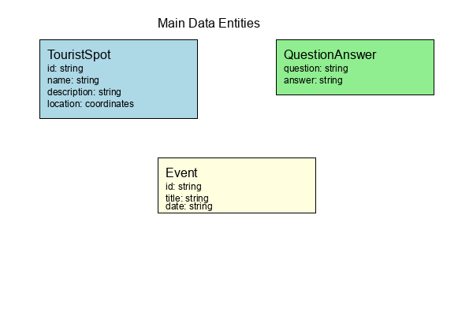
Data Model & APIs
Main Entities:
• TouristSpot: id, name, description, location, images, tags
• QuestionAnswer: question, answer pairs for chatbot
• Event: id, title, date, description
• TeamMember: name, role, bio
Sample API Endpoints:
• GET /api/tourist-spots - List all tourist spots
• GET /api/events - Upcoming events
• POST /api/chatbot/query - Chatbot interaction
Notes:
Data is stored in JSON format for simplicity. The entities represent the core information domains: tourism, events, and chatbot knowledge.

Slide 6
DevOps, Tests & Security
CI/CD: GitHub Actions workflow for deployment to GitHub Pages
Tests: Karma/Jasmine unit tests (34 spec files), Playwright E2E tests
Docker/K8s: Not implemented
Security: .env file present (not committed), basic input sanitization with DOMPurify
Code Quality: Prettier formatting, ESLint, good separation of concerns
Notes:
The project has solid testing coverage and automated deployment. Security measures are basic but appropriate for a frontend application.

Slide 7
Recommendations & Next Steps
High Priority (S):
• Add backend API for dynamic data updates
• Implement user authentication
• Add comprehensive error handling
Medium Priority (M):
• Add Docker containerization
• Implement caching for performance
• Add monitoring and analytics
Low Priority (L):
• Add dark mode toggle
• Implement PWA features
• Add multi-language support
Immediate Wins:
• Add README badges
• Run security audit
• Add API documentation
Notes:
Focus on backend development for data persistence and user management. Containerization would improve deployment reliability.

