Slide 1
Garment fitting application
Atte Karppinen

Slide 2
Overview
Garment fitting application
Simple, one purpose app
Used with smartphones
Vast selection

Slide 3
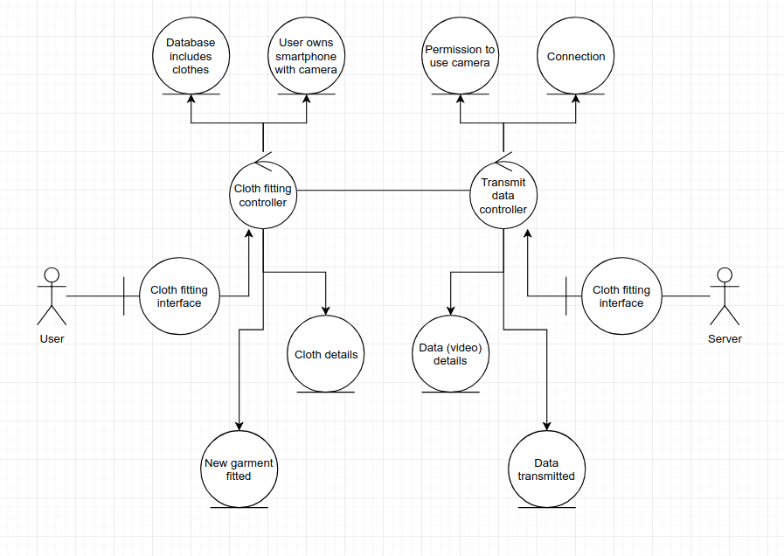
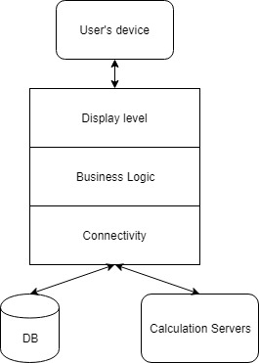
Architecture
Notes:
Model-View-Controller?
Analysis class

Slide 4
Target Market
Everyone interested in shopping
Maybe specialisation on specific garments
People with access to smart devices
Most likely audience
Teenagers
Young adults

Slide 5
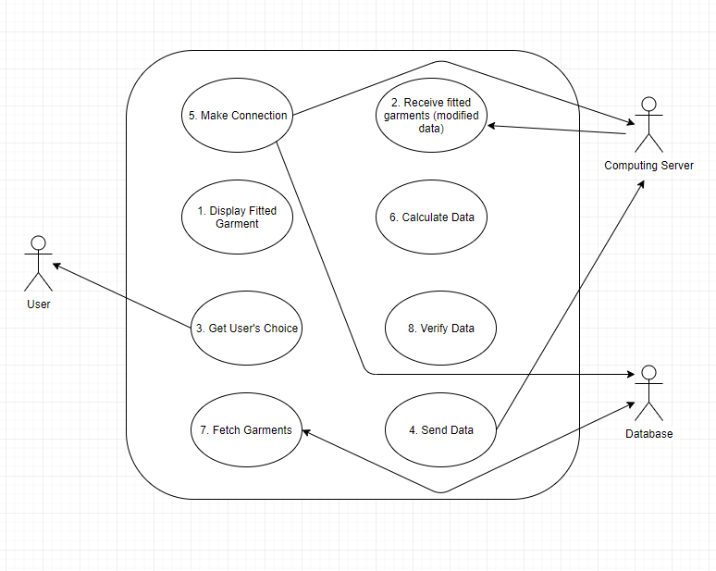
Project Plan

Slide 6
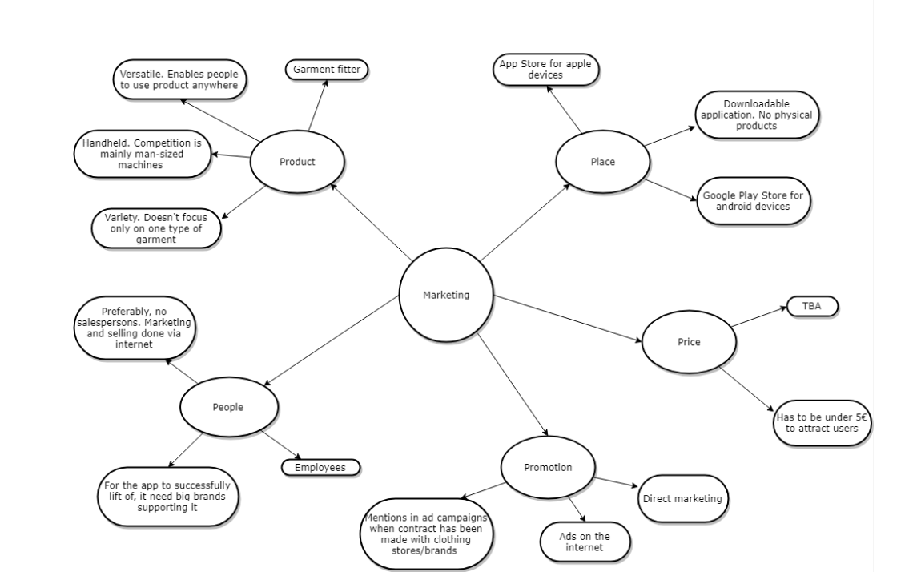
Mind Map

Slide 7
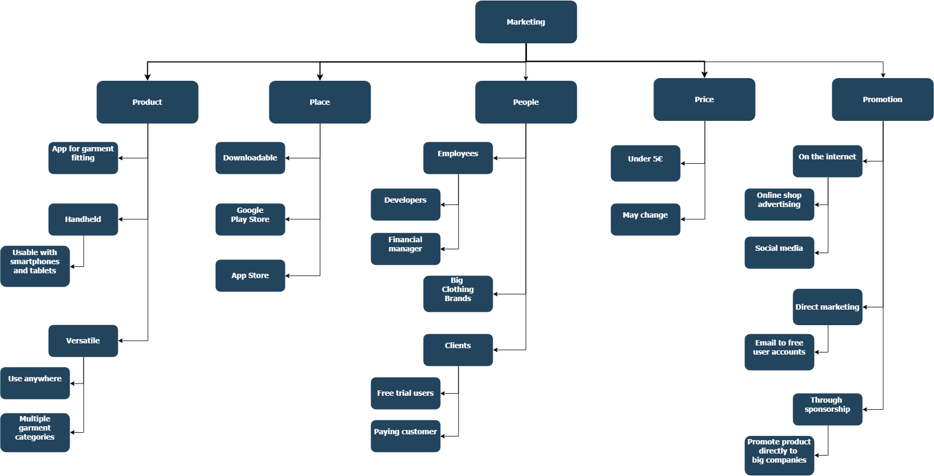
Work Breakdown Structure

Slide 8
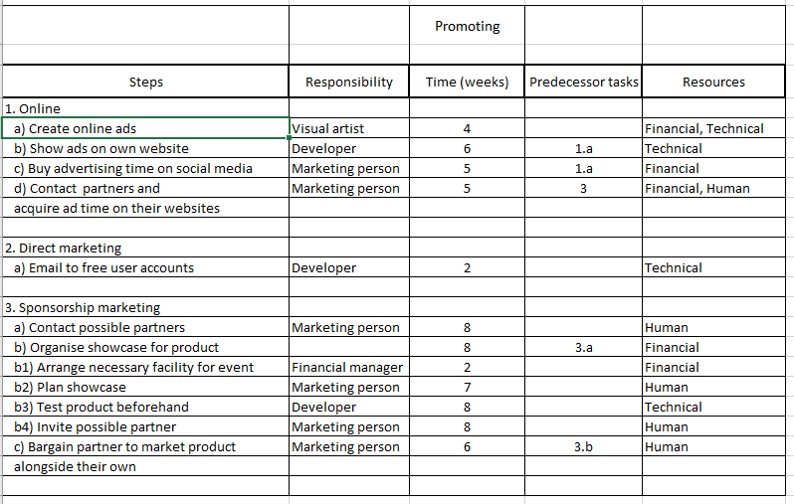
Action Plan

Slide 9
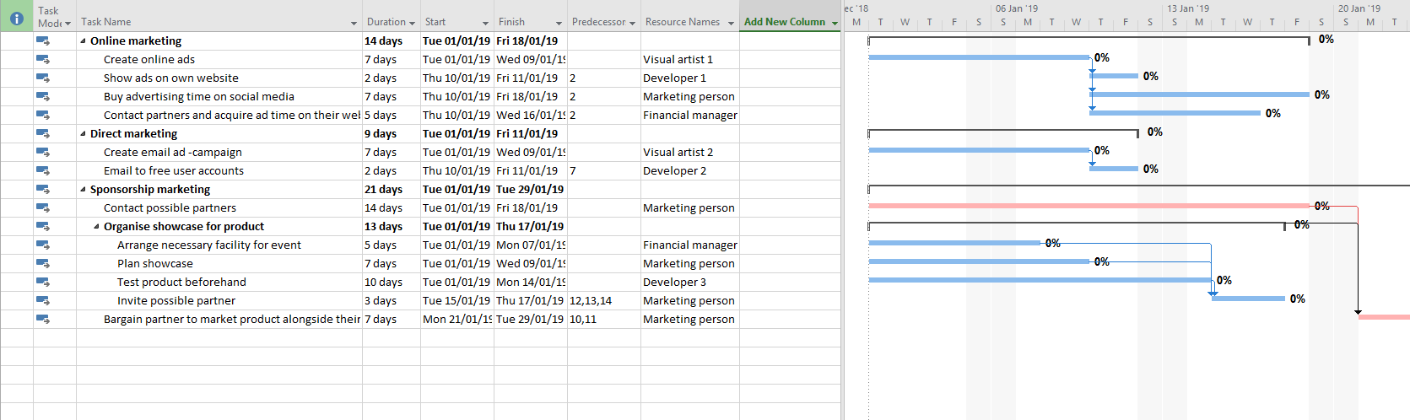
Gantt Chart

Slide 10
Cost Estimation
New technology involved
Object recognition
Requires experts
Big brands as financial backers is a must
Heavy duty hardware for real time calculations
ESTIMATION ~€15 million up front

Slide 11
Conclusion
High risk high reward
Success dependent on financial backers
Plausible technological vanguard

