Slide 1

Attendance Tracker
CS 495 - Capstone Computing
Jacob Cowles, Zack Witherspoon, Greyson Wright

Slide 2
Attendance Tracker
What
Students can scan for class attendance
Students can view their attendance for each class
Teachers can view students who missed and attended class
Teachers can view statistics on their classes
Why
Harder for students to cheat the system
Easier and more accurate for teachers to take role
Teachers can easily view statistics to better manage their classes

Slide 3
Goal
Our goal was to end up with a fully functioning, dynamic front end with a properly styled UI on the Android side and to redo the QR-Scanner to be more flexible and work like a true qr-scanner.
While we were successful in creating a fully functional front-end with live data, we had to pivot our plans of redoing the QR-Scanner and remodeling the UI on the Android side.

Slide 4
Testing
We created roughly 60 test cases across the web and android side.
On the Android side, the test cases mainly focused on:
Handling responses from API calls.
Creating Attendance objects and Class objects from API calls is a major part of the app that we wanted to verify would work locally as well as in the field.
On the web side, the test cases covered:
Database layer
Web API controllers
Factories
Models

Slide 5
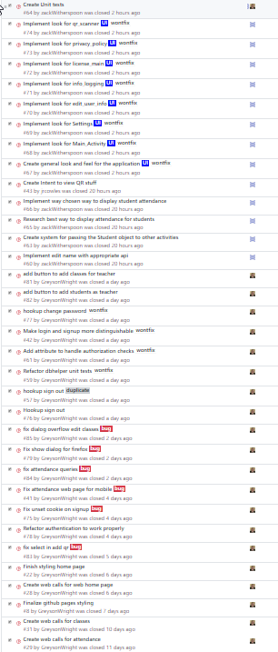
Sprint 3 Review
We created 35 issues and were able to complete 22 out of 35.
Implemented Features:
Implemented several API for attendance viewing and class viewing
Created several new test cases to add to the test repository
Wrote several queries concerning attendance and classes
Went from hard-coded front-end to fully-functioning front-end with dynamic data and modals

Slide 6
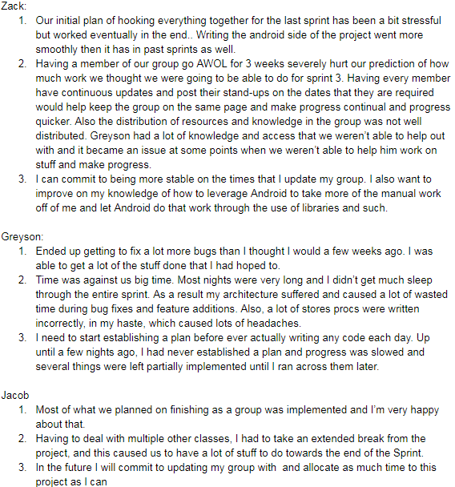
Sprint 3 Retrospective
Good:
Transitioning from a hard-coded layout to a dynamic system was more difficult than we expected but did work in the end.
Bad:
Sprint 3 gave us a challenge in the realm of different members working different amount of hours on the project.
Planning what to write before starting to code was an issue most of faced.
Determining how long stories would take to complete
Improvement:
Improving communication in the group
Improving planning the architecture before starting to code

Slide 7
Demo

