Slide 1

Attendance Tracker
CS 495 - Capstone Computing
Jacob Cowles, Zack Witherspoon, Greyson Wright

Slide 2
Attendance Tracker
What
Students can scan for class attendance
Students can view their attendance for each class
Teachers can view students who missed and attended class
Teachers can view statistics on their classes
Why
Harder for students to cheat the system
Easier and more accurate for teachers to take role
Teachers can easily view statistics to better manage their classes

Slide 3
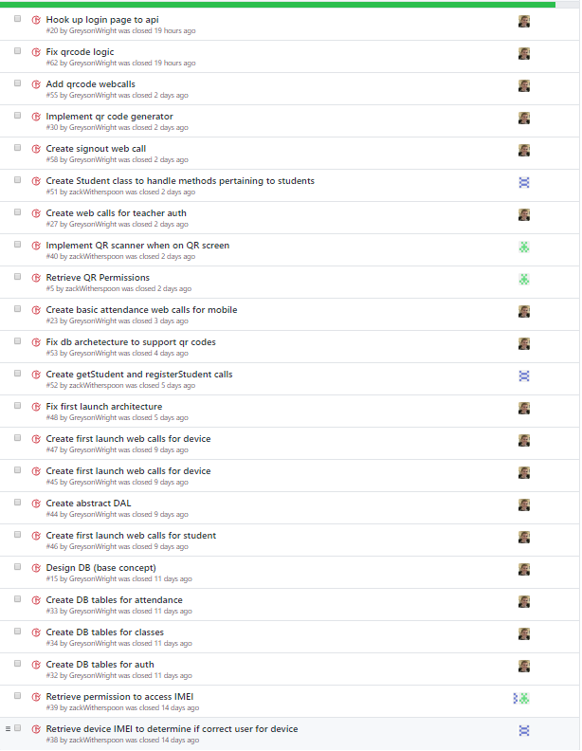
Sprint 2 Review
We created 24 issues and were able to complete 23 out of 24.
Implemented Features:
Able to grab the IMEI from a device and use that for verification on sign-on
Created 10+ RESTful API with unit cases
Implemented student sign up through use of IMEI and through the created API
Created the scanning of QR codes that can either pass/fail based on location

Slide 4
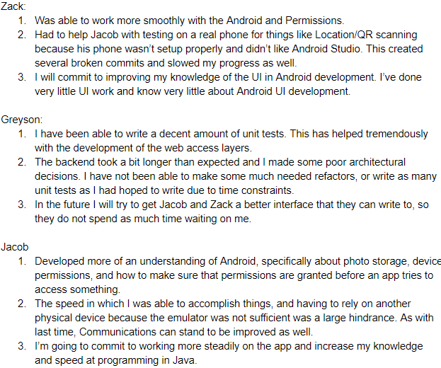
Sprint 2 Reflection

Slide 5
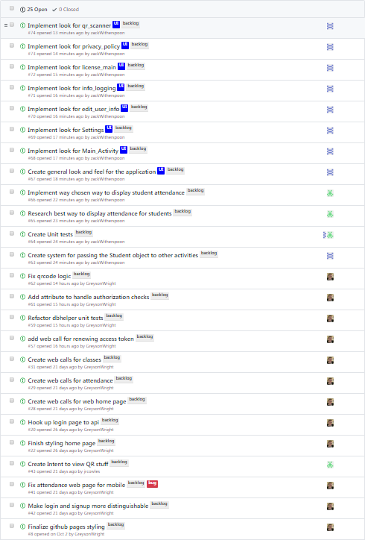
Current Backlog and Sprint 3 Planning
https://waffle.io/AttendanceTracker/AttendanceTracker

Slide 6
Demo time

Slide 7
