Slide 1

Attendance Tracker
CS 495 - Capstone Computing
Jacob Cowles, Zack Witherspoon, Greyson Wright

Slide 2

Why?
Digital Web Interface
Saves Paper
No clickers/ clicker replacement

Slide 3

Why?
Large Class Sizes
Stressed Attendance
Harder to Cheat
Classroom management features in the future

Slide 4
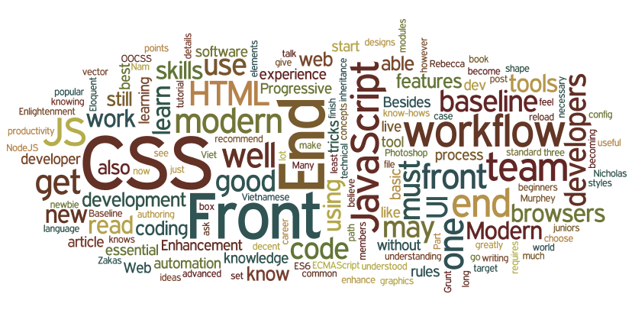
Mobile Front-End
Students can scan in and/or out
Include information like mybama username, cwid, and name
View missed and attended classes
Future Feature: allow teachers to manage classes, attendance, and manual role input
Notes:
Students scan QR code with possible location verification via location services

Slide 5

Web Portal
For teachers only
Manual role input
View and manage classes
Export and view attendance
Create and manage QR codes
Notes:
QR codes can be configured (expire, expiration time)
QR codes can be viewed online
attendance can be exported as csv or xlsx (download or email)

Slide 6

Technical Details
MSSQL DB
.NET Core MVC
HTML, CSS, JS, Razor
OWIN Auth
Android Studio with Java

Slide 7

Possible Challenges/Obstacles
Possible 3rd party API access
Blackboard, Moodle, Canvas, etc.
Import and export formats
Students that don’t have phones
Creative differences

Slide 8

Timeline
Database design
Functioning Database
Functioning Android/Web mockup
Begin Backend implementation
Hook up Backend to Android/Web front-ends
Final Q&A
Bug Fixes
Possible Future features
Project completion and submission

