Slide 1
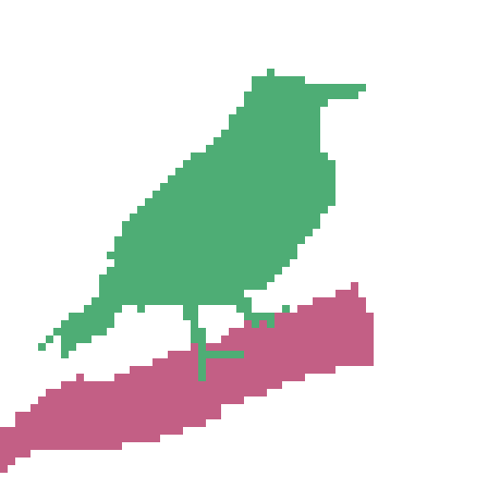
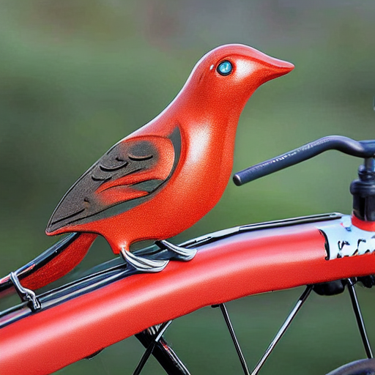
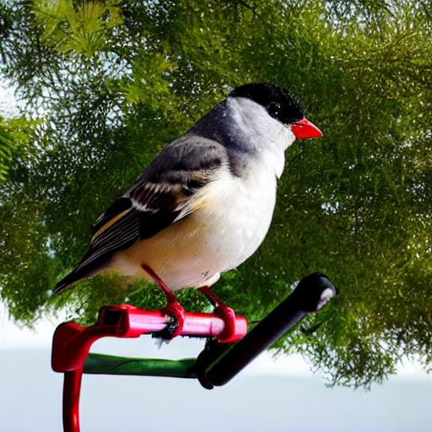

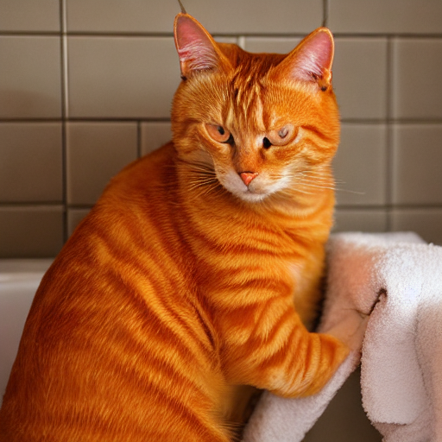
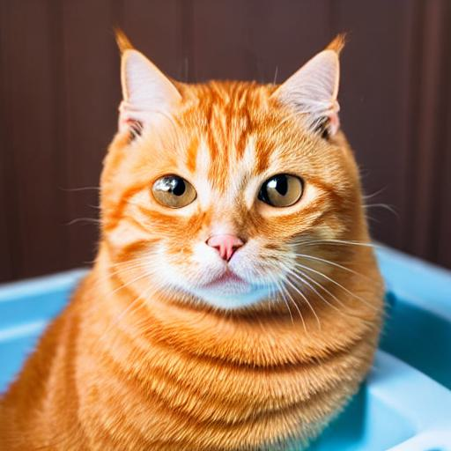
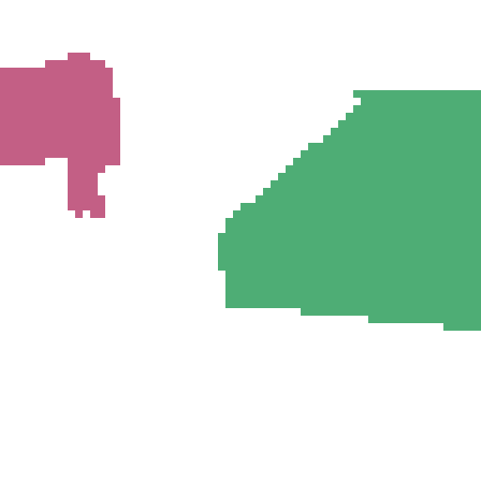
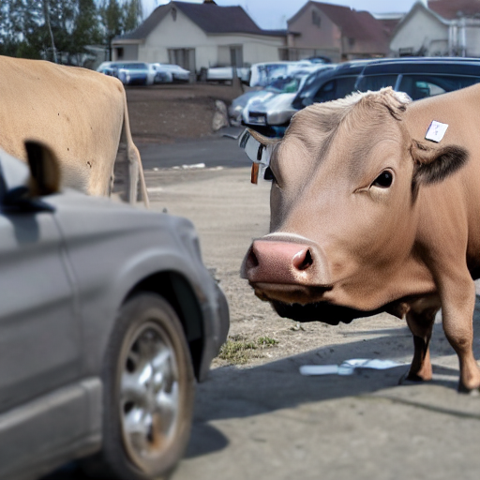
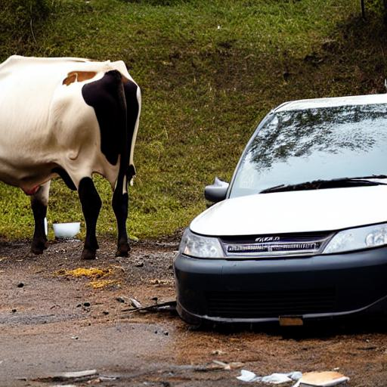

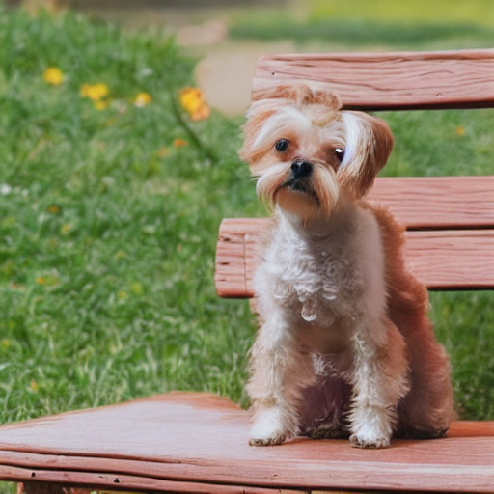
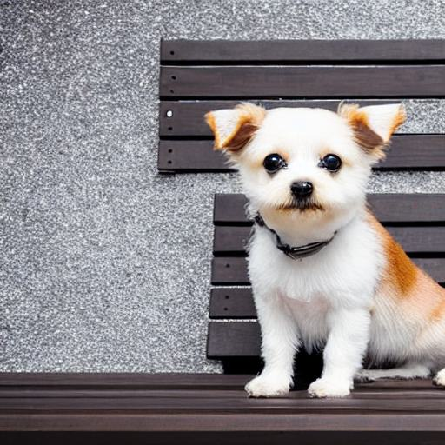
26
An orange tabby cat lying in a bathroom sink
69
2

Slide 2

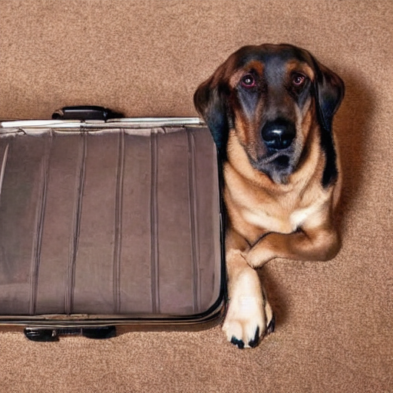
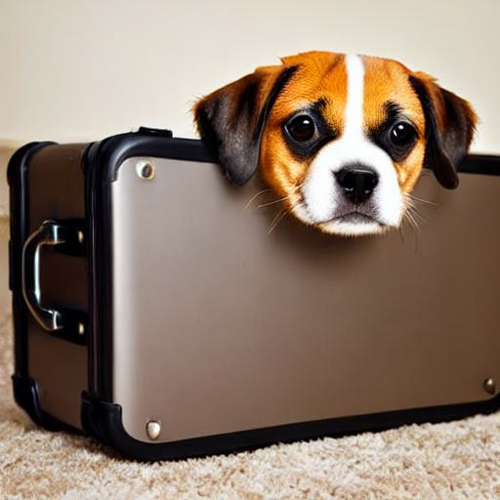

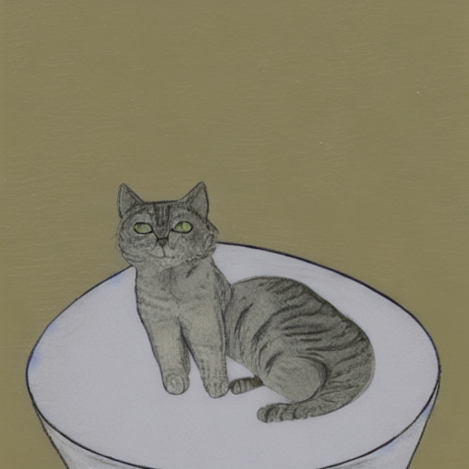
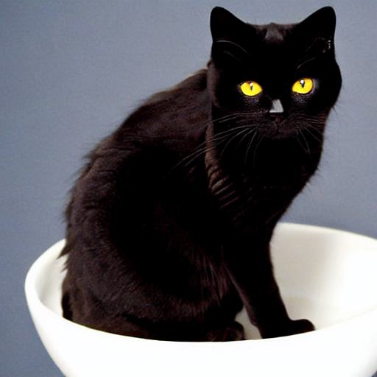
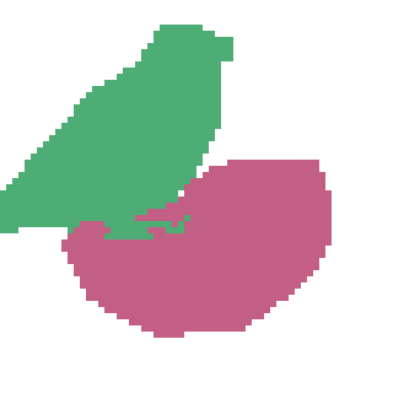
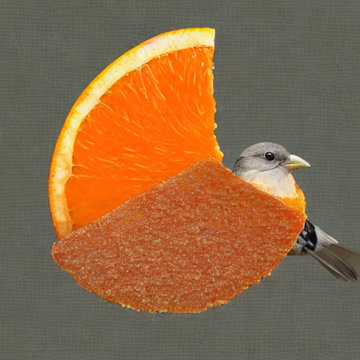
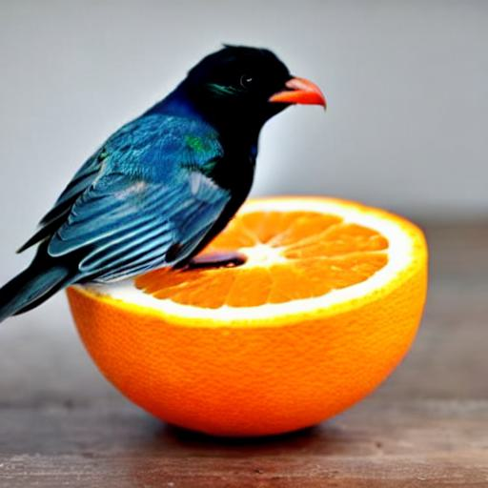
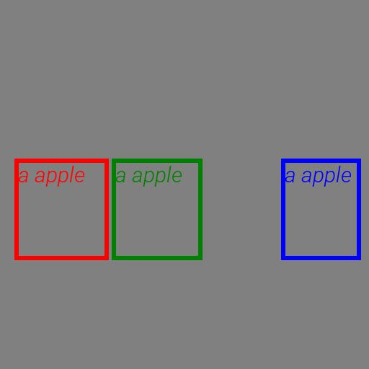
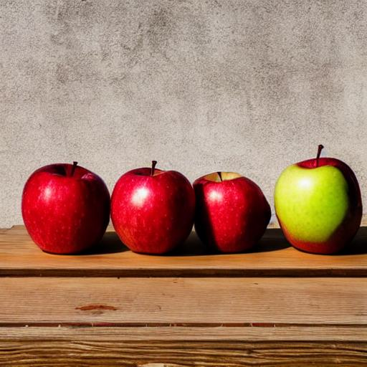
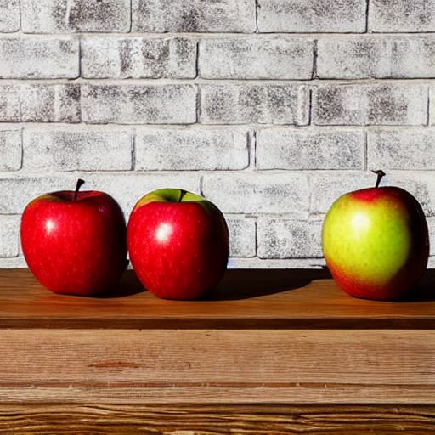

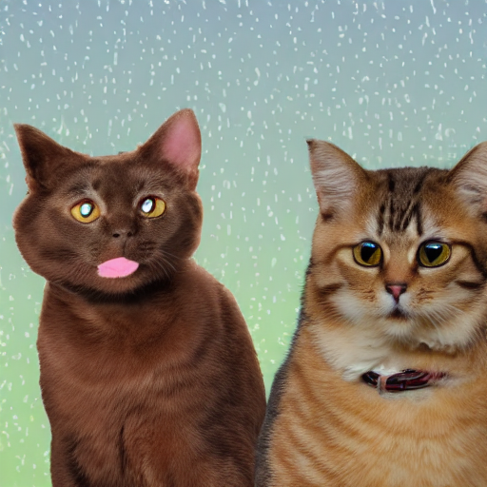
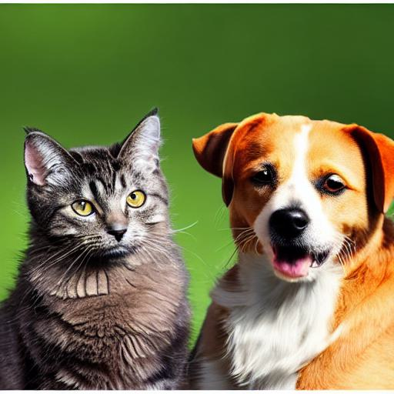
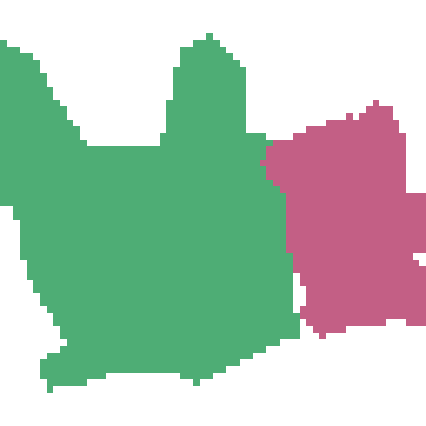
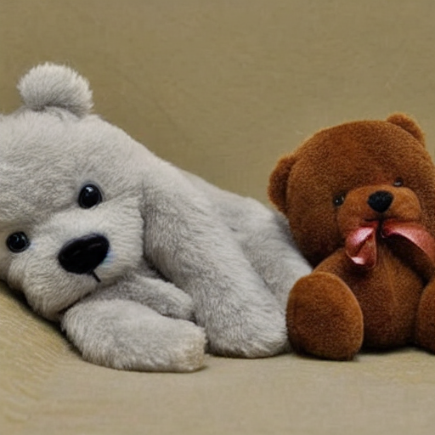
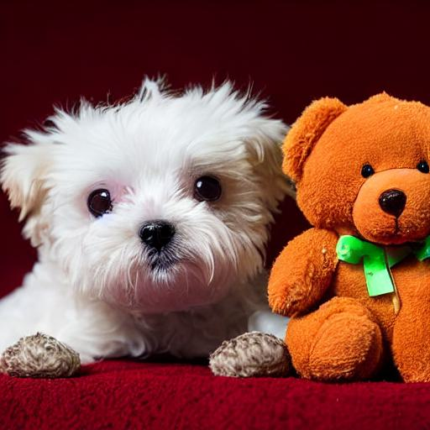
The dog is laying down in the suitcase
A cat is sitting in a white bowl
Semantic mask
DenseDiffusion
StableDiffusion + Ours
An orange tabby cat lying in a bathroom sink
Semantic mask
DenseDiffusion
StableDiffusion + Ours
A bird is sitting on the handlebars of a bicycle
Semantic mask
DenseDiffusion
StableDiffusion + Ours
A bird sitting on top of an orange slice
A cow standing next to a damaged car on a dirty lot
Semantic mask
DenseDiffusion
StableDiffusion + Ours
Three apples are sitting side-by-side on a wooden table
Semantic mask
DenseDiffusion
StableDiffusion + Ours
Semantic mask
DenseDiffusion
StableDiffusion + Ours
A dog and a cat standing side by side
Layout
GLIGEN
GLIGEN + ours
A small dog lays with a teddy bear
156
Semantic mask
DenseDiffusion
StableDiffusion + Ours
A little dog sitting on a wooden bench
Semantic mask
DenseDiffusion
StableDiffusion + Ours
Semantic mask
DenseDiffusion
StableDiffusion + Ours

Slide 3
106
127
156
120

