Slide 1
House Price Analysis
Name: Attila Hostyanszki
Student Number: 2548713

Slide 2
Purpose of the Analysis
The purpose of this project is to analyse factors that influence house prices
The objectives are:
Explore relationships between variables
Identify key predictors of house prices
Build a model to predict house prices

Slide 3
Data Overview
Data Preparation
The dataset contains information about 996 houses
Variables:
Square Footage
Number of Bedrooms
Number of Bathrooms
Year Built
Lot Size
Garage Size
Neighbourhood Quality
House Price

Slide 4
Data Inspection
Data Preparation
Before analysis, the dataset was checked for data quality:
Missing values
Duplicates
Structure of variables
Results:
No missing values were found
No duplicates were found

Slide 5
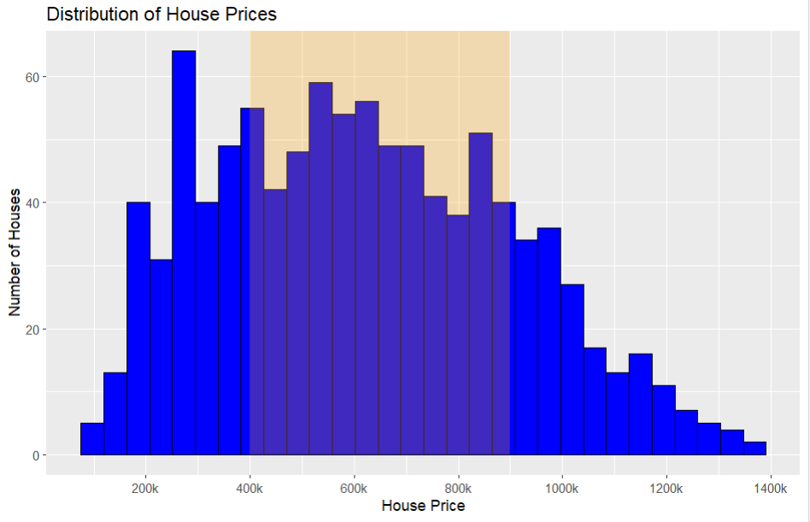
Distribution of House Prices
Explanatory data analysis
Most houses are priced between £400k and £900k
The distribution is right-skewed
Only a small number of houses have very high prices

Slide 6
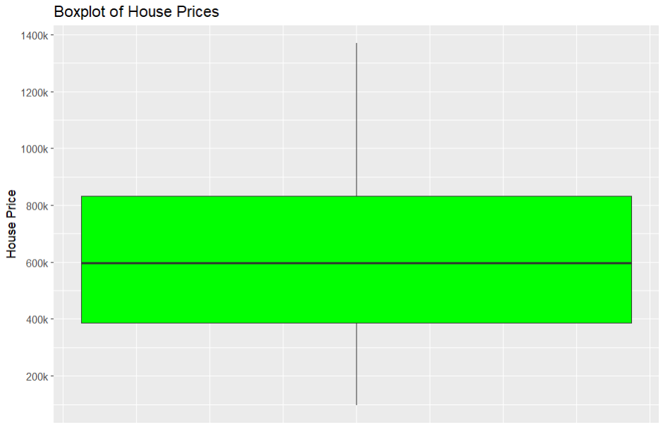
Boxplot of House Prices
Explanatory data analysis
The median house price is around £600k
Most house prices fall between £400k and £900k
A few houses have higher prices than the majority

Slide 7
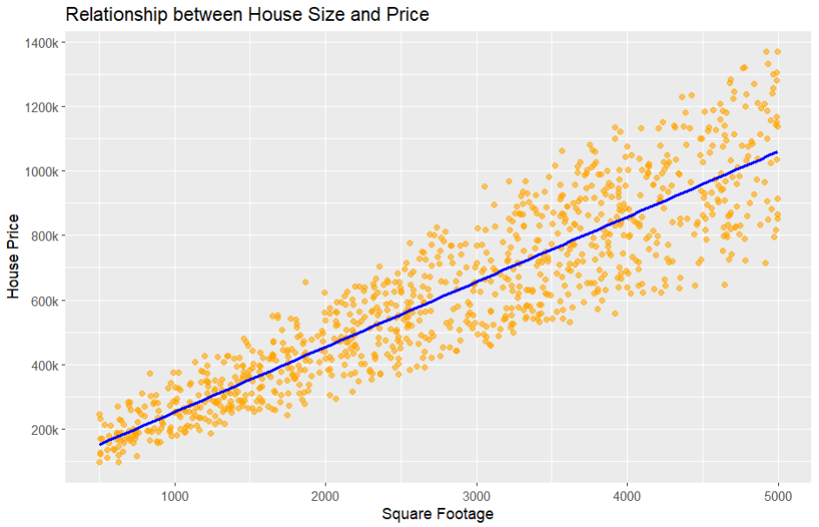
Relationship Between House Size and Price
Explanatory data analysis
There is a strong positive relationship between house size and house price (r = 0.904)
Larger houses are generally more expensive
This suggests that square footage is an important factor in determining house prices

Slide 8
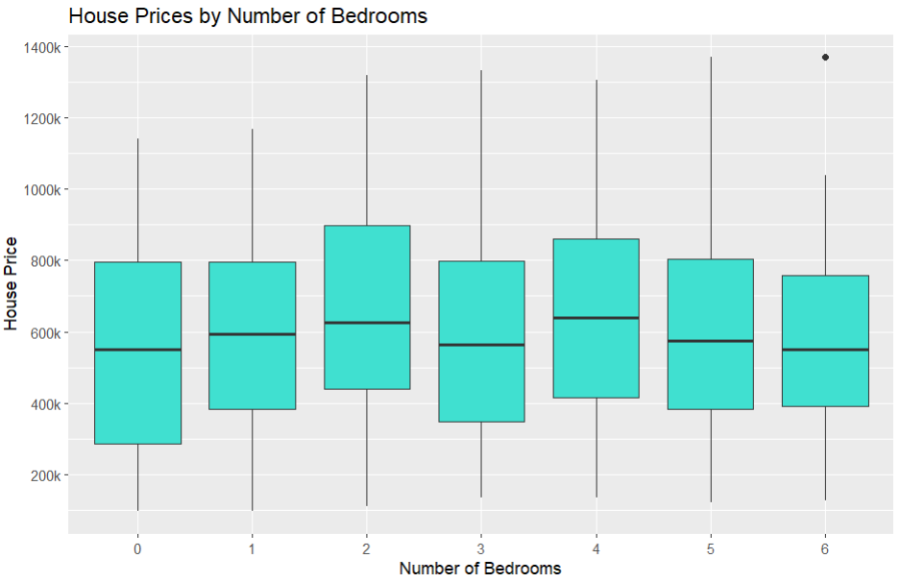
House Prices by Number of Bedrooms
Explanatory data analysis
Houses with more bedrooms tend to be more expensive
(r = 0.013)
However, the relationship is weaker than with house size
Correlation analysis shows house size has a much stronger relationship with price

Slide 9
Multiple Linear Regression Model
Predictive Modelling
A multiple linear regression model was used to predict house prices
The model included variables such as:
Square Footage
Number of Bedrooms
Number of Bathrooms
Year Built
Lot Size
Garage Size
Neighbourhood Quality
Model performance: R² = 0.83
The model explains about 83% of the variation in house prices

Slide 10
Conclusion
Key Findings
House size has the strongest relationship with house price
The number of bedrooms has a much weaker relationship
The regression model explains 83% of the variation in house price
The model can be used to estimate house price based on property characteristic.

