Slide 1
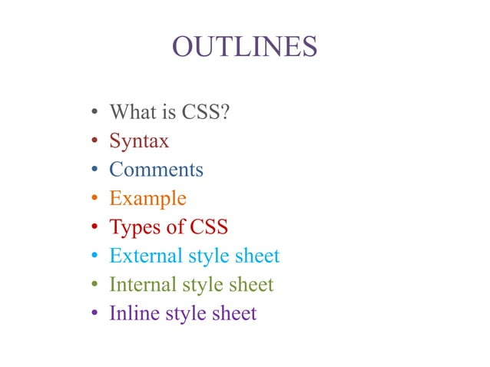

Slide 2
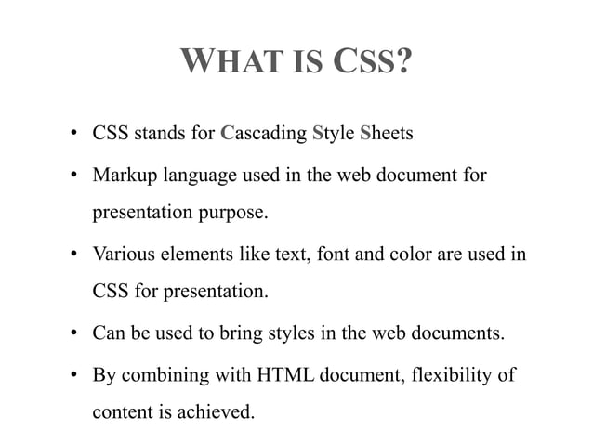

Slide 3
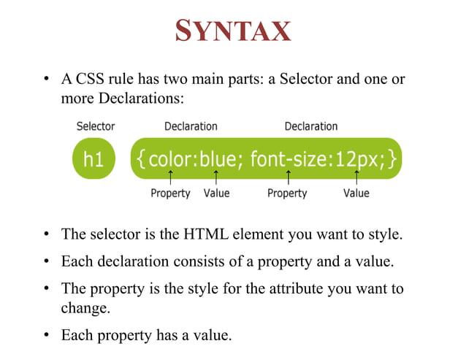

Slide 4
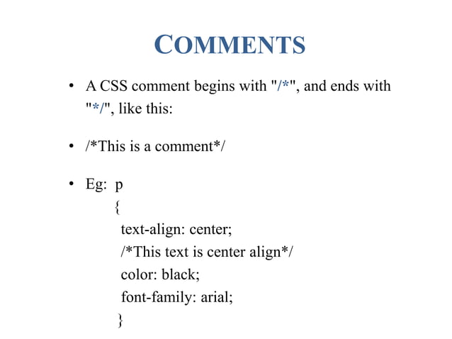

Slide 5
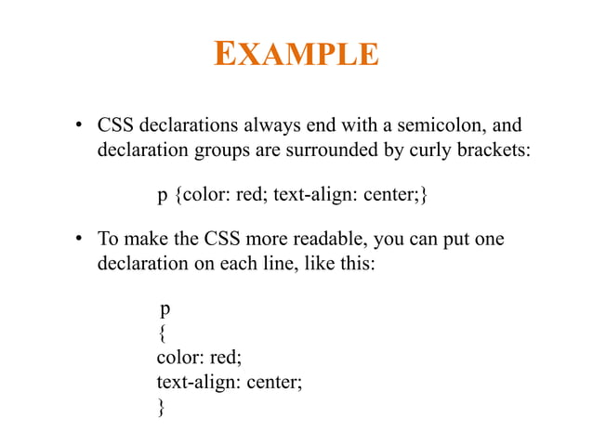

Slide 6
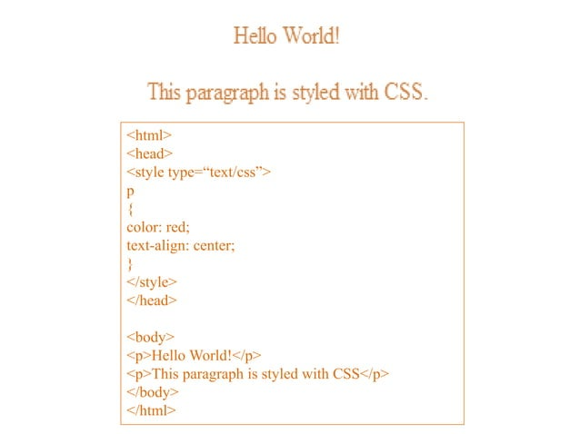

Slide 7
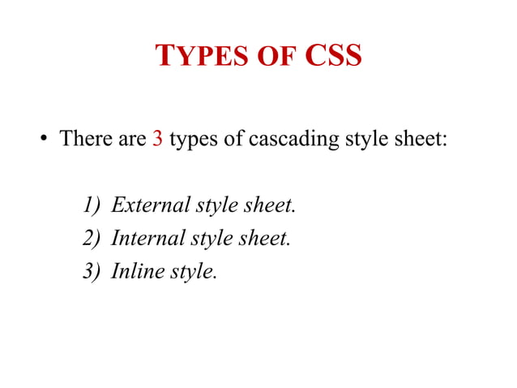

Slide 8
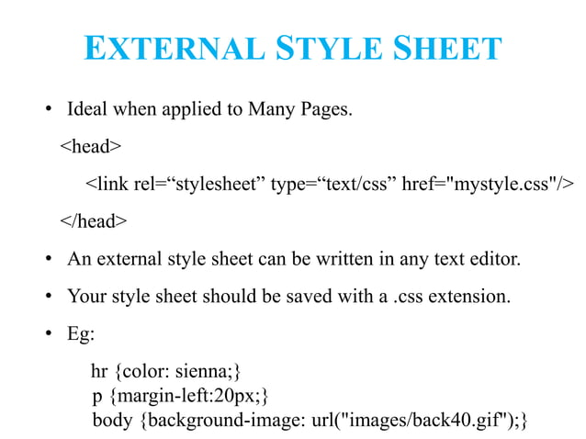

Slide 9
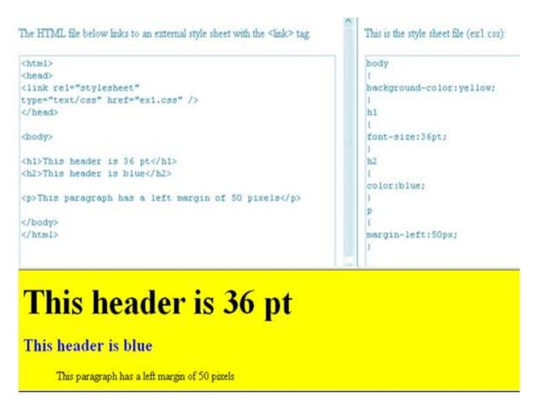

Slide 10
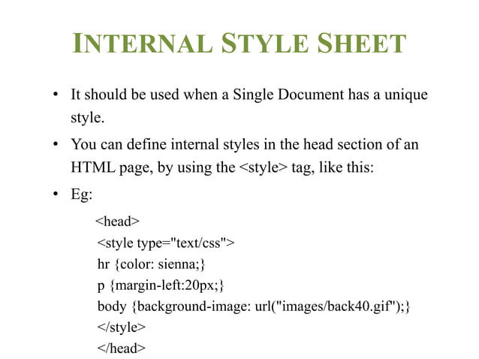

Slide 11
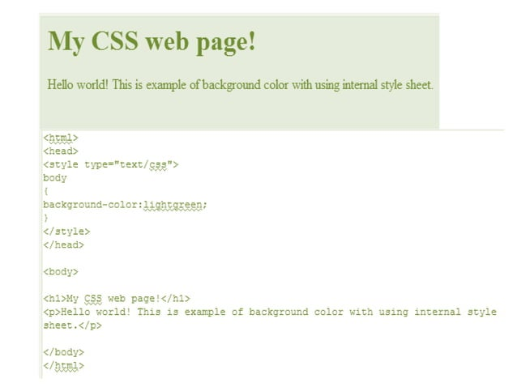

Slide 12
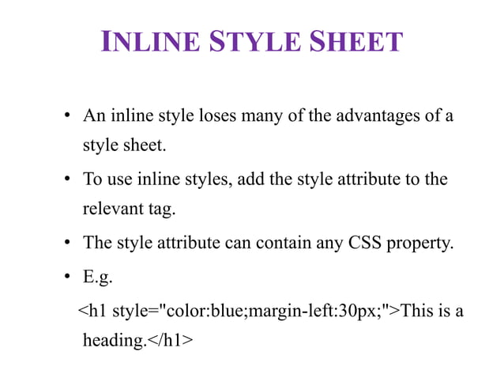

Slide 13
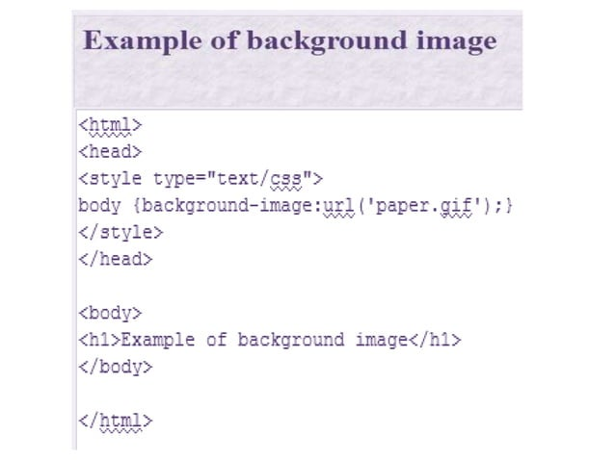

Slide 14
Div Definition and Usage
The <div> tag defines a division or a section in an HTML document.
The <div> tag is used as a container for HTML elements - which is then styled with CSS or manipulated with JavaScript.
The <div> tag is easily styled by using the class or id attribute.
Any sort of content can be put inside the <div> tag!
Note: By default, browsers always place a line break before and after the <div> element.

Slide 15
Code Div
<!DOCTYPE html>
<html>
<head>
<style>
.my{
border: 5px outset red;
background-color: lightblue;
text-align: center;
}
</style>
</head>
<body>
<h1>The div element</h1>
<div class="my">
<h2>This is a heading in a div element</h2>
<p>This is some text in a div element.</p>
</div>
<p>This is some text outside the div element.</p>
</body>
</html>

Slide 16
CSS Padding
<!DOCTYPE html>
<html>
<head>
<style>
div {
padding: 70px;
border: 1px solid #4CAF50;
}
</style>
</head>
<body>
<h2>CSS Padding</h2>
<div>This element has a padding of 70px.</div>
</body>
</html>

Slide 17
CSS height and width properties
<!DOCTYPE html>
<html>
<head>
<style>
div {
height: 50px;
width: 100%;
border: 1px solid #4CAF50;
}
</style>
</head>
<body>
<h2>CSS height and width properties</h2>
<div>This div element has a height of 50 pixels and a width of 100%.</div>
</body>
</html>

Slide 18
A Fancy Table
<!DOCTYPE html>
<html>
<head>
<style>
#customers {
font-family: Arial, Helvetica, sans-serif;
border-collapse: collapse;
width: 100%;
}
#customers td, #customers th {
border: 1px solid #ddd;
padding: 8px;
}
#customers th {
padding-top: 12px;
padding-bottom: 12px;
text-align: left;
background-color: #04AA6D;
color: white;
}
</style>
</head>
<body>
<h1>A Fancy Table</h1>
<table id="customers">
<tr>
<th>Company</th>
<th>Contact</th>
<th>Country</th>
</tr>
<tr>
<td>Alfreds Futterkiste</td>
<td>Maria Anders</td>
<td>Germany</td>
</tr>
<tr>
<td>Berglunds snabbköp</td>
<td>Christina Berglund</td>
<td>Sweden</td>
</tr>
<tr>
<td>Centro comercial Moctezuma</td>
<td>Francisco Chang</td>
<td>Mexico</td>
</tr>
<tr>
<td>Ernst Handel</td>
<td>Roland Mendel</td>
<td>Austria</td>
</tr>
<tr>
<td>Island Trading</td>
<td>Helen Bennett</td>
<td>UK</td>
</tr>
<tr>
<td>Königlich Essen</td>
<td>Philip Cramer</td>
<td>Germany</td>
</tr>
<tr>
<td>Laughing Bacchus Winecellars</td>
<td>Yoshi Tannamuri</td>
<td>Canada</td>
</tr>
<tr>
<td>Magazzini Alimentari Riuniti</td>
<td>Giovanni Rovelli</td>
<td>Italy</td>
</tr>
<tr>
<td>North/South</td>
<td>Simon Crowther</td>
<td>UK</td>
</tr>
<tr>
<td>Paris spécialités</td>
<td>Marie Bertrand</td>
<td>France</td>
</tr>
</table>
</body>
</html>

