Slide 1
Reducing Road Collsions In Brooklyn
Data-Driven Recommendation using 2012-2018 Data from the New York Police Department (NYPD)
Jacopo Attolini, 24th of October 2021

Slide 2
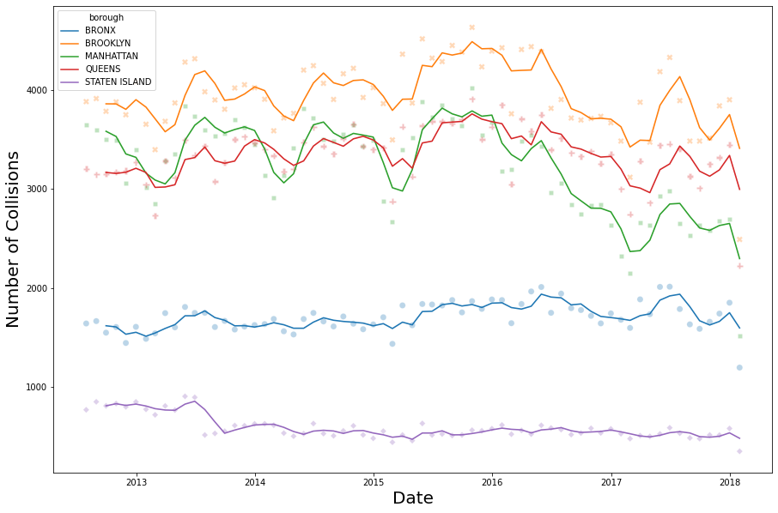
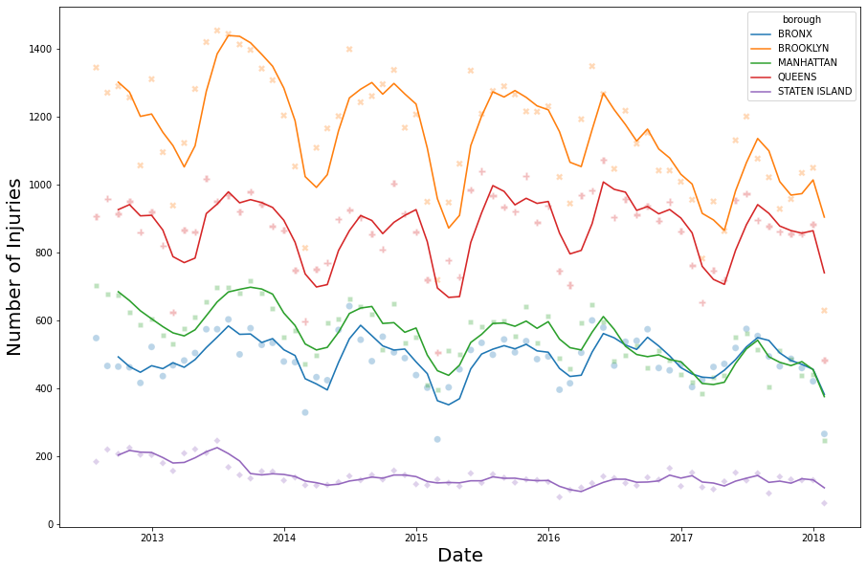
ROAD COLLISIONS ARE A BIG ISSUES FOR NYC, MORE SO FOR BROOKLYN
2012-2018 Time Series Analysis of Number of collisions and injuries
Source: New York Motor Vehicle Collisions Data, provided by the NYPD
Number of monthly collisions by NY borough (6 Months Moving Average)
Number of road injuries by NY borough (6 Months Moving Average)

Slide 3
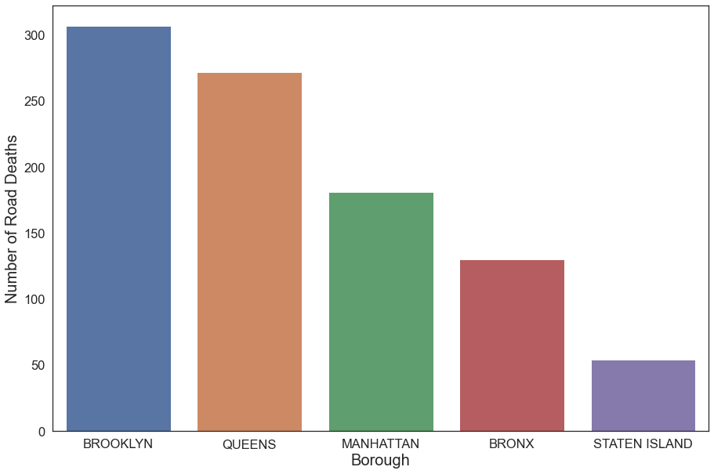
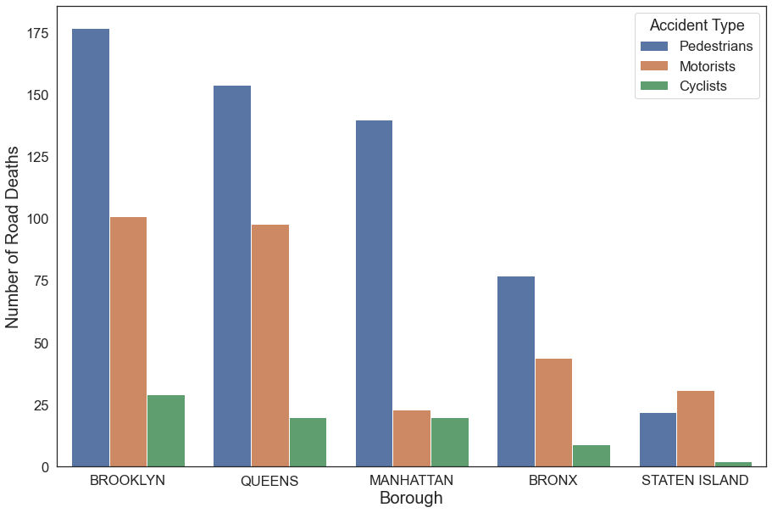
BROOKLYN IS THE BORUGH WITH THE MOST DEATH BY ROAD ACCIDENTS, REGARDLESS THE TYPE OF ACCIDENT
2012-2018 Analysis of Number of Road Deaths in New York
Source: New York Motor Vehicle Collisions Data, provided by the NYPD
2012 – 2018 Cumulative Road Deaths in New York, by Borough and by accident type
2012 – 2018 Cumulative Road Deaths in New York, by Borough

Slide 4
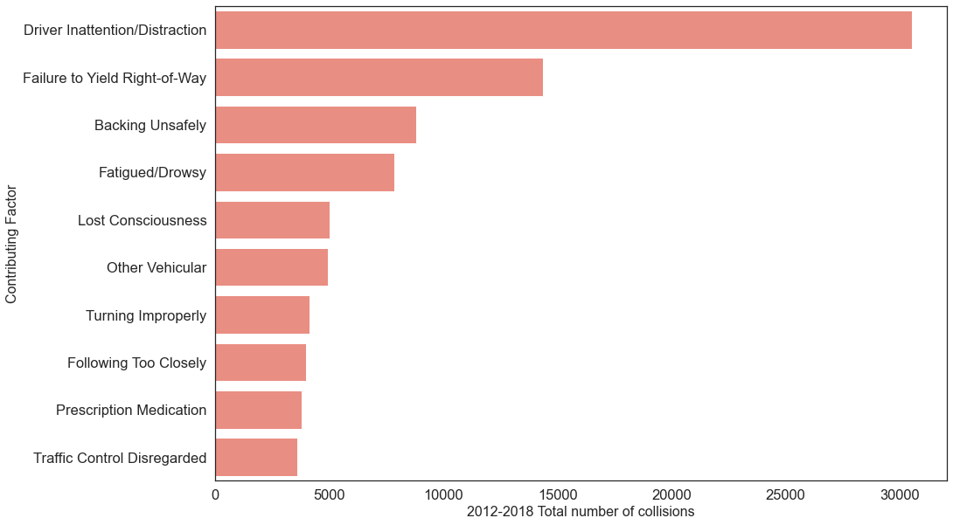
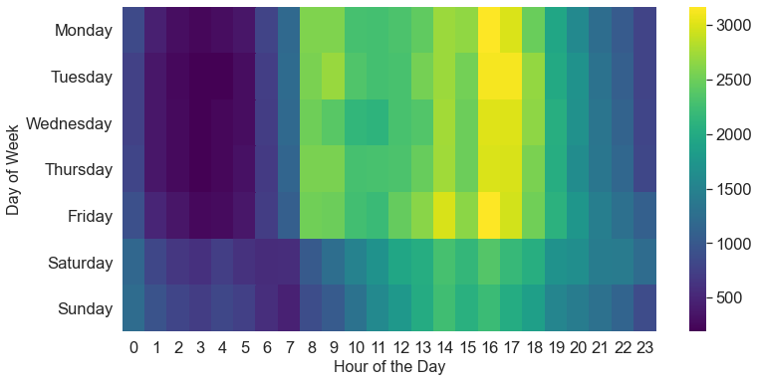
FOCUS ON BROKLYN – MAIN CAUSES OF COLLISIONS AND ANALYSIS OF TIME OCCURRENCE
2012-2018 Analysis of Road Collisions in Brooklyn, NY
Source: New York Motor Vehicle Collisions Data, provided by the NYPD
2012 – 2018 TOP 10 Accidents Contributing Factors in Brooklyn, New York
2012 – 2018 Brooklyn Cumulative Collisions heatmap, by weekday and hour
Key Findings:
Most of the collisions are happening during the working week at peak business hours.
Driver Inattention is the most cited cause of accidents in Brooklyn between 2012-2018

Slide 5
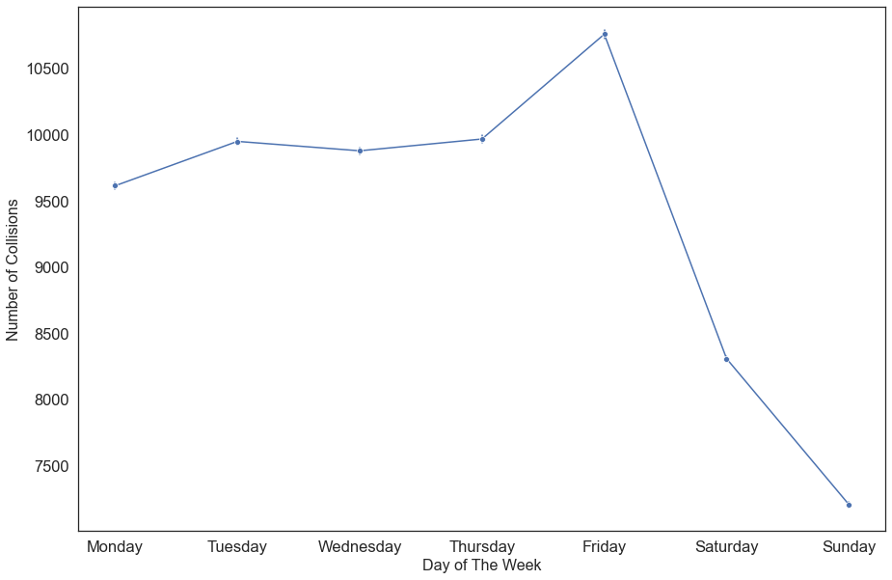
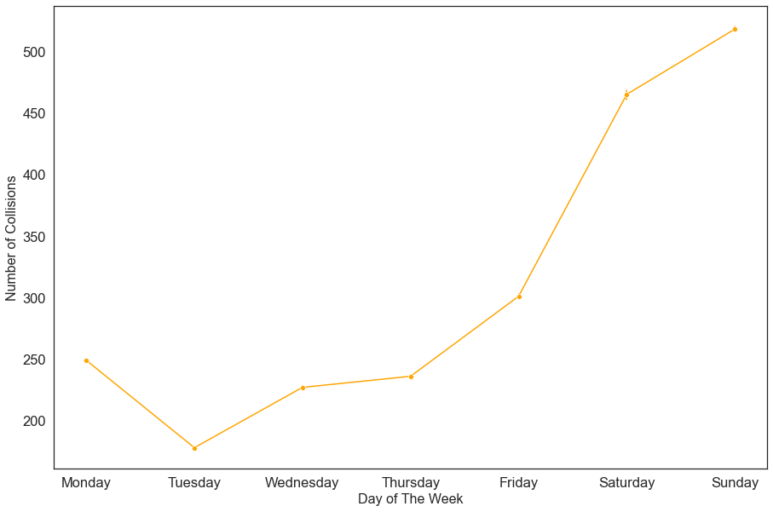
FOCUS ON BROKLYN – MAIN CAUSES OF COLLISIONS AND ANALYSIS OF TIME OCCURRENCE
2012-2018 Analysis of Road Collisions in Brooklyn, NY
Source: New York Motor Vehicle Collisions Data, provided by the NYPD
2012-2018 Brooklyn Cumulative number of collisions caused by factors correlated with drivers’ inattention, by week of the Day
2012-2018 Brooklyn Cumulative number of collisions caused by alcohol consumption, by week of the Day
Contributing factors correlated with drivers’ inattention are: 'Backing Unsafely',
'Failure to Yield Right-of-Way’, 'Following Too Closely’, 'Passing or Lane Usage Improper’, 'Turning Improperly’, 'Unsafe Lane Changing'
Key Findings:
Collisions related to driver inattentions are mainly happening during the working week
On the opposite, accidents related to alcohol consumption are mainly happening during the weekends

Slide 6
DATA DRIVEN RECCOMENDATIONS
2012-2018 Analysis of Road Collisions in Brooklyn, NY
Source: New York Motor Vehicle Collisions Data, provided by the NYPD
Launch of a strong campaigns to promote awareness of risk related to driver inattention.
The campaign should be aimed at changing behavior of drivers
Driver inattention accidents are mainly happening during the weekday, at peak business hours. Campaigns should be aired on the radio and on social media during the most affected hours of the day.
Focus on texting and driving, one of the leading sources of driving inattention (source: Driving Distraction report by the EU commission, 2015)
Disincentivize Drink & Drive during the weekends
Make taxis and Ubers available during the weekend in Brooklyn.
Campaign against drink and drive aimed towards young people on Social Media, during the weekends
Creation of a Public Dashboard to track progress
The data used is well suited for the creation of a public dashboard where involved stakeholders and the public may look at key metrics on road collisions in Brooklyn
4. Merge other data sources for Future Research
Possible questions: Do accidents correlate with weather, sport events, concerts, festivities?
This would improve capabilities to predict increased risk of accidents and prevent them

Slide 7
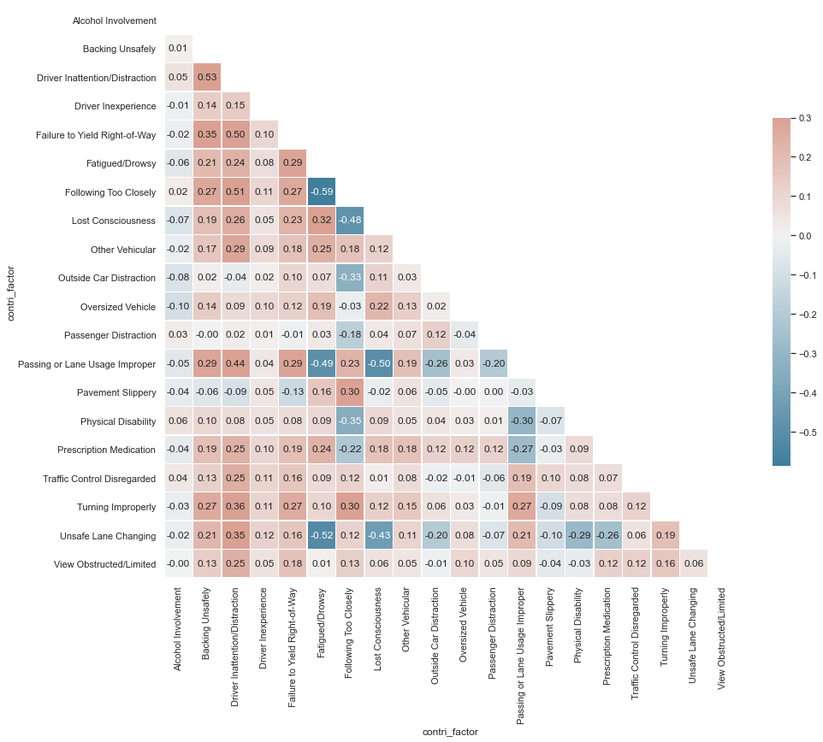
APPENDIX 1 – CORRELATION BETWEEN TOP 20 CAUSES OF ACCIDENTS IN BROOKLYN, NEW YORK
2012-2018 Analysis of Road Collisions in Brooklyn, NY
Source: New York Motor Vehicle Collisions Data, provided by the NYPD

