Slide 1

KONKAN GYANPEETH COLLEGE OF ENGINEERING

Slide 2
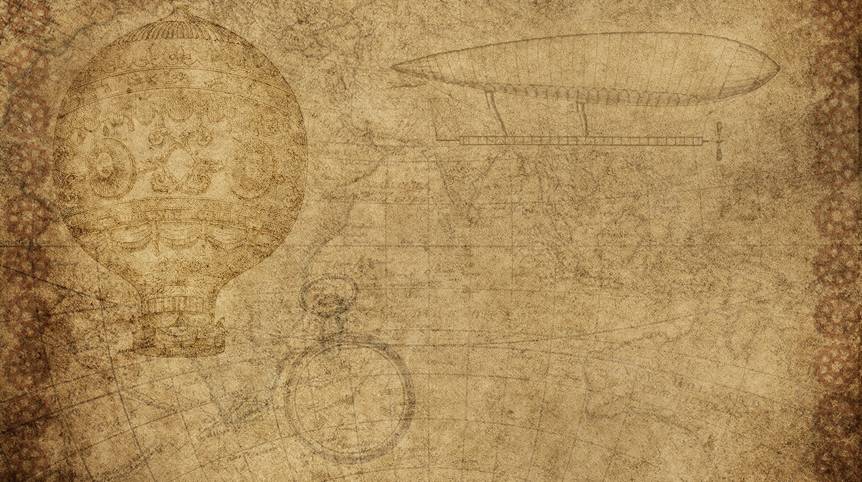

Coplat!!!(mini project)
Atharva Ashok Patil
Bhushan Deepak Dhonde
Vivek Ananta Bajage
Project Guide :-
Prof. R. V. Sangale
Presentation by:-

Slide 3


COPLAT!!
This project is about building a programmers community.
And it has different parts given in next slide!

Slide 4
Why this topic!?
It can create online coders community!
It can be a great way to communicate between the coders!
It can be place to share idea’s!
It can make us learn many topics and increase our skills!

Slide 5

Different parts of project!
Account Creation
Login system
Uploading posts
Comments
logout

Slide 6

Account creation!!
The registration is done with the help register page which asks for user’s name ,user’s email and the password user wanna set, all these information is sent to database and is saved there. So whenever user wanna login the user can.

Slide 7
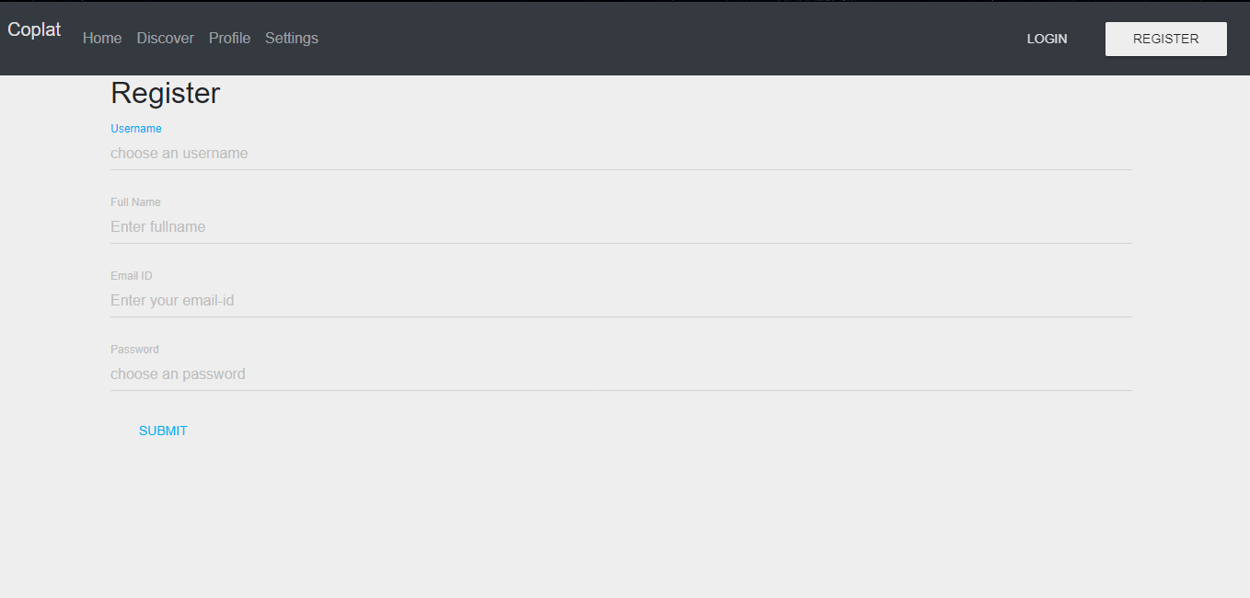

Slide 8

Login system
On login page user has to enter the username and their password to login, the information is checked with the database if correct the user is logged in and sent to next page else it shows a dialog box saying couldn’t login.

Slide 9
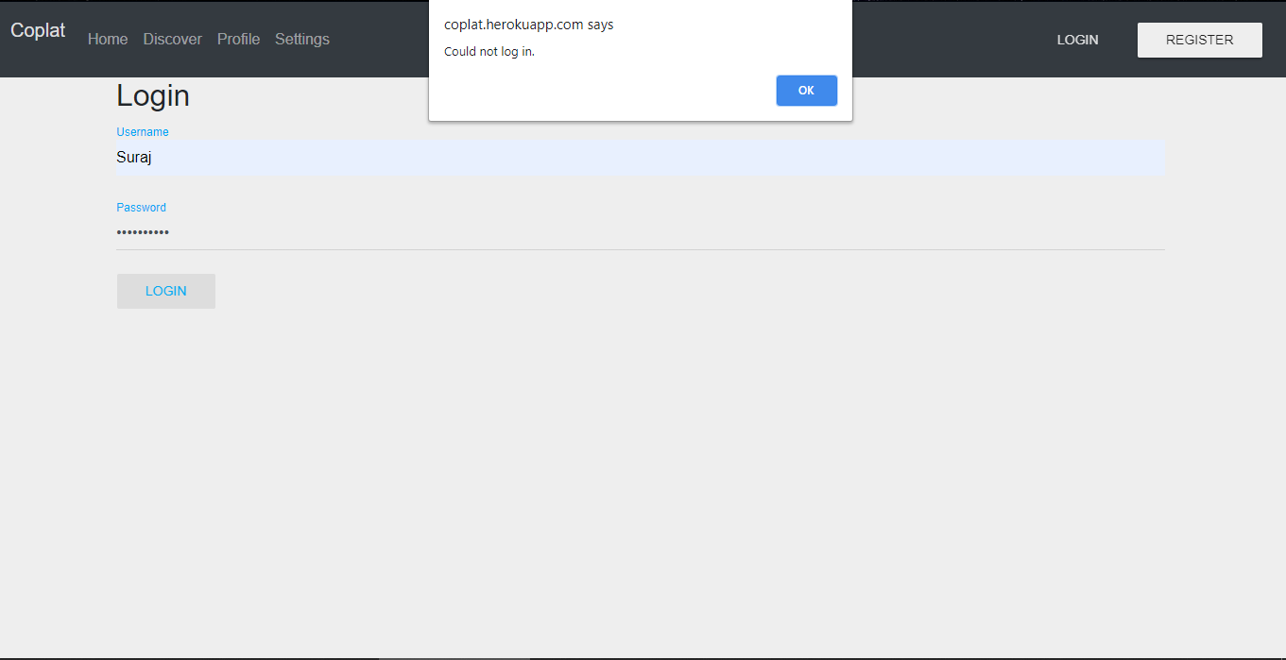

Slide 10

Uploading posts!!
When the user is logged in the new user session is created and a home page is shown where user can post texts and their source code according to user choice. These posts are shown on home page wall. Every post contains the code window and its output window where any user can watch it.

Slide 11
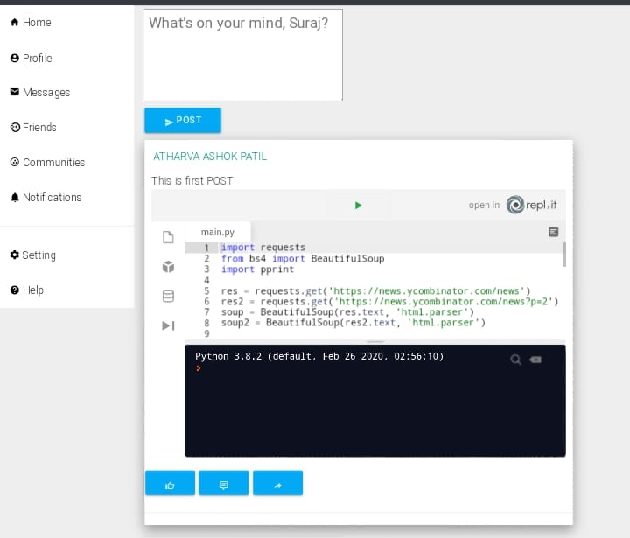

Slide 12


Comments!!
People can comment on the posts present on the home page wall using the option present below the posts and add their reaction in the comment section

Slide 13

Logout!!
There’s a option at top-right corner of page of logout. On clicking of which the user session is removed and user is redirected to the login page.

Slide 14
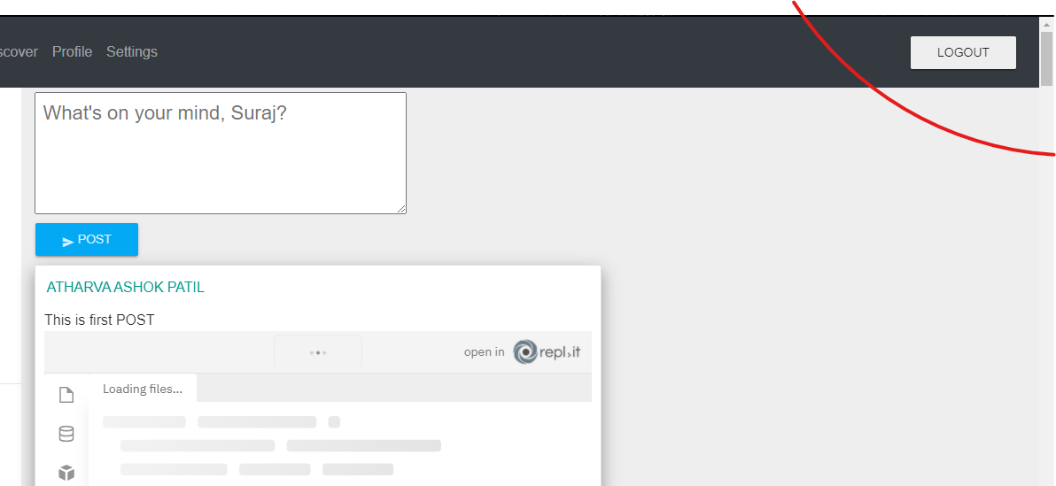

Slide 15
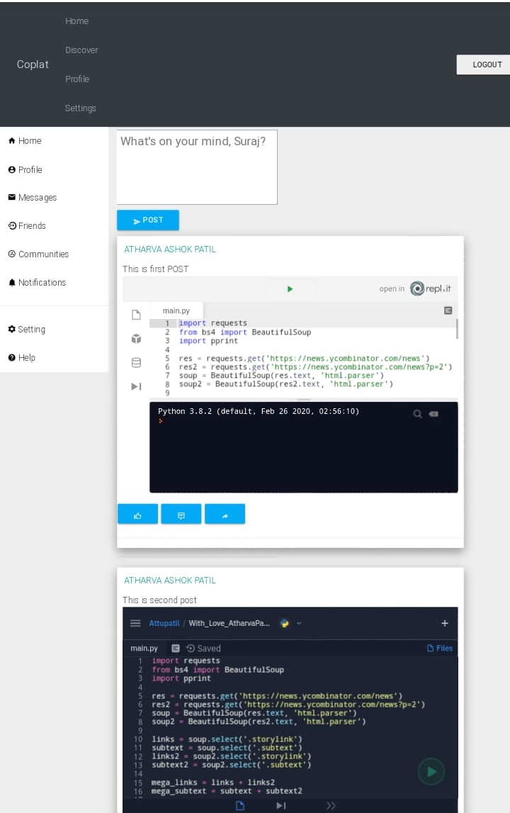
Homepage!!
We’ve whole lot of things present on homepage we got tabs to redirect you to different section, we’ve got a posts and its comments, we’ve got an button to post to post things, we’ve got a logout option!

Slide 16
Application of Project!!
It can create a coder’s community!!
It will make the code sharing between coders easy.
The project will help people post their queries and get it solved by the community!
It can be use as a bridge between teachers and students where it will easier for students and teachers to share code easily.

Slide 17

Future upgrades!!
User can have their profile page where all their posts will be visible.
User can create multiple groups with their friends.
User can use web based Editor which can run different langauges files.
Friends organization module maintains the friend list, handles request and sends request to the other user. Profiles and Friends lists are two key features on social network sites.

Slide 18
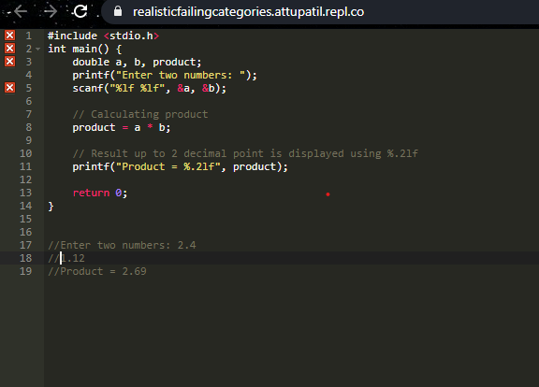
Future upgrades!

Slide 19
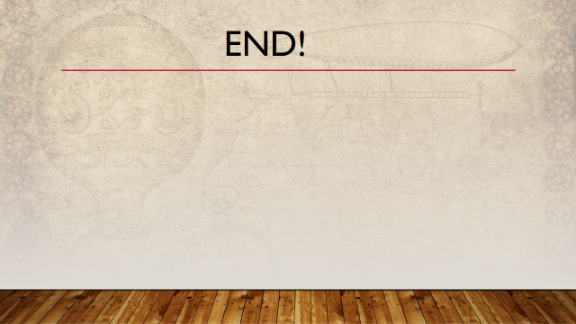
END!

