Slide 1


Smart Agricultural Resource and Farm
Operations Management System (SARFOMS)
Final Capstone Presentation
DPR400210 – Database Programming | Final Examination (Capstone Project)
Student: Ruben King | Student ID: 29761/2025

Slide 2
Introduction
2 / 10
SARFOMS is a full Oracle database system connecting two real markets: farmers who need equipment they cannot afford to own, and equipment owners whose machines sit idle between jobs.
It simultaneously monitors the crops that equipment services, using IoT-style sensor data (soil moisture, temperature, humidity).
Built across a normalized 13-table schema plus a full PL/SQL application layer: sequences, views, procedures, functions, triggers, packages, cursors, auditing, and an Oracle APEX front end.
13
10+10+10
10
3
Tables
Views / Procs / Funcs
Triggers
Packages

Slide 3


The Problem
3 / 10
Idle Capital
No Matching System
No Crop Visibility
Equipment sits unused most of the year on both sides of the market
No formal way for farmers and equipment owners to find each other
Once equipment is rented, nobody tracks whether the crop is responding well

Slide 4
Methodology
4 / 10
A strictly phased build — each phase depends only on what came before it, never forward:
1
2
3
4
5
6
7
8
Problem &
Process
ERD &
Normalization
Tables &
Sample Data
Sequences &
Views
Procedures,
Functions,
Packages
Triggers &
Auditing
Advanced SQL
& Reports
APEX, Testing
& Final Report
Tooling: Oracle Database + SQL Developer for all schema/PL-SQL work; Oracle APEX for the application layer; Git/GitHub for version tracking.
Verification discipline: every phase was cross-checked against the schema created in Phase III before being written, rather than assumed — including a full static audit pass at the end that caught zero logic bugs but flagged process gaps.
Where a requirement referenced entities outside the approved schema, it was explicitly mapped to the closest real equivalent and documented — never silently invented.

Slide 5
Database Design — 13 Tables, 3NF
5 / 10
People
Assets
Transactions
System / Monitoring
FARMER
EQUIPMENT_OWNER
TECHNICIAN
EQUIPMENT
EQUIPMENT_CATEGORY
FARM
CROP
BOOKING
PAYMENT
MAINTENANCE_RECORD
SENSOR_READING
PUBLIC_HOLIDAY
AUDIT_LOG
Every FK relationship enforces referential integrity; the schema is normalized to 3NF with one deliberate, documented denormalization: AUDIT_LOG stores table_name/record_id generically rather than a strict FK, since one audit table must reference many parent tables.

Slide 6




Implementation — Core PL/SQL Layer
6 / 10
10 Views
Operational + management reporting, reused directly by packages and APEX report pages
10 Procedures
Including conflict-checked booking creation and full maintenance lifecycle control
10 Functions
Callable directly inside SELECT statements — harvest countdowns, revenue rollups, utilization
3 Packages
PKG_CROP_MANAGEMENT, PKG_FARM_OPERATIONS, PKG_REPORTS — grouped by business domain
Design principle: nothing is duplicated between layers without reason — e.g. PKG_REPORTS.sp_display_operational_stats reuses VW_FARM_DASHBOARD_SUMMARY%ROWTYPE rather than re-listing 9 variables by hand.

Slide 7
Implementation — Business Rules, Auditing & APEX
7 / 10
10 Triggers
Including the mandatory rule: BOOKING changes are blocked on weekdays and public holidays
5-Table Audit Trail
BOOKING, PAYMENT, EQUIPMENT, MAINTENANCE_RECORD, FARMER — deliberately excluding national_id from logs
22 Automated Tests
PASS / FAIL / SKIP suite, adaptive to the actual calendar date it's run on
Oracle APEX Design
3 roles, 10 forms, 6 reports, full page-by-page documentation ready to build

Slide 8
Results — Testing & Validation
8 / 10
All schema, constraint, trigger, function, procedure, package, and cursor tests passed.
1 test (equipment status auto-sync) is correctly SKIPPED rather than failed on weekdays, since the mandatory business rule blocks the very update needed to observe it — by design, not a defect.
Full static code audit across all 13 phases found zero logic bugs — only process gaps (this presentation closes two of them).
Run 29761_2025_RubenKing_SARFOMS_Testing.sql in SQL Developer with SERVEROUTPUT ON to reproduce this live.

Slide 9
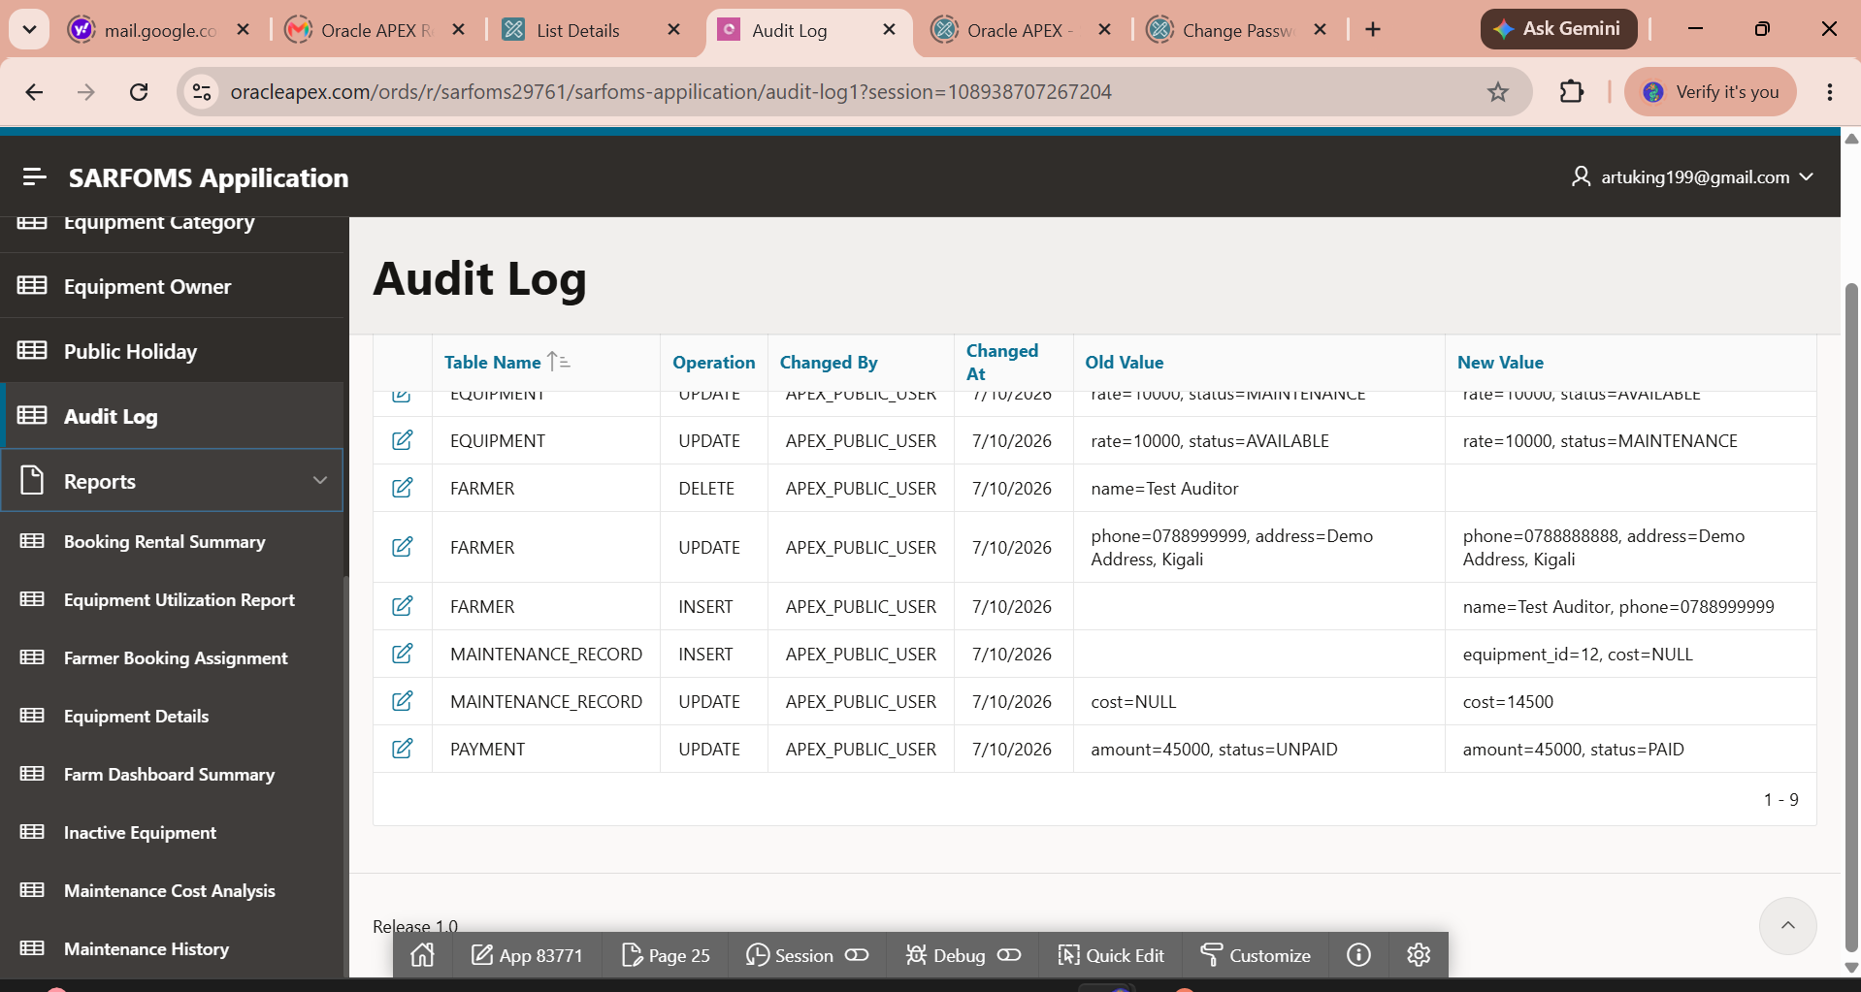
Innovation Component_Oracle APEX Interface

Slide 10
Conclusion & Future Enhancements
9 / 10
What SARFOMS Delivers
Where It Goes Next
A genuinely normalized, constraint-enforced schema — not just tables that happen to hold data
Every PL/SQL layer cross-referencing the ones below it, documented explicitly rather than duplicated silently
A mandatory institutional business rule enforced at the trigger level, impossible to bypass from any client
A designed, documented, and testable path to a live Oracle APEX application
Deploy the designed Oracle APEX application for real, live use in the workspace
Replace manual service-reminder procedure calls with real email/SMS notifications
Connect real IoT sensor hardware directly into SENSOR_READING via a REST endpoint
Add simple forecasting (linear regression) over revenue and sensor history for the dashboard

Slide 11

Conclusion & Future Enhancements
9 / 10
What SARFOMS Delivers
Where It Goes Next
A genuinely normalized, constraint-enforced schema — not just tables that happen to hold data
Every PL/SQL layer cross-referencing the ones below it, documented explicitly rather than duplicated silently
A mandatory institutional business rule enforced at the trigger level, impossible to bypass from any client
A designed, documented, and testable path to a live Oracle APEX application
Deploy the designed Oracle APEX application for real, live use in the workspace
Replace manual service-reminder procedure calls with real email/SMS notifications
Connect real IoT sensor hardware directly into SENSOR_READING via a REST endpoint
Add simple forecasting (linear regression) over revenue and sensor history for the dashboard
Thank You
Questions & Discussion
Smart Agricultural Resource and Farm Operations Management System (SARFOMS)
Ruben King | 29761/2025 | DPR400210

