Slide 1
Cascade Cup-ShadowFax
By Atufa Shireen

Slide 2
Problem Statement
Given the order and rider details as described, create a model that can predict rider-driven cancellation in advance (i.e. before getting marked as cancelled or delivered)

Slide 3
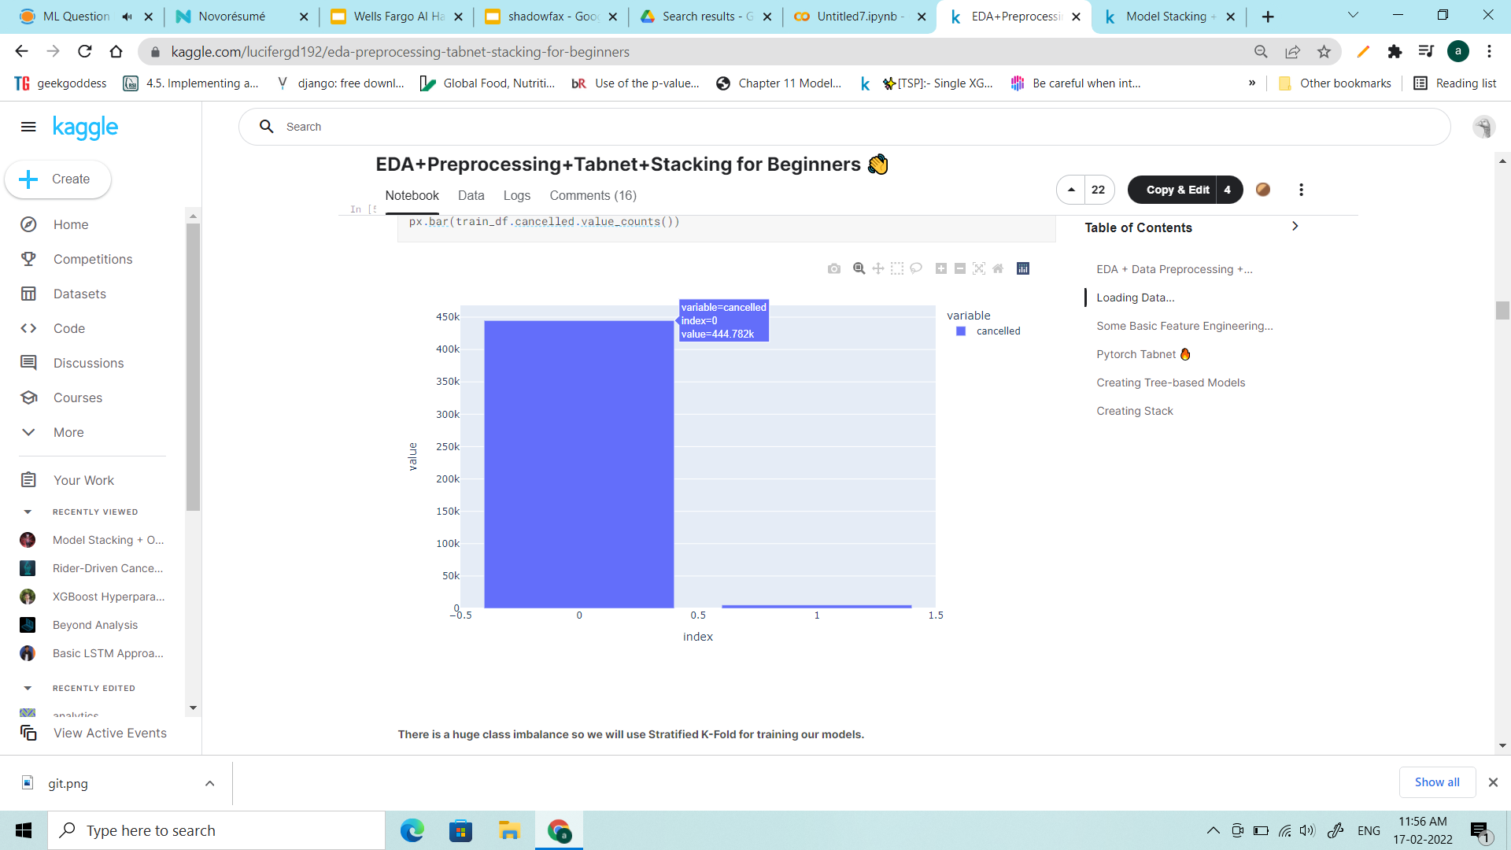
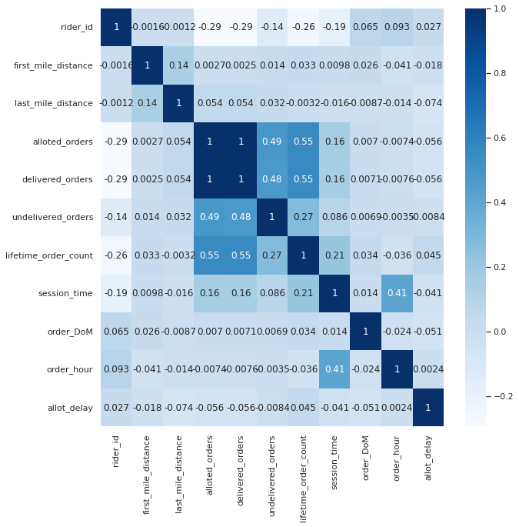
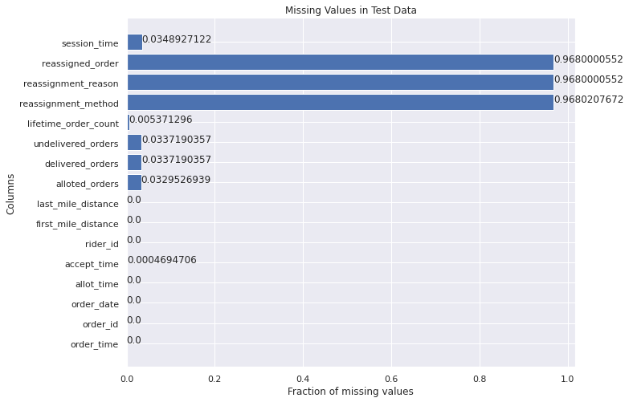
Assumptions & Overviews
Classes Labels are Imbalanced, i.e., cancellation of orders id very rare instance.
Missing percentage is almost same in train and test data.
Both the test and train data, had more than 95% of missing values, for reassignment order,method, moreover it means cancellation of order, and hence can be dropped.
Undelivered orders = Allotted orders-Delivered orders, hence one of these features can be dropped.

Slide 4
Feature Engineering
Date column, splitted into the following features,
Date
Weekday
Hour
Created new feature from the difference of Accept time and Allot time, as time_took_accept and dropped the latter ones.
Negative time_took_accept shows error in data collection, and were were marked as zero.
Hours are binned into 6 categories (wrt to cancellation in training data).

Slide 5
Missing Imputation
All the null and 0 lifetime count order has cancelled orders, hence filling nans here with 0.
Remaining columns(session_time,undelivered_orders,time_took_accept) were filled by the mean wrt rider’s history.
Remaining Nan values in these columns were filled zero.

Slide 6
Modelling
Sampling Techniques
Random Up and Down Sampling with Random Forest
Random sampling(5218 random samples from negative class and respective positive class).
SMOTE
Ensembling techniques
Xgboost
Catboost
LightGBM
Stacking

Slide 7
Results
Catboost model outperformed other algorithms, in dealing with imbalanced dataset.
Using optuna for hyper parameter tuning, the model was able to achieve ~0.64 of auc_score.

