Slide 1

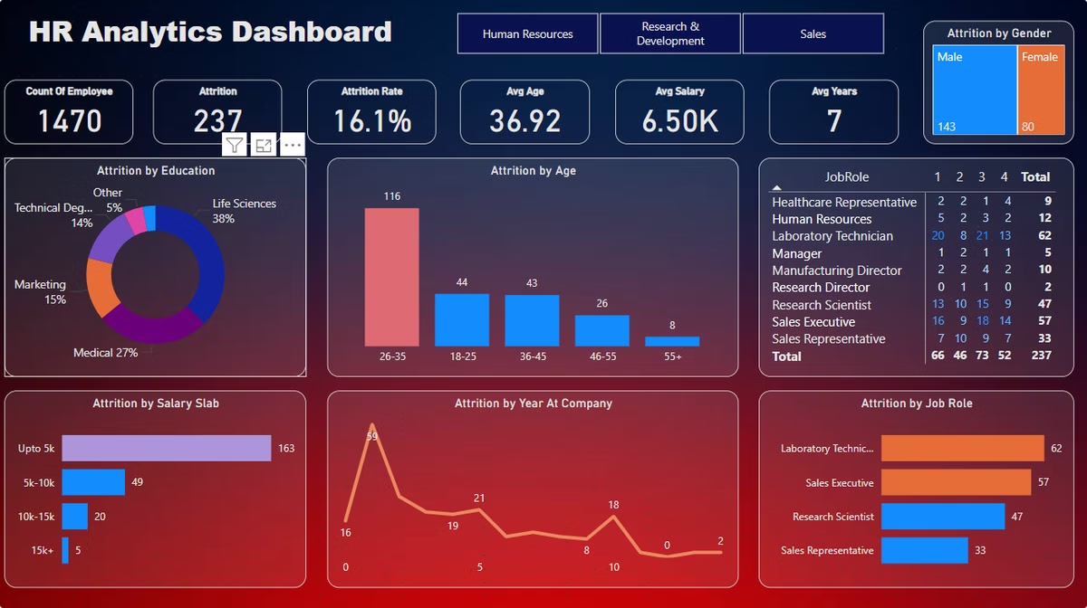
HR Attrition Analytics Dashboard with Power BI
Welcome to the HR Attrition Analytics Dashboard, a powerful tool for analyzing and understanding employee turnover using Power BI. This presentation will walk you through the key features and insights of this dashboard.

Slide 2

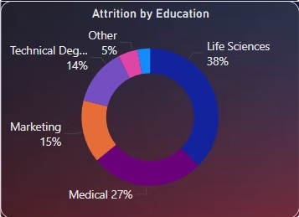
Attrition by Education
Key Insights from Attrition by Education
Life Science (38%) and Medical (27%) show the highest attrition rates, indicating a need for deeper analysis of job satisfaction and career growth in these groups.
Employees with "Other" backgrounds (5%) have the lowest attrition, suggesting possible stability factors that can be replicated across other groups.
These insights highlight the need for tailored retention strategies based on educational backgrounds.

Slide 3

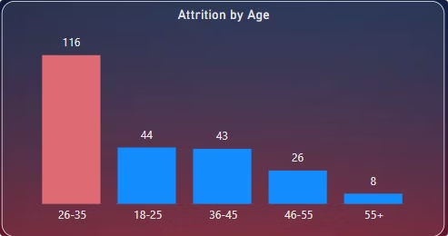
Attrition by Age
26–35 years: Highest attrition rate, highlighting potential mid-career challenges.
18–25 years: Second highest, possibly due to early career transitions.
36–45 years: Third highest, indicating retention gaps in experienced employees.
Insights suggest addressing career growth, job satisfaction, and work-life balance to reduce attrition in these age groups.

Slide 4

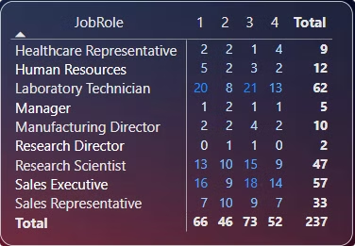
Job Role and Rating
Roles with lower performance ratings show higher attrition, indicating a need for better support and training for underperforming employees.
Certain roles, such as Sales Executive and Laboratory Technician, exhibit higher attrition rates, suggesting role-specific challenges like workload or job satisfaction.
Employees with high ratings but still leaving may point to factors beyond performance, such as career growth or compensation gaps.

Slide 5

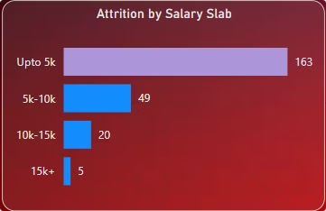
Attrition by Salary Slab
Up to 5K: Highest attrition, indicating dissatisfaction with entry-level compensation.
5–10K: Moderate attrition, suggesting some improvement but still a concern.
Above 10K: Significantly lower attrition, highlighting the importance of competitive salaries.
Insights suggest revisiting compensation structures to improve retention, particularly for lower salary slabs.

Slide 6

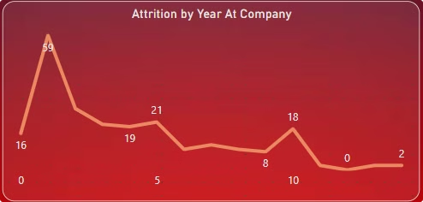
Attrition by Years at Company
0–1 Year: Highest attrition, indicating challenges with onboarding or early job expectations.
5 Years: Another peak, suggesting possible stagnation or lack of growth opportunities.
10 Years: Attrition spikes again, potentially due to career shifts or retirement considerations.
Insights highlight the need for better onboarding, mid-career growth plans, and long-term engagement strategies.

Slide 7

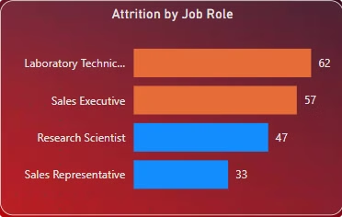
Attrition by Job Role
Laboratory Technician: Highest attrition, indicating potential issues like workload or limited growth opportunities.
Sales Executive: Second highest, possibly due to performance pressures or high targets.
Research Scientist: Moderate attrition, suggesting the need for better role-specific engagement.
Sales Representative: Lower but notable attrition, highlighting retention challenges in sales roles.
Insights emphasize role-specific strategies to address unique challenges and improve retention.

Slide 8

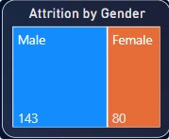
Attrition by Gender
Male Employees: Higher attrition rate, possibly due to factors such as career dissatisfaction, job stress, or lack of growth opportunities.
Female Employees: Lower attrition, suggesting better retention or more stability in their roles.
Insights indicate a need for targeted strategies to address the causes of higher attrition among male employees, such as career development and work environment improvements.

Slide 9
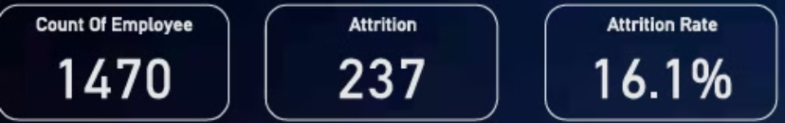
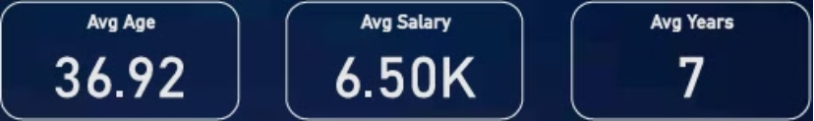
Key Performance Indicators
Count of Employee
Attrition
Attrition Rate
Average Age of Employee
Average Salary
Average Years

Slide 10

Filters for Deeper Insights
This dashboard provides department-level filters to drill down and analyze attrition data for specific HR, Research & Development, or Sales departments.

