Slide 1

Algorithm Project 2
ATUL ACHARYA
ANIL ANKITHA
ARORA SRISHTI
KOTHARI KHUSH MILAN
PAL ARATRIKA

Slide 2
Contents
PArt A
Part B, C & D
Demonstration
Q&A

Slide 3

Part A
ALGORITHM DESIGN
MEMORY SEARCH

Slide 4
KEY POINTS
If the nearest hospital from Node ‘1’ is ‘h’ and the shortest path is ‘1’-‘2’-‘3’-‘h’, then ‘h’ is the nearest hospital to all the nodes lying in this path
When expanding an arbitrary Node ‘x’ and after a certain depth it reaches a Node ‘y’ whose nearest hospital has been found, the algorithm can cut the maximum depth of exploration to cost of expansion to Node ‘y’ + path length of Node ‘y’

Slide 5
A
B
D
C
E
H1
H2

Slide 6
A
B
D
C
E
H1
H2

Slide 7
A
B
D
C
E
H1
H2

Slide 8
A
B
D
C
E
H1
H2

Slide 9
Part A
Pseudocode

Slide 10

find_path(node)
FOR all nodes do:
IF node is hospital
CONTINUE with next iteration
IF node’s path has been found
CONTINUE with next iteration
ASSIGN min_cost:= infinity
ASSIGN connection:= null
ENQUEUE(node)
WHILE queue is not empty and
node’s path has not been found
do:
current_node = DEQUEUE()
FOR all neighbors of
current_node do:
IF neighbor is hospital
retrieve path using neighbor
ELSE IF neighbour’ path has been found
and cost of expansion to neighbour +
path cost of neighbour to
hospital < min_cost:
min_cost = cost of expansion to
neighbour + path cost of
neighbour to hospital
connection = neighbour
ELSE IF cost of expansion > min_cost
retrieve path using connection
ELSE:
IF neighbour has been visited:
CONTINUE next iteration
Mark neighbour as ‘visited’
ENQUEUE neighbour

Slide 11
retrieve_path(node)
IF node’s path has not been found:
node’s path = [node]
WHILE node is not null DO:
node.parent’s path =
[node.parent] + node’s path
node = node.parent

Slide 12
Part A
Analysis

Slide 13
|V| = the length of adjacency-list i.e, there |V| key-value pairs.
|V| is total number of nodes in graph G
h = Number of hospitals
|E| = Number of edges
Best Case
Every node is a hospital.
1 comparison: shortest_path = |h|
Time Complexity: O(|h|) due to |h| comparisons.

Slide 14
|V| = the length of adjacency-list i.e, there |V| key-value pairs.
|V| is total number of nodes in graph G
h = Number of hospitals
|E| = Number of edges
Worst Case
Node is not in shortest_path or hospitals
Time complexity: find_path: O(|E|)
retrieve_path: O(|V| - h )
Combined Time Complexity: O( (|V|-h) |E| )

Slide 15
Experimental Analysis

Slide 16
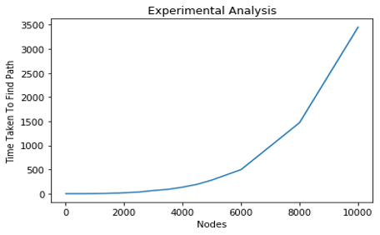
For part A

Slide 17
Part B, C & D
ALGORITHM DESIGN
MULTI-SOURCE BFS

Slide 18
IDEA
Solving the problem using a multi-source BFS with a small modification.
Step 1: Enqueue all hospitals and first visit all the source vertices.
Step 2: Visit the vertices which are at a distance 1 from all source vertices, then at a distance 2 from all source vertices and so on
Step 3: Add entries of tuples of the form (node id, hospital id) to the queue to keep a track of the hospital that the node is being expanded from.
Step 4: Stop enqueuing any successive (node id, hospital id) combination, once the ‘k’ nearest hospitals of a node have been found.

Slide 19
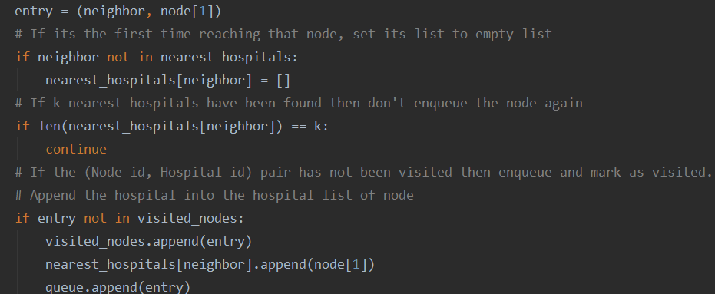
CODE SNIPPET
STOPPING CONDITION

Slide 20
Part B, C & D
Pseudocode

Slide 21
ENQUEUE all hospitals
Mark all hospitals as visited
WHILE queue is not empty DO:
node = DEQUEUE()
FOR all neighbours of node DO:
IF length of neighbour’s
hospital list = k:
CONTINUE next iteration
ELSE IF (neighbour, hospital
id) is not visited:
Mark (neighbour, hospital
id) as ‘visited’
ENQUEUE ((neighbour,
hospital id))
APPEND hospital id to
neighbour’s hospital list

Slide 22
Part B,C & D
Analysis
Notes:
Lets see the algorithmic analysis.

Slide 23
V = total number of vertices
h = number of hospital vertices
k = number of nearest hospitals required
Initialisation: takes O(1)
Pre-process:
Mark hospital nodes as visited and push all hospital nodes into the queue
takes O(h)
For each k:
Each vertex is visited one time
Each edge is traversed twice, both forward and backward
O(k*(|V|+2|E|)) time complexity
If k = 1, it satisfies part B, it is not dependent on h
If k = 2, it satisfies part C
Notes:
V is the total number of vertices, h denotes the total number of hospitals, k the required nearest hospitals and E the number of edges. First all the hospital nodes need to be marked visited and pushed into the queue which takes O(h) time. Then for each k hospitals, vertices are visited once and each edge is traversed twice, both forward and backward. Hence it follows O(k*(V+2E)). This satisfies part B, when k=1 as it does not depend on h and it satisfies part c when k =2

Slide 24
Average Case Complexity:
O( k * ( |V| + 2 |E| ) )
Worst Case Complexity:
Occurs for a complete graph
E = V(V-1)
Hence O( V² )
Best Case Complexity:
Occurs for a sparse, connected graph
Or if all nodes are at distance 1 from hospitals
E = V-1
Hence O(V)
Notes:
The average case, as explained before is shown here again. In the worst case, the graph is fully connected so number of edges is V(V-1) hence the complexity will be O(V^2). In the best case, it is a sparse graph where E= V-1 and hence it has time complexity of O(V).

Slide 25
Part B,C & D
Experimental Analysis
Notes:
Now we will look at the experimental analysis for this algorithm.

Slide 26
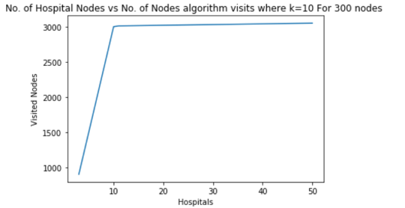
NUMBER OF HOSPITALS VS VISITED NODES
Notes:
The X-axis on the graph indicates the number of hospital nodes and y-axis represents the number of visited nodes. In this particular case we have chosen 10 hospitals for 300 nodes. From the graph we can observe that there is a steep linear relationship till a threshold value of k where the visited nodes equal number of hospital nodes*number of total nodes. After the threshold, the slope of the line is very less. Hence, the performance of the algorithm is better with h>k, which is the general case, and it grows very slowly after h crosses k. From here we can conclude that the time complexity depends on k*V.
As you can see, after reaching k, the growth is less and hence when k=1, this part of the graph is followed. So it is independent of h and satisfies the condition of part b

Slide 27
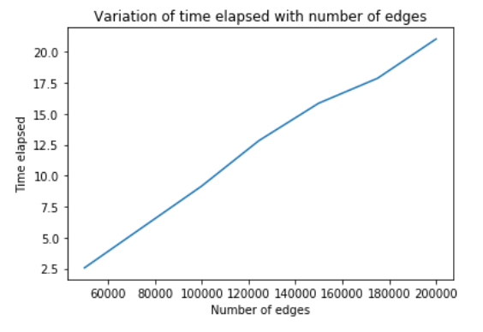
Number of edges vs time elapsed
Notes:
In this above graph, the X-axis shows the Number of edges and the Y axis shows the Time elapsed to run the algorithm. It is a linear relationship between the time elapsed and the number of edges hence from here we can conclude that the time complexity will depend on k*E.
Combining both the inferences, the time complexity comes to O(k*(V+2E)) which is consistent with our algorithm analysis.

Slide 28
thank You!
Any questions?

