Slide 1
C++20 STL Features: 1 Year of Development on GitHub
Stephan T. Lavavej "Steh-fin Lah-wah-wade"
Principal Software Engineer, Visual C++ Libraries
stl@microsoft.com
@StephanTLavavej

Slide 2
Getting Started
Please hold your questions until the end
Write down the slide numbers
Part 0: Overview
What's happened in the last year
Part 1: C++20 STL Features
Everything here is Standard, except as noted
Part 2: GitHub Development
For contributors and observers

Slide 3
Overview
Part 0

Slide 4
CppCon 2019 ➔ CppCon 2020
Announced at CppCon 2019
github.com/microsoft/STL
Apache License v2.0 with LLVM Exception
Implemented ~50 C++20 features
Majority from our amazing contributors
Extensively reviewed and tested
Released VS 2019 16.5, 16.6, 16.7, 16.8 Preview 3
GitHub migration ongoing
Build system (native desktop), test suite, issue database
Goal: Complete C++20 in 2020
No promises, but we're working hard; refers to repo only

Slide 5
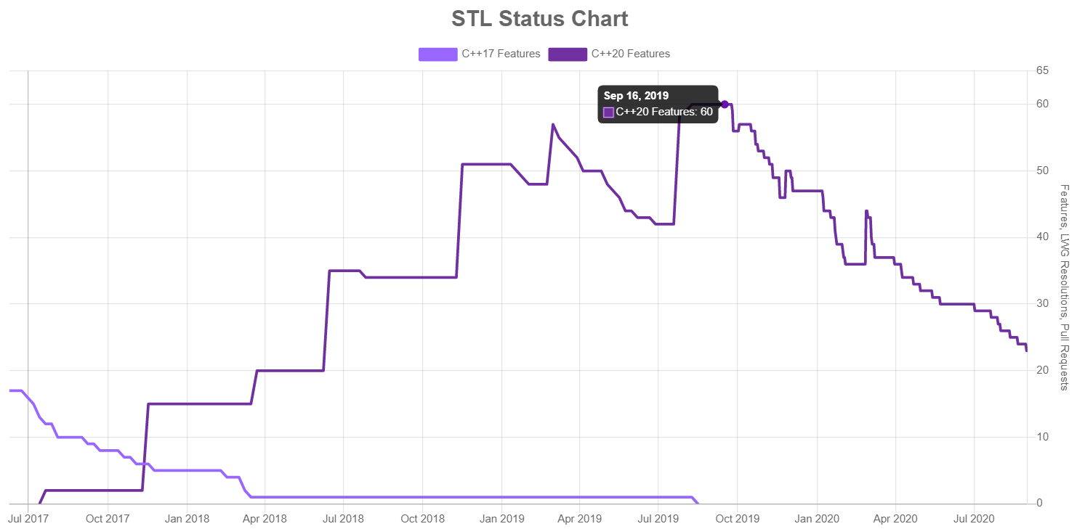
C++20 Features: 60 ➔ 23 Left

Slide 6
C++20 STL Features
Part 1

Slide 7
Comparing Integers

Slide 8
Usual Arithmetic Conversions
#include <iostream>
using namespace std;
int main() {
cout << boolalpha;
short s = -1;
unsigned int ui = 1729;
cout << (s < ui) << endl;
}
What does this print?
warning C4018: '<': signed/unsigned mismatch
warning: comparison of integers of different signs: 'short' and 'unsigned int' [-Wsign-compare]
This prints false 🙀

Slide 9
Integer Comparison Functions
GH-621 implemented by Neargye
#include <iostream>
#include <utility>
using namespace std;
int main() {
cout << boolalpha;
short s = -1;
unsigned int ui = 1729;
cout << cmp_less(s, ui) << endl;
}
This prints true ✔

Slide 10
<utility>
template <class T, class U>
constexpr bool cmp_equal(T t, U u) noexcept;
template <class T, class U>
constexpr bool cmp_not_equal(T t, U u) noexcept;
template <class T, class U>
constexpr bool cmp_less(T t, U u) noexcept;
template <class T, class U>
constexpr bool cmp_greater(T t, U u) noexcept;
template <class T, class U>
constexpr bool cmp_less_equal(T t, U u) noexcept;
template <class T, class U>
constexpr bool cmp_greater_equal(T t, U u) noexcept;
template <class R, class T>
constexpr bool in_range(T t) noexcept;

Slide 11
constexpr Algorithms

Slide 12
C++20 constexpr Everything
constexpr enables compile-time programming without arcane templates
Algorithms:
P0202R3 constexpr <algorithm> And exchange() (GH-425)
P0879R0 constexpr Algorithms, Part II (GH-425, BillyONeal)
P1645R1 constexpr <numeric> Algorithms (GH-399, Neargye)
More:
P0415R1 constexpr <complex> Again (GH-367, Neargye)
P0595R2 is_constant_evaluated() (GH-353, Jennifer Yao – MSVC compiler)
P1006R1 constexpr pointer_to() (GH-397, AdamBucior)
P1023R0 constexpr array Comparisons (GH-599, Weheineman)
P1032R1 Miscellaneous constexpr (GH-491, miscco)
P1065R2 constexpr INVOKE (GH-703, AdamBucior)
Work in progress (mnatsuhara):
GH-37 P0784R7 Library Support For More constexpr Containers
GH-43 P0980R1 constexpr string
GH-45 P1004R2 constexpr vector

Slide 13
constexpr In Everyday Programming
constexpr has steadily increased in power
It's just code that runs on your machine instead of the user's
Example: lookup tables
Everyone uses lookup tables
Arrays are maximally space-efficient, very time-efficient
Sorted arrays: binary_search, lower_bound, equal_range
Now you can use constexpr algorithms
Easy: static_assert with constexpr is_sorted
string_view is also constexpr; not limited to numeric data
More advanced: constexpr sort your lookup tables

Slide 14
static_assert is_sorted
Compile-time evaluation = no run-time codegen, even in debug builds
#include <algorithm>
#include <array>
#include <filesystem>
#include <string>
#include <string_view>
using namespace std;
int main() {
static constexpr array skipped_extensions{".dll"sv, ".exe"sv, ".obj"sv};
static_assert(ranges::is_sorted(skipped_extensions));
for (const auto& ent : filesystem::recursive_directory_iterator{"."}) {
const string extension = ent.path().extension().string();
if (ranges::binary_search(skipped_extensions, extension)) {
continue;
}
// ...
}
}

Slide 15
Erasing Elements

Slide 16
Container Erasure Strategies
Erasing unwanted elements before C++20:
vector-like: erase-remove idiom
list-like: remove/remove_if member functions
map-like: handwritten loop calling m.erase(iter)
Many potential hazards 🙀
remove_if(v.begin(), v.end(), pred); 🐞
v.erase(remove_if(v.begin(), v.end(), pred)); 🐞
Quadratic complexity vec.erase(iter) loop 🐌
Invalidating iterators while looping 🐞
Skipping elements while looping 🐞

Slide 17
Uniform Container Erasure
GH-236 and GH-566 implemented by SuperWig
#include <iostream>
#include <string>
#include <vector>
using namespace std;
void print(const vector<string>& v) {
for (const auto& e : v) { cout << e << " "; }
cout << "\n";
}
int main() {
vector<string> v{"bear", "dog", "cat", "lion", "ox", "dog"};
auto pred = [](const auto& s) { return s.size() > 3; };
erase_if(v, pred);
print(v); // dog cat ox dog
erase(v, "dog");
print(v); // cat ox
}

Slide 18
atomic_ref

Slide 19
atomic vs. atomic_ref
atomic<T>: atomic access and storage for T
atomic_ref<T>: atomic access for separate T
Scenarios (see P0019R8):
Distinct single-threaded and multi-threaded parts
Pay the cost for atomic operations only when necessary
Distinct non-conflicting and conflicting parts
Layout compatibility; works with T within C structs
Near-identical interface
Encapsulates platform/architecture-specific code
atomic/atomic_ref support wait/notify_one/notify_all

Slide 20
Highly Artificial Example 🤖
GH-843 implemented by AlexGuteniev
#include <atomic>
#include <iostream>
#include <thread>
using namespace std;
int main() {
int i{500};
i += 500; // ordinary read/write
{ atomic_ref atom{i};
thread t1{[&atom] { for (int val{0}, x{0}; x < 70;) {
if (atom.compare_exchange_weak(val, val + 10)) { ++x; }}}};
thread t2{[&atom] { for (int val{0}, y{0}; y < 29;) {
if (atom.compare_exchange_weak(val, val + 1)) { ++y; }}}};
t1.join(); t2.join(); }
cout << i << endl; // ordinary read, 1729
}

Slide 21
span

Slide 22
span Encapsulates Ptr-Len Pairs
span is a non-owning view of contiguous elements
span<T> is like a pair of T* and size_t, but better
spans are implicitly constructible from arrays and vectors
Avoids ownership confusion, accidental pointer arithmetic
span<T> ➔ span<const T>; span<Derived> ➔❌ span<Base>
Shallow const, like T*
span<const T> can be reassigned, can't modify elements
const span<T> can't be reassigned, can modify elements
MSVC's std::span checks debug; gsl::span always

Slide 23
Contiguous Range Constructor
GH-142, GH-500, GH-587 implemented by miscco
#include <array>
#include <iostream>
#include <span>
#include <vector>
using namespace std;
void print(const span<const int> s) { // not a template!
for (const auto& e : s) { cout << e << " "; }
cout << endl;
}
int main() {
static constexpr int classic[]{1, 2, 3};
print(classic);
print(array{4, 5, 6});
print(vector{7, 8, 9});
}

Slide 24
Contiguous > Random-Access
Can we print(deque{-1, -1, -1}); ?
candidate function not viable: no known conversion from 'std::deque<int, std::allocator<int> >' to 'const span<const int>' for 1st argument
This constructor is powered by C++20 ranges!
Specifically ranges::contiguous_range (and more)
Extensible to user-defined contiguous ranges

Slide 25
And More!

Slide 26
So Many New Features, Including:
atomic<shared_ptr<T>>, atomic<weak_ptr<T>>
GH-601 by AdamBucior
<bit> (bit_cast, rotating/counting, power-of-2)
Several PRs by barcharcraz
make_shared() For Arrays
GH-309 by AdamBucior, tested by Weheineman
midpoint(), lerp()
Paolo Torres and BillyONeal initially implemented this
GH-1048 by statementreply completed this
<numbers> Math Constants
GH-261 by SuperWig

Slide 27
GitHub Development
Part 2

Slide 28
How We Use GitHub
Code: linear history, few feature branches
Issues: cxx20, LWG, bug, performance, etc.
Pull Requests: Used for all development
Continuous Integration: Azure Pipelines
Code format validation: clang-format, line length, etc.
Projects: Code reviews, C++20 features, etc.
Wiki: Changelog, checklists, other resources
Status Chart: Generated via GitHub's GraphQL API

Slide 29
Code: github.com/microsoft/STL
Product: stl/inc, stl/src
Build system: CMake/Ninja
vcpkg submodule acquires Boost.Math for Special Math
tests/std, tests/libcxx, tests/tr1 (legacy)
llvm-project submodule for libc++'s test suite
Uses Python and lit (LLVM Integrated Tester)
Linear history, squashed commits
Feature branches are uncommon
feature/spaceship, feature/format

Slide 30
Issues
cxx20 issues track all remaining C++20 features
GH-39 P0896R4 <ranges>
LWG issues track bugfixes in the Standard itself
GH-333 LWG-3070 path::lexically_relative
bug, performance, throughput, enhancement
Porting from Developer Community, Azure Boards, todos
GH-713 boyer_moore_searcher
vNext issues affect binary compatibility
Will start vNext after finishing C++20

Slide 31
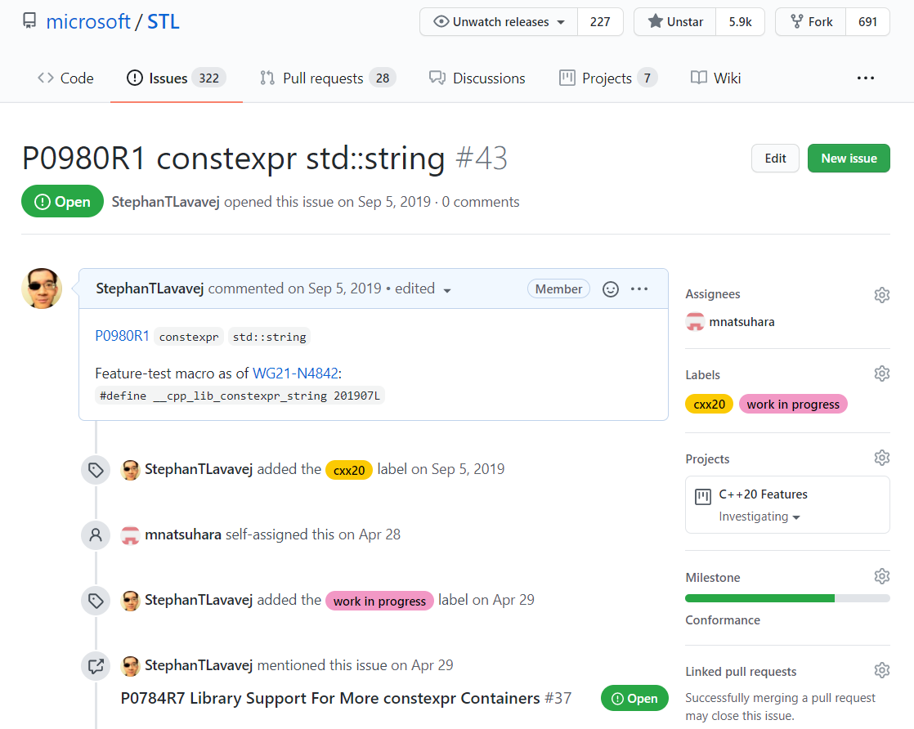
cxx20 Issues

Slide 32
Pull Requests
GH-724 Fix boyer_moore_searcher
Fixed a 43-year-old bug by implementing a 40-year-old fix
Explained bug, fix, ABI, testing; others provided more info
GH-142 P0122R7 <span>
691 comments!
GH-1173 Fix ostr << flt precision
Fixed long-standing bugs while preserving ABI
Every PR is extensively reviewed by 2 maintainers
Keeps code at production quality: always ready to ship
Helps the team understand the code and related features

Slide 33
Code Review Philosophy
The Standard Library has:
Unusually well-specified preconditions and postconditions
Unusually strict correctness and performance requirements
Indefinite lifespan: old codebase, yet must keep evolving
Careful code review avoids regressions, new bugs
Especially important for binary compatibility
Codebase consistency is important, especially now
Ideally, looks like the work of a single author
Consistent code ➔ consistent behavior, fewer unique bugs
Makes inconsistent code stand out as unusual or incorrect

Slide 34
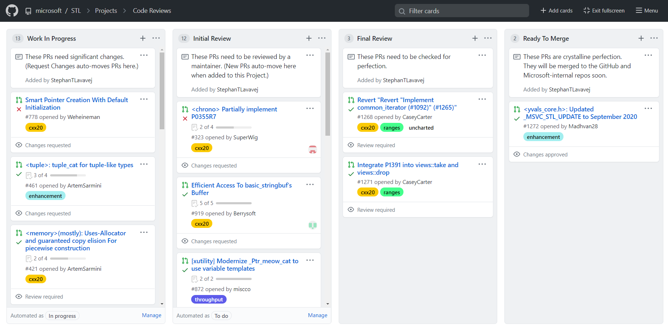
Code Reviews Project

Slide 35
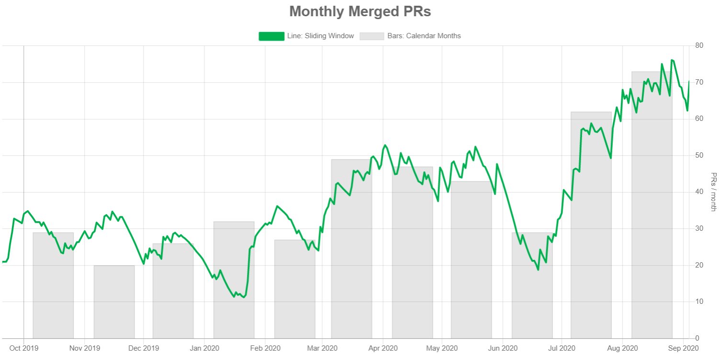
Status Chart: Monthly Merged PRs

Slide 36
Year 1 ends. Year 2 begins!

Slide 37
More Info
Links
Repository: github.com/microsoft/STL
Changelog: github.com/microsoft/STL/wiki/Changelog
Status Chart: microsoft.github.io/STL/
C++20: wg21.link/n4861
Questions
GitHub Discussions tab
Discord server (see README)

Slide 38
Bonus Slides

Slide 39
Compile-Time/Run-Time Hybrid
template <class _Rx, class _Ty>
_NODISCARD constexpr bool in_range(const _Ty _Value) noexcept {
// ... see <utility> lines 721-745 ...
constexpr auto _Ty_min = _Min_limit<_Ty>();
constexpr auto _Rx_min = _Min_limit<_Rx>();
if constexpr (_STD cmp_less(_Ty_min, _Rx_min)) {
if (_Value < _Ty{_Rx_min}) {
return false;
}
}
// ... similarly for _Value > _Ty{_Rx_max} ...
return true;
}

Slide 40
Associative Erasure
std::erase_if() is linear time
Inspects the entire value_type
Associative containers have member .erase(key)
Inspects only the key, using the container's predicate
Ordered: "Logarithmic" time, O(K + log N)
Unordered: "Constant" time, average O(K), worst O(N)
Only std::erase_if() is provided for associative
Avoids potential confusion

Slide 41
Continuous Integration
Scripts prepare Azure Virtual Machine Scale Sets
Currently up to 12 VMs, each with 16 cores
VMs install VS (with Clang, CMake, Ninja), Python, CUDA
We enforce clang-format for product/test code
Saves an incredible amount of time
Our parallelize tool runs it quickly, only on C++ files
Failed checks display the edits that clang-format wants
Building all architectures is very fast
Testing x86/x64 takes about an hour
Many tests, multiplied by many compiler configurations

Slide 42
Projects
Code Reviews (primary dashboard!)
Work In Progress ➔ Initial Review ➔ Final Review ➔ Ready To Merge ➔ Done
GitHub Migration
C++20 Features
Available ➔ Investigating ➔ Reviewing PR ➔ Done
Maintainer Priorities
Large features: Chrono, Format, Spaceship

Slide 43
Wiki
Changelog
Infeasible: Look at commit history between releases
Old process: Record commits, write them up later
New process: Merge PR, add Changelog entry immediately
Advice for Reviewing Pull Requests
MSVC STL Contributors Meeting Notes
Macro _MSVC_STL_UPDATE
Updated every month by new contributors
Custom Autolinks
DevCom-724444, LLVM-41915, LWG-3080, WG21-P1209

Slide 44
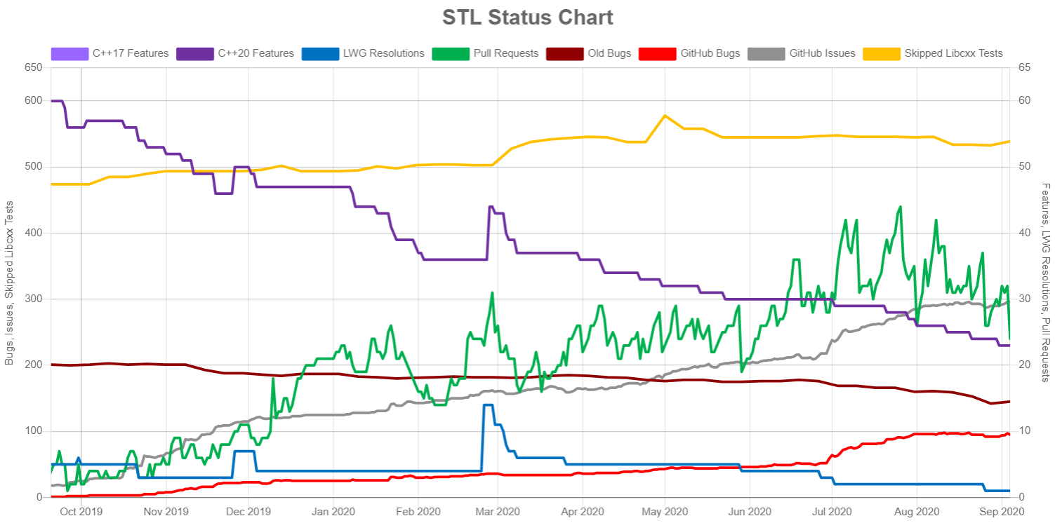
Status Chart

Slide 45
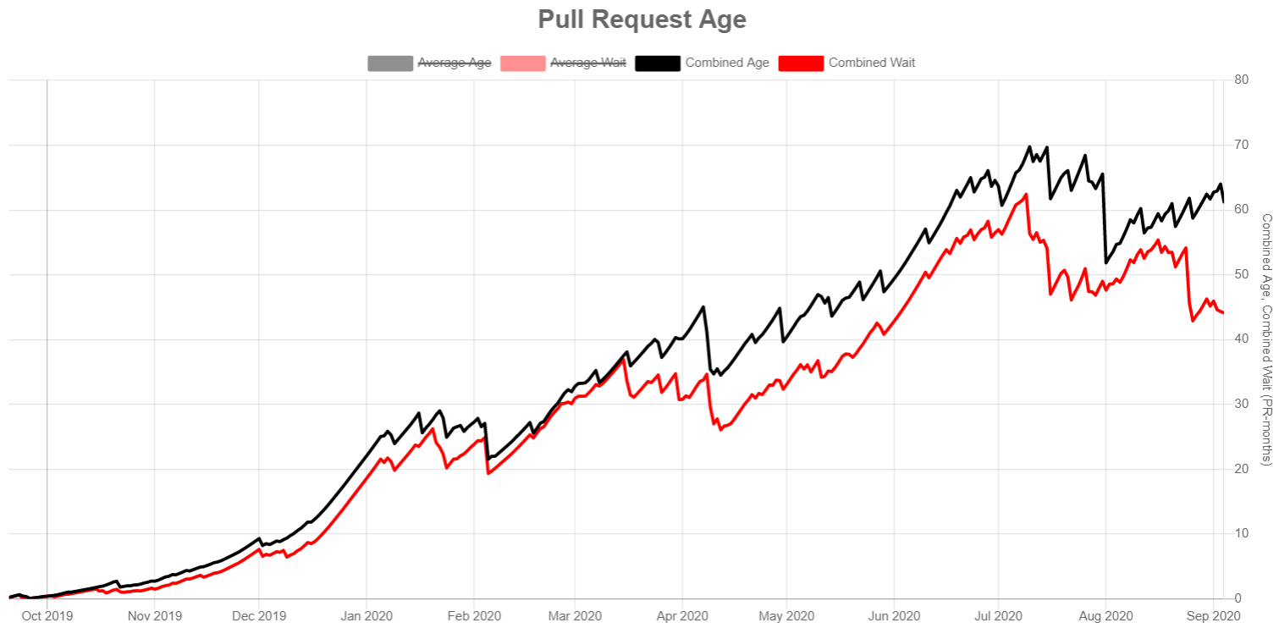
Status Chart: Pull Request Age

