Slide 1
SECURE DATA HIDING IN IMAGES USING STEGANOGRAPHY
CAPSTONE PROJECT
Presented By:
Student Name : Atul Kumar
College Name & Department : St. Xavier's College
(Dep. of computer science)

Slide 2
OUTLINE
Problem Statement
Technology used
Wow factor
End users
Result
Conclusion
Git-hub Link
Future scope

Slide 3
Problem Statement
In today's digital world, secure communication is a major challenge as traditional methods are vulnerable to interception. Steganography allows messages to be hidden inside images, but most tools are complex and not user-friendly. StegoMagic simplifies this process by providing an interactive, browser-based tool to easily encode and decode secret messages within images using a security key for added protection.

Slide 4
Technology used
Frontend Technologies:
HTML, CSS, JavaScript – For building the user interface.
Canvas API – To manipulate image pixels for encoding and decoding
Libraries & Tools:
JavaScript (Vanilla JS) – For handling encoding, decoding, and UI interactions.
GitHub Pages – For hosting the web application.
Platform:
Web-Based (Runs in Browser) – No installation required, works on all modern browsers.

Slide 5
Wow factors
User-Friendly & Fully Browser-Based – No software installation required, works on any device with a web browser.
Mechanical Switch-Style Buttons – Interactive UI with 3D button effects that feel like a real keyboard switch.
Secure Message Encoding with a Custom Security Key – Ensures only authorized users can decode hidden messages.
Lightweight & Fast – Uses pure JavaScript and Canvas API, making it efficient and responsive.

Slide 6
End users
Privacy-Conscious Individuals – People who want to securely hide confidential messages in images.
Cybersecurity Enthusiasts & Developers – Those interested in steganography, cryptography, and secure communication.
Students & Researchers – Useful for learning about steganography and digital security concepts.
Journalists & Activists – Can use it to share sensitive information securely without raising suspicion.
General Users – Anyone who enjoys hidden messages, digital puzzles, or secret communication.

Slide 7
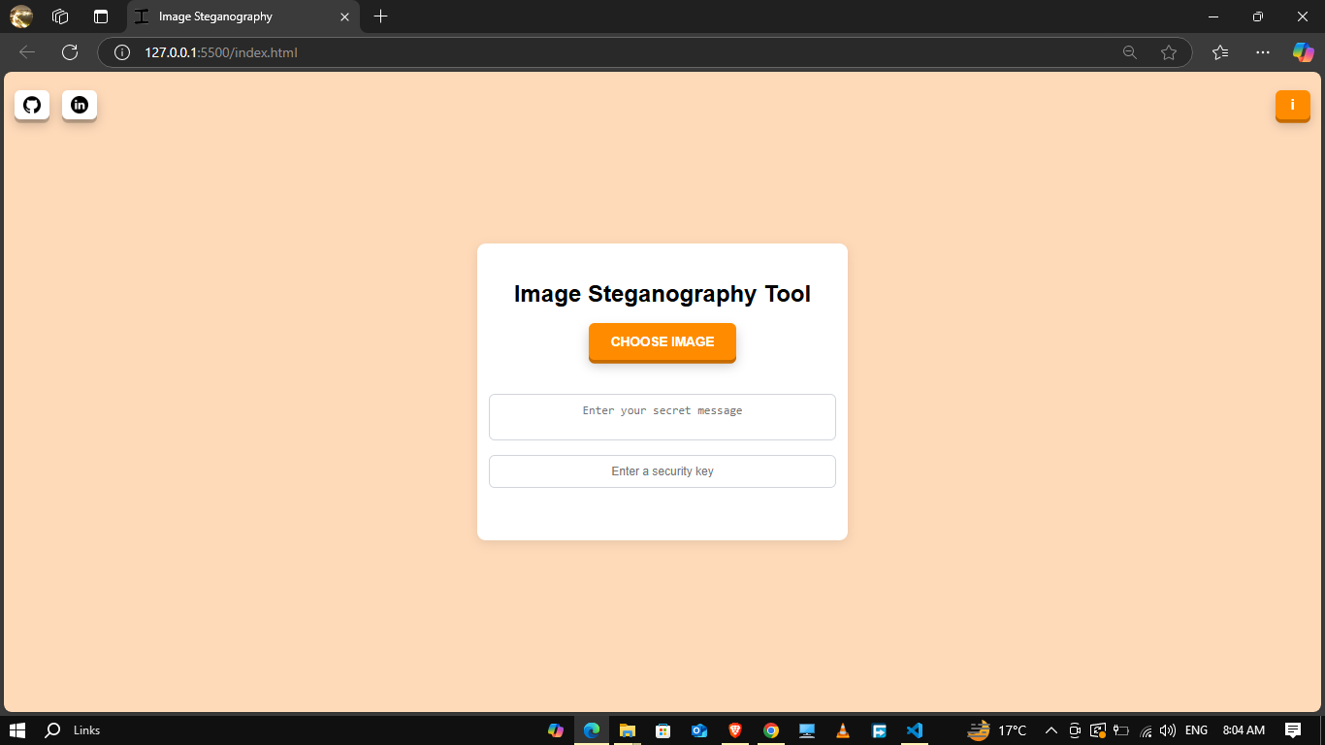
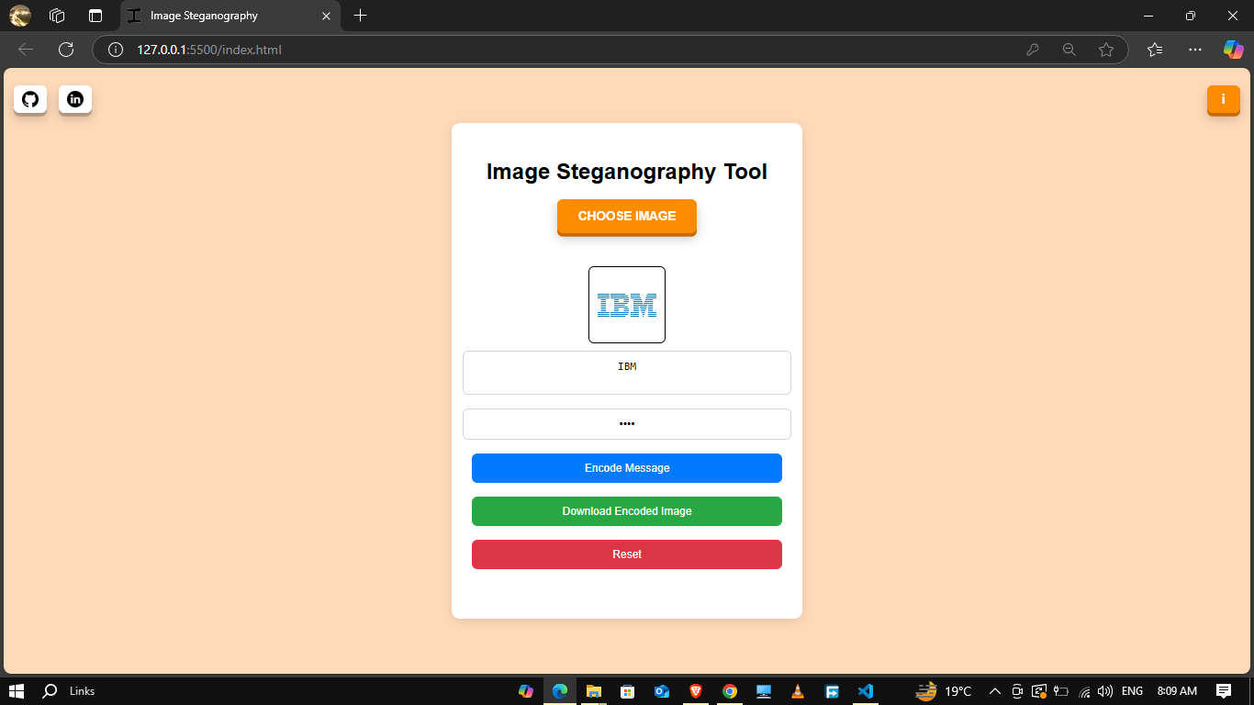
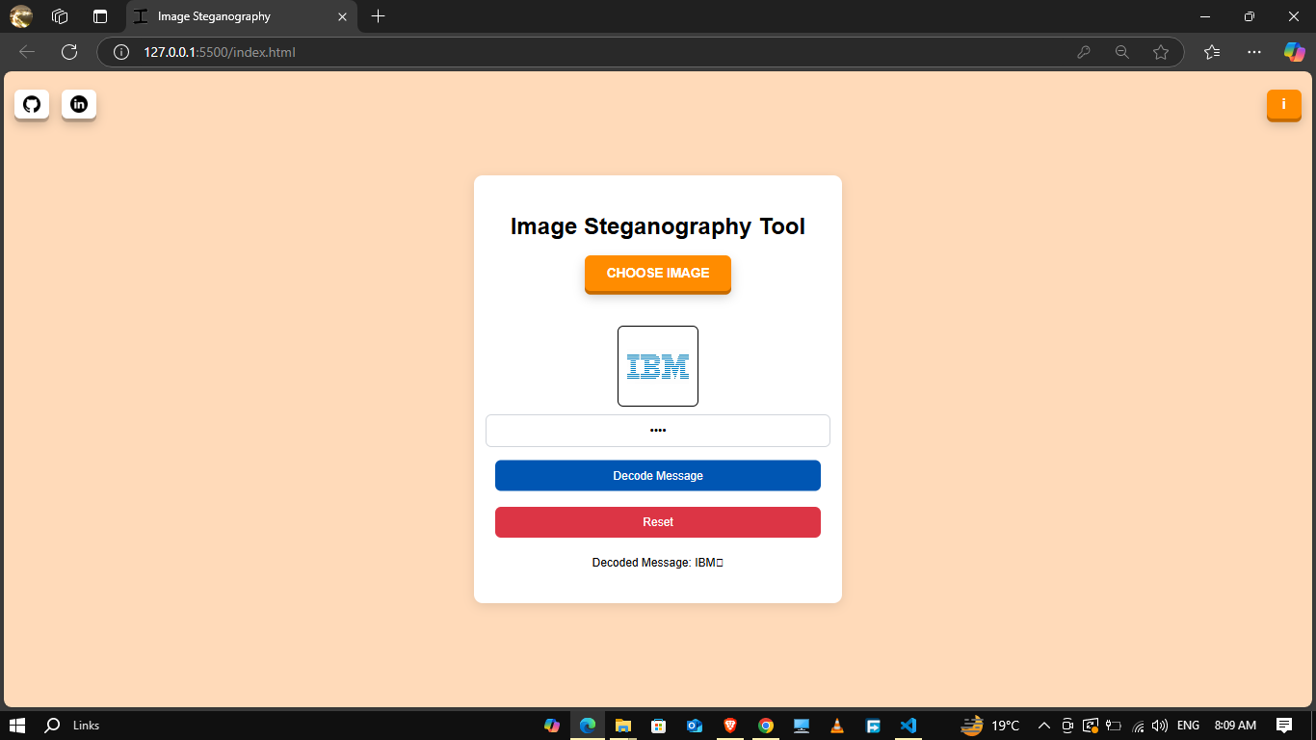
Results

Slide 8
Conclusion
StegoMagic successfully addresses the challenge of secure message transmission by providing an easy-to-use, browser-based steganography tool. Unlike traditional methods that are complex and require technical expertise, StegoMagic allows users to seamlessly hide and retrieve messages inside images with a security key for protection.
With its interactive UI, mechanical switch-style buttons, and fun animations, the tool makes steganography accessible to everyone, from privacy-conscious users to cybersecurity enthusiasts and students. This project simplifies secret communication while ensuring security and ease of use.

Slide 9
GitHub Link
https://github.com/Atul-kr07/StegoMagic.git

Slide 10
Future scope(optional)
Support for More Image Formats – Extend functionality to JPEG, BMP, and GIF formats for wider compatibility.
Advanced Encryption Techniques 🔐 – Enhance security by adding AES or RSA encryption before encoding messages.
Mobile App Development 📱 – Create an Android & iOS app for secure steganography on smartphones.
Cloud-Based Steganography ☁️ – Allow users to encode/decode messages online without downloading images.
AI-Based Message Detection 🤖 – Use AI and machine learning to improve steganalysis and prevent unauthorized access.
Audio & Video Steganography 🎥 – Expand beyond images to hide messages inside audio and video files.

Slide 11
THANK YOU

