Slide 1







MAR ATHANASIUS COLLEGE OF ENGINEERING KOTHAMANGALAM (AUTONOMOUS)
Cradlix
ABX & Co.
#CreateAndElevate

Slide 2
PROBLEM STATEMENT
The project addresses the challenge of accurately and reliably detecting a baby's cries to ensure timely parental response, reduce caregiver anxiety, and improve infant well-being—overcoming the limitations of traditional baby monitors.
The project fills key gaps in the baby monitoring market by providing affordable, intelligent cry detection with accurate alerts and the potential to distinguish between types of cries—capabilities lacking in most traditional monitors, which leads to missed signals and increased parental stress.

Slide 3
SOLUTION / INNOVATION
Proposed Solution
Key Features/Innovations
Develop an affordable, smart baby monitoring system.
Accurate Cry Detection: Real-time sound analysis reliably identifies genuine infant cries and minimizes false alarms.
Use sound sensors to accurately detect infant cries in real time.
Wi-Fi-Enabled Alerts: Instantly notifies caregivers via smartphone notifications, even when they are away from the baby's room.
Differentiate cries from background noise to reduce false alarms.
Instantly alert caregivers through visual cues and smartphone notifications.
Visual Status Indicators: Integrated OLED display and RGB LEDs provide at-a-glance updates on baby's status.
Enable future capability to classify different types of cries for more tailored responses.
Optional Lullaby Playback: Automatically plays soothing music to help comfort the baby when crying is detected.
Machine Learning Ready: Designed for future integration of AI to recognize and classify different types of baby cries.

Slide 4
IMPACT & BENEFITS
Increases infant safety by ensuring fast, accurate alerts for caregiver response.
Reduces parental stress and anxiety thanks to reliable cry detection and fewer false alarms.
Improves sleep quality for both babies and caregivers by minimizing unnecessary wake-ups.
Enables parents to multitask with confidence through instant wireless notifications.
Enables parents to multitask with confidence through instant wireless notifications.

Slide 5
TECHNOLOGY / METHODOLOGY
Technology Stack/Tools Used
Approach/Methodology
The ESP32 processes real-time sound from the INMP441 MEMS microphone to detect infant cries.
Upon cry detection, the OLED display (SSD1306) immediately prompts the caregiver to identify the reason for crying.
The caregiver uses the TTP224 4-channel touch sensor to select the appropriate cry reason.
Each cry event, along with the selected reason and timestamp, is saved locally on the SD card module.
The same event data is simultaneously uploaded to Firebase, enabling real-time remote monitoring and centralized storage.
This modular approach supports future analytics, reporting, and integration of machine learning for further system enhancements.
ESP 32
INMP441 MEMS High Precision Omnidirectional Microphone Module I2S
TTP224 4 Channel Capacitive Touch Sensor Module
Firebase
Adafruit SSD1306 (OLED display control)
SD Card Module

Slide 6
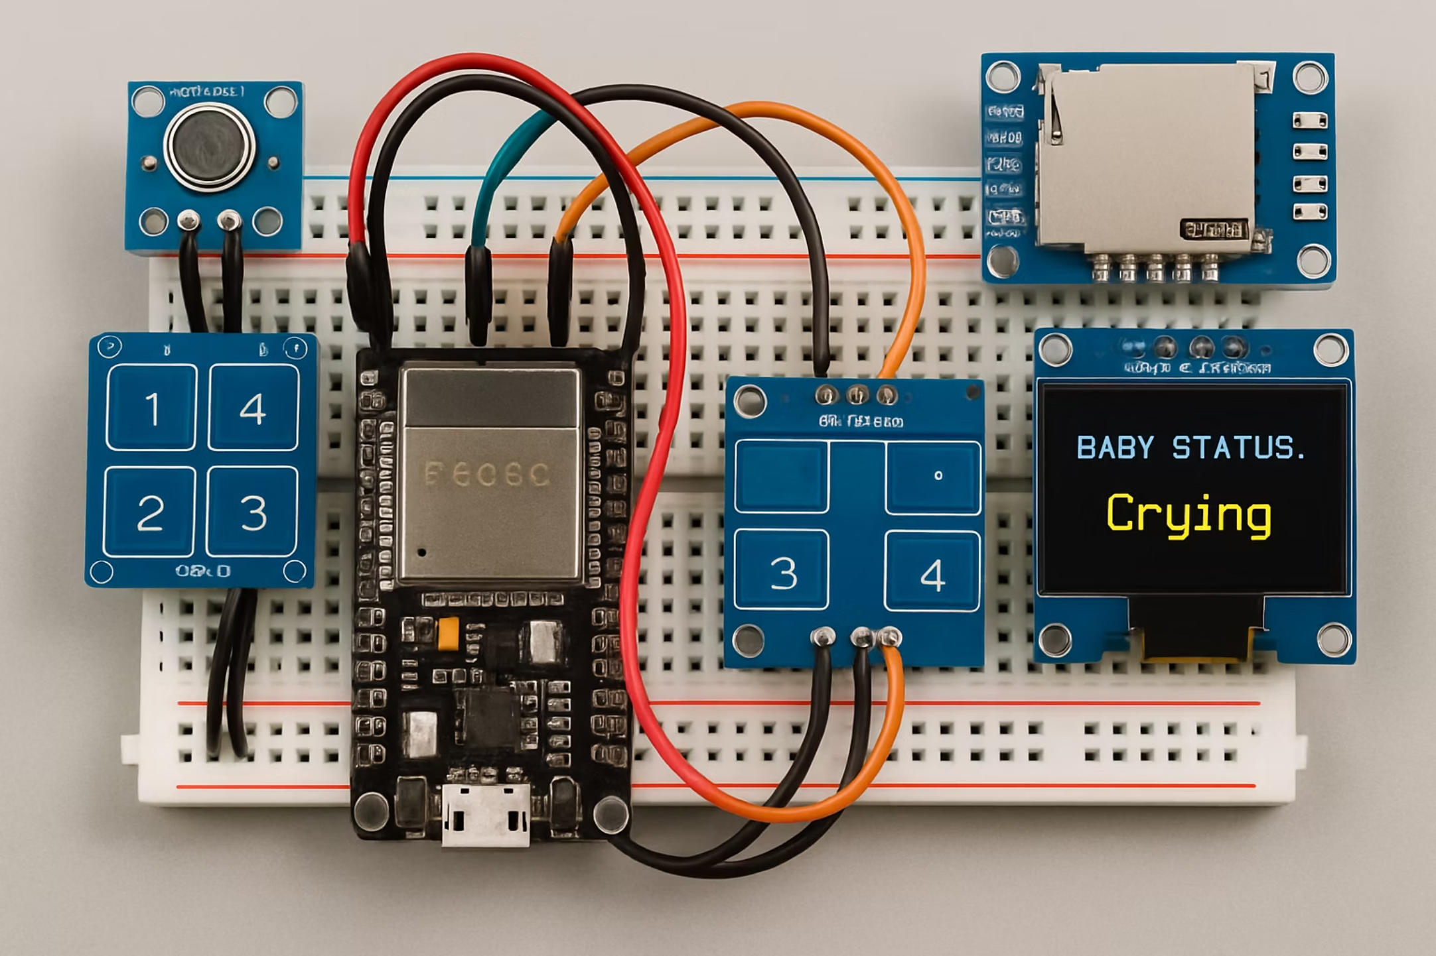
PROTOTYPE

Slide 7
FEASIBILITY
All components are affordable, widely available, and compatible for smooth integration.
ESP32 offers reliable processing power and easy cloud connectivity via Firebase.
Development is simplified thanks to open-source libraries for each module.
The system is modular and can be assembled with basic prototyping skills.
Design allows for future upgrades, including advanced features or machine learning.

Slide 8
CHALLENGES FACED
Key Challenges or Obstacles
Solutions/Workarounds
Ensuring accurate cry detection while minimizing false alarms from background noise.
Use noise filtering and adjustable sensitivity to improve cry detection accuracy.
Achieving reliable, real-time data syncing with Firebase.
Implement local data buffering and automatic syncing to handle network issues with Firebase.
Collecting consistent and accurate user-labelled cry data.
Balancing power efficiency with prompt system response.
Provide clear prompts on the OLED and simple touch input to encourage consistent user labeling.
Enable ESP32 low-power modes and optimize code for energy efficiency.
Support over-the-air firmware updates for easy improvements and fixes.

Slide 9
FUTURE SCOPE
Integrate machine learning for automatic classification of different types of baby cries.
Develop a mobile or web dashboard for real-time data visualization and caregiver insights.
Expand system features with additional sensors (e.g., temperature, humidity) for comprehensive monitoring.
Optimize power efficiency and enable remote firmware updates for easier maintenance.
Foster open-source collaborations to accelerate innovation and feature development.
Integrate with IoT and smart home devices, enabling actions such as automated notifications, smart lighting adjustments, or connecting with digital assistants for a more seamless caregiving environment.

Slide 10
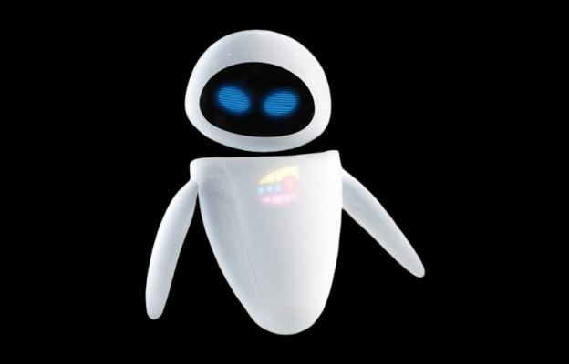
TEAM DETAILS
TEAM NAME: ABX & Co.
LEADER NAME: Amal Babu / CSE(AI) / 3rd
TEAM MEMBER 1: Atul Biju / CSE(AI) / 3rd
TEAM MEMBER 2: aaa / CSE(AI) / 3rd
INSTITUTION NAME: Adi Shankara Institute of Engineering and Technology
https://github.com/Atul013/Cradlix

