Slide 1

A Technical & Practical Learning Club
… A Club for enhancing Practical Learning
Celebrating one year of its establishment
(Feb 2020 – Feb 2021)

Slide 2
Started in February 2020

Slide 4
Focused on Enhancing Practical Learning & developing practical skills among the students so that they easily enter into professional world tomorrow

Slide 5
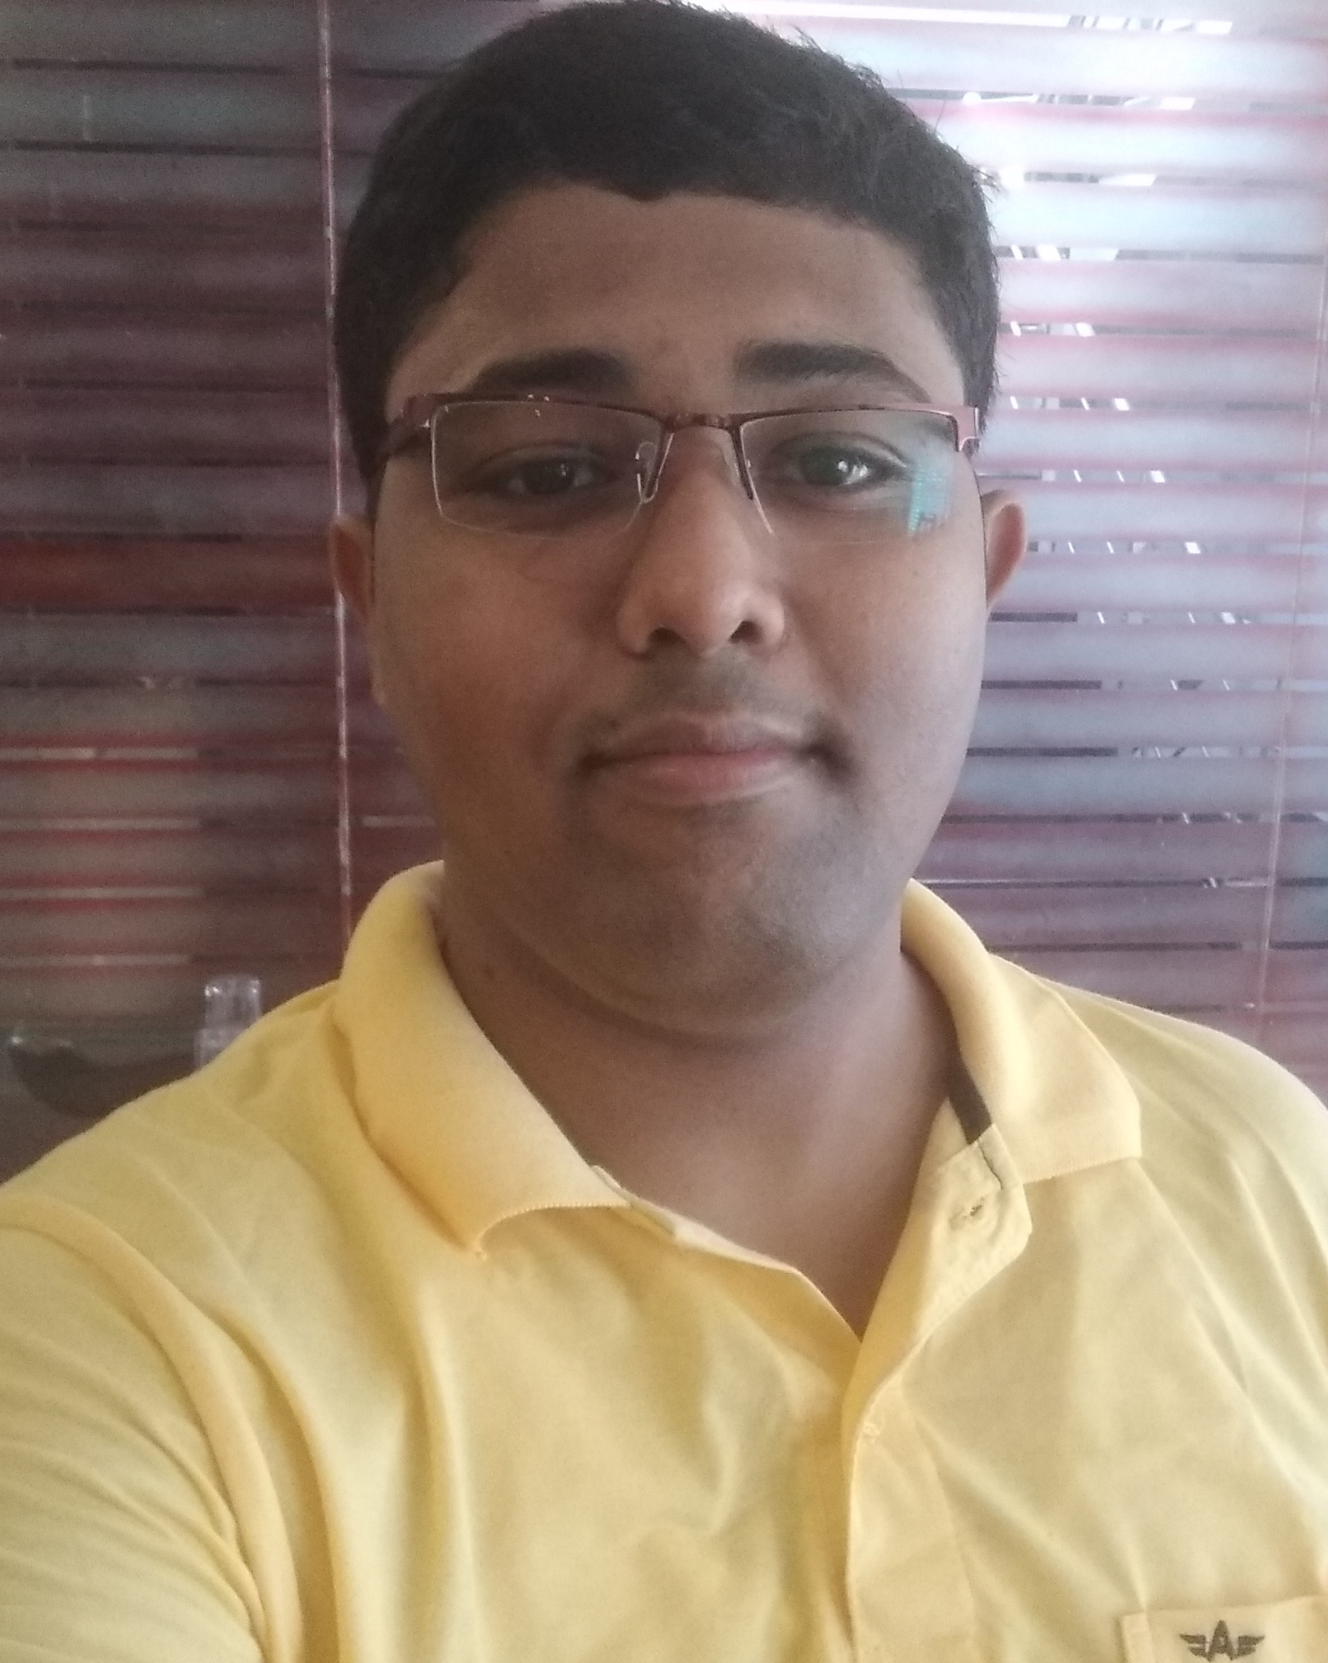
Founded by:
ATUL KUMAR
B. Tech 2k18 batch,
Motihari College of Engineering,
Motihari(Bihar)
Assisted by:
RAHUL KUMAR
B. Tech 2k18 batch,
Motihari College of Engineering,
Motihari(Bihar)
SHIVAM KUMAR
B. Tech 2k18 batch,
Institute of Engineering & Management,
Kolkata(West Bengal)

Slide 6
Our 1st Year of Successful Journey
(Event History)

