Slide 1
Machine Learning for Efficient Assessment and Prediction of Human Performance in Collaborative Learning Environments
Presented By:
Atul Chandran (1TJ15CS009)
Under the Guidance of:
Mr. Srinivasa H P
Associate Professor
TJIT

Slide 2
AGENDA
INTRODUCTION
LITERATURE SURVEY
EXISTING SYSTEM
PROPOSED SYSTEM
SYSTEM OVERVIEW
SYSTEM DESIGN
CONCLUSION AND FUTURE ENHANCEMENT
REFERENCES

Slide 3
ABSTRACT
The objective of this work is to propose a machine learning-based methodology system architecture and algorithms to find patterns of learning, interaction, and relationship and effective assessment for a complex system involving massive data that could be obtained from a proposed collaborative learning environment (CLE).
This paper focuses on proposing a Machine Learning - (ML)-based system architecture to promote understanding of the behaviours, group dynamics, and interactions in the CLE.

Slide 4
INTRODUCTION
Collaborative learning methods have been implemented broadly by organizations at all stages, as research recommends that active human involvement in cohesive and micro group communications is critical for effective learning.
In current research, an important line of inquiry focuses on finding accurate
evidence and valid assessment of these micro-level interactions
which supports collaborative learning.
In this paper, we propose a three-stage method to explore and study collaborative group behaviours. The first stage integrates and processes multimodal data obtained in a collaborative learning environment (CLE) that includes sensor input, audio, video, eye tracking, facial expressions, movement, posture, gestures, and behavioural interaction log data.

Slide 5
LITERATURE SURVEY
Sl. No | Title/Author/Journal/Year | Advantages | Drawbacks
[1] | “A tough nut to crack: Measuring collaborative problem solving” L. Lei, J. Hao, A. von Davier, P. Kyllonen, and J-D. Zapata-Rivera., Handbook of Research on Technology Tools for Real-World Skill Development, 2018. | Reflects each problem at hand effectively. Provides specified and detailed steps. | Time consuming. Might be incomprehensible. Long process.
[2] | “Modelling behaviour dynamics using computational psychometrics within virtual worlds” P. Cipresso, Frontiers in Psychology, 2015. | Helps with impressive visualization. Improves educational value. Overcomes language barrier. | Lacks flexibility. Ineffective human connections.

Slide 6
LITERATURE SURVEY
Sl. No | Title/Author/Journal/Year | Advantages | Drawbacks
[3] | “Modelling behaviour dynamics using computational psychometrics within virtual worlds”, Aitor Almeida, Gorka Azkune, 2018. | Predicts human behaviour efficiently based on a given dataset. | Vanishing Gradient Problem. Cannot be stacked into deeper models. Unable to keep track of long-term dependencies.
[4] | “Shared mental models in support of adaptive, instruction for teams using the GIFT tutoring architecture” J. Fletcher and R. Sottilare, 2017. | Virtual classroom with interactive facilities. Large range of tutors to choose from. Schedule of availability. | Lesson interruption. A lack of opportunity to develop social skills. Distraction from programs running on a computer.

Slide 7
LITERATURE SURVEY
Sl. No | Title/Author/Journal/Year | Advantages | Drawbacks
[5] | “Twitter Sentiment Analysis with Deep Convolutional Neural Networks”, Aliaksei Severyn, Alessandro Moschitti, 2015. | Ability to accept huge number of data. High computational power. Faster and efficient performance. | Lack of ability to be spatially invariant to input data. High computational cost.
[6] | “ImageNet classification with deep convolutional neural networks”, A. Krizhevsky, I. Sutskever, and G. Hinton, 2012. | Every level of visual information is processed. Ability to distinguish images based on few test-case scenarios | High amount of operations. Unable to maximize inter-class variability.

Slide 8
EXISTING SYSTEM
The existing system worked on predicting the human behaviour on statistical approach which was effective, but a lot time and resource consuming.
Fewer algorithms were used for prediction making this whole mechanism manual than automated.
DISADVANTAGES:
The existing process was not automated leading to resource and time wastage.
Data categorization and distribution was ambiguous.
The existing system could not identify cross-cutting capabilities or solutions.

Slide 9
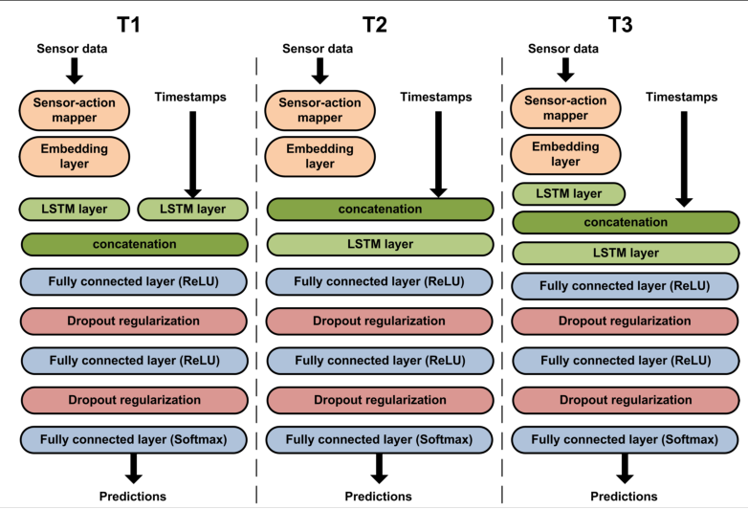
Human behavior prediction system using LSTM (Long short-term memory network)

Slide 10
PROPOSED SYSTEM
This paper proposes the following three-stage method to explore and study collaborative group behaviour.
The first stage integrates and processes multimodal data obtained in a collaborative learning environment (CLE) that includes sensor input, audio, video, eye tracking, facial expressions, movement, posture, gestures, and behavioural interaction log data.
The second stage performs feature extraction and cloud computation using computational psychometrics (CP) and convolutional neural network (CNN)-based deep learning for skill, pattern, and trend identification.
Finally, the third stage uses the parameters measured in the previous two stages to understand and model group interactions, competencies, and collaborative behaviour at a micro-level.
The third stage uses machine learning for effective assessment and visualization of group dynamics.

Slide 11
ADVANTAGES
Built upon the Hadoop data analytics platform which improves the efficiency of data storage.
Additive feature of CNN(Convolutional Neural Network) and deep learning concepts using Python or R programming makes this process a lot more efficient.
Usage of HPC (High Performance Computing) infrastructure for massive data processing.
Usage of machine learning for effective assessment and visualization.

Slide 12
SYSTEM OVERVIEW
The system has the following components:
Data Integration and Processing
Large amounts of CLE multimodal interaction data that provide the identities of humans, machines, sensors, etc. are collected from different sources will be processed.
The solutions are built upon the Hadoop data analytics platform.

Slide 13
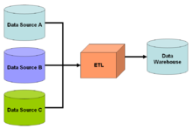
Relation between data sources, ETL and data warehouse.

Slide 14
SYSTEM OVERVIEW
Massive data intensive CNN (deep learning) based cloud computing and Computational Psychometrics (CP)
Deployment of a feature extraction algorithm including CNN based deep learning for skill, pattern, trend identification.
A convolutional neural network is a class of deep neural networks, most commonly applied to analysing visual imagery. CNNs use a variation of multilayer perceptron designed to require minimal pre-processing.
Computational Psychometrics is an interdisciplinary field fusing theory-based psychometrics, learning and cognitive sciences, and data-driven AI-based computational models as applied to large-scale/high-dimensional learning

Slide 15
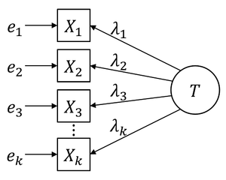
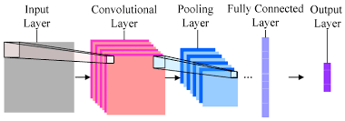
Computational Psychometrics (CP)
CNN (Deep Learning)

Slide 16
SYSTEM OVERVIEW
Effective Assessment (EA)
The effective assessment (EA) module locates and retrieves data after the computation is finished using the CNN and CP modules illustrated in the above modules.
EA module identifies/detects clusters of interactions, and abilities based on degree, connected components, and it performs collaborative learning skill analysis.
The EA module also performs predictive decision-making based on group behaviours.

Slide 17
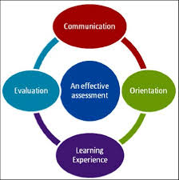
Effective Assessment (EA)

Slide 18
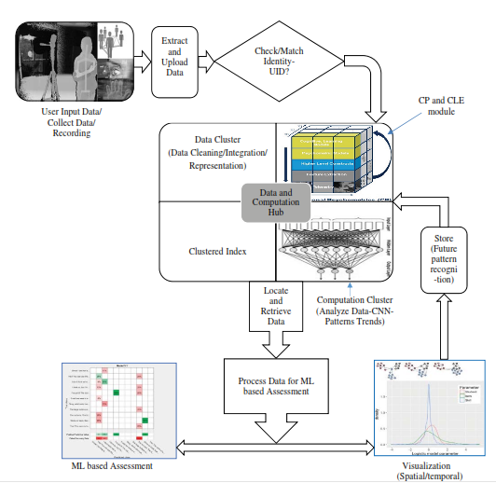
SOFTWARE ARCHITECTURE
In current research, an important line of inquiry focuses on finding accurate evidence and valid assessment of these micro-level interactions which supports collaborative learning.

Slide 19
CONCLUSION
A machine learning (ML)-based system architecture to identify evidence about teamwork skills from the behaviour, group dynamics, and interactions in the CLE has been illustrated here.
Development of a three-stage robust architecture for data intensive computing and efficient assessment of teamwork CPS skills.

Slide 20
FUTURE ENHANCEMENT
Attempt to build text-based Natural Language Processing (NLP) / models to classify various performances of CPS sub skills from the data collected throughout the study.
Additional feature extraction that may be used during this phase will be implemented for CNN based pattern identification.

Slide 21
REFERENCES
[1]. L. Lei, J. Hao, A. von Davier, P. Kyllonen, and J-D. Zapata-Rivera. “A
tough nut to crack: Measuring collaborative problem solving.” Handbook
of Research on Technology Tools for Real-World Skill Development. IGI
Global, 2016. 344-359. Web. 28 Aug. 2018. doi:10.4018/978-1-46669441-5.ch013
[2]. P. Cipresso, “Modeling behavior dynamics using computational
psychometrics within virtual worlds,” Frontiers in Psychology, vol. 6, no.
1725, p. 22, 6 November 2015.
[3]. J. Fletcher and R. Sottilare, “Shared mental models in support of adaptive,
instruction for teams using the GIFT tutoring architecture,” International
Journal of Artificial Intelligence in Education, pp. 1-21, 2017.
[4]. A. von Davier, “Virtual and collaborative assessments: Examples,
implications, and challenges for educational measurement.,” in Invited
Talk at the Workshop on Machine Learning for Education at International
Conference of Machine Learning, Lille, France, 2015.

Slide 22
THANK YOU

