Slide 1


E-Commerce Sales Analysis with SQL
In this analysis, we will be delving into the world of e-commerce using SQL. By leveraging this powerful language, we can extract valuable insights from vast amounts of data. Through our analysis, we aim to understand customer behavior, optimize marketing strategies, and ultimately maximize revenue for online businesses.
by Atul Gaikwad

Slide 2
Creating the Database and Tables
Orders Table
Customers Table
Products Table
create table orders(order_id text,customer_id text,order_status text, order_purchase_timestamp text,order_approved_at text ,
order_delivered_carrier_date text , order_delivered_customer_date text , order_estimated_delivery_date text );
SELECT * FROM ecommerce_analysis_project.orders;
CREATE TABLE customers (
customer_id VARCHAR(255),
customer_unique_id VARCHAR(255),
customer_zip_code_prefix INT,
customer_city VARCHAR(255),
customer_state VARCHAR(2)
);
SELECT * FROM ecommerce_analysis_project.customers;
CREATE TABLE products (
product_id VARCHAR(255),
product_category VARCHAR(255),
product_name_length FLOAT,
product_description_length FLOAT,
product_photos_qty FLOAT,
product_weight_g FLOAT,
product_length_cm FLOAT,
product_height_cm FLOAT,
product_width_cm FLOAT
);
SELECT * FROM ecommerce_analysis_project.products;

Slide 3
More Tables
Sellers Table
Order Items Table
Payments Table
CREATE TABLE sellers (
seller_id VARCHAR(255) NOT NULL,
seller_zip_code_prefix INT NOT NULL,
seller_city VARCHAR(255) NOT NULL,
seller_state VARCHAR(2) NOT NULL
);
SELECT * FROM ecommerce_analysis_project.sellers;
CREATE TABLE order_items (
order_id VARCHAR(255),
order_item_id INT,
product_id VARCHAR(255),
seller_id VARCHAR(255),
shipping_limit_date DATETIME,
price DECIMAL(10, 2),
freight_value DECIMAL(10, 2)
);
SELECT * FROM ecommerce_analysis_project.order_items;
CREATE TABLE payments (
order_id VARCHAR(255),
payment_sequential INT,
payment_type VARCHAR(255),
payment_installments INT,
payment_value DECIMAL(10, 2)
);
SELECT * FROM ecommerce_analysis_project.payments;

Slide 4
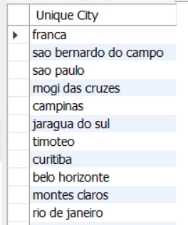
QUESTION AND THEIR QUERY N SOLUTION :
# BASIC QUESTION :
#1.List all unique cities where customers are located:
QUERY :
SELECT DISTINCT customer_city AS "Unique City" FROM customers;
OUTPUT:

Slide 5

#2.Count the number of orders placed in 2017.
QUERY :
SELECT COUNT(*) AS orders_2017
FROM orders
WHERE YEAR(order_purchase_timestamp) = 2017;
OUTPUT :
:

Slide 6
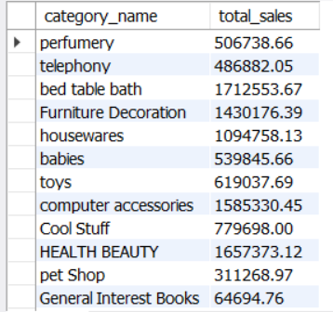
#3.Find the total sales per category:
QUERY :
SELECT products.product_category AS category_name, SUM(payments.payment_value) AS total_sales
FROM payments
JOIN orders ON payments.order_id = orders.order_id
JOIN order_items ON orders.order_id = order_items.order_id
JOIN products ON order_items.product_id = products.product_id
GROUP BY products.product_category;
OUTPUT :

Slide 7

#4. Calculate the percentage of orders paid in installments.
QUERY :
SELECT
COUNT(DISTINCT CASE WHEN payment_installments > 1 THEN order_id END) * 100.0 / COUNT(DISTINCT order_id) AS installment_percentage
FROM
payments;
OUTPUT :

Slide 8
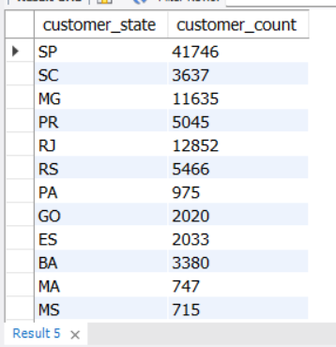
#5.Count the number of customers from each state.
QUERY :
SELECT
customers.customer_state,
COUNT(*) AS customer_count FROM ecommerce_analysis_project.customers
GROUP BY customers.customer_state;
OUTPUT:

Slide 9
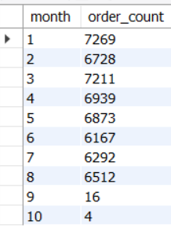
#Intermediate Problems
# 1.Calculate the number of orders per month in 2018.
QUERY :
SELECT
MONTH(orders.order_purchase_timestamp) AS month,
COUNT(*) AS order_count
FROM ecommerce_analysis_project.orders
WHERE YEAR(orders.order_purchase_timestamp) = 2018
GROUP BY MONTH(orders.order_purchase_timestamp);
Output:

Slide 10
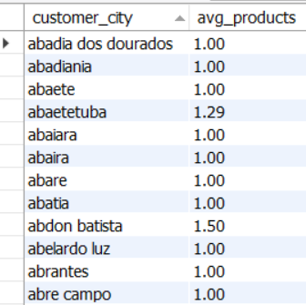
# 2.Find the average number of products per order, grouped by customer city.
QUERY :
SELECT
customers.customer_city,
ROUND(AVG(order_items.order_item_id), 2) AS avg_products
FROM ecommerce_analysis_project.order_items
JOIN ecommerce_analysis_project.orders
ON order_items.order_id = orders.order_id
JOIN ecommerce_analysis_project.customers
ON orders.customer_id = customers.customer_id
GROUP BY customers.customer_city;
OUTPUT:

Slide 11
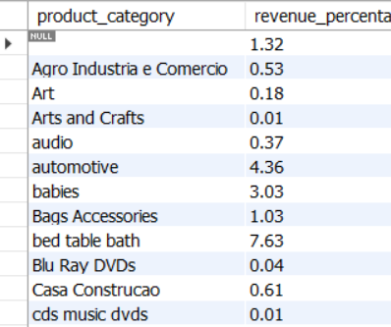
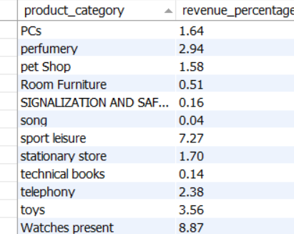
#3. Calculate the percentage of total revenue contributed by each product category.
QUERY :
SELECT
products.product_category,
ROUND((SUM(order_items.price) * 100.0) / (SELECT SUM(price) FROM ecommerce_analysis_project.order_items), 2) AS revenue_percentage
FROM ecommerce_analysis_project.order_items
JOIN ecommerce_analysis_project.products
ON order_items.product_id = products.product_id
GROUP BY products.product_category;
Output :

Slide 12
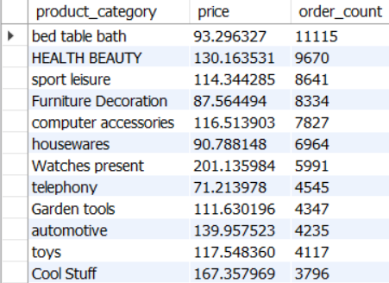
#4.Identify the correlation between product price and the number of times a product has been purchased.
QUERY :
SELECT
products.product_category,
AVG(order_items.price) AS price,
COUNT(order_items.product_id) AS order_count
FROM
order_items
JOIN
products ON order_items.product_id = products.product_id
GROUP BY
products.product_category
ORDER BY
order_count DESC;
OUTPUT:

Slide 13
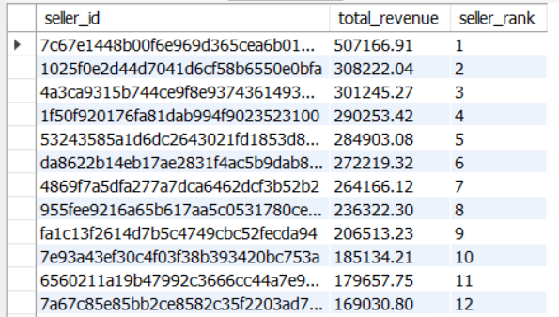
#5. Calculate the total revenue generated by each seller and rank them by revenue.
QUERY :
SELECT
order_items.seller_id,
SUM(payments.payment_value) AS total_revenue,
RANK() OVER (ORDER BY SUM(payments.payment_value) DESC) AS seller_rank
FROM
order_items
JOIN
payments ON order_items.order_id = payments.order_id
GROUP BY
order_items.seller_id
ORDER BY
total_revenue DESC;
OUTPUT:

Slide 14
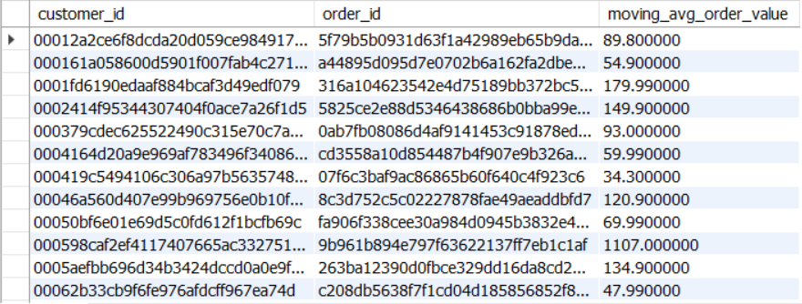
#ADVANCED QUESTIONS :
#1. Calculate the moving average of order values for each customer over their order history.
QUERY :
SELECT
customer_orders.customer_id,
customer_orders.order_id,
AVG(customer_orders.order_value) OVER (PARTITION BY customer_orders.customer_id ORDER BY customer_orders.order_date ROWS BETWEEN 2 PRECEDING AND CURRENT ROW) AS moving_avg_order_value
FROM (
SELECT
orders.customer_id,
orders.order_id,
SUM(order_items.price) AS order_value,
orders.order_purchase_timestamp AS order_date
FROM ecommerce_analysis_project.orders
JOIN ecommerce_analysis_project.order_items
ON orders.order_id = order_items.order_id
GROUP BY orders.customer_id, orders.order_id, orders.order_purchase_timestamp
) customer_orders;
OUTPUT:

Slide 15
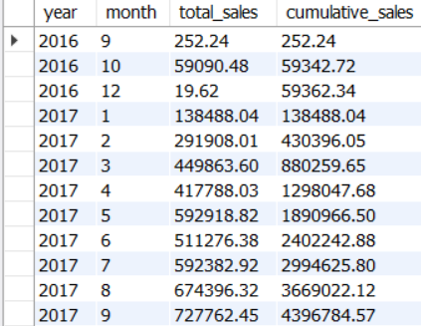
#2. Calculate the cumulative sales per month for each year.
QUERY :
SELECT
YEAR(orders.order_purchase_timestamp) AS year,
MONTH(orders.order_purchase_timestamp) AS month,
SUM(payments.payment_value) AS total_sales,
SUM(SUM(payments.payment_value)) OVER (PARTITION BY YEAR(orders.order_purchase_timestamp) ORDER BY MONTH(orders.order_purchase_timestamp)) AS cumulative_sales
FROM orders
JOIN payments ON orders.order_id = payments.order_id
GROUP BY
YEAR(orders.order_purchase_timestamp), MONTH(orders.order_purchase_timestamp)
ORDER BY
year, month;
OUTPUT :

Slide 16
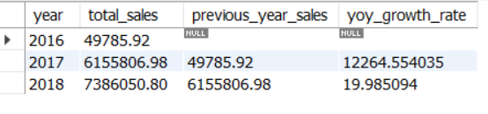
# 3. Calculate the year-over-year growth rate of total sales.
QUERY :
SELECT
YEAR(orders.order_purchase_timestamp) AS year,
SUM(order_items.price) AS total_sales,
LAG(SUM(order_items.price)) OVER (ORDER BY YEAR(orders.order_purchase_timestamp)) AS previous_year_sales,
((SUM(order_items.price) - LAG(SUM(order_items.price)) OVER (ORDER BY YEAR(orders.order_purchase_timestamp))) / LAG(SUM(order_items.price)) OVER (ORDER BY YEAR(orders.order_purchase_timestamp)) * 100) AS yoy_growth_rate
FROM ecommerce_analysis_project.orders
JOIN ecommerce_analysis_project.order_items
ON orders.order_id = order_items.order_id
GROUP BY YEAR(orders.order_purchase_timestamp);
OUTPUT :

Slide 17

#4.. Calculate the retention rate of customers, defined as the percentage of customers who make another purchase within 6 months of their first purchase.
QUERY :
SELECT
COUNT(DISTINCT retained.customer_id) AS retained_customers,
COUNT(DISTINCT first_purchase.customer_id) AS total_first_time_customers,
(COUNT(DISTINCT retained.customer_id) / COUNT(DISTINCT first_purchase.customer_id)) * 100 AS retention_rate
FROM
(SELECT customer_id, MIN(order_purchase_timestamp) AS first_purchase_date
FROM orders
GROUP BY customer_id) AS first_purchase
LEFT JOIN orders AS retained
ON first_purchase.customer_id = retained.customer_id
AND retained.order_purchase_timestamp > first_purchase.first_purchase_date
AND DATEDIFF(retained.order_purchase_timestamp, first_purchase.first_purchase_date) <= 180;
OUTPUT :

Slide 18
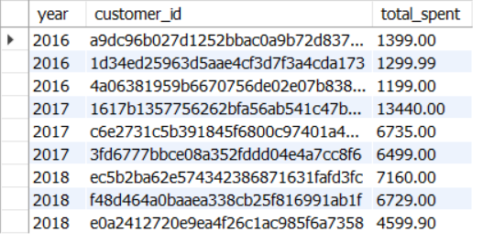
#5. Identify the top 3 customers who spent the most money in each year.
QUERY :
SELECT
yearly_customer_spending.year,
yearly_customer_spending.customer_id,
yearly_customer_spending.total_spent
FROM (SELECT
YEAR(orders.order_purchase_timestamp) AS year,
orders.customer_id,
SUM(order_items.price) AS total_spent,
RANK() OVER (PARTITION BY YEAR(orders.order_purchase_timestamp) ORDER BY SUM(order_items.price) DESC) AS `rank`
FROM ecommerce_analysis_project.orders
JOIN ecommerce_analysis_project.order_items
ON orders.order_id = order_items.order_id
GROUP BY YEAR(orders.order_purchase_timestamp), orders.customer_id
) yearly_customer_spending
WHERE yearly_customer_spending.`rank` <= 3;
OUTPUT:

Slide 19
CONCLUSION :
The E-Commerce Analysis Project provides a comprehensive examination of an online retail platform’s data,
yielding valuable insights for strategic decision-making. Key areas of focus include customer insights, sales
performance, payment behavior, revenue generation, and growth trends.
By segmenting customers geographically, targeted marketing campaigns can be developed,
enhancing customer acquisition and retention. Analyzing total sales by product category reveals
which categories informs inventory management. Payment behavior insights help tailor
flexible options to boost conversion rates.
Identifying top-performing sellers and analyzing revenue contributions allows for better resource allocation
and partnership decisions. Additionally, examining year-over-year sales growth and moving averages aids in recognizing
patterns for future performance improvement.
The analysis also highlights top customers based on spending, guiding personalized marketing efforts to strengthen
relationships and increase lifetime value. Ultimately, the project underscores the critical role of data in driving informed
business strategies, optimizing operations, and enhancing customer satisfaction. This data-driven approach serves as a sustained competitiveness in the evolving e-commerce landscape, enabling businesses to navigate challenges
and seize growth opportunities effectively.

