Slide 1
Automatic construction of lexical analyzer-(LEX)
Also Known as Scanner Generator.
Lex, or in a more recent implementation Flex, that allows one to specify a lexical analyzer by specifying regular expressions to describe patterns for tokens. The input notation for the Lex tool is referred to as the Lex language and the tool itself is the Lex compiler. Behind the scenes, the Lex compiler transforms the input patterns into a transition diagram and generates code, in a file called lex.yy.c, that simulates this transition diagram.

Slide 2
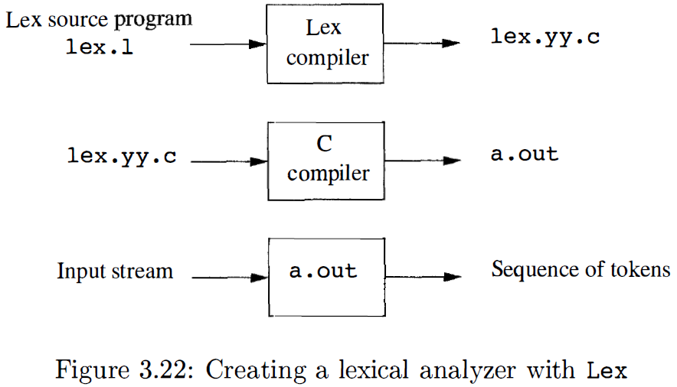
Automatic construction of lexical analyzer-(LEX)

Slide 3
Automatic construction of lexical analyzer-(LEX)
Structure of Lex Programs:
A Lex program has the following form:
declarations
%%
translation rules
%%
auxiliary functions

Slide 4
Automatic construction of lexical analyzer-(LEX)
The declarations section includes declarations of variables, manifest constants ( identifiers declared to stand for a constant, e.g. , the name of a token) , and regular definitions,
The translation rules each have the form Pattern { Action } Each pattern is a regular expression, which may use the regular definitions of the declaration section. The actions are fragments of code , typically written in C, although many variants of Lex using other languages have been created.
The third section holds whatever additional functions are used in the actions. Alternatively, these functions can be compiled separately and loaded with the lexical analyzer.

Slide 5
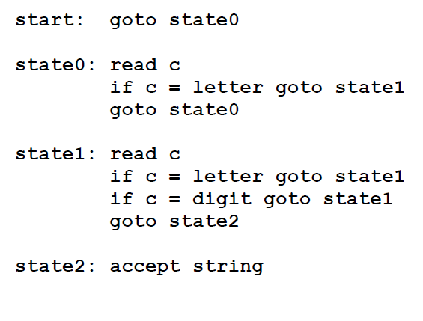
Lex

Slide 6
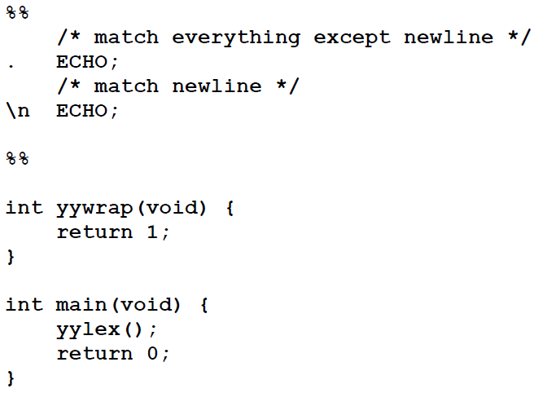
Lex
……..Definitions section……
%%
……Rules section……..
%%
……….C code section (subroutines)……..
The input structure to Lex.
Echo is an action and predefined macro in lex that writes code matched by the pattern.

Slide 7
Regular Expressions

Slide 8
Lex Regular Expressions (Extended Regular Expressions)
A regular expression matches a set of strings
Regular expression
Operators
Character classes
Arbitrary character
Optional expressions
Alternation and grouping
Context sensitivity
Repetitions and definitions

Slide 9
Operators
“ \ [ ] ^ - ? . * + | ( ) $ / { } % < >

Slide 10
Character Classes []
[abc] matches a single character, which may be a, b, or c
Every operator meaning is ignored except \ - and ^
e.g.
[ab] => a or b
[a-z] => a or b or c or … or z
[-+0-9] => all the digits and the two signs
[^a-zA-Z] => any character which is not a
letter

Slide 11
Arbitrary Character .
To match almost character, the operator character . is the class of all characters except newline

Slide 12
Optional & Repeated Expressions
a? => zero or one instance of a
a* => zero or more instances of a
a+ => one or more instances of a
E.g.
ab?c => ac or abc
[a-z]+ => all strings of lower case letters
[a-zA-Z][a-zA-Z0-9]* => all alphanumeric strings with a leading alphabetic character

Slide 13
Pattern Matching Primitives
Metacharacter | Matches
. | any character except newline
\n | newline
* | zero or more copies of the preceding expression
+ | one or more copies of the preceding expression
? | zero or one copy of the preceding expression
^ | beginning of line / complement
$ | end of line
a|b | a or b
(ab)+ | one or more copies of ab (grouping)
[ab] | a or b
a{3} | 3 instances of a
“a+b” | literal “a+b”

Slide 14
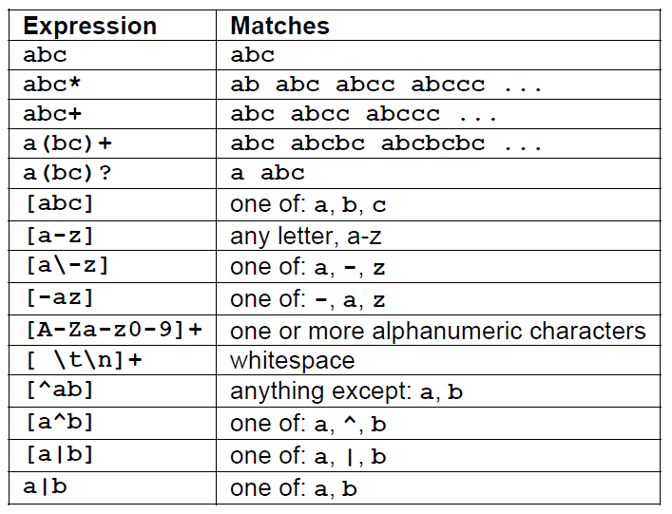
Lex
Pattern Matching examples.

Slide 15
Lex Predefined Variables
yytext -- a string containing the lexeme
yyleng -- the length of the lexeme
yyin -- the input stream pointer
the default input of default main() is stdin
yyout -- the output stream pointer
the default output of default main() is stdout.
cs20: %./a.out < inputfile > outfile
E.g.
[a-z]+ printf(“%s”, yytext);
[a-z]+ ECHO;
[a-zA-Z]+ {words++; chars += yyleng;}

Slide 16
Lex Library Routines
yylex()
The default main() contains a call of yylex()
yymore()
return the next token
yyless(n)
retain the first n characters in yytext
yywarp()
is called whenever Lex reaches an end-of-file
The default yywarp() always returns 1

Slide 17
Review of Lex Predefined Variables
Name | Function
char *yytext | pointer to matched string
int yyleng | length of matched string
FILE *yyin | input stream pointer
FILE *yyout | output stream pointer
int yylex(void) | call to invoke lexer, returns token
char* yymore(void) | return the next token
int yyless(int n) | retain the first n characters in yytext
int yywrap(void) | wrapup, return 1 if done, 0 if not done
ECHO | write matched string
REJECT | go to the next alternative rule
INITAL | initial start condition
BEGIN | condition switch start condition

Slide 18
User Subroutines Section
You can use your Lex routines in the same ways you use routines in other programming languages.
%{
void foo();
%}
letter [a-zA-Z]
%%
{letter}+ foo();
%%
…
void foo() {
…
}

Slide 19
User Subroutines Section (cont’d)
The section where main() is placed
%{
int counter = 0;
%}
letter [a-zA-Z]
%%
{letter}+ {printf(“a word\n”); counter++;}
%%
main() {
yylex();
printf(“There are total %d words\n”, counter);
}

Slide 20
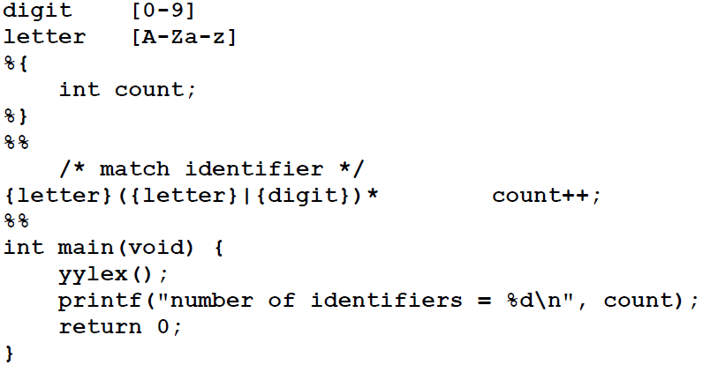
Lex
Whitespace must separate the defining term and the associated expression.
Code in the definitions section is simply copied as-is to the top of the generated C file and must be bracketed with “%{“ and “%}” markers.
substitutions in the rules section are surrounded by braces ({letter}) to distinguish them from literals.

Slide 21
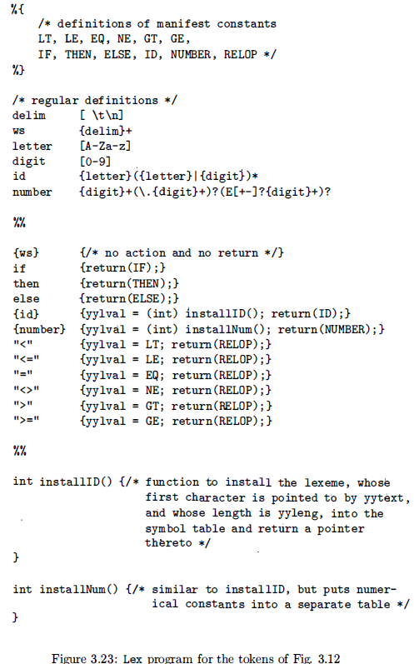
Lex includes this file and utilizes the definitions for token values. To obtain tokens yacc calls yylex . Function yylex has a return type of int that returns a token. Values associated with the token are returned by lex in variable yylval

Slide 22
Usage
To run Lex on a source file, type lex scanner.l
It produces a file named lex.yy.c which is a C program for the lexical analyzer.
To compile lex.yy.c, type cc lex.yy.c –ll
To run the lexical analyzer program, type
./a.out < inputfile

