Slide 1
Automatic construction of parsers (YACC), YACC specifications.

Slide 2
Automatic construction of parsers (YACC), YACC specifications.
Two classical tools for compilers:
Lex: A Lexical Analyzer Generator
Yacc: “Yet Another Compiler Compiler” (Parser Generator)
Lex creates programs that scan your tokens one by one.
Yacc takes a grammar (sentence structure) and generates a parser.
Lexical Rules
Grammar Rules
Lex
Yacc
Input
yylex()
yyparse()
Parsed Input

Slide 3
Automatic construction of parsers (YACC), YACC specifications.
Lex and Yacc generate C code for your analyzer & parser.
Lexical Rules
Grammar Rules
C code
Lex
C code
Yacc
Parsed
Input
Input
yylex()
yyparse()
token
stream
char
stream
C code
C code
Lexical Analyzer
(Tokenizer)
Parser

Slide 4
Automatic construction of parsers (YACC), YACC specifications.
Often, instead of the standard Lex and Yacc, Flex and Bison are used:
Flex: A fast lexical analyzer
(GNU) Bison: A drop-in replacement for (backwards compatible with) Yacc
Byacc is Berkeley implementation of Yacc (so it is Yacc).
Resources:
http://en.wikipedia.org/wiki/Flex_lexical_analyser
http://en.wikipedia.org/wiki/GNU_Bison
The Lex & Yacc Page (manuals, links):
http://dinosaur.compilertools.net/

Slide 5
Automatic construction of parsers (YACC), YACC specifications.
Yacc is not a new tool, and yet, it is still used in many projects.
Yacc syntax is similar to Lex/Flex at the top level.
Lex/Flex rules were regular expression – action pairs.
Yacc rules are grammar rule – action pairs.
declarations
%%
rules
%%
programs

Slide 6
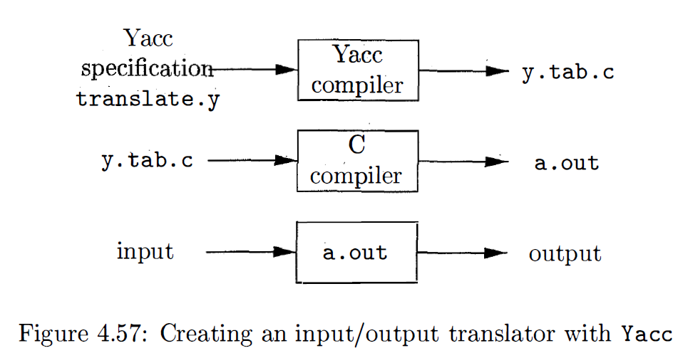

Slide 7
Declaration Section
There are two sections in the declarations part of a Yacc program; both are optional. In the first section, we put ordinary C declarations, delimited by %{ and % }. Here we place declarations of any temporaries used by the translation rules or procedures of the second and third sections.
Ex. #include <ctype .h>
The C preprocessor to include the standard header file <ctype . h> that contains the predicate isdigit.
Also in the declarations part are declarations of grammar tokens.
%token DIGIT
Tokens declared in this section can then be used in the second and third parts of the Yacc specification. , If Lex is used to create the lexical analyzer that passes token to the Yacc parser, then these token declarations are also made available to the analyzer generated by Lex.

Slide 8
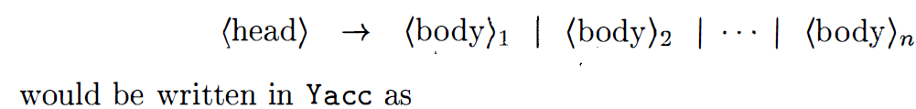
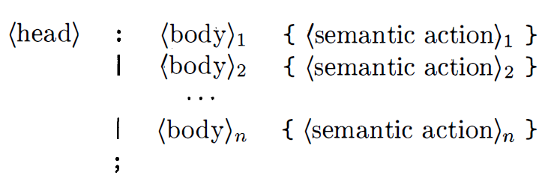
The Translation Rules Part
In the part of the Yacc specification after the first %% pair, we put the translation rules . Each rule consists of a grammar production and the associated semantic action. A set of productions that we have been writing:

Slide 9
In a Yacc production, unquoted strings of letters and digits not declared to be tokens are taken to be non terminals. A quoted single character, e.g. ' c' , is taken to be the terminal symbol c , as well as the integer code for the token represented by that character (i.e., Lex would return the character code for ' c ‘ to the parser, as an integer) . Alternative bodies can be separated by a vertical bar, and a semicolon follows each head with its alternatives and their semantic actions. The first head is taken to be the start symbol.

Slide 10
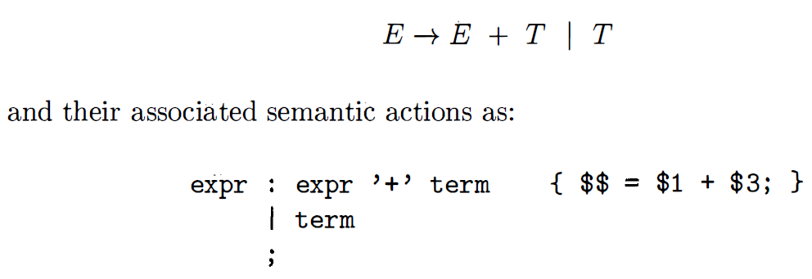
A Yacc semantic action is a sequence of C statements. In a semantic action, the symbol $$ refers to the attribute value associated with the nonterminal of the head, while $i refers to the value associated with the ith grammar symbol (terminal or nonterminal) of the body. The semantic action is performed whenever we reduce by the associated production, so normally the semantic action computes a value for $$ in terms of the $i's. In the Yacc specification, we have written the two E-productions

Slide 11
Note that the nonterminal term in the first production is the third grammar symbol of the body, while + is the second. The semantic action associated with the first production adds the value of the expr and the term of the body and assigns the result as the value for the nonterminal expr of the head. We have omitted the semantic action for the second production altogether, since copying the value is the default action for productions with a single grammar symbol in the body. In general, { $$ = $ 1 ; } is the default semantic action. Notice that we have added a new starting production
line : expr ' \n ' { print f C " %d\n" , $ 1 ) ; }
to the Yacc specification. This production says that an input to the desk calculator is to be an expression followed by a newline character. The semantic action associated with this production prints the decimal value of the expression followed by a newline character.

Slide 12
The Supporting C-Routines Part
The third part of a Yacc specification consists of supporting C-routines. A lexical analyzer by the name yylex() must be provided. Using Lex to produce yylex() is a common choice; The lexical analyzer yylex() produces tokens consisting of a token name and its associated attribute value. If a token name such as DIGIT is returned, the token name must be declared in the first section of the Yacc specification.
The attribute value associated with a token is communicated to the parser through a Yacc-defined variable yylval. It reads input characters one at a time using the C-function getchar() . If the character is a digit, the value of the digit is stored in the variable yylval, and the token name DIGIT is returned. Otherwise, the character itself is returned as the token name.

Slide 13
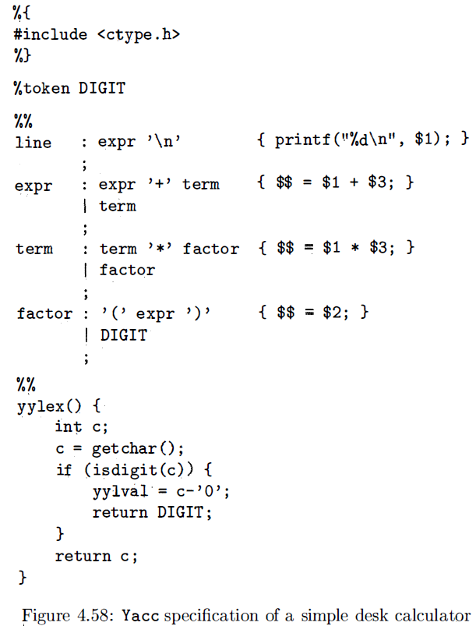
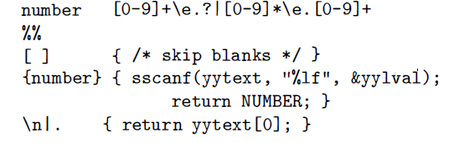

Slide 14
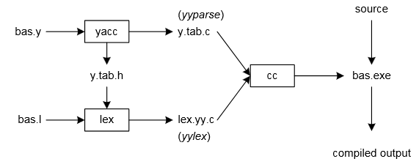
yacc –d bas.y # create y.tab.h, y.tab.c
lex bas.l # create lex.yy.c
cc lex.yy.c y.tab.c –o bas.exe # compile/link

Slide 15
Yacc reads the grammar descriptions in bas.y and generates a syntax analyzer (parser), that includes function yyparse, in file y.tab.c. The –d option causes yacc to generate definitions for tokens and place them in file y.tab.h. Lex reads the pattern descriptions in bas.l, includes file y.tab.h, and generates a lexical analyzer, that includes function yylex, in file lex.yy.c.
Finally, the lexer and parser are compiled and linked together to create executable bas.exe. From main we call yyparse to run the compiler. Function yyparse automatically calls yylex to obtain each token.

Slide 16
%token INTEGER
This definition declares an INTEGER token. Yacc generates a parser in file y.tab.c and an include file, y.tab.h:
#ifndef YYSTYPE
#define YYSTYPE int
#endif
#define INTEGER 258
extern YYSTYPE yylval;
Lex includes this file and utilizes the definitions for token values. To obtain tokens yacc calls yylex. Function yylex has a return type of int that returns a token. Values associated with the token are returned by lex in variable yylval. For example,
[0-9]+ { yylval = atoi(yytext); return INTEGER; }
would store the value of the integer in yylval, and return token INTEGER to yacc. The type of yylval is determined by YYSTYPE. Since the default type is integer this works well in this case. Token values 0-255 are reserved for character values. For example, if you had a rule such as
[-+] return *yytext; /* return operator */
the character value for minus or plus is returned. Note that we placed the minus sign first so that it wouldn’t be mistaken for a range designator. Generated token values typically start around 258 because lex reserves several values for end-of-file and error processing.

Slide 17
By default yylval is of type int, but you can override that from the YACC file by re#defining YYSTYPE.
The Lexer needs to be able to access yylval. In order to do so, it must be declared in the scope of the lexer as an extern variable. The original YACC neglects to do this for you, so you should add the following to your lexer, just beneath
#include <y.tab.h>:
extern YYSTYPE yylval;
Bison does this for you automatically.
#ifndef checks whether the given token has been #defined earlier in the file or in an included file; if not, it includes the code between it and the closing #else or, if no #else is present, #endif statement.

Slide 18
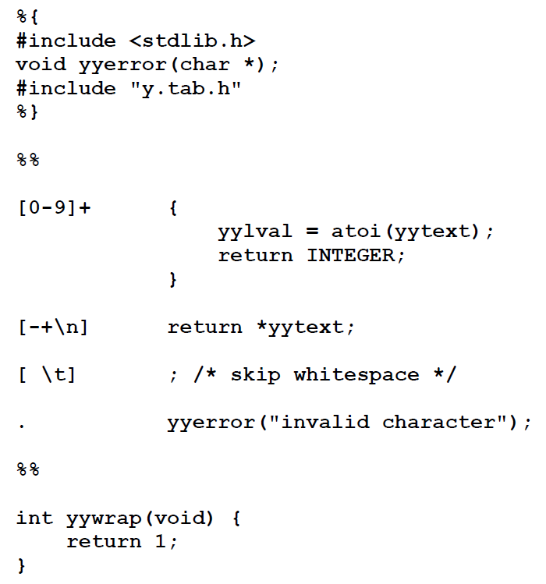

Slide 19
Internally yacc maintains two stacks in memory; a parse stack and a value stack. The parse stack contains terminals and nonterminals that represent the current parsing state. The value stack is an array of YYSTYPE elements and associates a value with each element in the parse stack. For example when lex returns an INTEGER token yacc shifts this token to the parse stack. At the same time the corresponding yylval is shifted to the value stack. The parse and value stacks are always synchronized so finding a value related to a token on the stack is easily accomplished.

Slide 20
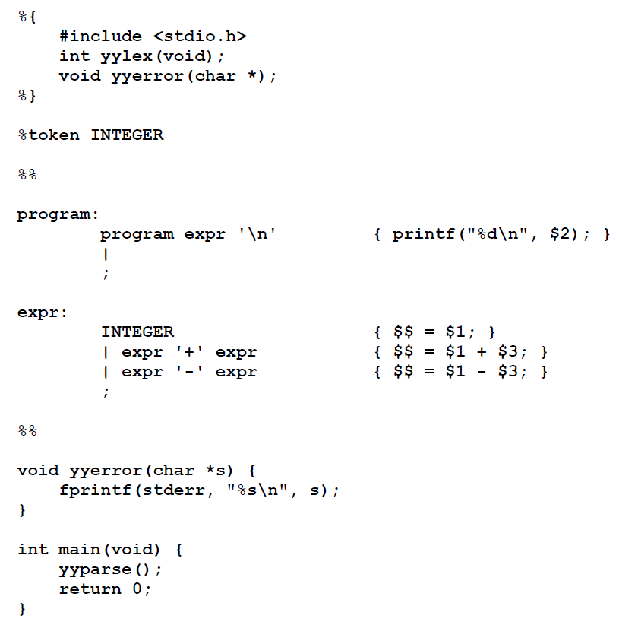

Slide 21
The left-hand side of a production, or nonterminal, is entered left-justified and followed by a colon. This is followed by the right-hand side of the production. Actions associated with a rule are entered in braces.
With left-recursion, we have specified that a program consists of zero or more expressions. Each expression terminates with a newline. When a newline is detected we print the value of the expression. When we apply the rule
expr: expr '+' expr { $$ = $1 + $3; }
we replace the right-hand side of the production in the parse stack with the left-hand side of the same production. In this case we pop “expr '+' expr” and push “expr”. We have reduced the stack by popping three terms off the stack and pushing back one term. We may reference positions in the value stack in our C code by specifying “$1” for the first term on the right-hand side of the production, “$2” for the second, and so on. “$$” designates the top of the stack after reduction has taken place. The above action adds the value associated with two expressions, pops three terms off the value stack, and pushes back a single sum. As a consequence the parse and value stacks remain synchronized.

Slide 22
Numeric values are initially entered on the stack when we reduce from INTEGER to expr. After INTEGER is shifted to the stack we apply the rule
expr: INTEGER { $$ = $1; }
The INTEGER token is popped off the parse stack followed by a push of expr. For the value stack we pop the integer value off the stack and then push it back on again. In other words we do nothing. In fact this is the default action and need not be specified. Finally, when a newline is encountered, the value associated with expr is printed.
In the event of syntax errors yacc calls the user-supplied function yyerror. If you need to modify the interface to yyerror then alter the canned file that yacc includes to fit your needs. The last function in our yacc specification is main. This example still has an ambiguous grammar. Although yacc will issue shift-reduce warnings it will still process the grammar using shift as the default operation.

Slide 23
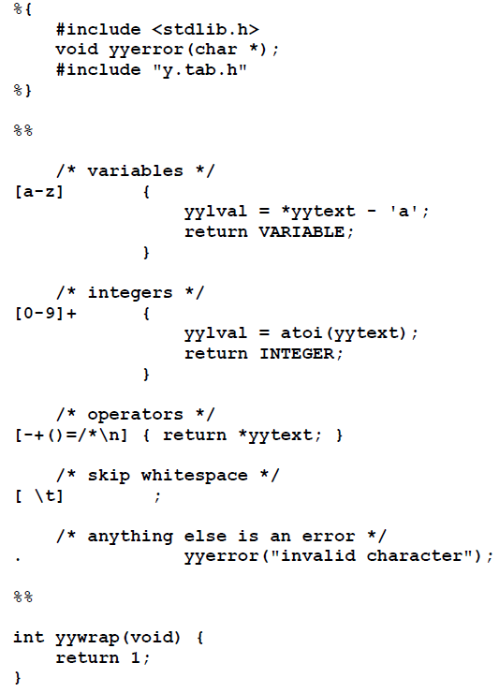
The lexical analyzer returns VARIABLE and INTEGER tokens. For variables yylval specifies an index to the symbol table sym. For this program sym merely holds the value of the associated variable. When INTEGER tokens are returned, yylval contains the number scanned.

Slide 24
The input specification for yacc follows. The tokens for INTEGER and VARIABLE are utilized by yacc to create #defines in y.tab.h for use in lex. This is followed by definitions for the arithmetic operators. We may specify %left, for left-associative or %right for right associative. The last definition listed has the highest precedence. Consequently multiplication and division have higher precedence than addition and subtraction. All four operators are left-associative. Using this simple technique we are able to disambiguate our grammar.

Slide 25
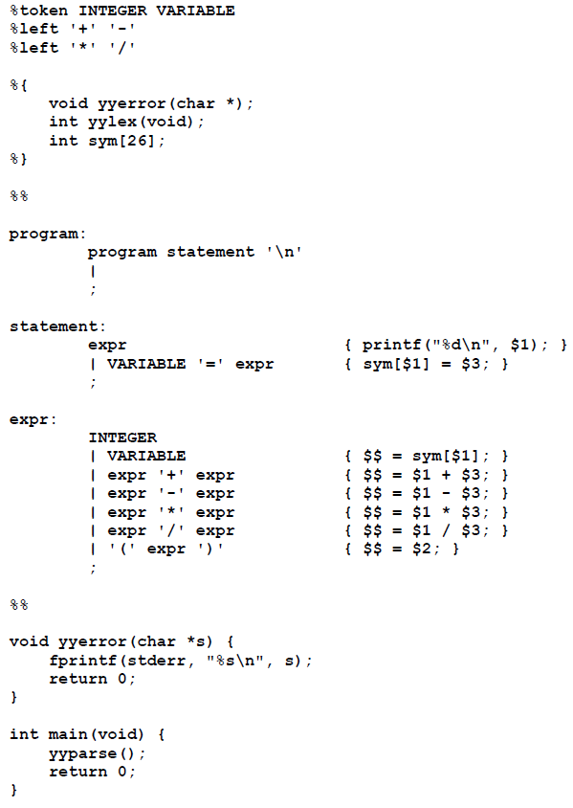

Slide 26
extern void *malloc();
malloc accepts an argument of type size_t, and size_t may be defined as unsigned long. If you are passing ints (or even unsigned ints), malloc may be receiving garbage (or similarly if you are passing a long but size_t is int).

